Slide 1

Hangman
Project by: David Hendricks, Nathan Mumford, Shaun Fisher

Slide 2
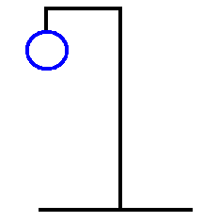
Purpose
To create the game, Hangman
Using object-oriented programming including:
Classes
Vectors
File Input-Output

Slide 3

Old Code…
Not Object-Oriented
Contained 4 Words
Using case methods
Bugs in Survival Rounds
Unnecessarily Long Code
No display of correct answer

Slide 4
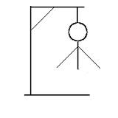
New Code
Object-Oriented Programming
Loads of Functions
Option to replay at the end of game
More Interactive
ASCII Art
Survival Round
More options for the user to choose from in the menu
Over 130,000 words!

Slide 5

Challenges
Organizing the words lengths into each file
Making the whole project object-oriented
Changing string types into vectors
Troubleshooting sections of the code
Saving the Hangman
Menu
Crossing over from X-Code to Visual Studio

Slide 6
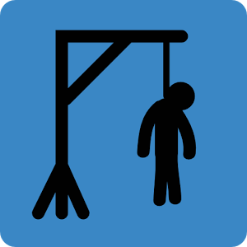
“Cool” Factor
Survival Rounds
Use of Python coding
NEW CHALLENGE MODE
Now, we present out coding!

Slide 7

THE END
Good Luck.

