Slide 1
Lenaion Labs
Nathan White
Natural language processing solutions for greenwashing and ESG

Slide 2

The Problem
Saving the world is complicated
Environment and Climate 2050
Greenwashing and spin
Social responsibility and equality
NLP for investing: A solution?
Lenaion Labs
lenaion.com

Slide 3
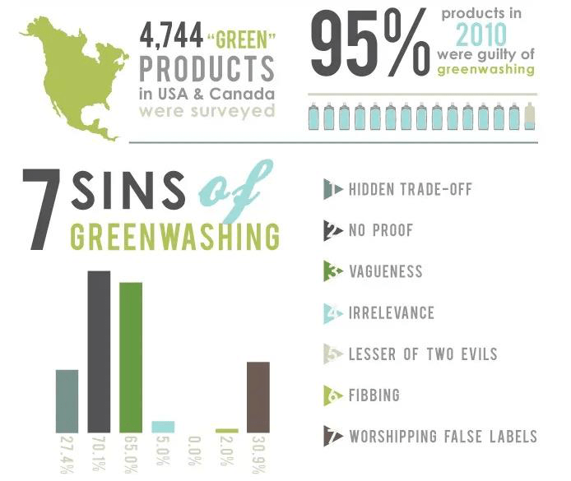
The Problem
Lenaion Labs
lenaion.com

Slide 4


The Solution
0.9 0.2
-0.6 0.3
Reports and documents
Our NLP-based greenwashing API
Quantitative investment signals
Lenaion Labs
lenaion.com

Slide 5
Solution Strengths
Speed
Automated analysis in seconds
Focus
Dedicated API for greenwashing signals
Freedom
No longer limited to third party analyses
Lenaion Labs
lenaion.com

Slide 6
The Solution
Our API provides concerned entities
NLP-based tools
that analyse greenwashing exposure
to maximise impact
Lenaion Labs
lenaion.com

Slide 7
What we need
Pre-seed investing:
Expand our MVP into a commercialisable product
Lenaion Labs
lenaion.com

Slide 8
Contact
Nathan White, Founder, Lenaion Labs
Phone: 0410 432 092
Email: contact@lenaion.com
LinkedIn: linkedin.com/in/nathanmwhite
Lenaion Labs
lenaion.com

Slide 9
Business Model Canvas
Key
Partners
Key
Activities
Value
Proposition
Customer
Relationships
Customer
Segments
Talent sources—universities, consultancies
Legal protection and planning
Financial firms in ESG space
Greenwashing API development and deployment
Greenwashing API for ESG screening
Automated services
Co-creation
B2B in Finance:
Fund Management Firms
Investment and Trading Firms
Government
Key
Resources
Channels
Online delivery
Social media and e-mail communication
Qualified staff: environmental, AI, marketing
Cost Structure
Revenue Streams
Staff—remote/WFH
Consulting–environmental expertise
AI deployment & hosting (AWS, etc.); equipment for AI training
B2B model
Greenwashing/ESG API subscriptions
ESG vetting services (government, corporate, etc.)
http://www.businessmodelgeneration.com
Designed by: Business Model Foundry AG
The makers of Business Model Generation and Strategyze

Slide 10
Competitive Analysis
Competitive Analysis Matrix
 | Metrics API | ESG-specific Screening | Quantitative Greenwashing Metrics | Customer-directed Analysis | Focused Greenwashing Analysis
Lenaion Labs | ✓ | ✓ | ✓ | ✓ | ✓
SESAMm | ✓ | ✓ | ✓ | ✓
Morningstar | ✓ | ✓ | ✓
RepRisk | ✓ | ✓
Bloomberg | ✓ | ✓
Refinitiv | ✓ | ✓
Straive |  | ✓
Competitors

