Slide 1
Lenaion Labs
Nathan White
Natural language processing solutions for greenwashing

Slide 2

The Problem
Saving the world is complicated
Environment and Climate 2050
Greenwashing and spin
Social responsibility and equality
NLP-based screening: A solution?
Lenaion Labs
lenaion.com

Slide 3
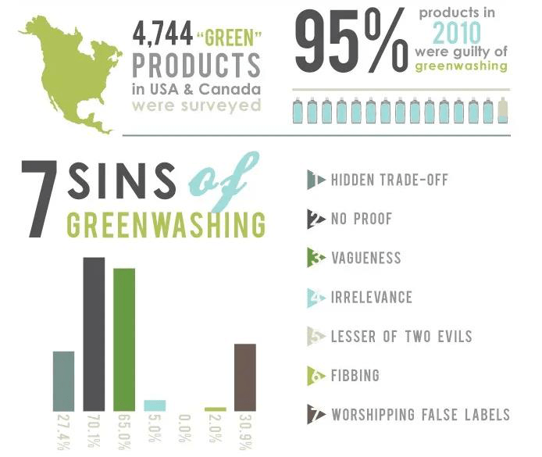
The Problem
Lenaion Labs
lenaion.com

Slide 4


The Solution
green natural gas
0.9 0.2
Reports and documents
Our NLP-based greenwashing AI
Detected Phrases and Metrics
Lenaion Labs
lenaion.com

Slide 5
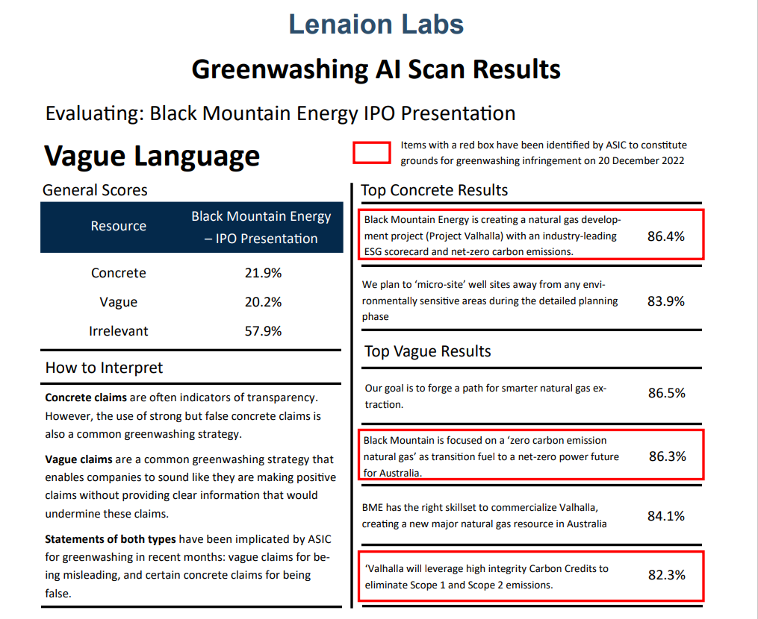
The Solution

Slide 6
Solution Strengths
Speed
Automated analysis in seconds
Focus
Dedicated greenwashing solutions
Freedom
Customisability for a specific focus
Lenaion Labs
lenaion.com

Slide 7
The Solution
Our AI provides NLP-based tools
that analyse greenwashing exposure
to maximise impact
Lenaion Labs
lenaion.com

Slide 8
What we need
Investment: seed capital
Outcomes:
Marketing
Development: Carbon credit rating system
Lenaion Labs
lenaion.com

Slide 9
Contact
Nathan White, Founder, Lenaion Labs
Phone: 0410 432 092
Email: contact@lenaion.com
LinkedIn: linkedin.com/in/nathanmwhite
Lenaion Labs
lenaion.com

Slide 10
Business Model Canvas
Key
Partners
Key
Activities
Value
Proposition
Customer
Relationships
Customer
Segments
Talent sources—universities, consultancies
Legal protection and planning
Greenwashing AI development and deployment
Greenwashing detection platform
Automated services
Co-creation
B2G
B2B:
energy,
ecotourism,
etc.
Key
Resources
Channels
Online delivery
Social media and e-mail communication
Qualified staff: environmental, AI, marketing
Cost Structure
Revenue Streams
Staff—remote/WFH
Consulting–environmental expertise
AI deployment & hosting (AWS, etc.); equipment for AI training
B2B model
Greenwashing platform subscriptions
Vetting services (government, business, etc.)
http://www.businessmodelgeneration.com
Designed by: Business Model Foundry AG
The makers of Business Model Generation and Strategyze

