Slide 1
Lenaion Labs
Nathan White
Natural language processing solutions for socially responsible investing

Slide 2

The Problem
Saving the world is complicated
Environment and Climate 2050
Greenwashing and spin
Social responsibility and equality
NLP for investing: A solution?
Lenaion Labs
lenaion.com

Slide 3
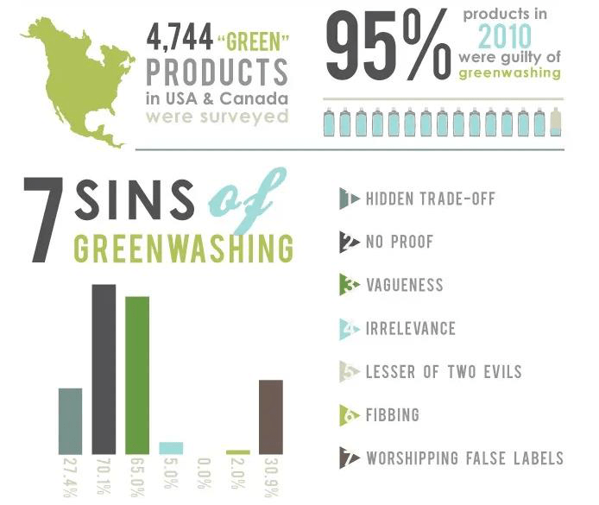
The Problem
Lenaion Labs
lenaion.com

Slide 4


The Solution
0.9 0.2
-0.6 0.3
Reports and documents
Our natural language processing API
Quantitative investment signals
Lenaion Labs
lenaion.com

Slide 5
Solution Strengths
Speed
Automated analysis in seconds
Originality
Obtain unique investment signals
Freedom
No longer limited to third party analyses
Lenaion Labs
lenaion.com

Slide 6
The Solution
Our API provides investment teams
NLP-based tools
that analyse environmental and social factors
to maximise impact
Lenaion Labs
lenaion.com

Slide 7
What we need
Advice
Introductions
Co-founder with industry connections
Lenaion Labs
lenaion.com

Slide 8
Contact
Nathan White, Founder, Lenaion Labs
Phone: 0410 432 092
Email: contact@lenaion.com
LinkedIn: linkedin.com/in/nathanmwhite
Lenaion Labs
lenaion.com

