Slide 1
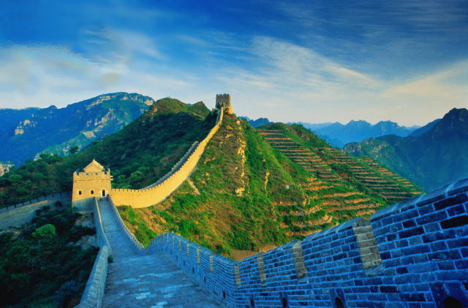
The Age of Exploration
Outcome: China and Japan’s Reactions

Slide 2

Constructive Response Questions
How did China and Japan react to European explorers/traders and why?

Slide 3
What Will We Learn?
The Ming & Qing Dynasties
The Voyages of Zheng He
Ming Relations with Foreign Countries
Contact with Japan

Slide 4
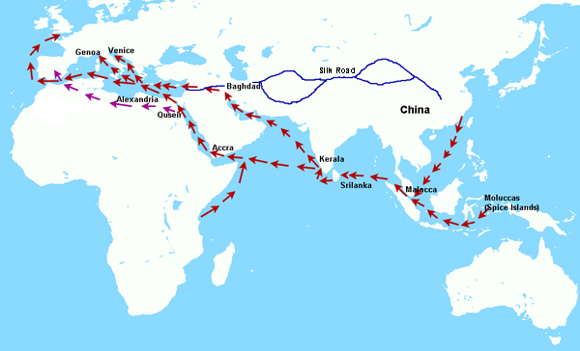
The Age of Exploration
Setting the Stage
East Asia was a hot spot for luxury goods
Many Europeans were looking to trade with China and Japan

Slide 5
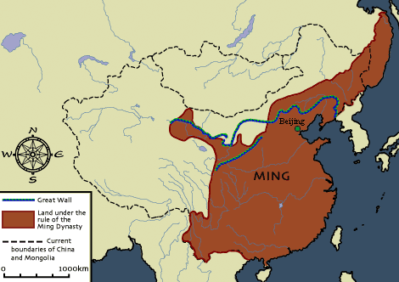
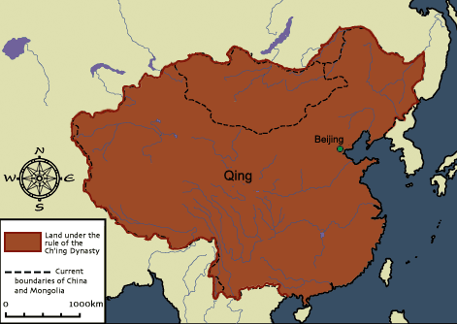
The Age of Exploration
Ming & Qing China
The Chinese people had rebelled and driven out their Mongol (Yuan) rulers and had established the Ming Dynasty (1368-1644)
The Ming government had ruled for 200 years and was weakening
Later, the Manchus, people from Manchuria, invaded China and established the Qing Dynasty which ruled for 260 years

Slide 6
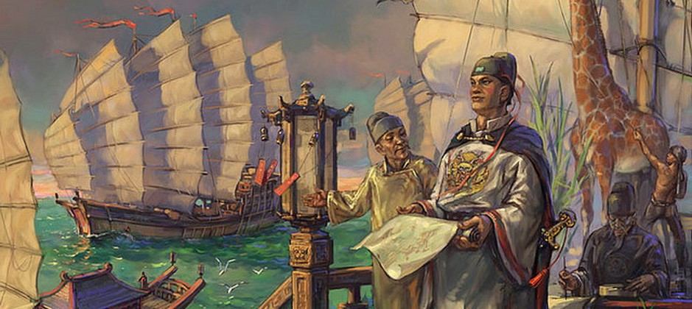
The Age of Exploration
The Ming Dynasty & The Voyages of Zheng He
Emperor Hongwu and son Yonglo were curious about the outside world and launched voyages of exploration
Chinese Admiral Zheng He led seven voyages
Purpose of Voyages: Show of China’s might and power

Slide 7
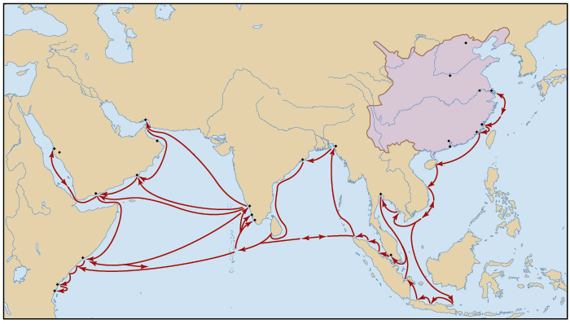
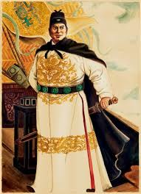
The Age of Exploration
The Voyages of Zheng He & The Ming Dynasty
Voyages ranged from Southeast Asia to eastern Africa
From 40 to 300 ships sailed on each voyage
Some ships were 400 feet long (p. 537)

Slide 8
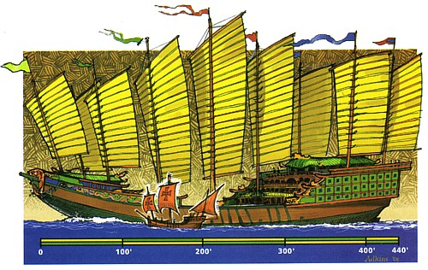
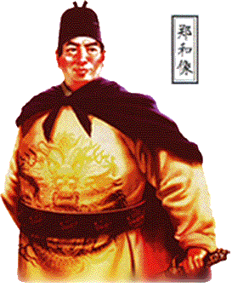
Zheng He

Slide 9
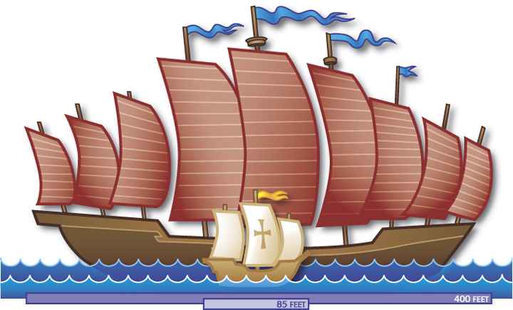
The Age of Exploration
The Voyages of Zheng He & The Ming Dynasty
Voyages included sailors, soldiers, carpenters, interpreters, accountants, doctors and religious leaders
After 7th voyage and Zheng He’s death, China withdrew into isolation and destroyed the fleet

Slide 10
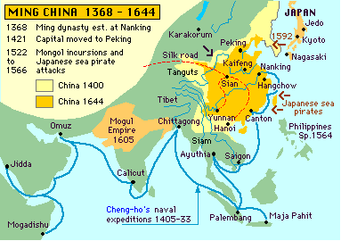
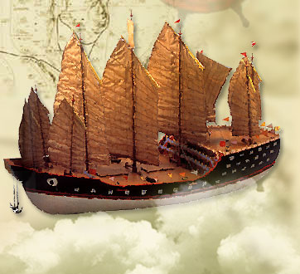

Zheng He’s Voyages
In 1498, Da Gama reached Calcutta, China’s favorite port!

Slide 11


The Age of Exploration
Ming Relations with Foreign Countries & Rules
China’s trade policies in the 1500s reflected isolation
If foreign states wanted to trade with China, they would have to follow Chinese rules because the Chinese did not want Europeans threatening the peace and prosperity the Ming had brought to China.
China had a long history of being self-sufficient as well

Slide 12
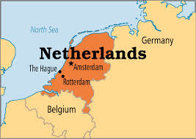
The Age of Exploration
Ming Relations with Foreign Countries & Rules
Rules
Only the government was allowed to conduct foreign trade
Trading was only allowed at certain ports
China expected Europe to pay tribute to Ming leaders;
Tribute is a peace tax
Kowtow ritual: kneeling in front of the emperor and touching forehead to ground 9 times
The Dutch accepted these restrictions and were allowed to trade

Slide 13
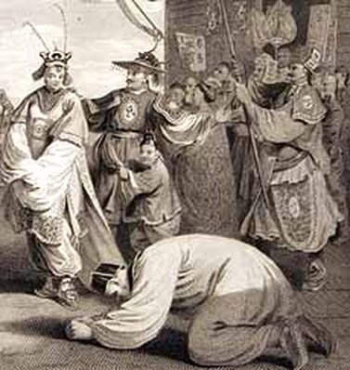
Kowtow

Slide 14
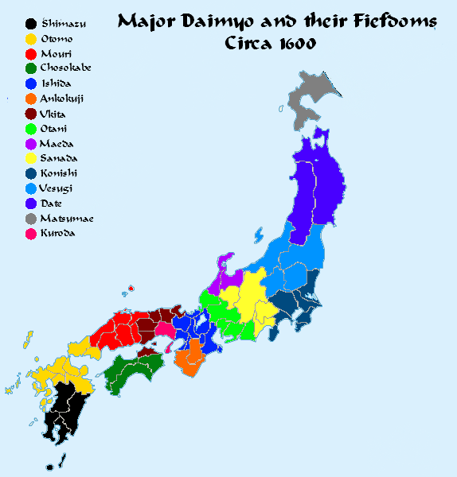
The Age of Exploration
Japan
In 1467, civil war shattered Japan’s feudal system and the country became chaotic
Warrior chieftains called daimyos became lords in a new Japanese feudalistic system

Slide 15
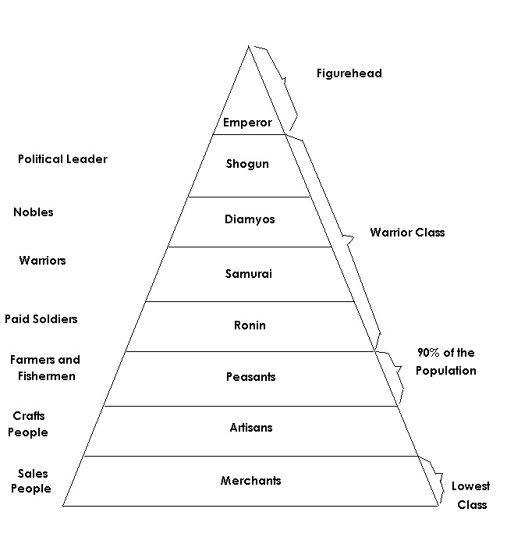


Slide 16

The Age of Exploration
Contact Between Europe and Japan
Europeans began coming to Japan in the 16th century and were welcomed
Within a century, the aggressive Europeans had worn out their welcome
The Portuguese brought clocks, eyeglasses, tobacco, and firearms
By 1600, European missionaries had converted 300,000 Japanese to Christianity
After peasant rebellion (most were Christian) the shoguns ruthlessly persecuted Christians and led to the formation of an exclusion policy

Slide 17

The Age of Exploration
The Closed Country Policy
1639 the shoguns sealed Japan’s borders and excluded merchants and missionaries
Only port of Nagasaki remained open but only to Dutch and Chinese traders
Lasted for more than 200 years
Why???
Japanese were forbidden to leave so as to not bring back foreign ideas
Japan wanted to continue to develop as a self-sufficient country

Slide 18
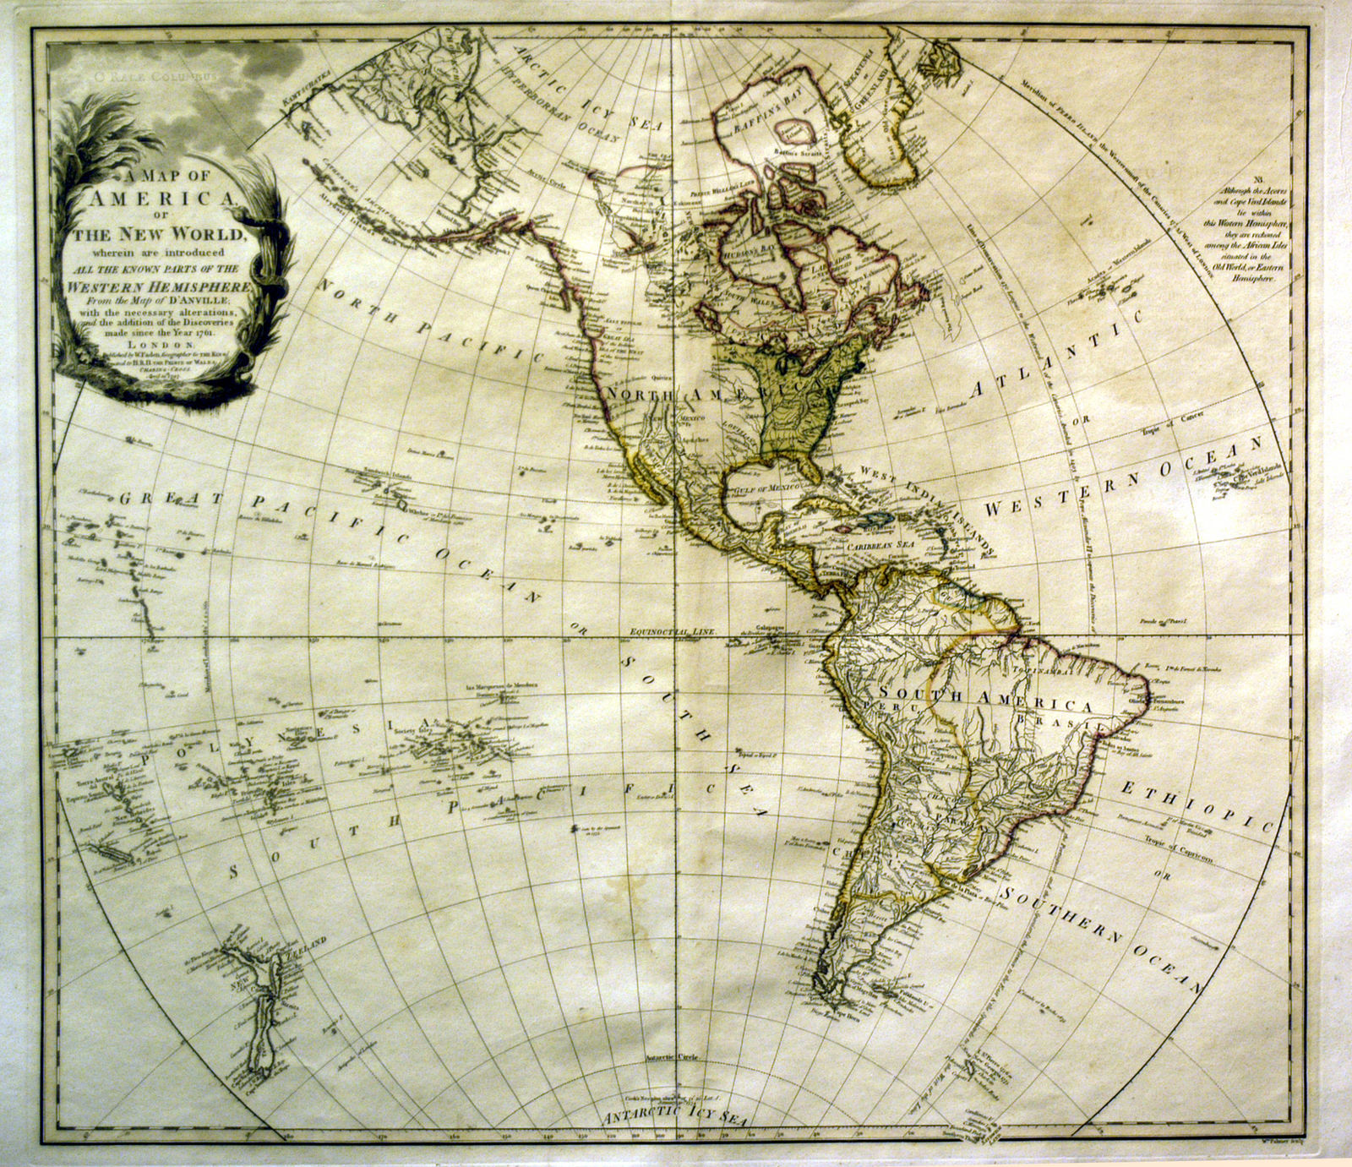
The Age of Exploration
Result: Europeans begin to explore west across the Atlantic Ocean to the New World.

Slide 19
Constructive Response Questions
How did China and Japan react to European explorers/traders and why?

