Slide 1
Event-Driven Causal Information Extraction from Text
Author:
Nathan Scott

Slide 2
Roadmap
Introduction
Datasets
Annotations
Model
Performance

Slide 3
Introduction

Slide 4
how to automatically extract causal relationships from text
not concerned with existential definitions of causality, just the linguistic linking of events/states by some causal signal whether explicit or implicit
focusing on using discriminative span-based techniques.
head and tail are not just simple entities but may be more complex expressions representing real-world events or states
spans use a flat schema for annotation and model simplicity

Slide 5
An example
``The earthquake destroyed the city and left thousands of people without shelter”.
Annotation could be: an event (red) and a state (orange) where red causes orange…
``The earthquake destroyed the city and left thousands of people without shelter”.
Annotation could be: event (red), state (orange, green), where red causes orange and green…
``The earthquake destroyed the city and left thousands of people without shelter”.
Annotation could be: event (red)
``The earthquake destroyed the city and left thousands of people without shelter”.

Slide 6
An example
``On 22 December 2006 the British army, which was lead by John the bald, who had married Mary queen of Scots last week, breached the German front lines at Dunkirk. This, in turn prompted, but not before Johns right leg fell off, the German lines to disintegrate into a big mess.”
Annotation could be: events (red, green) with red causing green. The sentence has a lot of noise though with the underlined text being irrelevant, with some of this noise falling within the red event…
``On 22 December 2006 the British army, which was lead by John the bald, who had married Mary queen of Scots last week, breached the German front lines at Dunkirk. This, in turn prompted, but not before Johns right leg fell off, the German lines to disintegrate into a big mess.”

Slide 7
Datasets

Slide 8
There do not exist many free causal datasets. The few that were identified are not annotated in a compatible way. All of the identified datasets would have to be re-annotated to be useful. Primarily it is the span boundaries that is the sticking point.

Slide 9
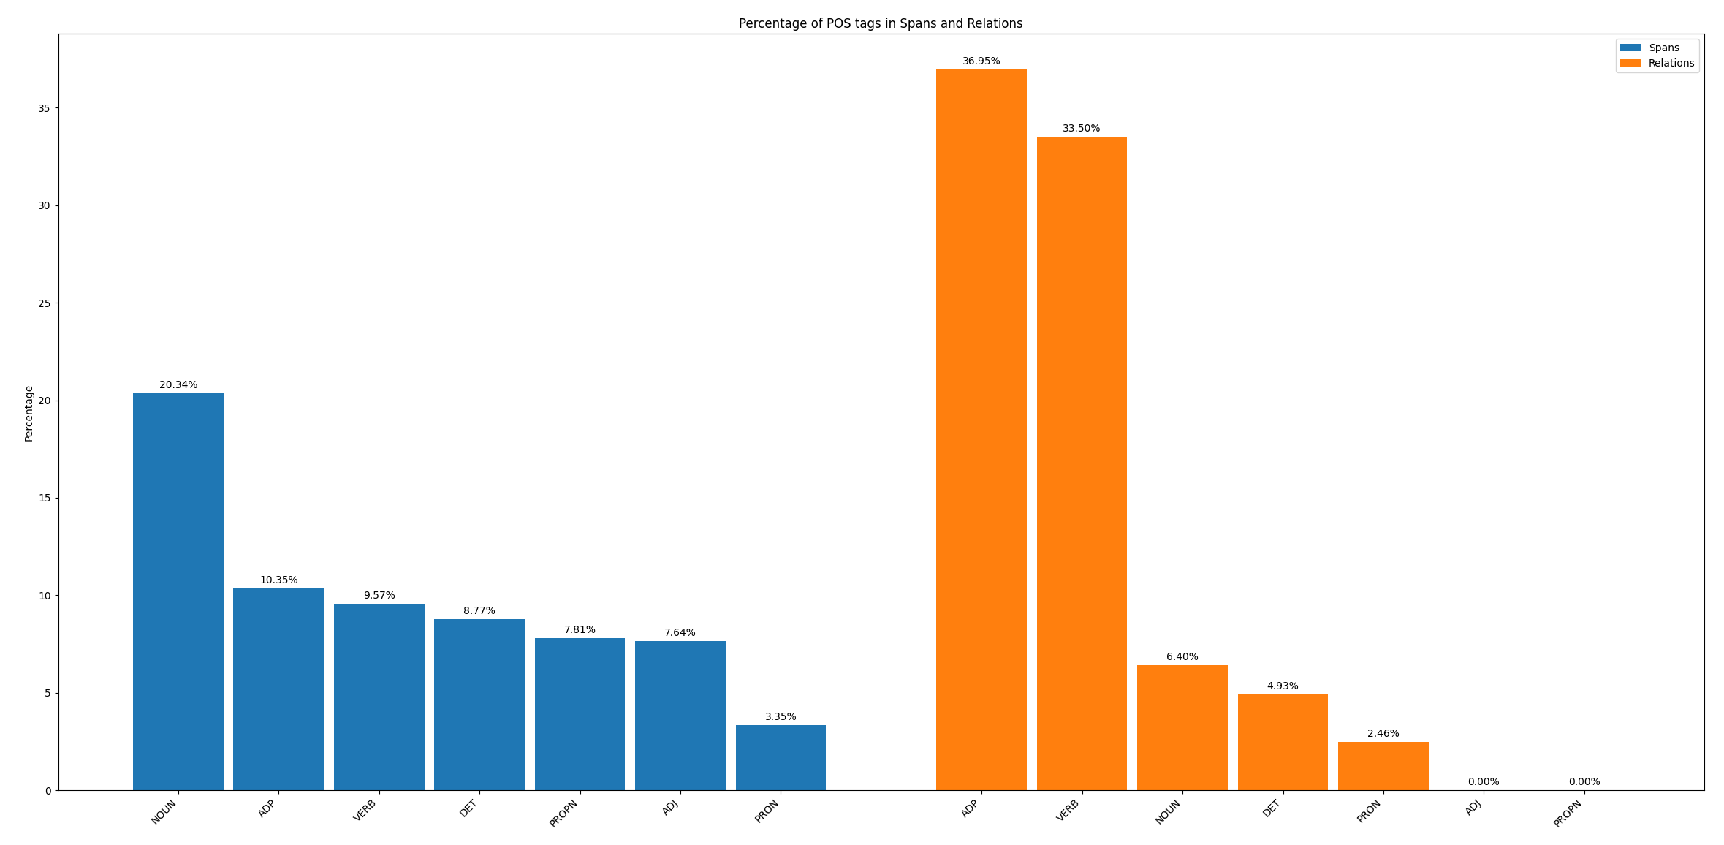
Altlex: has a single causal pair per observation, but the spans are just an whole side of the sequence, no real logic to the boundaries.

Slide 10
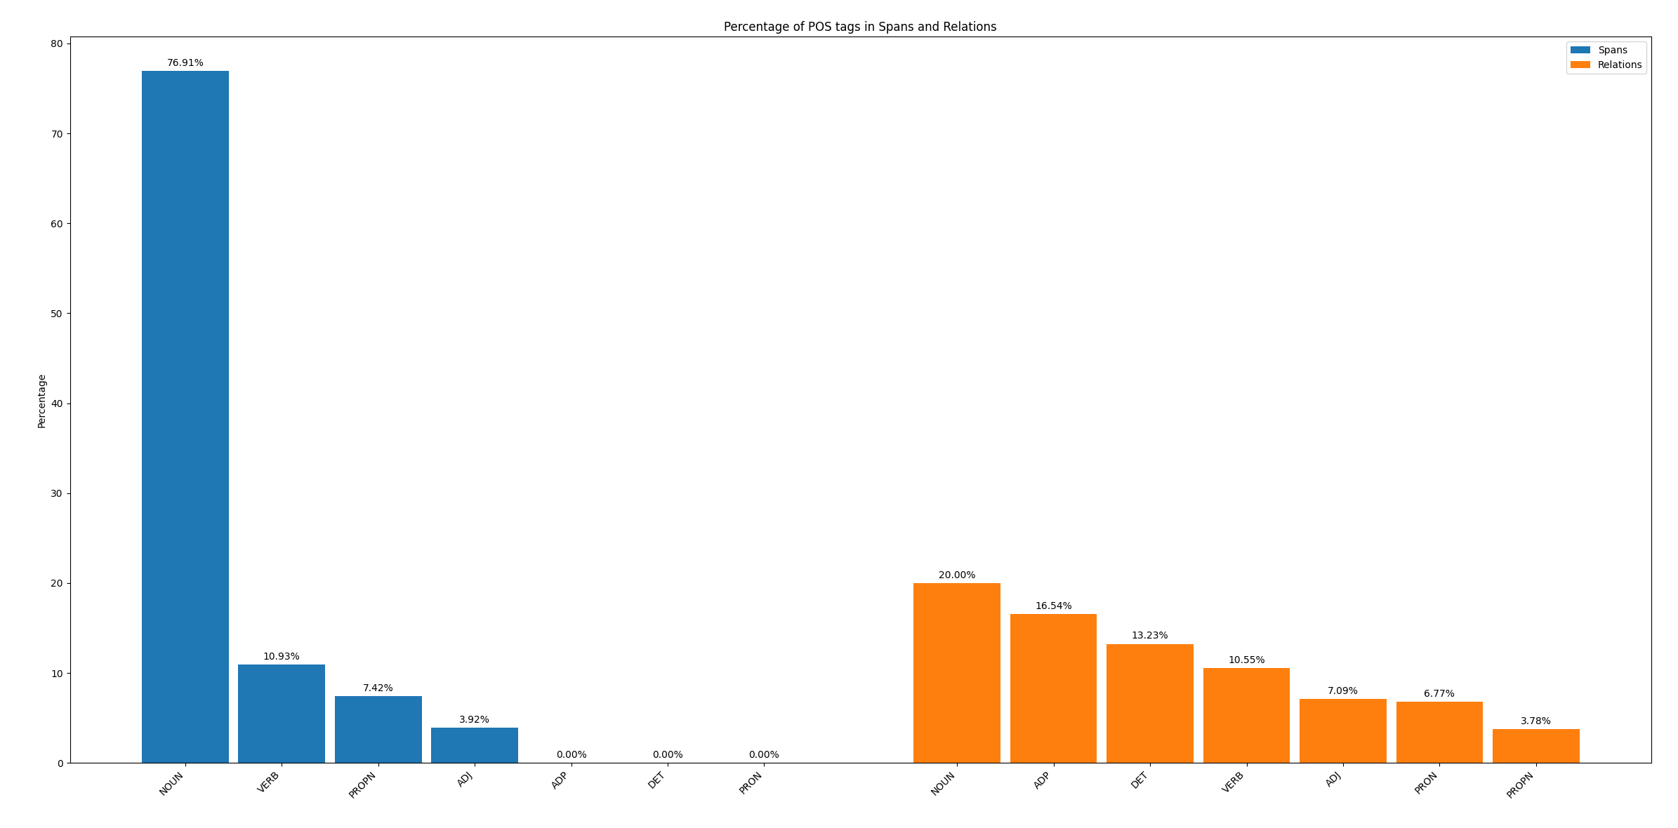

Semeval: has many samples, but has very short span (up to 4 words) annotated causal pairs. These are effectively just entity form or proxies for events/states.

Slide 11
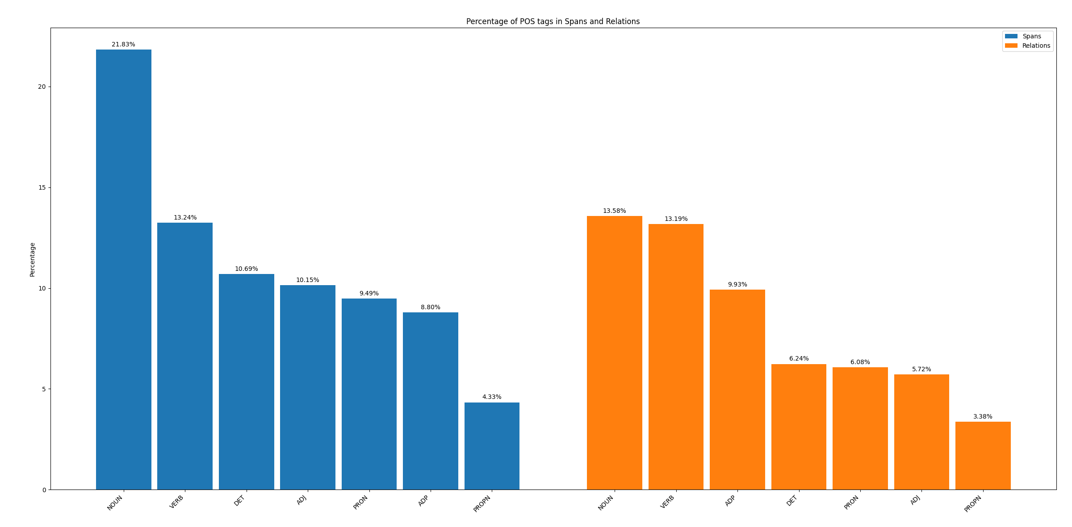
Because: similar issues to Altlex

Slide 12
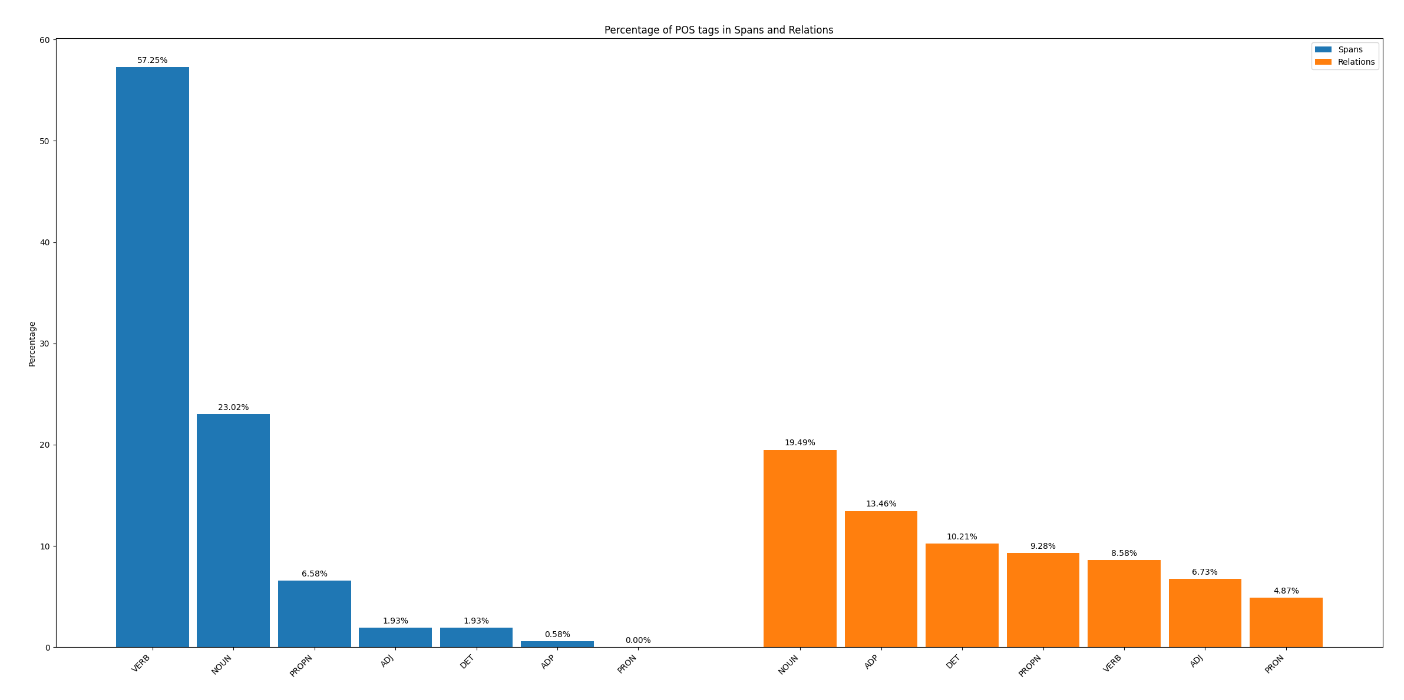
Causal Time Bank: short spans, no rational to annotations

Slide 13
ESL2: very short verbal triggers
AN <ARG0>EARTHQUAKE</ARG0> killed six children and left 14 others trapped when a mosque collapsed during a Koran reading session in Indonesia's Aceh province , <ARG1>bringing</ARG1> the confirmed death toll from the disaster to 11 .

Slide 14
Annotation

Slide 15
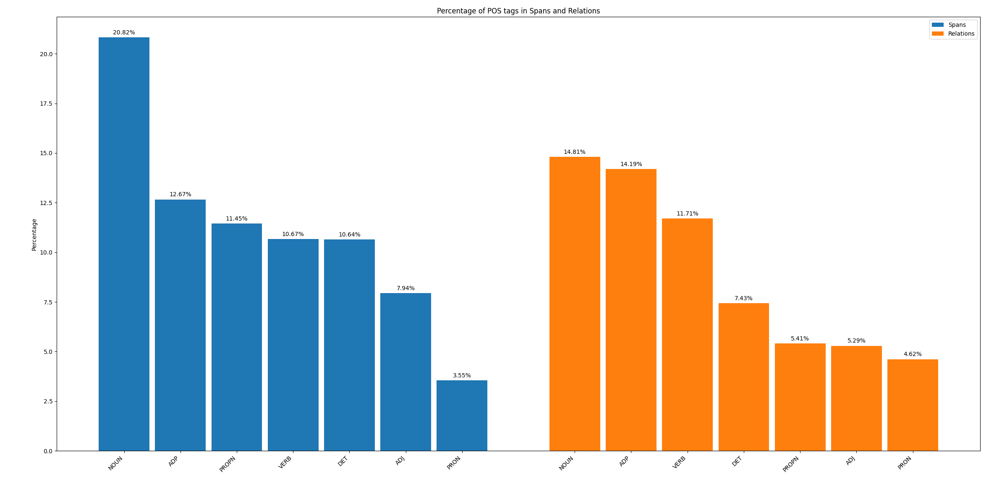
Using a custom annotation tool, around 900 observations where annotated from sequences pulled from Altlex, Maven, Cassie, Semeval as well as a few synthetic sequences generate by LLMs.
Primary issues with this dataset are the small size and the noise. There is noise due to the single annotator and speed of work, as well as simply the ambiguous nature of annotating flat long spans.
POS breakdown in the annotated spans is far more varied than for short span datasets

Slide 16
Annotation Guidelines
These annotation guidelines define a flat span-based approach for identifying events and states in text. This schema was chosen because it aligned well with the model architecture. Specifically, a span classification framework that predicts full event spans directly. It also proved to be far more practical and intuitive than complex hierarchical trigger-argument-role schemes, especially for solo annotation.
By selecting a single contiguous span that captures the event or state along with its relevant arguments, this method simplifies both the annotation process and the model’s learning task. That said, this approach is not without challenges. In sentences with convoluted structure, such as causal triggers surrounded by noisy or scattered arguments, it can be difficult to decide on clear span boundaries. These edge cases highlight some limitations of the flat span method, but in the majority of situations, it remains a practical and scalable solution that balances expressiveness with simplicity.
Flat Schema
Each span represents a single coherent event or state.
No nested structures or trigger/argument decomposition.
Annotate the best contiguous span that expresses the event/state.

Slide 17
Span Scope
Include the event trigger and all relevant arguments (e.g., agent, theme, time, cause).
Minor interleaved noise is acceptable if it improves span coherence.
Example: “A few months after the hotel’s bombing the Government of Pakistan had reconstructed it” is a valid single event span.
Span Boundary Preference
Prefer the widest natural span that fully describes the event or state.
Avoid fragmenting semantically integrated components (e.g., time or agent).
Annotating Embedded Events Separately
Annotate embedded events as separate spans if:
They are independently eventive.
They could be the head of a causal relation.
They are referable elsewhere in the text.
They convey meaning beyond acting as a modifier.
Overlapping Spans Are Allowed
Overlap is permitted if multiple distinct events share part of the same text.
Flat schema means no hierarchy, but does not require disjoint spans.

Slide 18
What Not to Annotate
Do not annotate attributional or discourse-level elements (e.g., “according to Xinhua” ).
Do not annotate standalone time expressions unless eventive.
Yes: “the explosion on 5 May”
No: “in 2008”
Causal Relations
Annotate binary causal links between spans only if:
One event logically or directly causes the other.
Avoid speculative, metaphorical, or weakly implied causality.
Heuristic for Ambiguous Cases
“Would this text span make sense as a row in a knowledge graph?”
If yes — annotate it.

Slide 19
Model

Slide 20
Inspirations: Spert, GraphER
Model Components:
Encoder type: Bert uncased vs Bert cased vs Spanbert cased
Pooling post encoder: pooling subword embeddings back to word token embeddings post encoder
LSTM post encoder
Shared vs separate encoder
Span binary filtering vs token tagging filter
Binary Filter => span representations => binary classification head => filter
Tagging Filter => token classification head => filter => span representations
Span Representation Construction
(Start, End), (Start, End, CLS, Width), (Start_win, End_win, Inner, CLS, Width), attention pooled
Relation Representation Construction
(Head, Tail, Context); Context => between, between-win, cross attention
Graph Transformer
Graph Embedder => add learnable embedding to distinguish Node(span) from Edge(relation)
Graph Transformer => just a standard multi layer MHA + FFN transformer
Marking: Marking each span and each relation separately in Bert and extracting the CLS representation
Temporary Teacher Forcing and the Lost Relation Penalty
Removing label guaranteed passage through the span and relation filtering blocks
Add penalties for filtering out span that is part of a positive relation
Redundant Span Penalty: penalty for spans that are too similar to another classified span
Hanging Relation Penalty: penalty for relation with a head/tail that is not a classified span
Similarity Loss Function: loss based on similarity between pred representations to label representations as opposed to strict loss (BCE, CE)

Slide 21
Spert
Span-based Joint Entity and Relation Extraction with Transformer Pre-training
Markus Eberts and Adrian Ulges
k predicted spans
k**2 rel candidates
Labels
NS
RCH
Rel Classifications
Word Tokenized Sequences
BERT
NS
SCH
Span Classifications
Labels
span classification loss
relation classification loss
XCH
Classification Head
Span Pair Representation Generation
NS
BERT
Bert tokenizer and model
Span Representation Generation
Negative Sampler

Slide 22
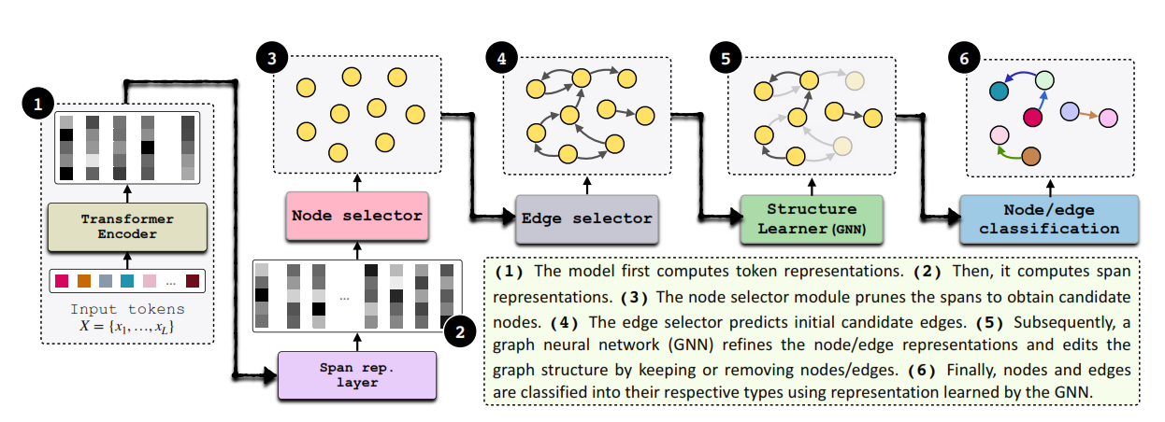
GraphER
GraphER: A Structure-aware Text-to-Graph Model for Entity and Relation Extraction
Urchade Zaratiana, Nadi Tomeh, Niama El Khbir, Pierre Holat, Thierry Charnois Code: https://github.com/urchade/GraphER

Slide 23
Model – variant A
top k spans
k**2 rel candidates
top j rels
Labels
BCH
GET
RCH
Rel Classifications
Word Tokenized Sequences
BERTP
LSTM
BCH
SCH
Span Classifications
Labels
span filter loss
rel filter loss
lost relation loss
graph loss
span classification loss
rel classification loss
redundant span loss hanging relation loss
xCH
Classification Head
Score Based Span/Rel Filter
Span Pair Representation Generation
BERTP
Bert tokenizer, model and sw to word pooler
GET
Graph Embedder and Transformer
Span Representation Generation

Slide 24
Model – variant B
top k spans
k**2 rel candidates
top j rels
Labels
BCH
GET
RCH
Rel Classifications
Word Tokenized Sequences
BERTP
LSTM
TCH
SCH
Span Classifications
Labels
tagger loss
rel filter loss
lost relation loss
graph loss
span classification loss
rel classification loss
redundant span loss hanging relation loss
XCH
Classification Head
Score Based Span/Rel Filter
Span Pair Representation Generation
BERTP
Bert tokenizer, model and sw to word pooler
GET
Graph Embedder and Transformer
Span Representation Generation

Slide 25
Performance

Slide 26
Performance Metrics
Only really using micro F1, but this doesn’t necessarily tell the full story
Eg. If a span is out by one or 2 insignificant word tokens, it is classified as incorrect and this filters through to relations too.
Span and Relation F1 Performance
Performance Variation: more variation for longer spans and more annotation noise
Performance over:
Dataset: shorter spans, less noise = better performance
Encoder: bert better for short span, spanbert worked better for long span
Separate Encoder: no real difference
Span filter type: token tagging for the spans gave similar performance with less resources
Span Construction: Start+End+Inner maxpool + CLS + Width worked marginally better
Rel Construction: Head + Tail + Context worked best
Rel Context Pooling: cross attention worked best
Teacher Forcing: warmup teacher forcing worked better than always on teacher forcing
Top k: 30-200 seemed to work best
Graph: seemed to have a minor benefit
Penalties: seemed to have a minor benefit
Cosine Similarity Loss: did not work at all

Slide 27
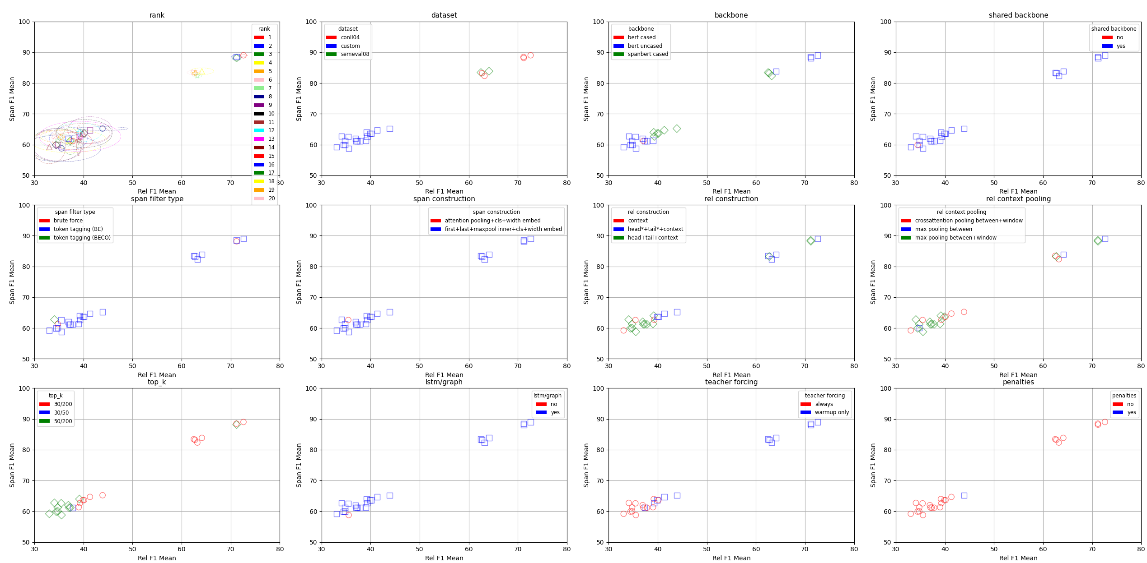

Slide 28
Val Set Samples
Summary Evaluation:
Category Count Percentage
Winner: preds 34~28%
Winner: labels 39~32%
Winner: both 48~39%
Winner: neither 5~4%
Annotation issues flagged 34~28%
Strengths of the Model (when preds wins or ties):
Improved Span Boundary Adherence: The model often avoids overly broad or speculative spans present in labels. It demonstrates better granularity and argument inclusion.
Better Causal Link Detection: Several times, the model detects plausible causal links that labels miss due to noisy or incomplete annotations.
Avoids Common Label Errors: For example, the model avoids labeling hypothetical/non-eventive spans or attributive phrases—common mistakes in labels.
Embedded Events: It successfully segments embedded or compound events more accurately than the labels, in some cases.
Weaknesses (when labels win):
Missed Relations: The model occasionally fails to predict causal relations even when spans are correct—this was the most frequent reason for preferring labels.
Over-fragmentation or Incomplete Spans: Some spans are too short or fragmented, excluding critical arguments or temporal markers.
Misinterpretation of Causality Structure: In a few instances, causal chains are mislinked (e.g., linking cause directly to final result, skipping intermediate steps).
Conclusion:
The model performs competently and sometimes better than noisy gold labels, especially in terms of:
Causal relation recovery
Span coherence
Guideline adherence
However, it still occasionally underperforms in relation recall and can misstructure causal chains when multiple effects or causes are present.

Slide 29
Val Set Samples
“seq": “Speech difficulties become evident due to an inability to recall vocabulary, which leads to frequent incorrect word substitutions (paraphasias).”
"span_labels": [
“L0": "Speech difficulties become evident due to an inability to recall vocabulary“
“L1": "frequent incorrect word substitutions ( paraphasias )“
],
"span_preds": [
“P0": "Speech difficulties become evident“
“P1": "an inability to recall vocabulary“
“P2": "frequent incorrect word substitutions ( paraphasias )“
],
"rel_labels": [
L0 => L1
],
"rel_preds": [
P1 => P0,
P1 => P2
]
Gemini’s verdict:
Predictions correctly identified the core cause ('inability to recall vocabulary') and its two distinct effects with appropriate spans and relations. Labels merged a cause and effect into one span (L0) and created an indirect/inaccurate causal link (L0->L1).

Slide 30
Val Set Samples
“seq": “His dominance was reinforced by his son Athelstan, who extended the borders of Wessex northward, in 917 conquering the kingdom of York and leading a land and naval invasion of Scotland.",
“span_labels": [
“L0": "His dominance was reinforced by his son Athelstan , who extended the borders of Wessex northward , in 917 conquering the Kingdom of York“
“L1”: "a land and naval invasion of Scotland“
],
"span_preds": [
“P0": "His dominance was reinforced by his son Athelstan , who extended the borders of Wessex northward“
“P1": "in 917 conquering the Kingdom of York and leading a land and naval invasion of Scotland“
],
"rel_labels": [
L0 => L1
],
“rel_preds": []
Gemini’s verdict:
Predictions offered a plausible event split and correctly omitted the weak causal link present in the labels. Label span L0 was very broad, and the causal relation L0->L1 was speculative.

Slide 31
Val Set Samples
“seq": "Because he had sealed under duress, however, John received approval from the Pope to break his word as soon as hostilities had ceased, provoking the First Barons’ War and an invited French invasion by Prince Louis of France (whom the majority of the English barons had invited to replace John on the throne and had him proclaimed king in London in May 1216).",
"span_labels": [
“L0": "John received approval from the Pope to break his word as soon as hostilities had ceased“
“L1": "an invited French invasion by Prince Louis of France“
“L2": "the First Barons ' War“
“L3": "he had sealed under duress“
"span_preds": [
“P0”: "had him proclaimed king in London in May 1216“
“P1": "had sealed under duress“
“P2": "John received approval from the Pope to break his word as soon as hostilities had ceased“
“P3": "the First Barons ' War“
“P4": "an invited French invasion by Prince Louis of France“
],
"rel_labels": [
L3 => L0,
L0 => L2,
L0 => L1
],
"rel_preds": [
P1 => P2,
P2 => P3,
P2 => P4,
P1 => P4
Also some hanging relations
],
Gemini pros verdict:
Labels correctly identified the main causal chain and relevant event spans supported by the text. Predictions matched most key spans but added an irrelevant one from the parenthesis and made significant errors in relations, including an invalid relation using a non-predicted span and an incorrect causal link.n L0->L1 was speculative.

Slide 32
Conclusion
Causal relation extraction from open-domain natural language remains challenging for a single discriminative model. Natural text is often ambiguous, implicit, and poorly structured for span-based labeling. While discriminative models can still be useful in constrained or simplified settings — such as short span scenarios — their effectiveness drops sharply in more complex use cases. A capable generative LLM may be better suited to handling the full task end-to-end or at least for some of the more complex interpretative parts.

