Slide 1


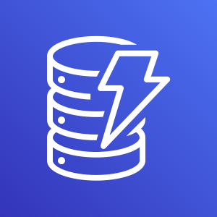





Your Development Machine
AWS Cloud
Amazon DynamoDB
Manually loading local credentials
Task Role
Local container
Disk
Cloud container
Amazon Elastic Container Service

Slide 2
Your Development Machine
AWS Cloud
Same credential provider as prod
Amazon DynamoDB
Local container
ECS Local
Task Role
Cloud container
Amazon Elastic Container Service
Local Credentials
Disk

