Slide 1

Slide 1
ROCKBUSTER STEALTH LLC LAUNCH STRATEGY ANALYSIS
Nathan Pena

Slide 2
Slide 2
Overview
Rockbuster Stealth LLC is a was a physical movie rental business all around the world before streaming was a common phenomenon.
The goal of this is analysis is to show the Rockbuster Stealth management team key data findings that can help them make decisions to compete with streaming services.
This presentation will give some statistics on film data and give an idea about the customer base trends by country
2

Slide 3
Slide 3
KEY DATA POINTS
Total Films: 1000
Total Customers: 599
Avg Rating: PG-13
Avg Replacement Cost: $20
Avg Film Length: 115 min
Avg Rental Duration: 5 days
Movie Genres: 17
Avg Rental Rate: $2.98
3

Slide 4

Slide 7
KEY DATA POINTS
Max Rental Duration
days
25%
Min Rental Duration
days
Avg Rental Duration
days

Slide 5
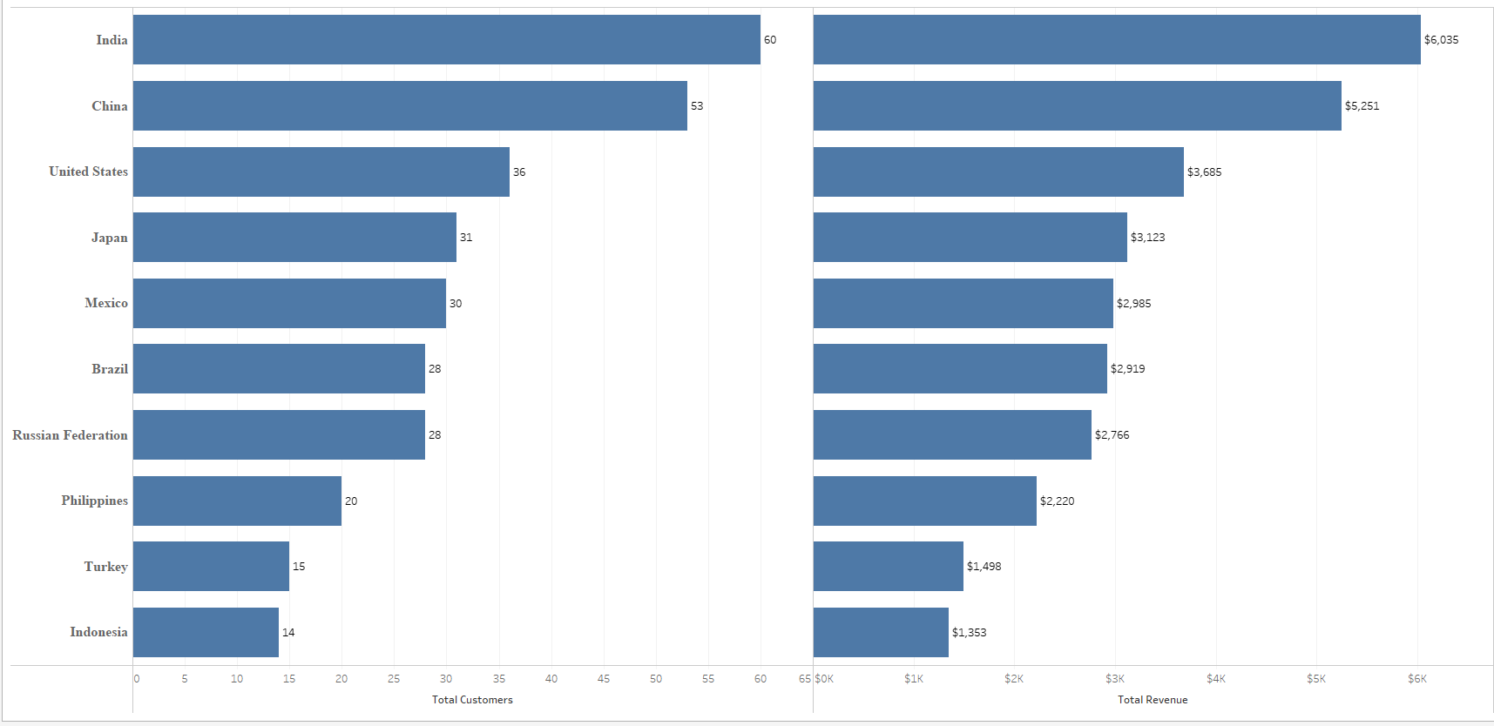
Slide 5
KEY DATA POINTS
Though this is intuitive, it is good to see that the data backs up a common assumption which is the Countries with the most customers correlates to the countries with the highest sales for Rockbuster. So, we want to target the countries and areas where we have the most customers.

Slide 6
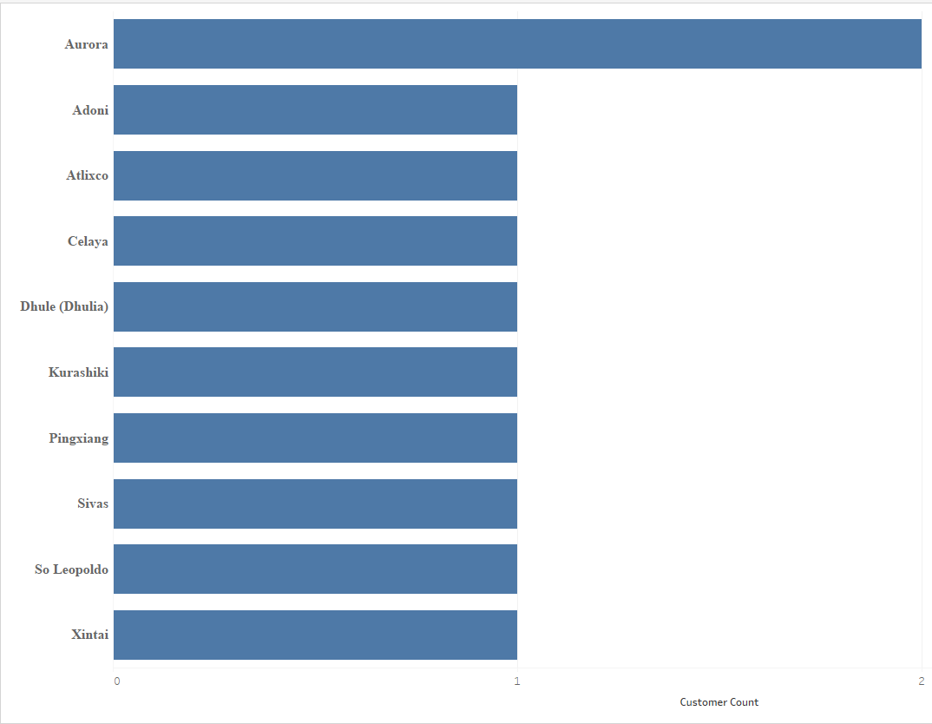
Slide 5
KEY DATA POINTS
This graph shows us the top 10 cities based on number of customers. Normally we would think that finding the top 10 cities would be a great data point to track so we could have promotions in those cities. But this data shows that we don’t need to focus on a city basis since our top city only has 2 customers. This is significant because it shows us what we don’t have to do rather than what we should do in our strategy of reaching more customers.

Slide 7
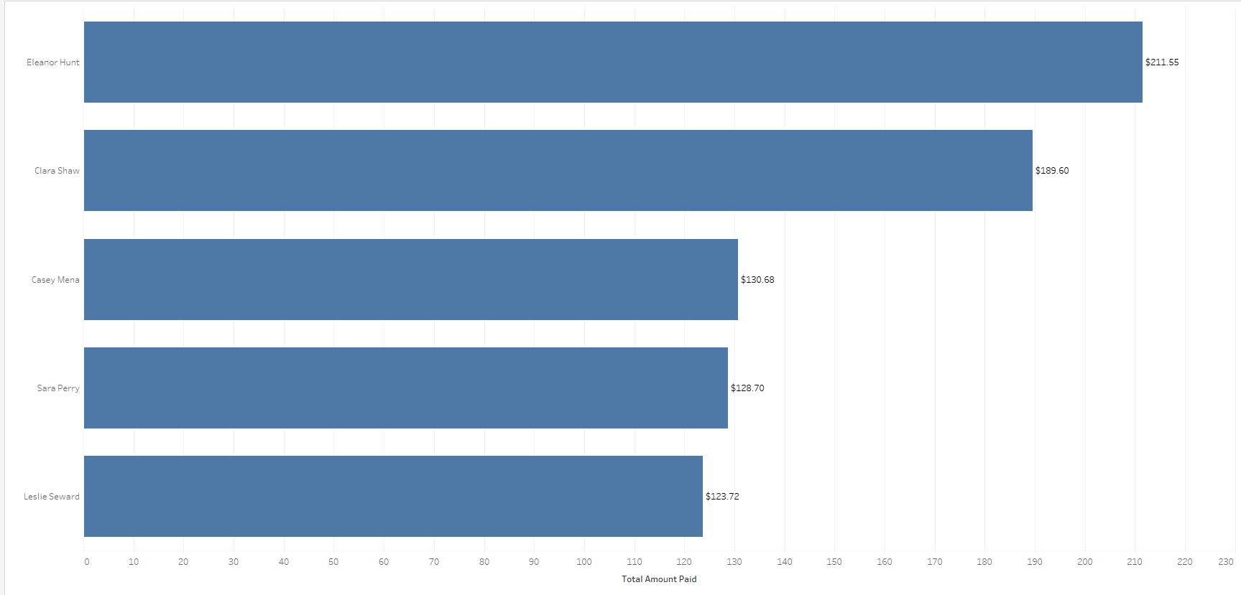
Slide 5
KEY RECOMMENDATIONS
This graph shows us our top 5 customers around the world based on total money spent at Rockbuster. We should highlight our top customers and make this an incentive to be in our top 5 customers list which we can promote and give special deals that make others want to be part of the top 5 for the month. Also this shows us what the top 5 are spending which is $123 up to $221. Given this info, we see it is reasonable to try to get people in the $100 club where customers who have spent $100 get specials.

Slide 8
Slide 5
KEY RECOMMENDATIONS
Targeting and keeping track of our customer base by Country is an effective strategy since this correlates to higher revenue. This means we would want to focus specials and marketing to our top Countries by customer as an easy way to gauge revenue simultaneously.
We don’t need to target on a City basis as this was shown to not be an effective strategy.
We should highlight our top customers and make this an incentive to be in our top 5 customers list which we can promote and give special deals that make others want to be part of the top 5 for the month.
We should create a $100 club where customers who have spent $100 get specials.

Slide 9
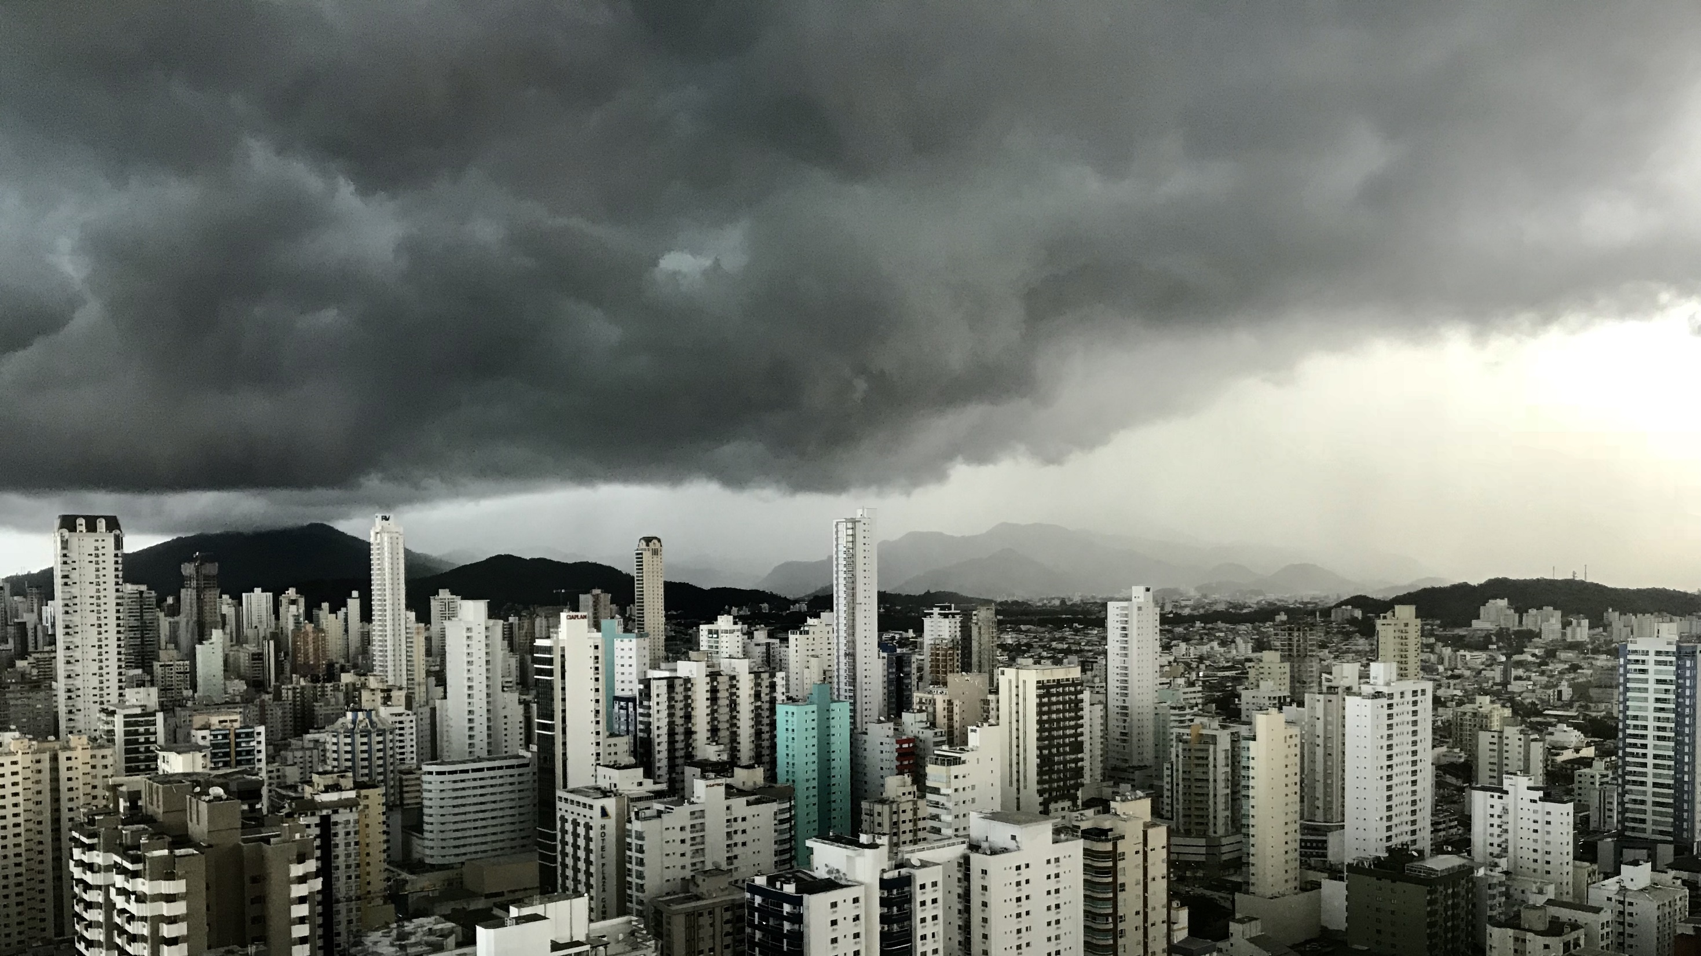
Slide 11
THANK YOU

