Slide 1

Noms
COS 333 Spring 2015 Project
Sean Pan, Annie Chu, Evelyn Ding, Clement Lee, Nathan Lam

Slide 2
Ever had this conversation?

Slide 3
Where do you want to go for dinner?
I don’t know, do you have a place in mind?
I don’t really… let’s look it up
Okay…

Slide 4
10 minutes later…

Slide 5
How about this!
I don’t really like this food…
How about this?
Erm…

Slide 6
You know how this ends…
All hell breaks loose…

Slide 7
Let us solve that problem
Noms

Slide 8
Key features
Restaurant discovery
Simplicity
One-stop portal
Algorithmic matching

Slide 9

Parse cloud code
Cosine similarity scoring
Data curation
Intelligent refiltering

Slide 10
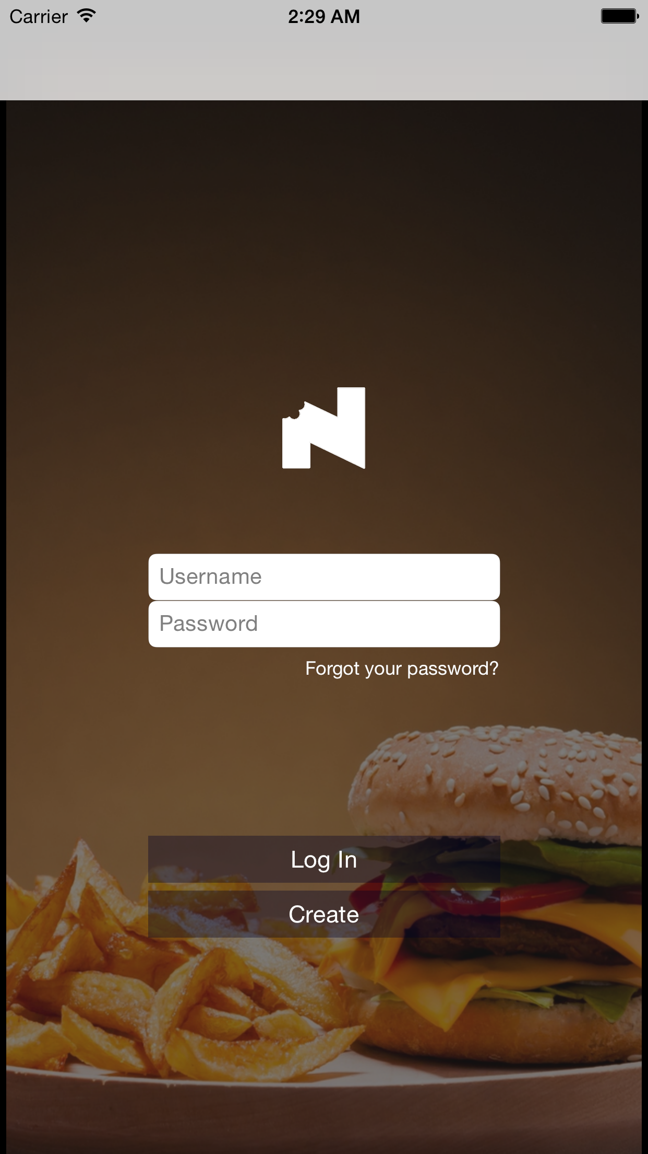
Design is not just what it looks like and feels like. Design is how it works.
Steve Jobs

Slide 11
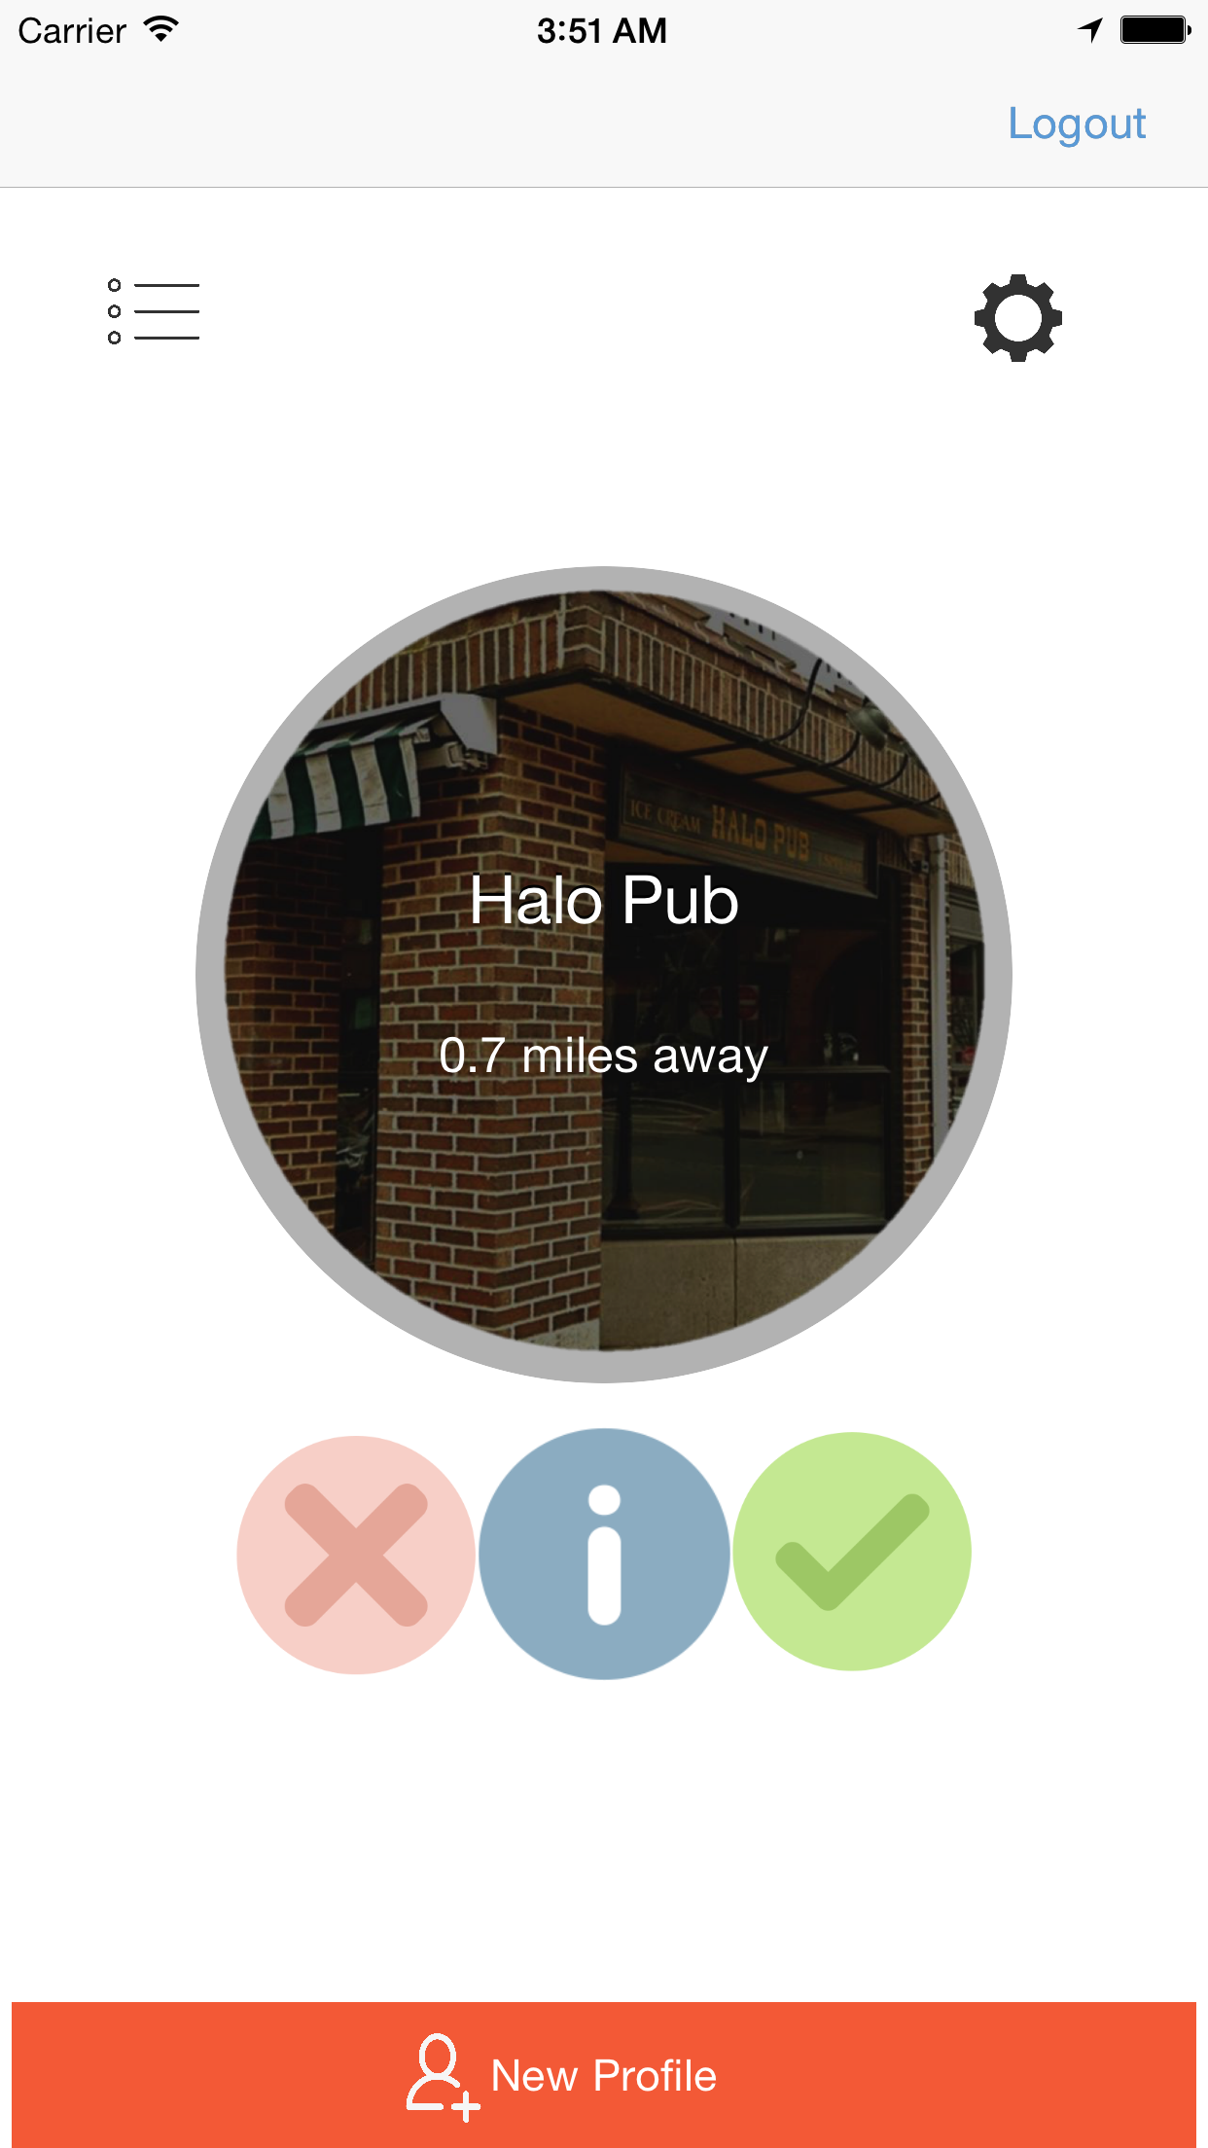
App design
Philosophy
Profiles
Preferences
Restaurant suggestions

Slide 12
Nom?

Slide 13
?
Questions

