Slide 1

Noms
COS 333 Spring 2015 Project
Sean Pan, Annie Chu, Evelyn Ding, Clement Lee, Nathan Lam

Slide 2
We all know how it goes.

Slide 3
What do you wanna eat?
I don’t really care, what do you want?
Uhhhhh…maybe Chinese? Let’s yelp it.
Yeah I really don’t care

Slide 4
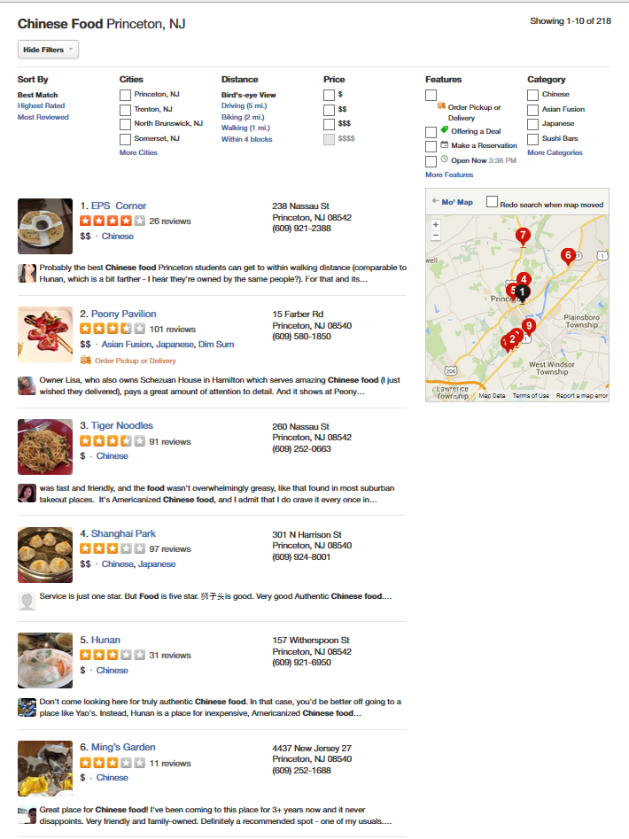

Slide 5
10 minutes later…

Slide 6
How about this!
I don’t really like this food…
How about this?
Erm…

Slide 7

You know how this ends…
All hell breaks loose…

Slide 8
Let us solve that problem
Noms

Slide 9
Key features
Restaurant discovery
Simplicity
One-stop portal
Algorithmic matching

Slide 10

Parse cloud code
Data curation
Cosine similarity scoring
Intelligent refiltering

Slide 11
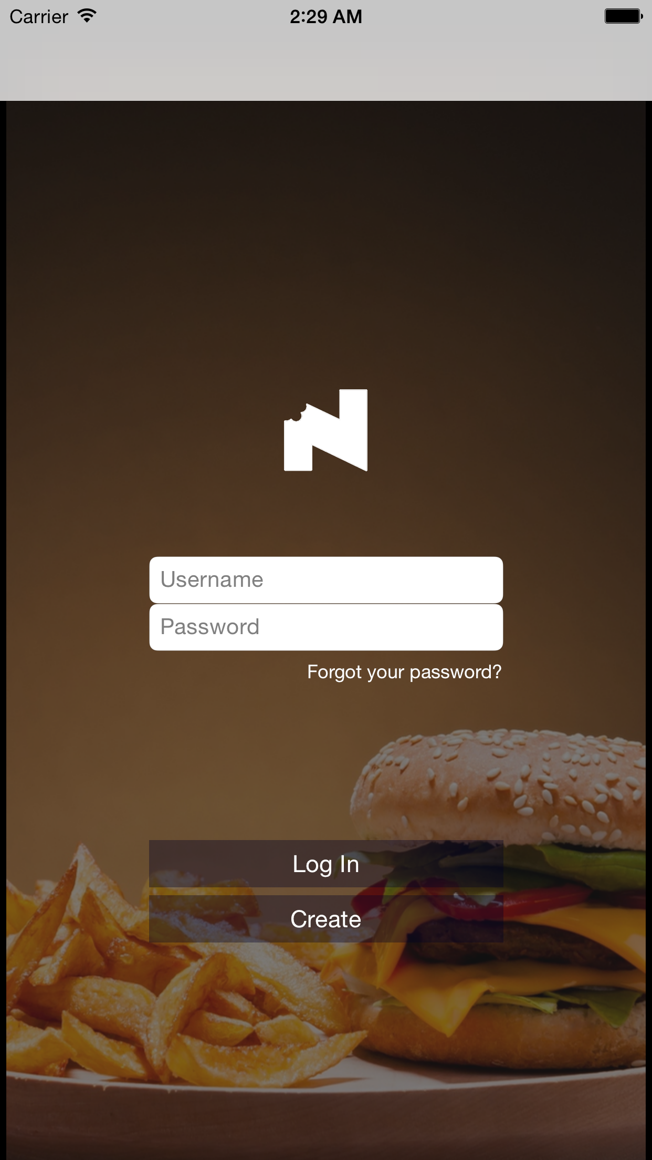
Design is not just what it looks like and feels like. Design is how it works.
Steve Jobs

Slide 12
App design
Philosophy
Profiles
Preferences
Restaurant information and follow up

Slide 13
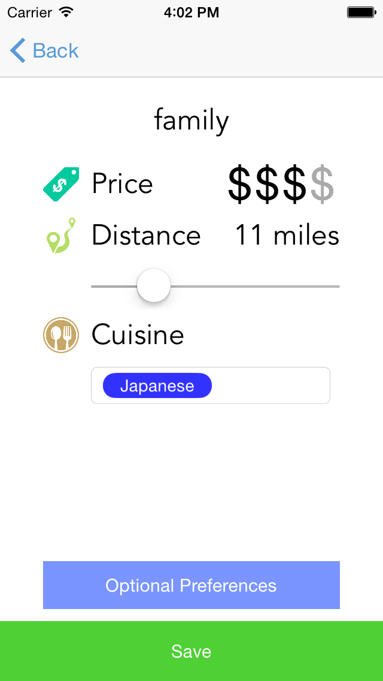
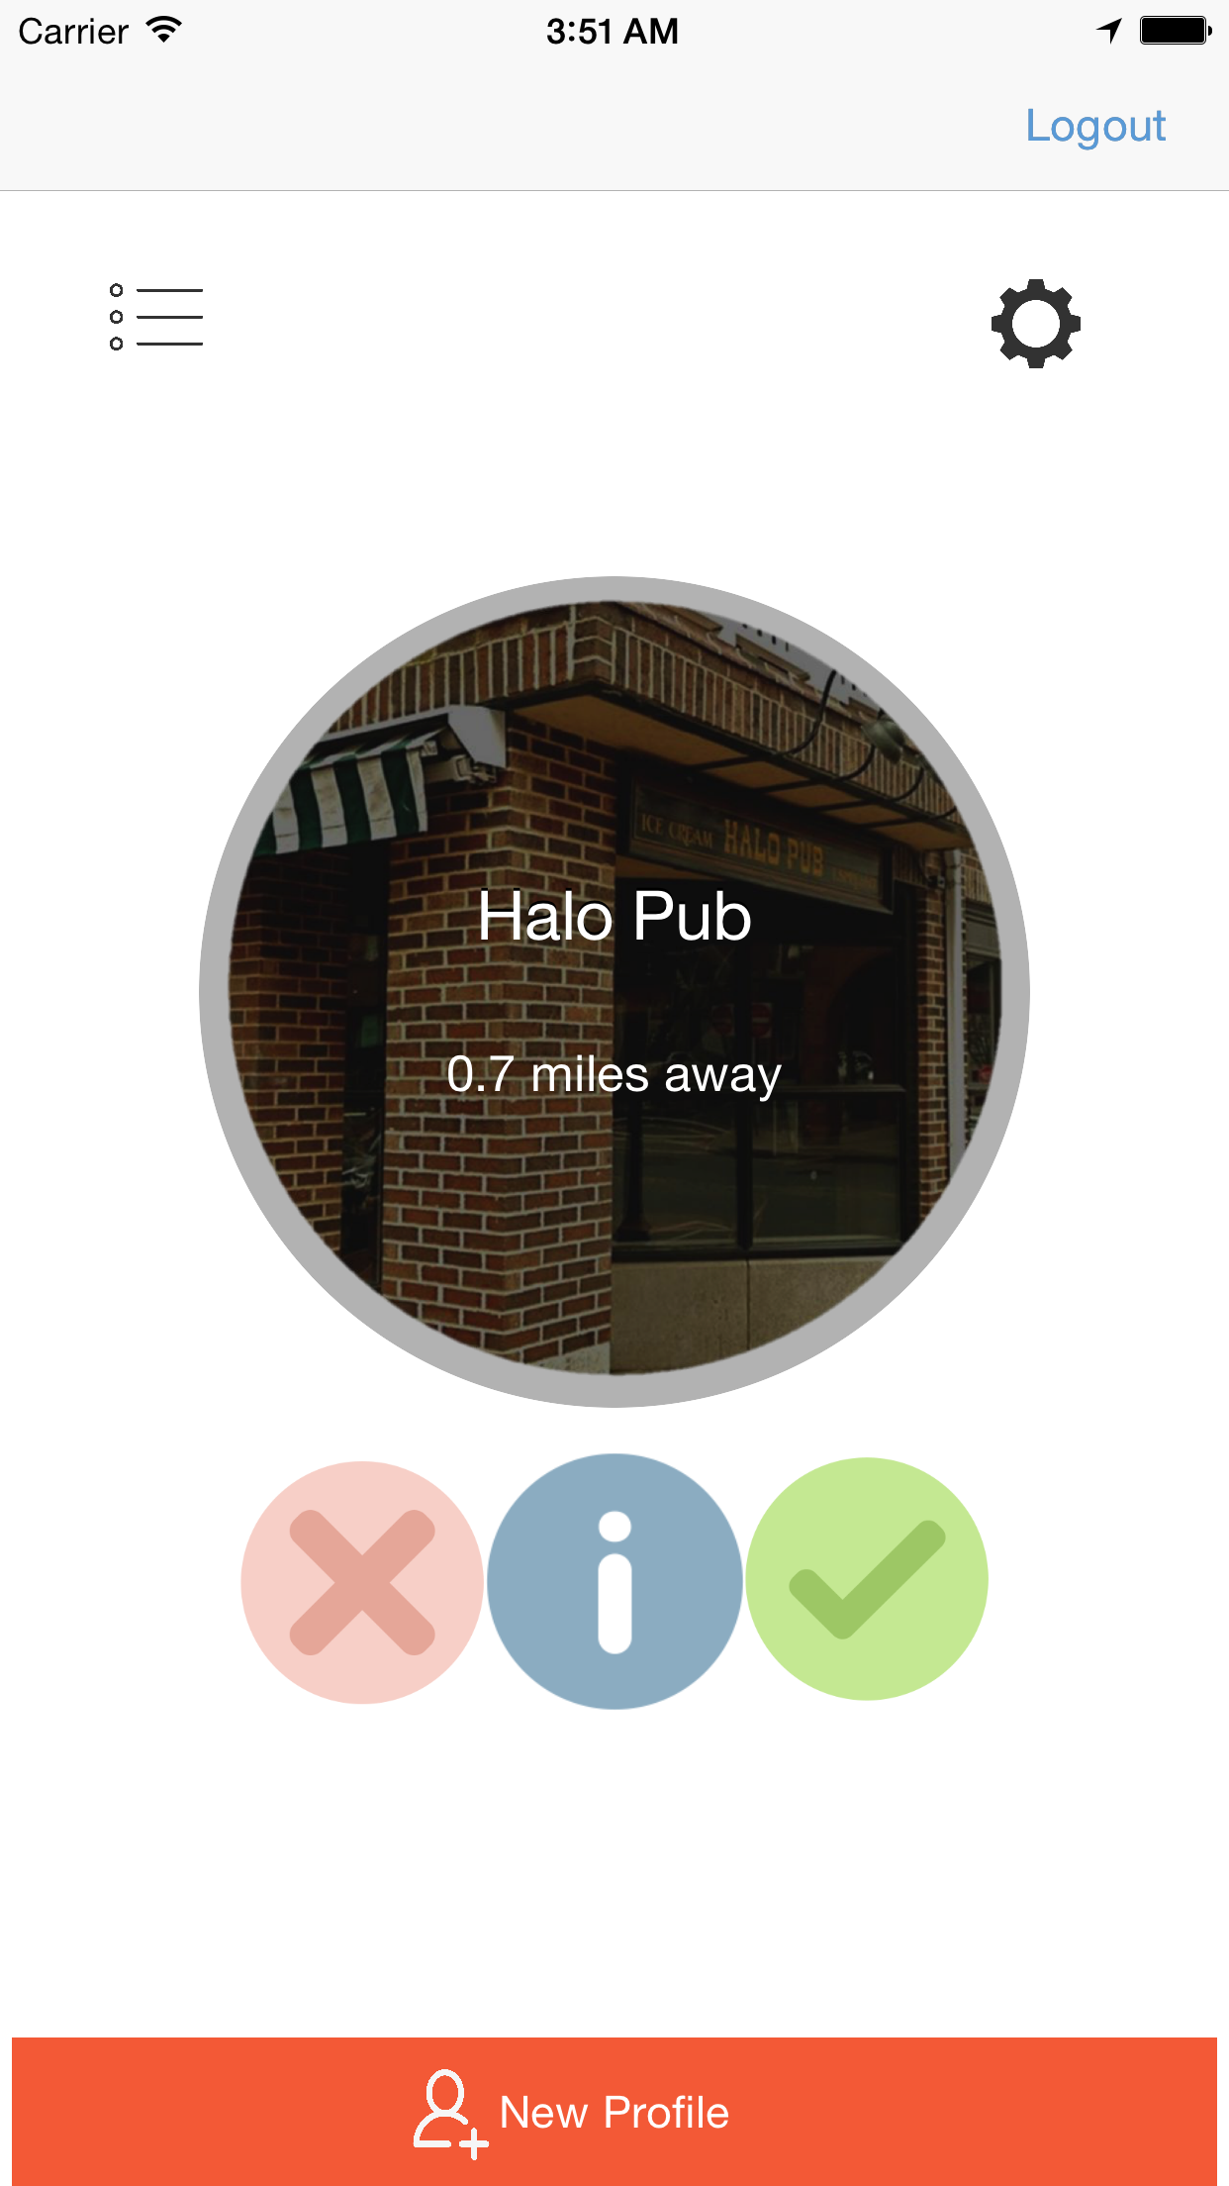
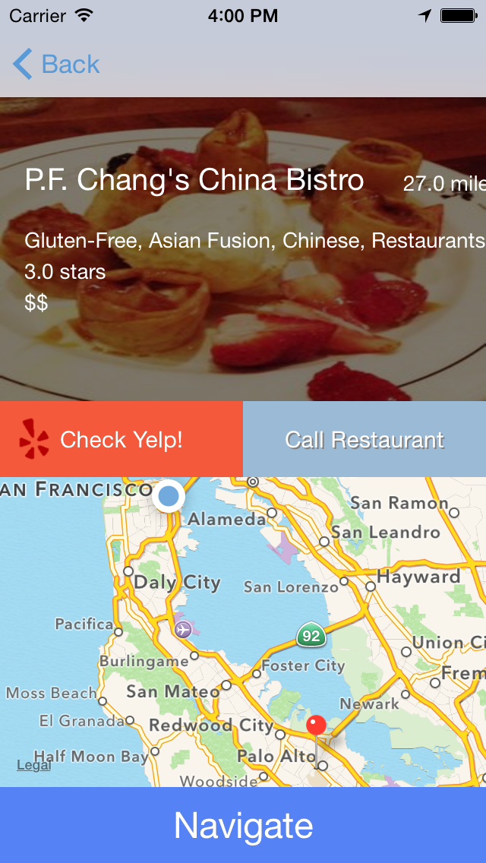
Screens

Slide 14
Nom?

Slide 15
?
Questions

