Slide 1
Flocking
By Nathan Taylor
CI342 Brighton 2016

Slide 2
Deliverable
To build a system to replicate a school of fish’s “swam behaviour” with emergent behaviour of the whole school using global behaviour.
use of AI based of Boids algorithm
Using unity to give a visual result of the simulation

Slide 3
Background info
Boids
Craig Reynolds in 1986
Movies/games
CGI animal flocking behaviour
Research
Simulations

Slide 4
motivation
Ai
Usable
Simulate
Visually appealing
Unity3D/C#
Something for industry use;
Entertainment
Military

Slide 5
nature
Other animal groups, birds and herds etc.
Reverse engineered a piece of nature
Fish don’t need a leader they follow each other and form a ‘school’ that swim together for various reasons, such as; for reproduction, protection, foraging, and social interaction.
Individual behaviour patterns that results in this swarm movement.

Slide 6
Problem definition
Emergence: simple rules that interfere to give rise to complexity

Slide 7
approaches
Class for agent
Position
Rotation
Velocity
acceleration
World
Agent configuration class declutter

Slide 8
Motion equations
Acceleration of agent is returned by combined function
Acceleration modified by the velocity of the agent over a short time
v = v + a * t
Velocity modified by the position of the agent over a short time
x = x + v * t
A + V clamped max A + V values (fish have finite a + v)

Slide 9
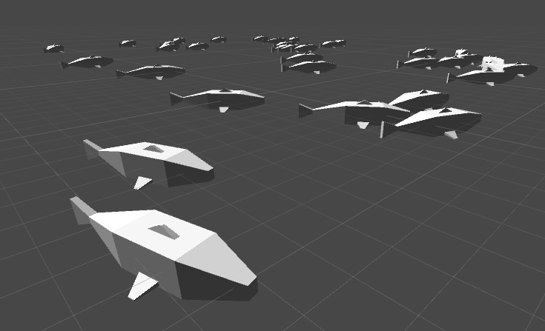
Agent class
Rules
Cohesion
Separation
Alignment
combine
Wrap around
Field of view
Avoidance

Slide 10
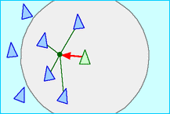
cohesion
Get all nearby neighbours
If no neighbours then no cohesion
Find centre of mass of all neighbours
Divide by total number of neighbours
Go towards the centre of mass
Normalize and return vector

Slide 11
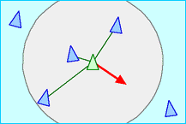
separation
Steer in the opposite direction from each of our nearby neighbours
Get all neighbours
If no neighbours then no separation
Add the contribution of each neighbour towards agent
Proportional force distance
Normalize and return the result

Slide 12
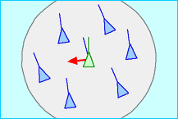
alignment
Steer agent to match direction and speed of neighbours
Get all neighbours
If no neighbours means no one to align to
Match direction and speed == match velocity
Do this for all neighbours
normalize

Slide 13
combination
Combine all three behaviours and calculate weighted sum
Cohesion
Separation
Alignment
Combine different behaviours in different proportions
Avoid collision rather than alignment
Weighted sum of all behaviours
Return acceleration

Slide 14
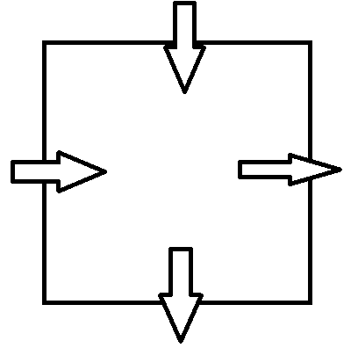
Wrap around
Constrict agents to a zone, if they go beyond that zone it’ll teleport/wraparound to the other side

Slide 15
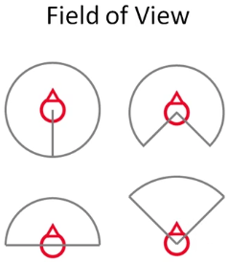
Field of view (FOV)
Since fish don’t have 360 field of view
Used a Boolean function to check if its in FOV
Return Boolean r = angle of velocity
Relative position of target to the agents position
Check if angle is more than max FOV value
Max FOV is default 180
Three rules now check to see if neighbour is in field of view

Slide 16
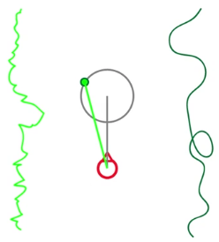
Wander Behaviour
Useful for single agents/small flocks/schools
Wander steer behaviour that looks purposeful
Smooth (right) and not full of jitters (left)
Using random vectors that are constricted to the circle position the target in front of the agent
project the target from local space to world space
steer the agent towards it

Slide 17
Avoidance and fleeing
flee from all enemies behaviour
run the opposite direction from the target
steer our velocity
Avoid while steering towards desired position and velocity

Slide 18
Predator
Same model but bigger
Overrides combine and essentially wanders
Fish agents are the ones to behave differently towards it

Slide 19
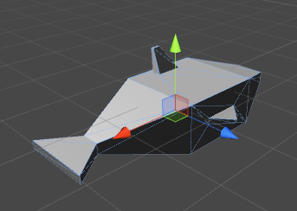
Challenges
Wander jitter
Size of circle random position vector is constricted to
Parent scaling on object
Look at/rotation of 3d model
3d space
GitHub loss of progress
Agent number optimization

Slide 20
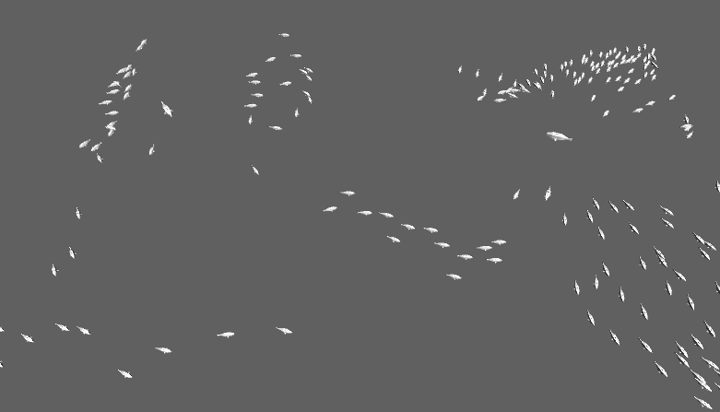
results
show build

Slide 21
analysis
Fluid motion
Room for experiment
Simple model
Applications

Slide 22
Image References
http://www.red3d.com/cwr/boids/

Slide 23
Thank you for your time
Any Questions?

