Slide 1
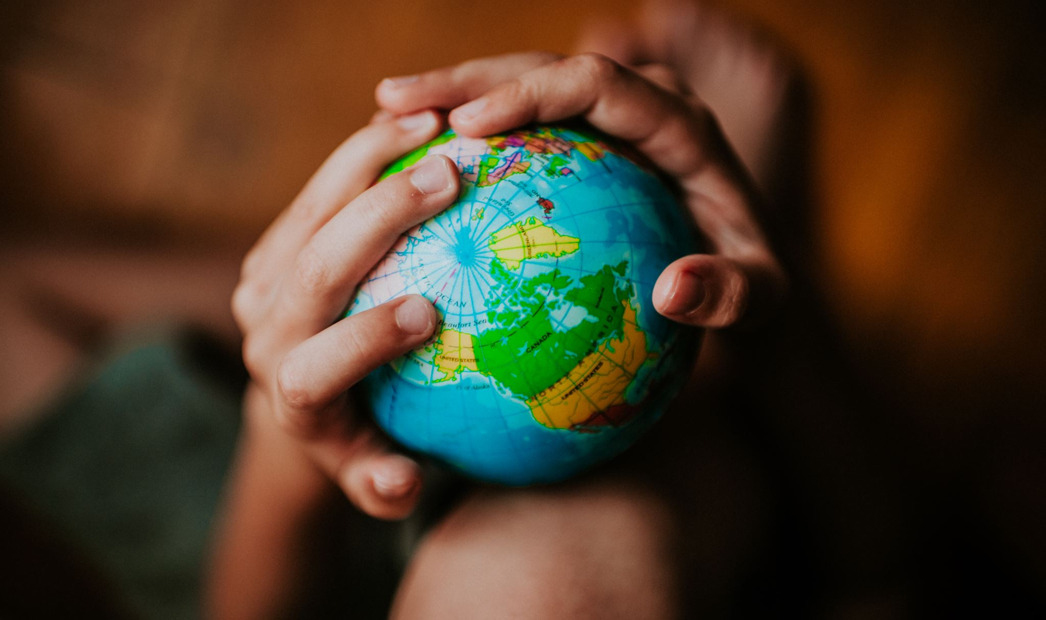
GLOBAL DEBT
Blake Gleason
Ungwhan Ahn
Camilo Toro
Faiza Ahmad

Slide 2
Fellow classmates, instructor and TA’s,
We stand before you today to address a critical issue that affects not only our country but the entire world - the issue of global debt.
In this presentation, we’ll show you ….

