Slide 1




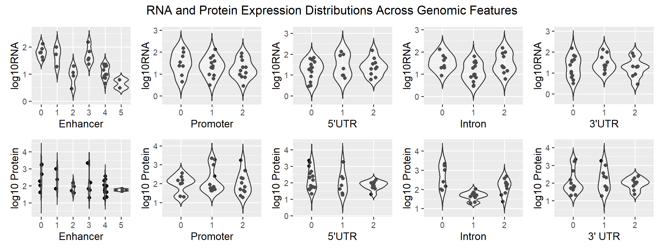
Tumor on chip
Shuo Li¹
Introduction
Method
Future Work
Result
Conclusion
Application
Acknowledgement

