Slide 1
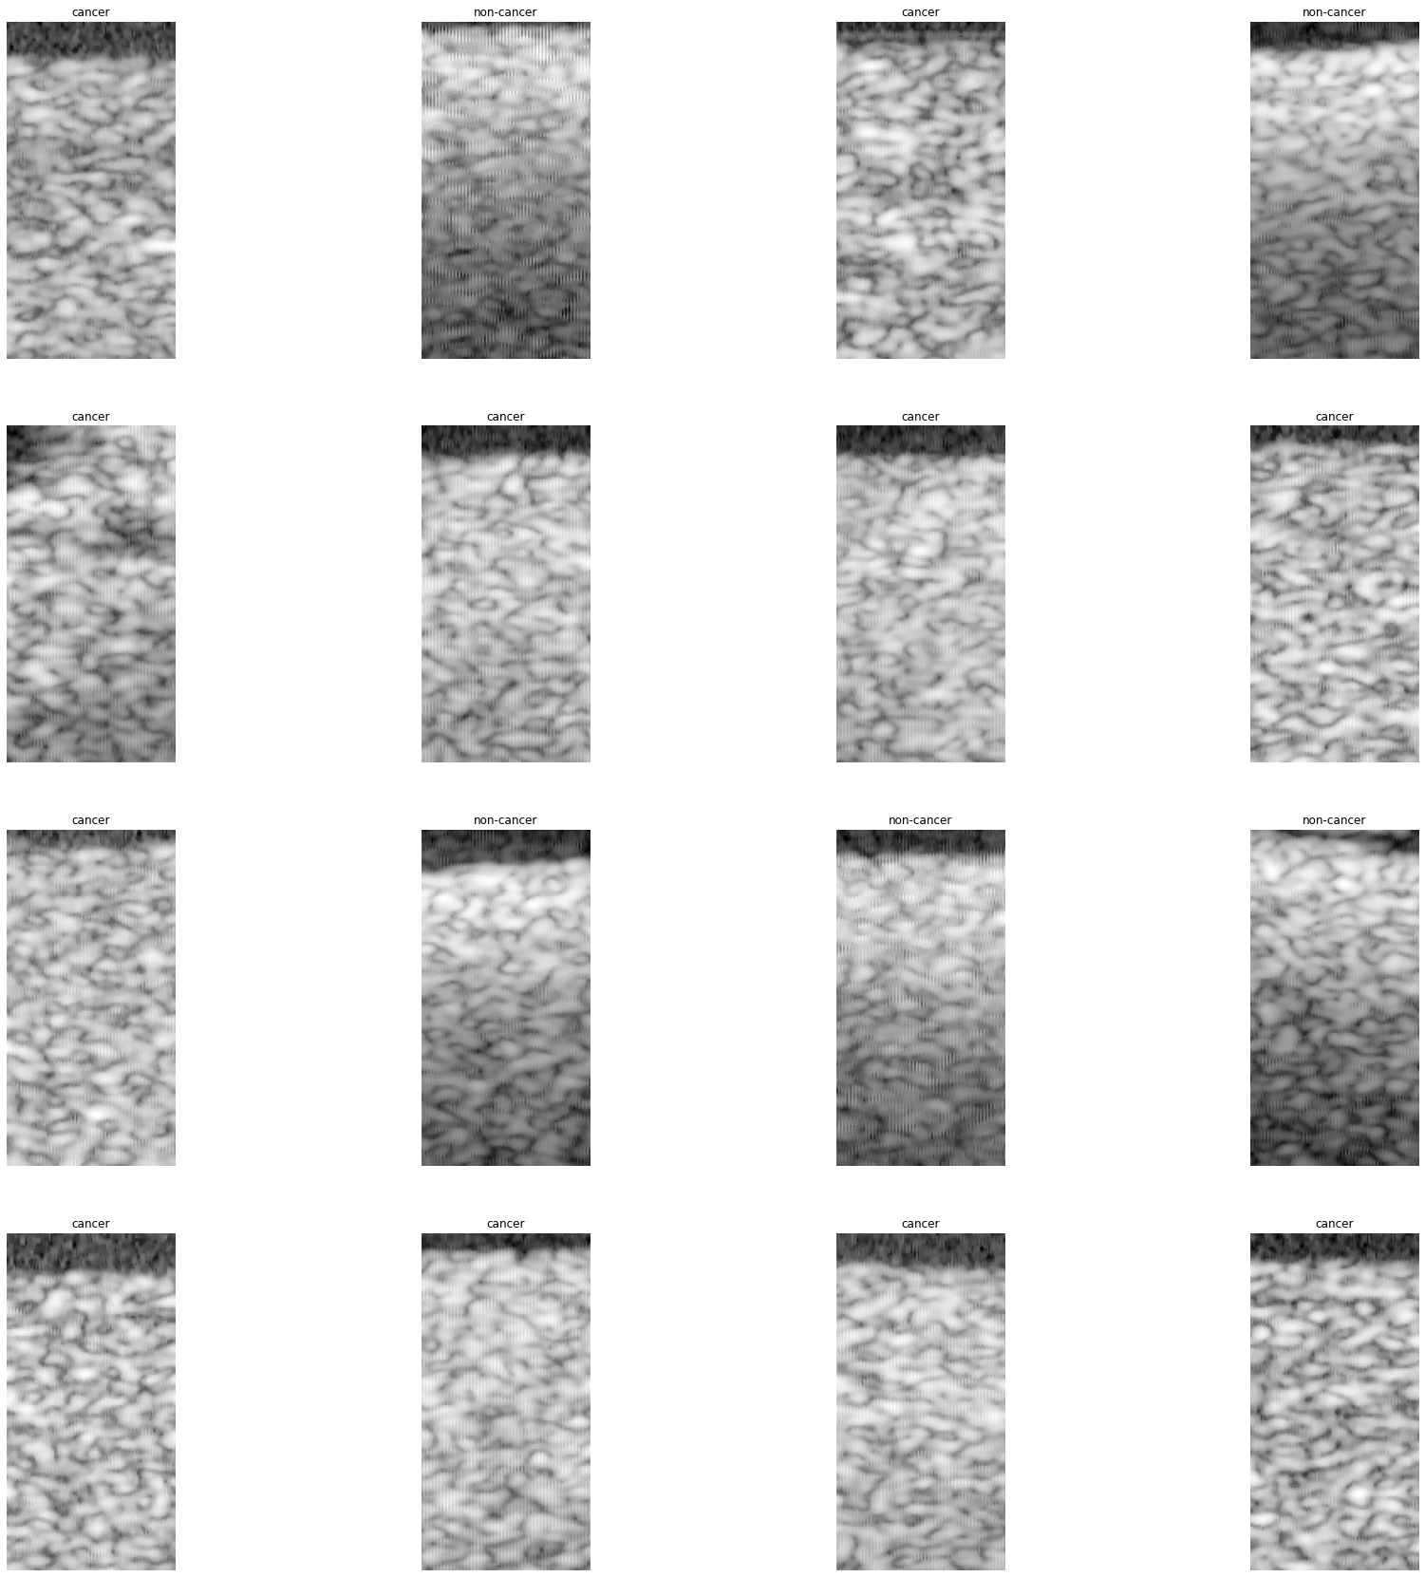
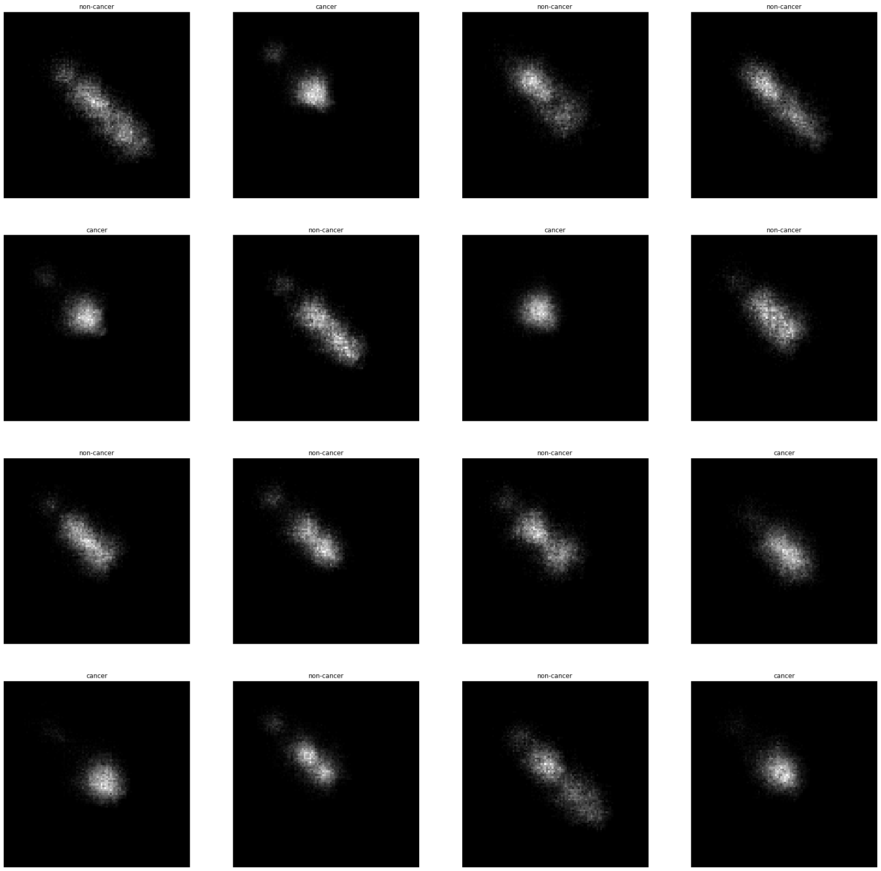
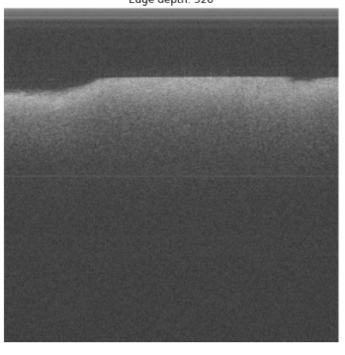
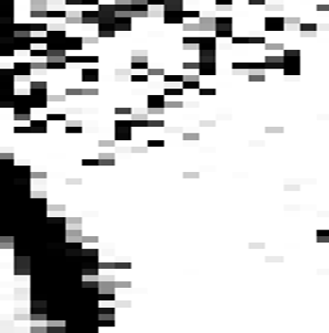
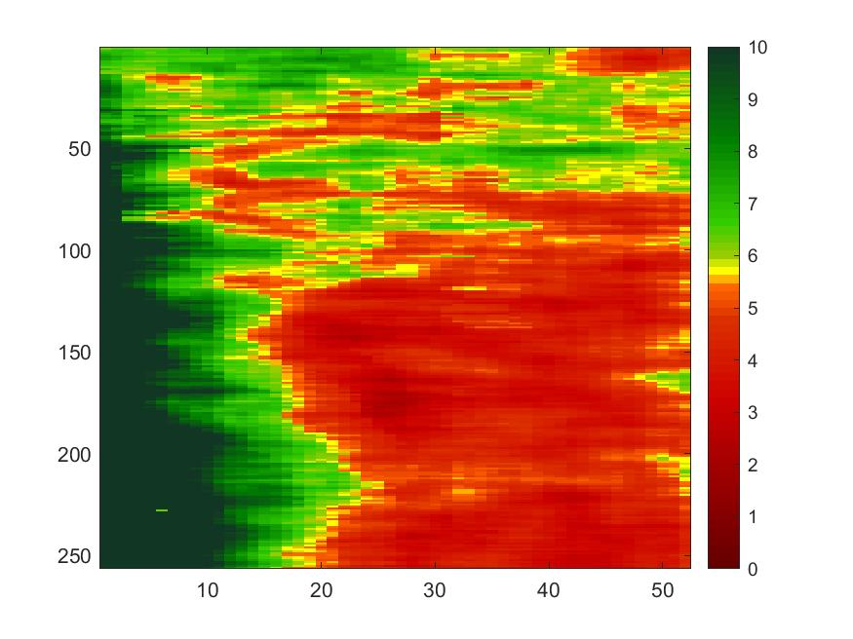
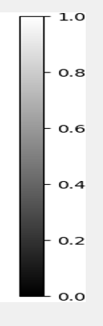
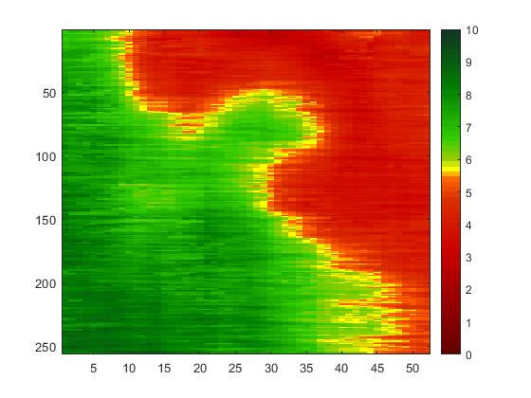
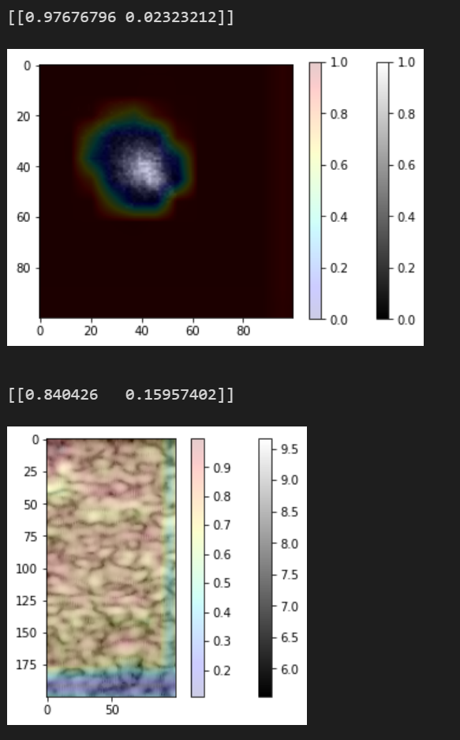
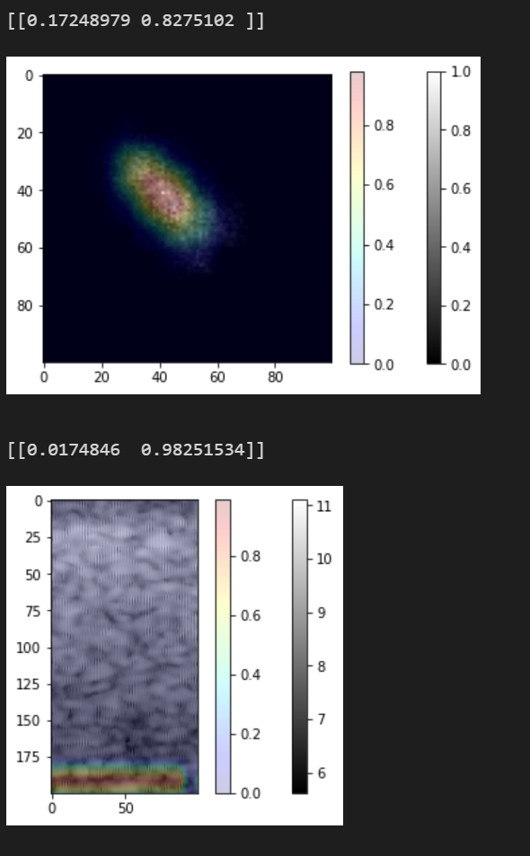
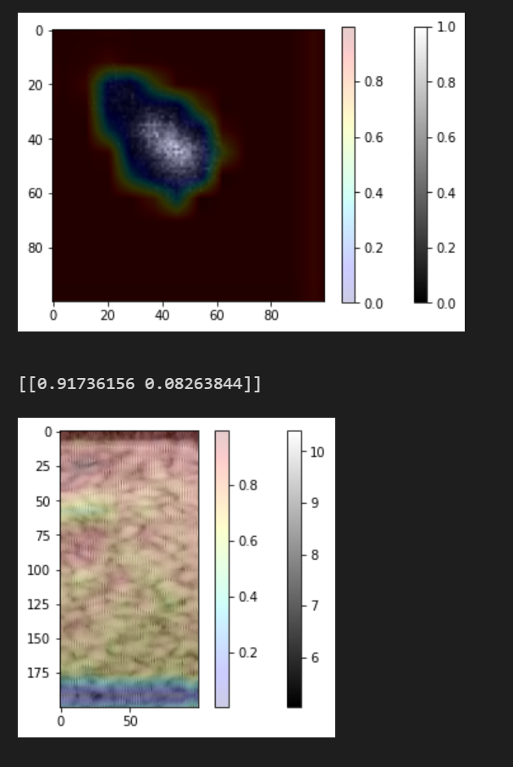
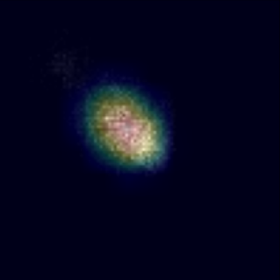
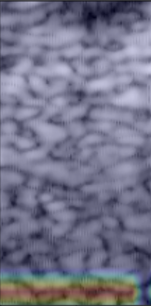
A
12 Patients
Avg: 62.6 years
Min: 33 years
Max: 78 years
B
*
A
7
4
1
B-frame slice
200x100
Training Set
Train the CNNs with 20% validation split.
Testing Set
Assess how well the CNNs generalize to unseen data.
Segmentation Set
Apply the model to mixed cancer and non-cancer samples.
Cancerous
Texture
100x100
4
3
2
2
`
OCT Sample
B-frame slice
# samples
16 non-cancer
5 non-cancer
18 cancer
5 cancer
Non-cancerous
*
2,048 Pixels
5,831 examples
1,610 examples
256 Frames
2,048 A-lines
Texture
B-frame Slices CNN
12x12
128
3x3x256
2x2x256
B
C
64
3x3
2x2
2
50x50
32
100x100
64
0
0.5
1
10
5.5
0
200x100
1024
P(Cancer)
P(Non-cancer)
Non-Cancer
Cancer
Non-Cancer
Cancer
2D convolution*
Fully connected with dropout
Texture CNN
2
Max pooling followed by 2D convolution**
Flatten
64
32
32
16
128
12x12
3x3
2x2
32
2
50x50
Concatenation
Grad-CAM layer
100x100
64
3x3 filters, same padding, ReLu in intermediate layers, softmax in final layer
* unstrided ** stride length 2 along the down-sampled dimension(s)
Positive
Negative
Model | Mean Accuracy | Standard Deviation | B-frame Slices | Texture | Sub-optimal Texture
Ensemble | 94.90% | 0.11% | t=132.21, F=23.44 | t=-0.39, F=1.81 | --
B-frame Slices | 85.01% | 0.52% | -- | t=-130.21, F=12.94 | --
Texture | 94.91% | 0.14% | t=130.21, F=12.94 | -- | --
Sub-optimal Ensemble | 90.03% | 0.17% | t=65.11, F=9.38 | -- | t=26.40, F=5.68
Sub-optimal Texture | 88.39% | 0.41% | -- | t=-107.26, F=7.91 | --
True
False
Lower Weight
Higher Weight

