Slide 1
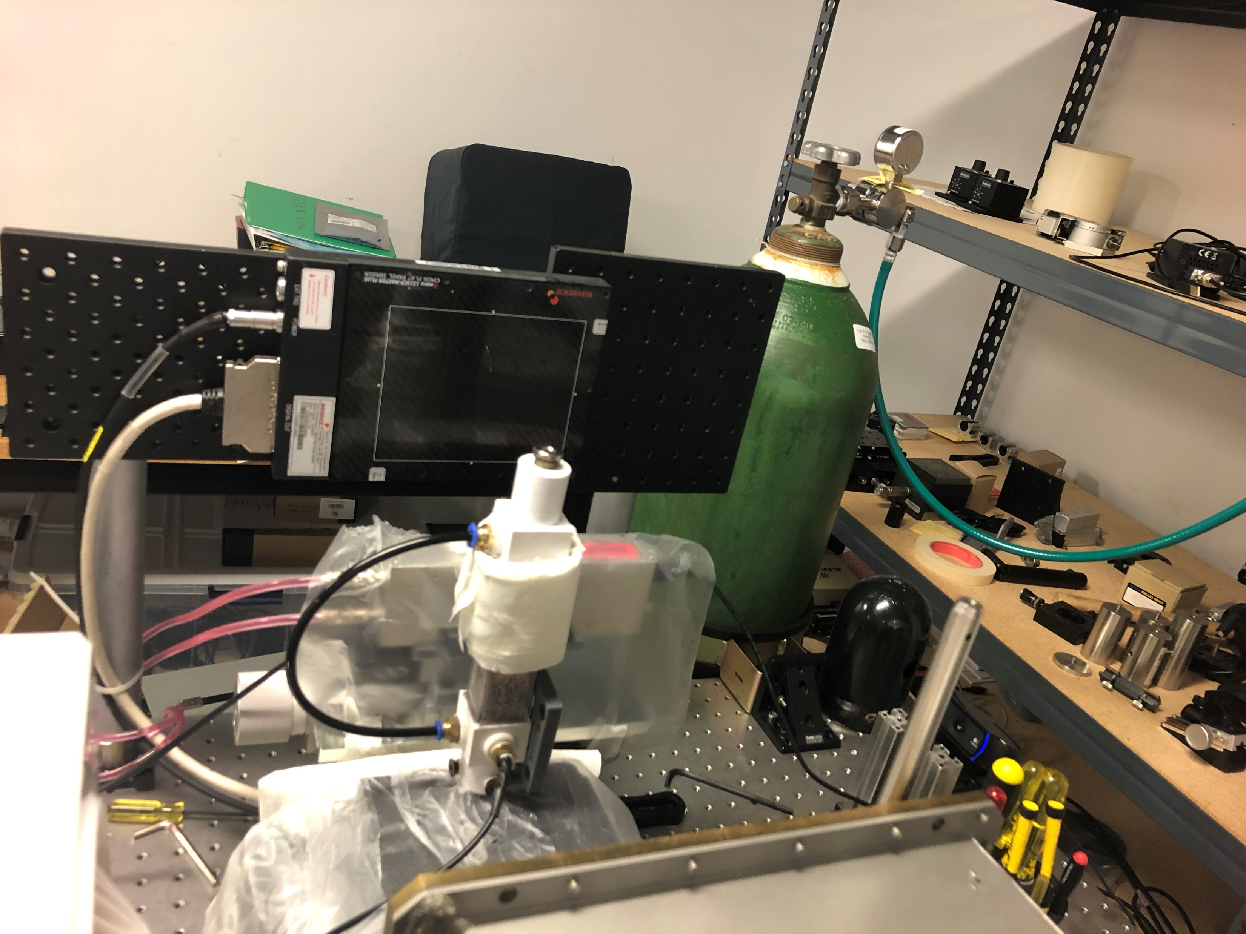
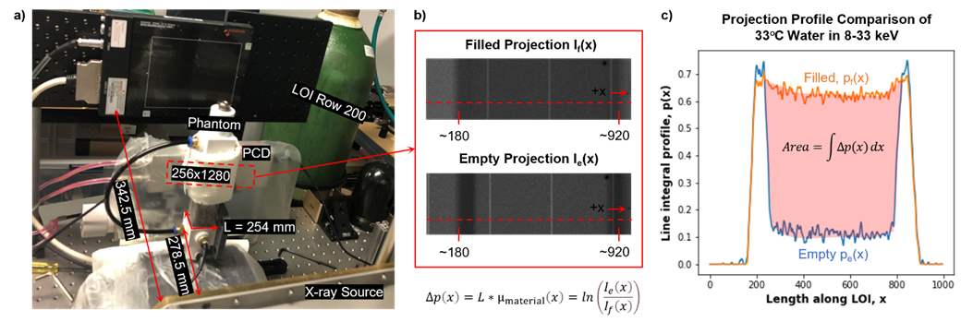
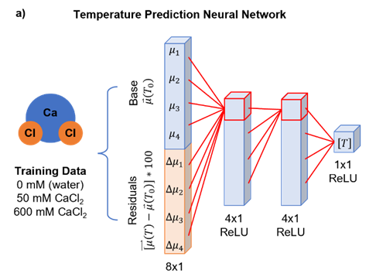
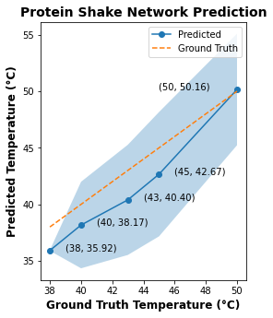
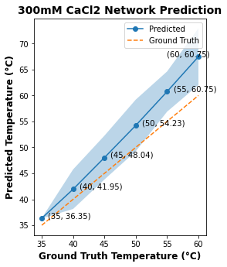
Projection profile comparison of 33°C water in 8-33 keV
Filled projection I_{f}(x)
Empty projection I_{e}(x)
Temperature prediction neural network
b)
Protein shake network prediction
300 mM CaCl₂ network prediction
$$μ(T)$$
Training data
Ground truth temperature (°C)
Ground truth temperature (°C)

Slide 2
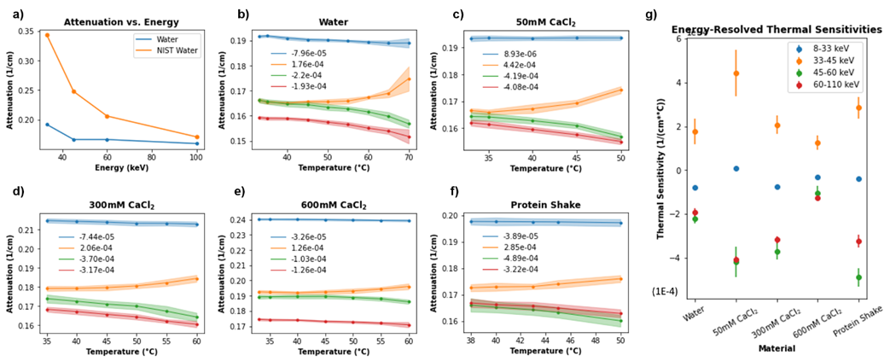
Attenuation vs. energy
Energy-resolved thermal sensitivities
(8-33 keV)
(33-45 keV)
(45-60 keV)
(60-100 keV)
(8-33 keV)
(33-45 keV)
(45-60 keV)
(60-100 keV)
(8-33 keV)
(33-45 keV)
(45-60 keV)
(60-100 keV)
Protein shake
(8-33 keV)
(33-45 keV)
(45-60 keV)
(60-100 keV)
(8-33 keV)
(33-45 keV)
(45-60 keV)
(60-100 keV)
(8-33 keV)
(33-45 keV)
(45-60 keV)
(60-100 keV)

