Slide 1
Weak Perspective Works

Slide 2
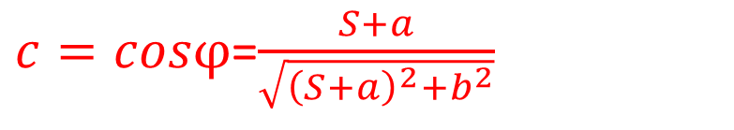
S
$A$=($\frac{aμ}{c}+aμ)\frac{bK′}{2}+\frac{aμ}{c}$ $\frac{b}{2}[K$- $K′]=\frac{abμ}{2}${$\text{(}\frac{1}{c}+1)K′+\frac{1}{c}[K\text{− }K′]$}= $\frac{abμ}{2}\text{(}K′+\frac{K}{c})$
$c=cosφ$=$\frac{S+a}{\sqrt{{\left(S+a\right)}^{2}+b^{2}}}$
^{φ}
^{b}
ª
^{μ}
^{aμ/c}
D
^{aμ}
Zoom K = (S+D)/S
^{K’b}
^{Kb}
Zoom K’ = (S+D)/(S+a)

Slide 3
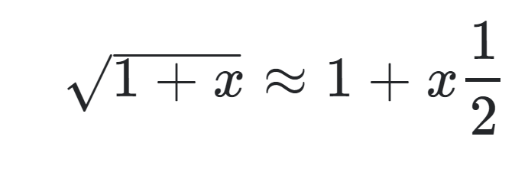
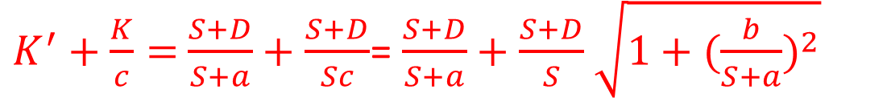
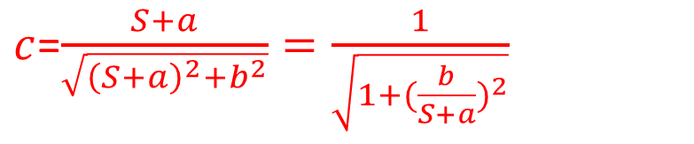
$A$=($\frac{aμ}{c}+aμ)\frac{bK′}{2}+\frac{aμ}{c}$ $\frac{b}{2}[K$- $K′]=\frac{abμ}{2}${$\text{(}\frac{1}{c}+1)K′+\frac{1}{c}[K\text{− }K′]$}= $\frac{abμ}{2}\text{(}K′+\frac{K}{c})$
K = (S+D)/S
K’ = (S+D)/(S+a)
$c$=$\frac{S+a}{\sqrt{{\left(S+a\right)}^{2}+b^{2}}}=\frac{1}{\sqrt{1+{(\frac{b}{S+a})}^{2}}}$
$K^{′}+\frac{K}{c}=$ $\frac{S+D}{S+a}+\frac{S+D}{Sc}$= $\frac{S+D}{S+a}+\frac{S+D}{S}$ $\sqrt{1+{(\frac{b}{S+a})}^{2}}$
$K^{′}+\frac{K}{c}Ǡ≈$ $\frac{S+D}{S+a}+\frac{S+D}{S}$ $\left(1+\frac{b}{2\left(S+a\right)}\right)=\frac{S+D}{S}\{\frac{S}{S+a}+1+\frac{b}{2\left(S+a\right)}$}
=$K \{1+\frac{2S+b}{2S+2a}$}$\text{=}K \{1+\frac{2S+2a−2a+b}{2S+2a}\text{\}}=K \{2−\frac{2a−b}{S+a}\text{\}}≈$2K

