Slide 1
An data driven investigation of the gamblers myth, ‘never back the early kick-off’
By Nathan Bryant

Slide 2
Background
An accumulator bet is a bet with multiple matches, in this case deciding the result of a match all to happen, so whether one of the picks or all of them lose, the bet is a loser.
A common accumulator is one that is some number of Premier League matches on a Saturday. Usually the first match is at 12:30pm, a few at 3pm and one more evening match.
When a punter loses the accumulator on the ‘early kick-off’ it is often seem as a gamblers sin. Never back the early kick-off.
Is there a statistical bias to kick-off times? Do better teams play worse? Do worse team overperform? Or is this all an emotional response to losing before the rest of the matches kick-off?

Slide 3
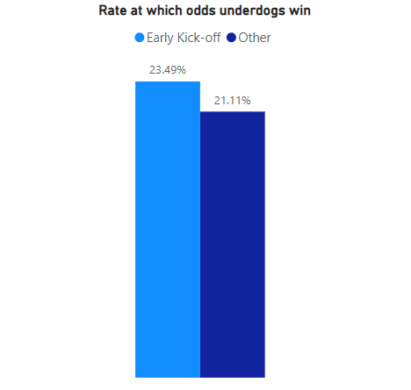
Rate of Winning
For every match played, in the ‘early kick-off’ and otherwise with can see a slight bias in the early kick-off matches.
This data considers any match won by the team who had higher odds pre-match.

Slide 4
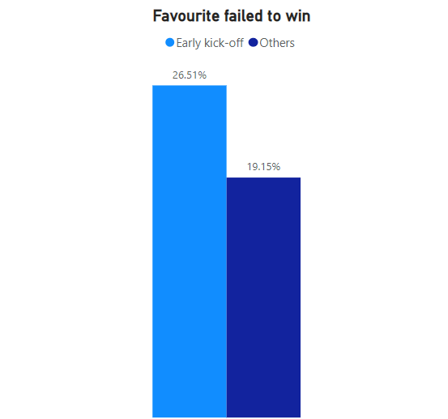
Win or Draw
We must consider that a bet will lose if the punter backs the favourite and a draw occurs also.
This data includes all matches that we’re lost by the odds favourite as before, as well as in the event of a draw
Here we can see a much more exaggerated bias towards the early kick-off, over 6% greater rate of odds-on favourites failing to win.

