Slide 1

Home
Notes:
actionButton
No alt text provided

Slide 2
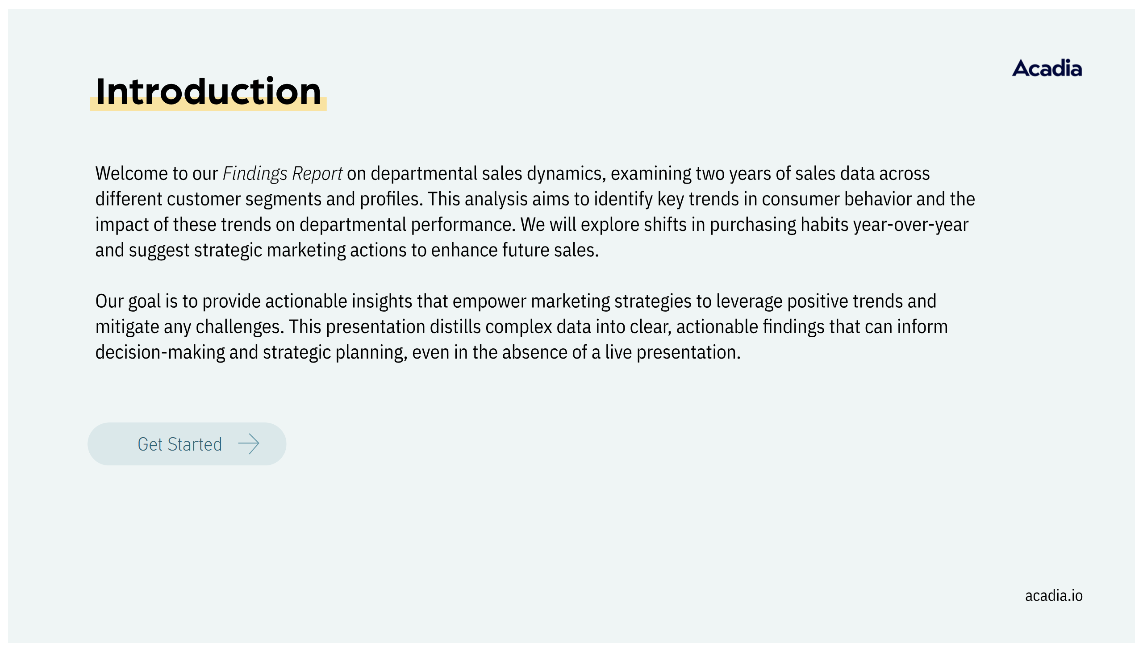
Introduction
Notes:
actionButton
No alt text provided
actionButton
No alt text provided

Slide 3
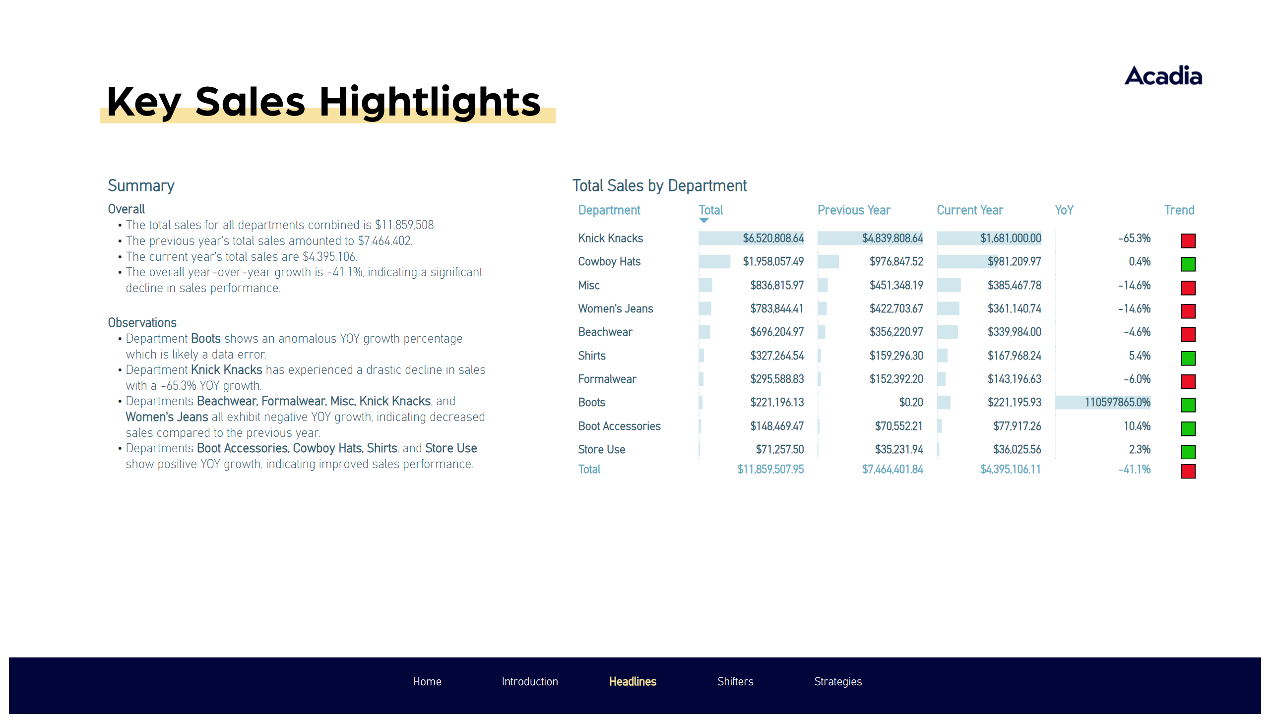
Headlines
Notes:
Summary
No alt text provided
shape
No alt text provided
Total Sales by Department
No alt text provided
pageNavigator
No alt text provided

Slide 4
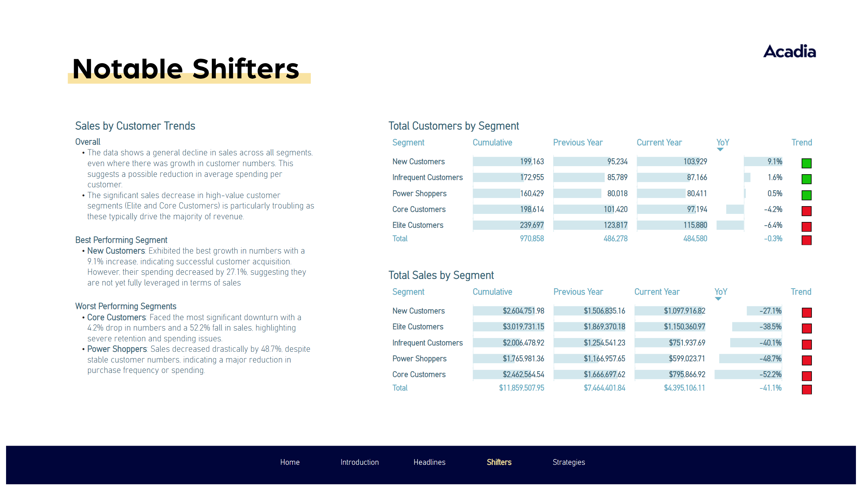
Shifters
Notes:
Sales by Customer Trends
No alt text provided
Total Sales by Segment
No alt text provided
Total Customers by Segment
No alt text provided
pageNavigator
No alt text provided

Slide 5
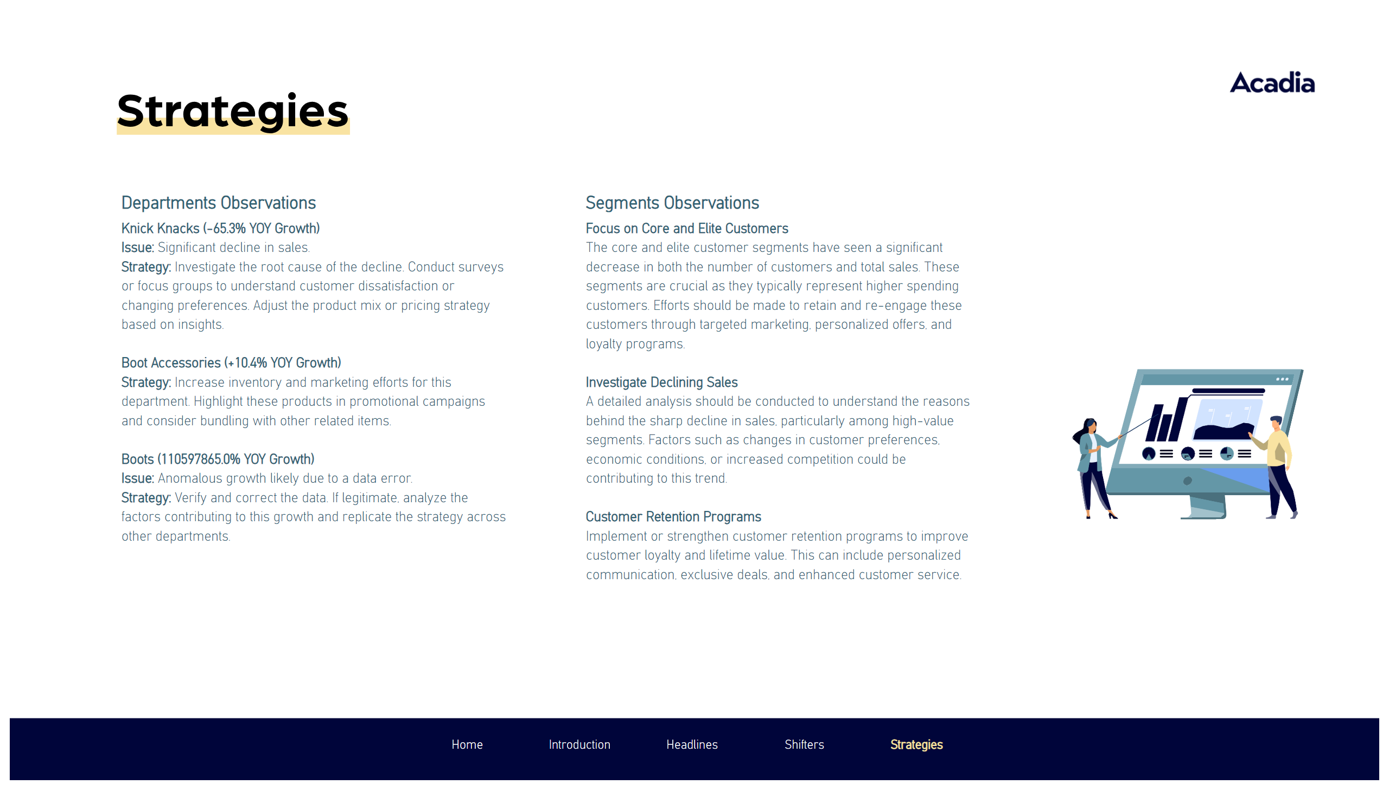
Strategies
Notes:
Departments Observations
No alt text provided
Segments Observations
No alt text provided
image
No alt text provided
pageNavigator
No alt text provided

Slide 6

End
Notes:
pageNavigator
No alt text provided

