Slide 1
Financial engineering
A presentation on project 4 and a reflection on phy480

Slide 2
Overview of presentation
Overview of Project 4 as Well as Why I Chose This Topic
The Work We Did With Project 4
Reflections on PHY480 In General

Slide 3
Why did I choose financial engineer?

Slide 4
Why did I choose financial engineering?
Future Career Interests
It Served As A Nice Break From Typical Curriculum
Not Computationally Challenging but A Nice Thought Exercise
Group Dynamics

Slide 5
What is the idea behind project 4
“Econophysics”
Two People, i and j, Meet Under Certain Circumstances
Whether Or Not They Exchange Money Depends on What We Looked At
Random Number Generation

Slide 6
What did we actually do?
Let’s actually get in to project 4 details

Slide 7
What did we actually do?
Model Basic Financial Interactions Between People
Introduce Some ”Real World” Parameters
Think

Slide 8
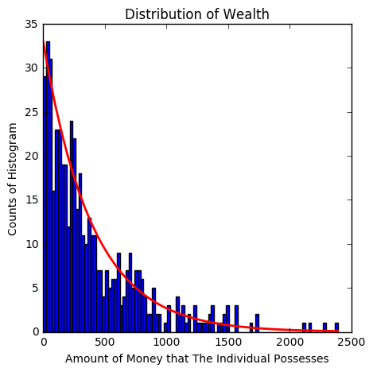
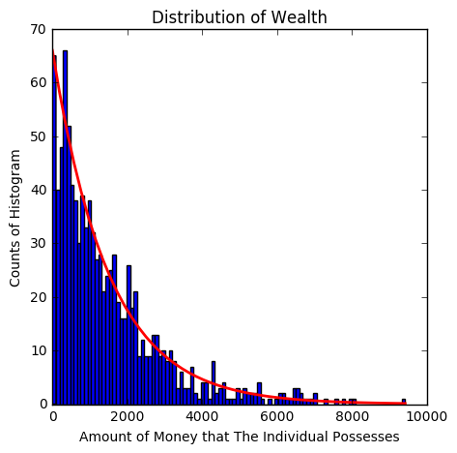
Part one: Basic Transactions
Notes:
Generate some uniform epsilon, they exchange some amount of money proportional to this. Always interact
First Plot is N=500 agents starting with $420 dollars for 10^7 transactions
Second Plot is N=1000 starting with $1500 for 10^6 transactions reaching “steady state”
Models society, a lot of people end up with nothing and some end up with everything

Slide 9
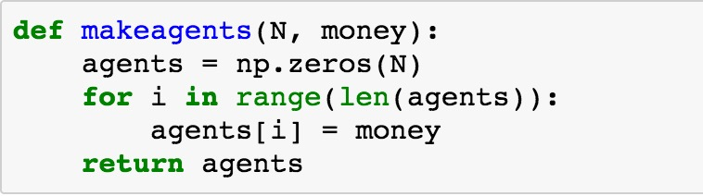
The code

Slide 10
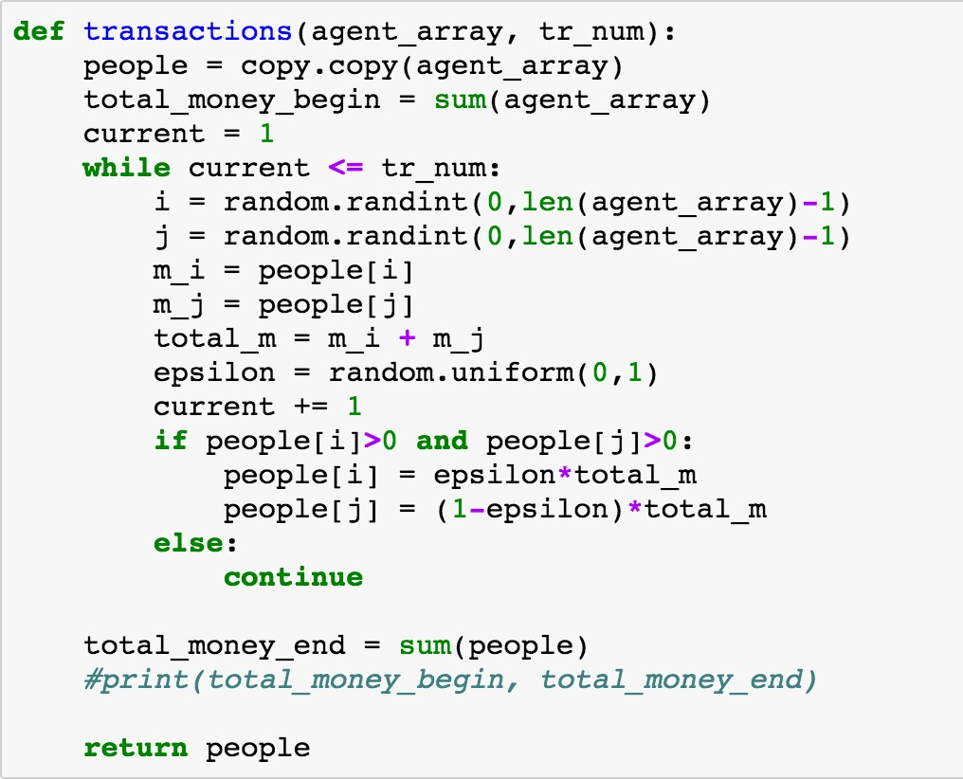
The code

Slide 11
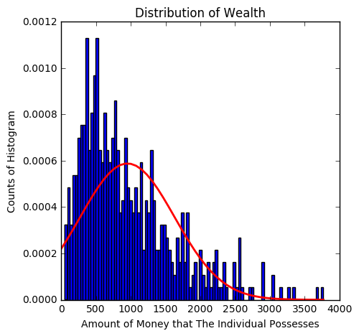
Part two: Savings
Notes:
Low savings of N=500, $1000, 10^6 transactions, 25% savings

Slide 12
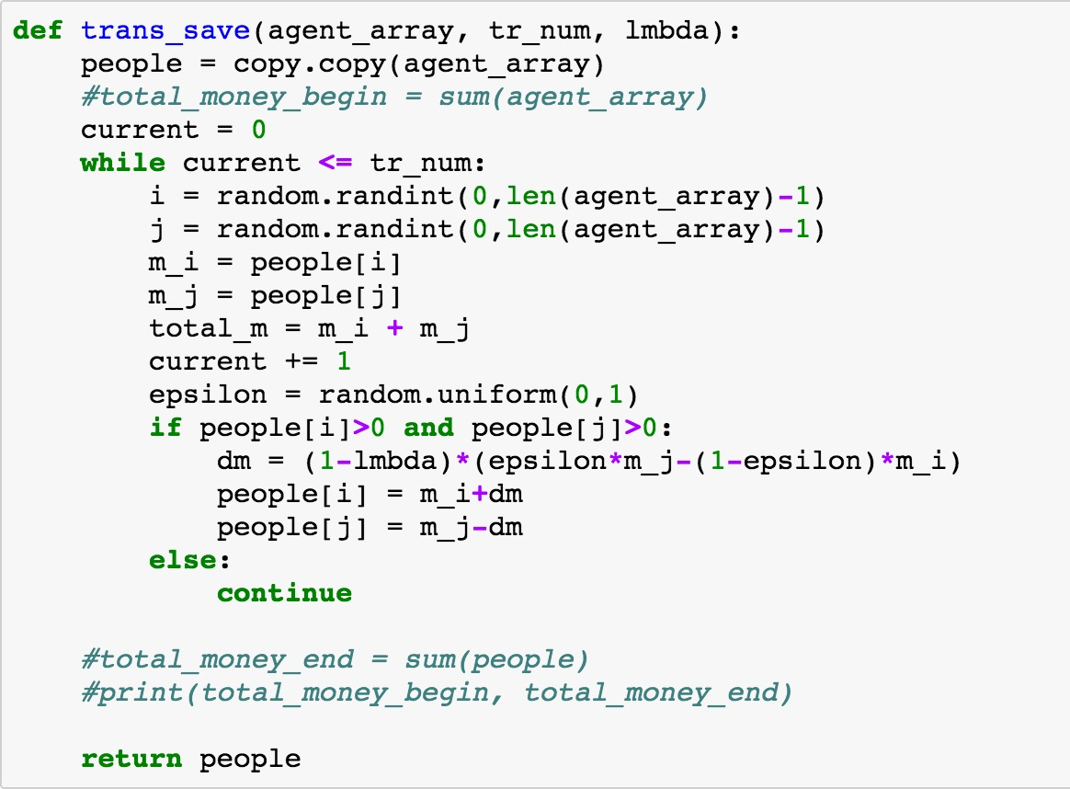
The Code

Slide 13
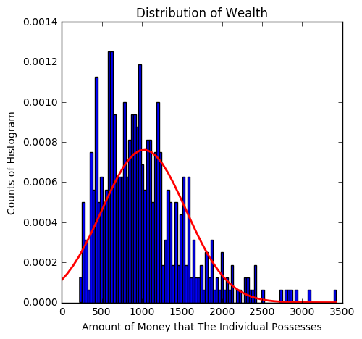
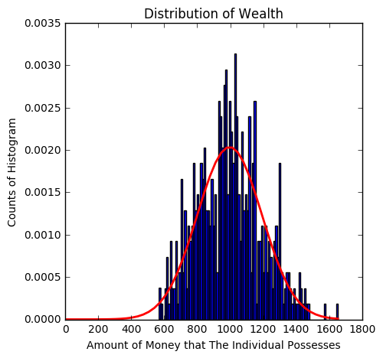
Notes:
Same set up, but now with 50% and 90% savings
Becomes a normal distribution
This again models the real world because when people have a chance to save, then the wealth becomes a little more distributed

Slide 14
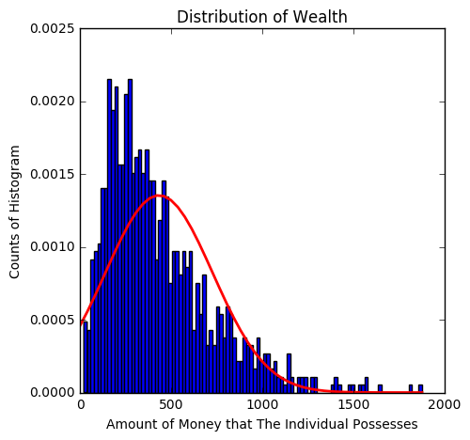
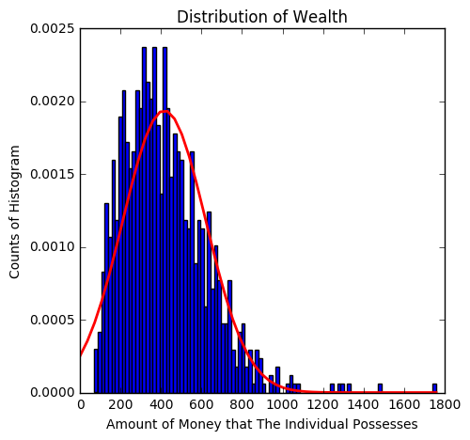
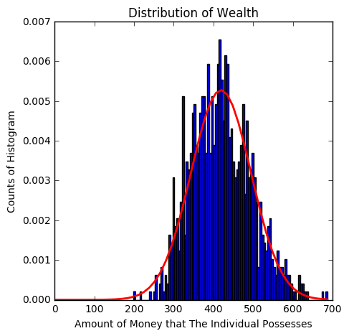
Notes:
Now 1000 people with $420 and 10^6 transactions at 0.25, 0.5, and 0.9 savings
More pronounced at higher amounts of people

Slide 15
So far so good
So Far We Were Able to Model Basics Transactions and Savings
Stop to Think About the Results
What’s Next?

Slide 16
Part Three: Nearest Neighbors
Notes:
Simple concept
People closer in wealth trade with one another with a higher probability
Rich trade with rich, etc. just like real life

Slide 17
How this works
Everyone Starts with Some Amount of Money (Why Can’t It Be Uniform Anymore?)
We Randomly Sample Two Indeces i,j (random.sample)
Calculate the Difference in Their Wealth
If m_i = m_j, Then the Transaction Happens
Compare to “user_set” (random.uniform)
If >user_set, Then the Transaction Occurs as With The Base Model
Notes:
People Can exchange money only if this probability due to wealth exceeds a uniform probability

Slide 18
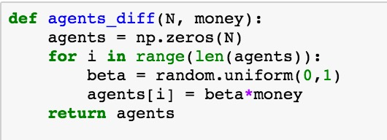
Make some agents

Slide 19
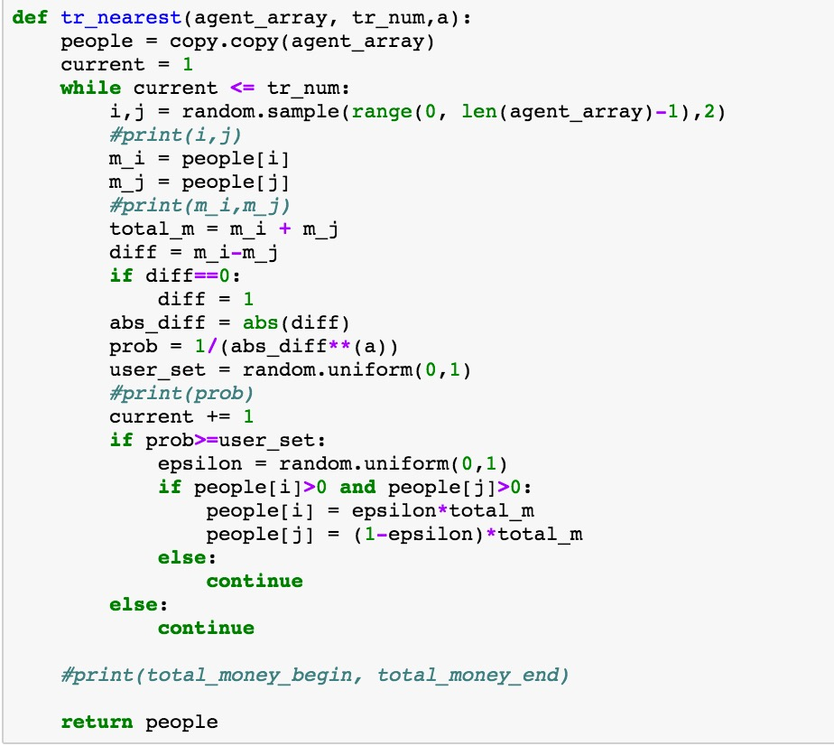
The code

Slide 20
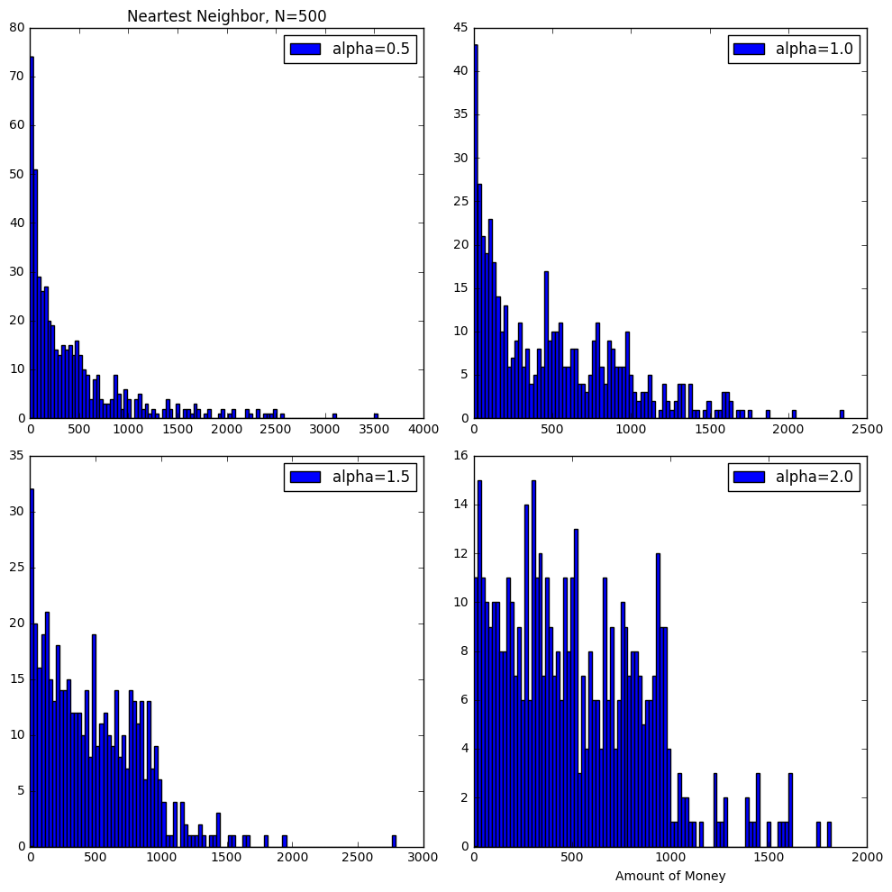
The Results for n=500, no Savings
Notes:
As we increase alpha, only transactions between those who are very close in wealth occur
This yields local peaks as well as some interesting “leveled off” distribution

Slide 21
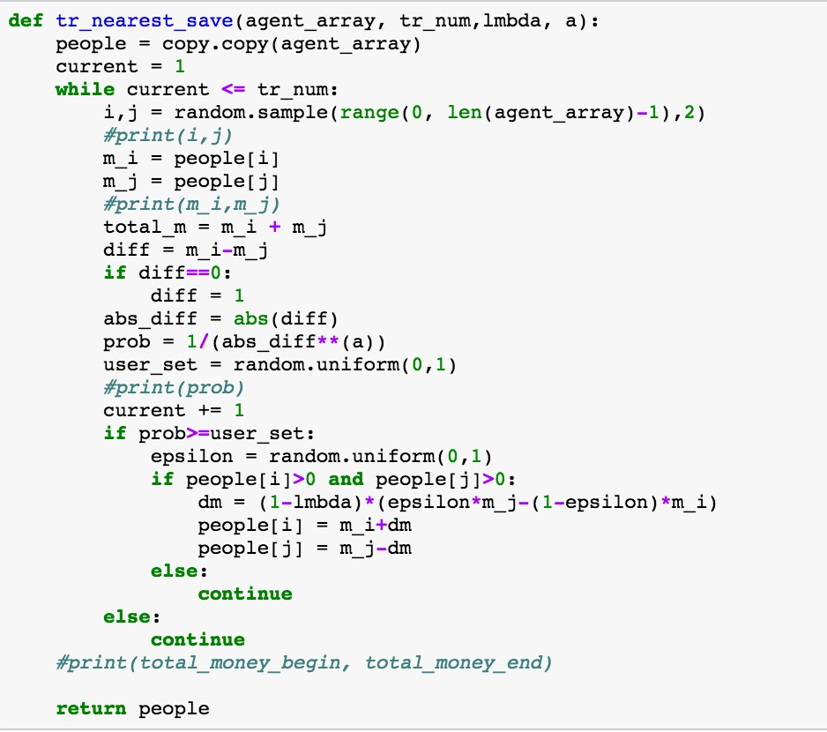
The code

Slide 22
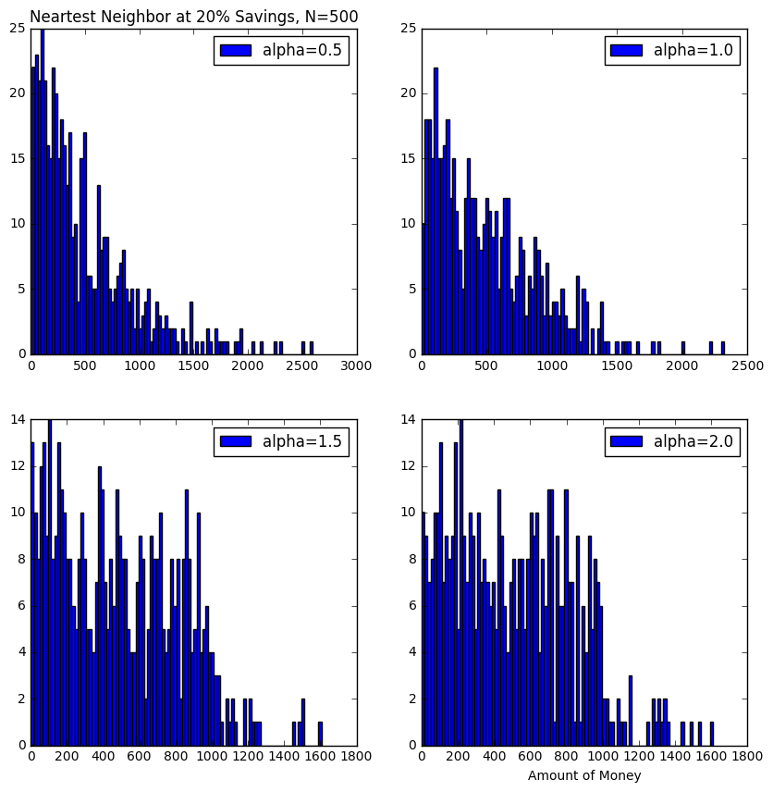
The results for N=500, 20% savings
Notes:
We did this same analysis for N=1000, but we saw the same general trends and I didn’t want to bore you with more graphs

Slide 23
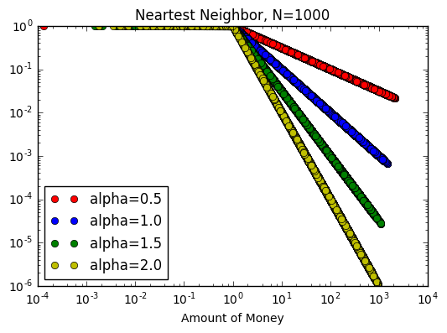
Goswami and Sen
Notes:
N=1000 case, matches literature exactly (no savings, but same should be expected)

Slide 24
It gets saucy: Previous interactions
Now We Take One Extra Factor Into Consideration
If People Have Interacted Before (Previous Transactions), Then More Likely to Exchange Money
Notes:
Think about this though, this makes sense. In real life, you’re more likely to exchange money with someone you’re familiar with. Would you loan money to a stranger or try a new restaurant when you know this one you go to all the time is still great

Slide 25
The Mathematics
Notes:
Basic Equations. Here I had the cool idea of storing the previous interactions as a matrix. It steals some CPU time, but it’s very effective when it comes to preserving information

Slide 26
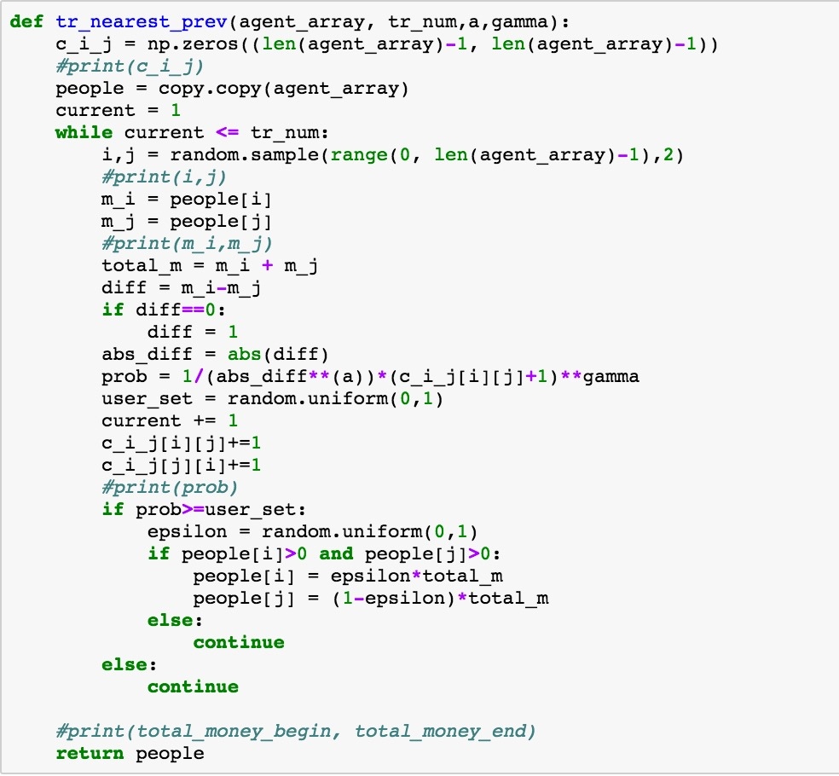
The code

Slide 27
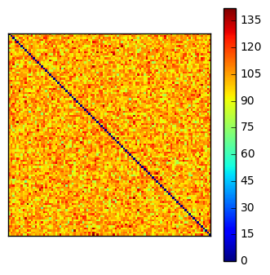
Cool colormap
Notes:
Showing previous interaction matrix. Stored information. Diagonal blacked out because I can’t equal j

Slide 28
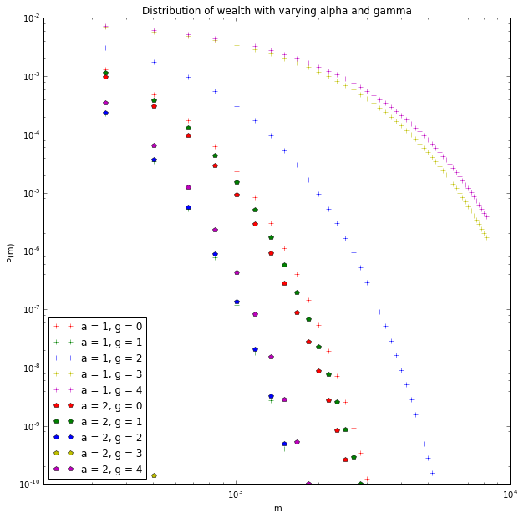
The Results: goswami and sen
Notes:
This is the famed plot of pareto tails found in the literature that we were able to reproduce based on varying alpha and gamma

Slide 29
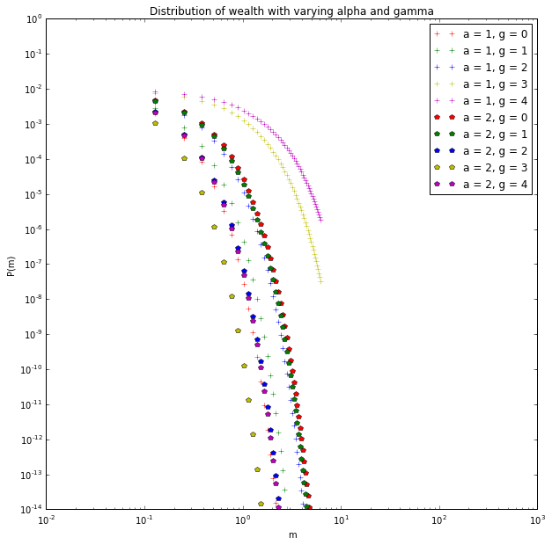
Another look
Notes:
This was the key result we wanted to look at. Shows probability of transactions for varying amounts of money

Slide 30
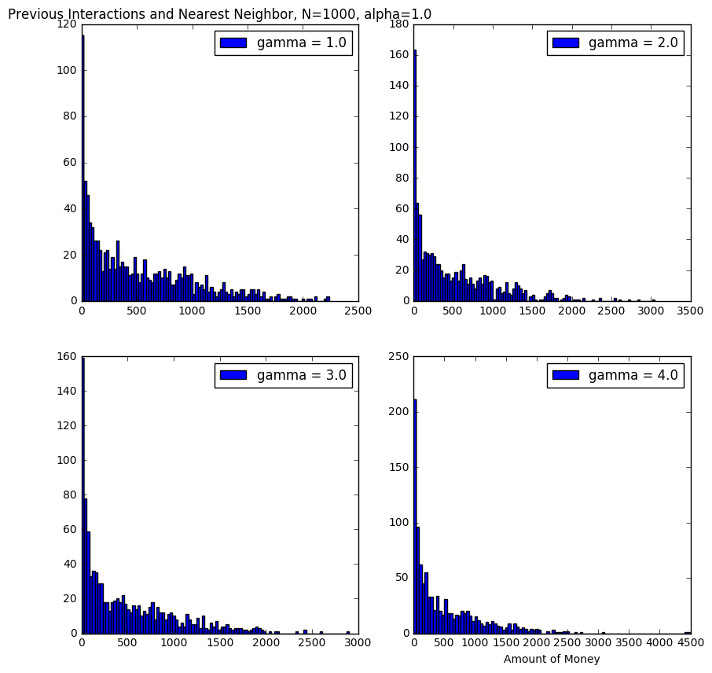
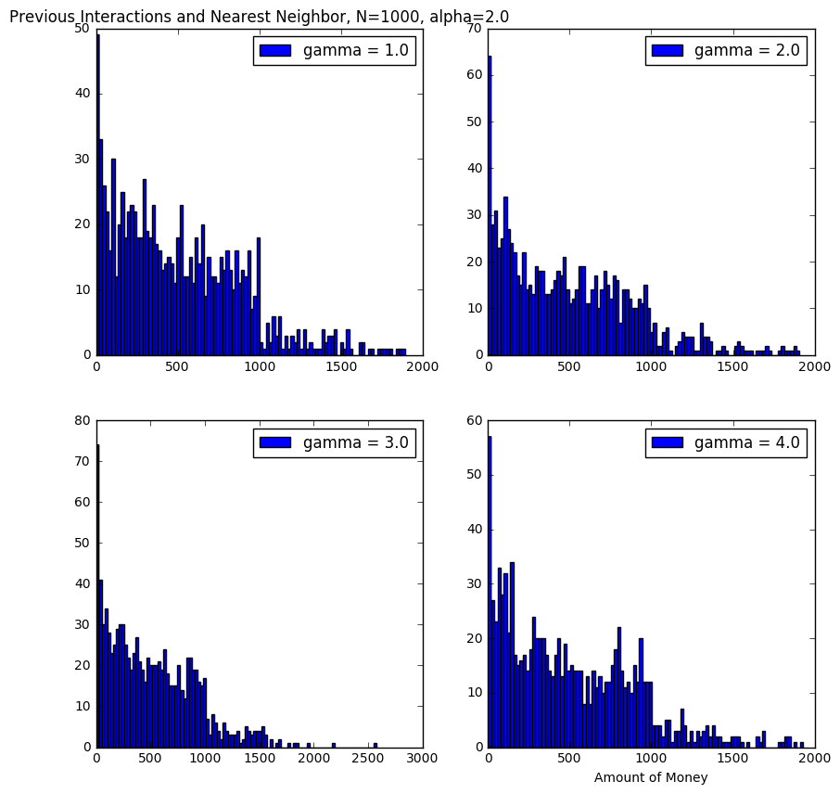
Less interesting but cool: distributions
Notes:
We see some of the same trends that we did before with alpha, but now there is some shift in the distributions due to the previous interactions

Slide 31
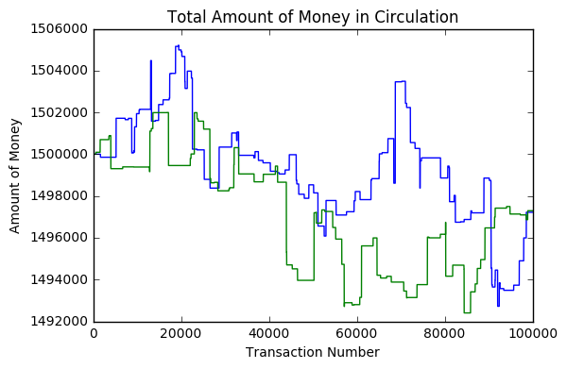
Now, there’s a problem
Notes:
Same simulation ran two times and plotted on top of one another N=1000, $1500, 10^5 transactions.
This is the total money in circulation plotted versus number of transactions. Floating points are yielding some loss of numerical precision. Negligible and something we acknowledge in our model but we don’t pay it much mind because we know the root of the evil

Slide 32
What more could have been done?
Interests on Savings
Proximity Included in Nearest Neighbor
One is the Business and Can Charge and Extra “Tax” and the Other the Consumer, Who Pays the Tax
Good and Bad Experiences with Previous Interactions
So Much More
Notes:
This is a new field fairly and these types of thought experiments are being done now. This work could yield some interesting results in the future and soon at that!

Slide 33
Some general reflections
Project 4 was cool, but I learned more than this
Notes:
So moving forward from all of the work that we did with project 4, I want to discuss this class in general and some major lessons I took from it. Any questions before this? Anything you need clarified? Anything I forgot to mention?

Slide 34
TOP 10 Phy480 Lessons/Takeaways
Don’t Try and Be More Clever Than the Code
Hardcoding is Only the Answer in Desperation (Absolute Desperation)
Beware Numerical Precision
CPU Time is a Thing, Be Nice to the Computer
Computation is About Expanding on Knowledge and Should be Fun
Language Can Have a Big Impact
Root Things in Algorithms, Let Math Be Your Friend
Get Git
I’m Capable of A Lot More Than I Gave Myself Credit For Originally
A Really Awesome Joke

Slide 35
Thank you for a great semester, Morten

