Slide 1
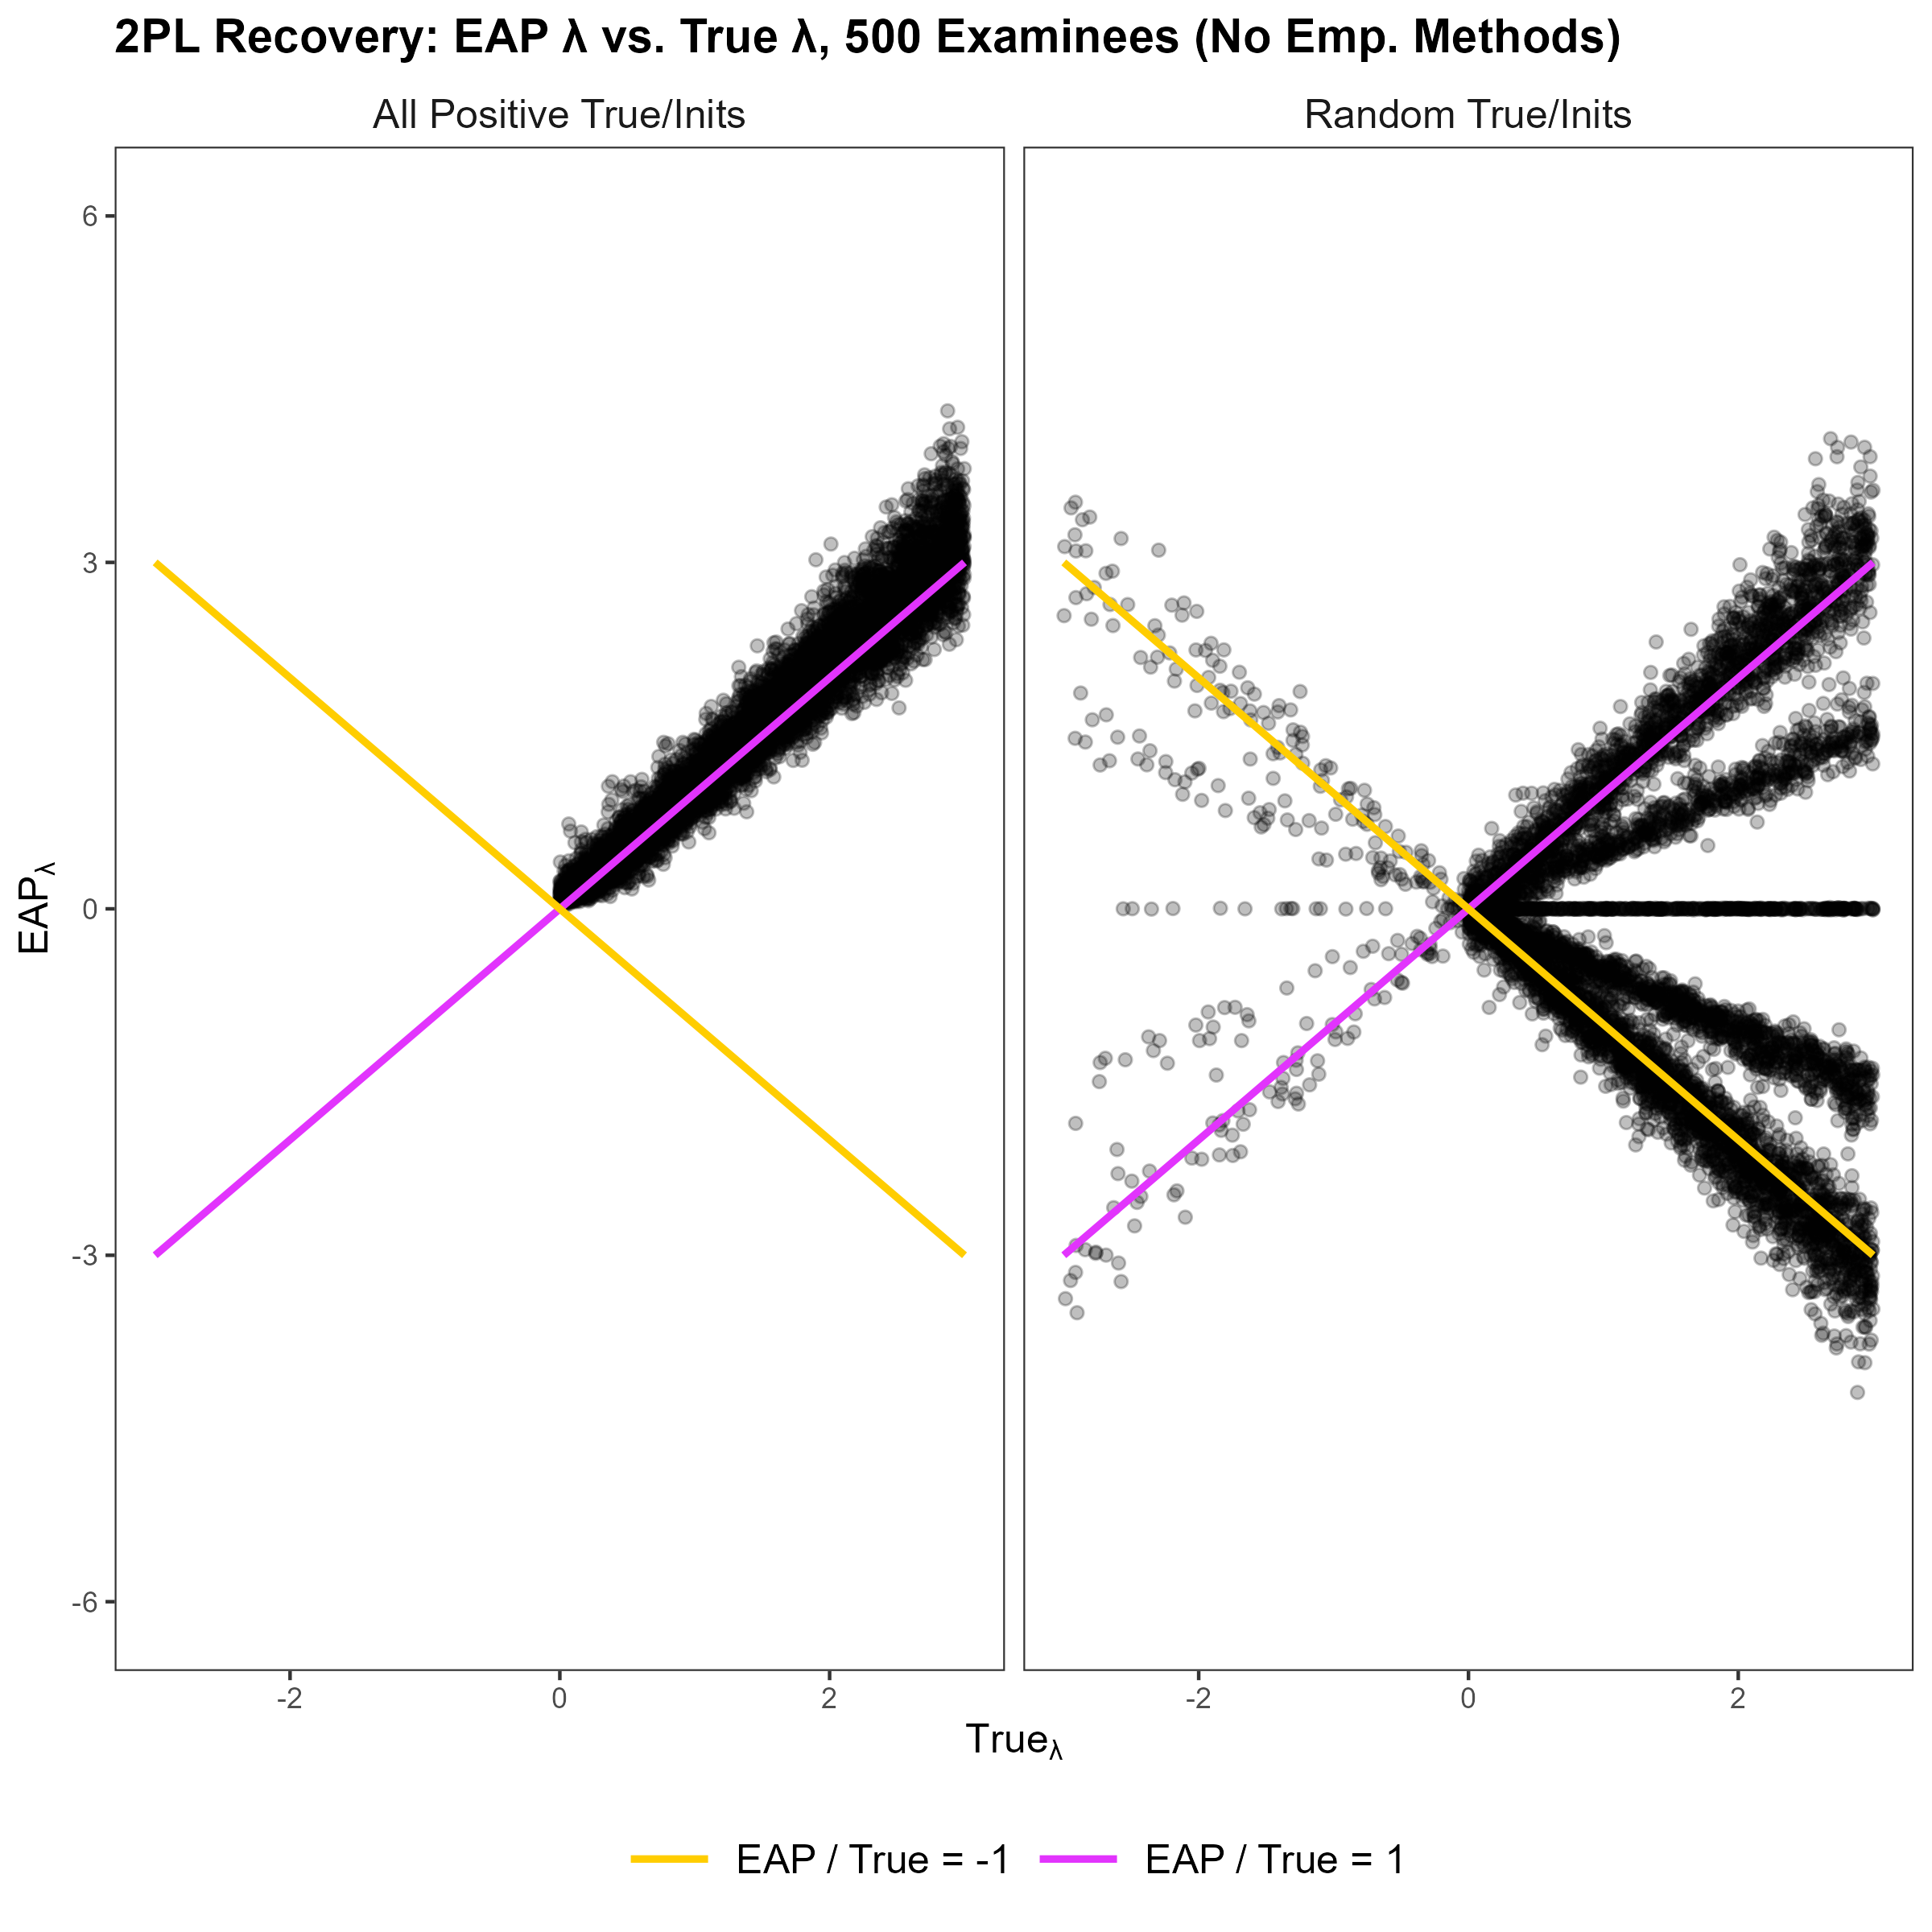
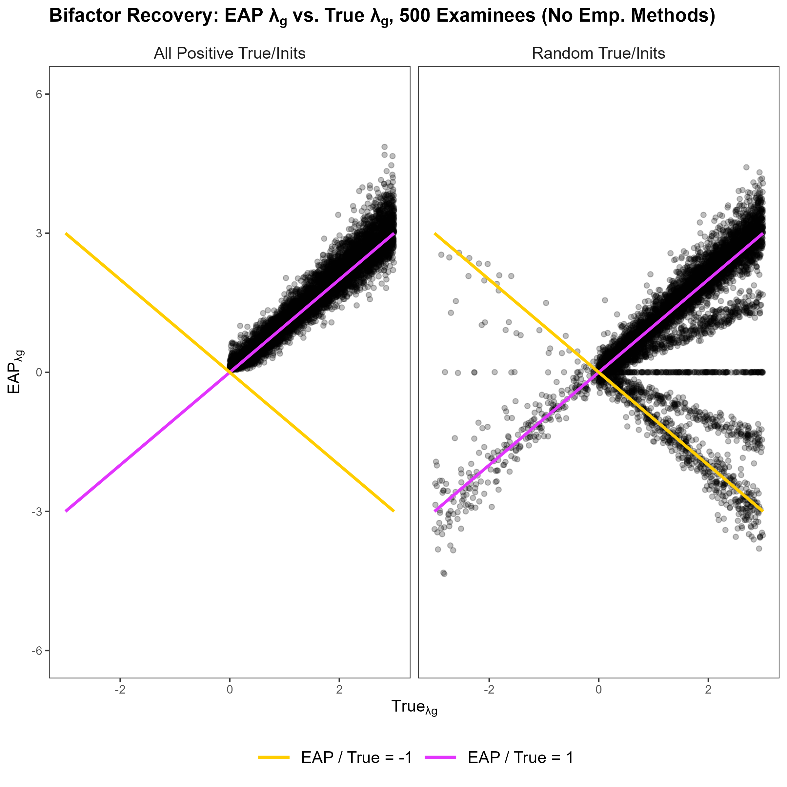
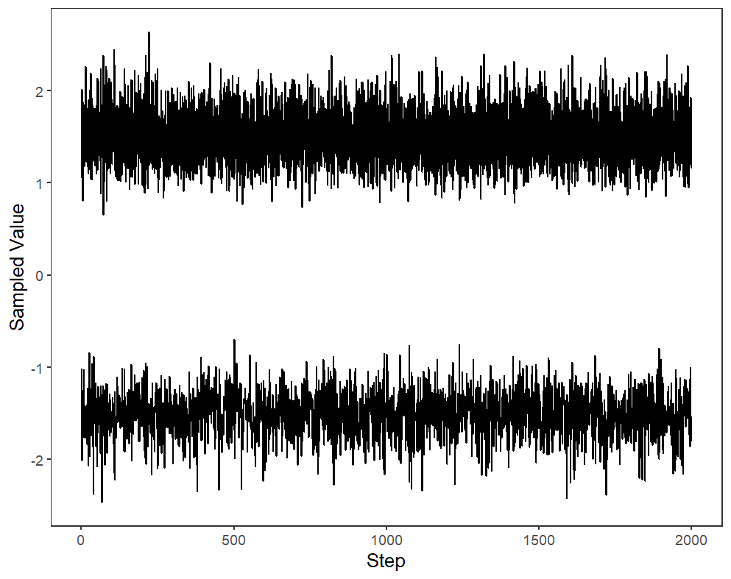
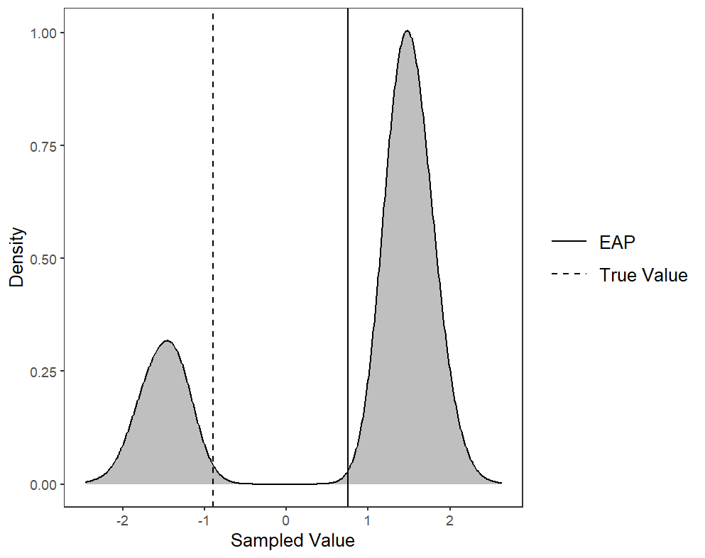
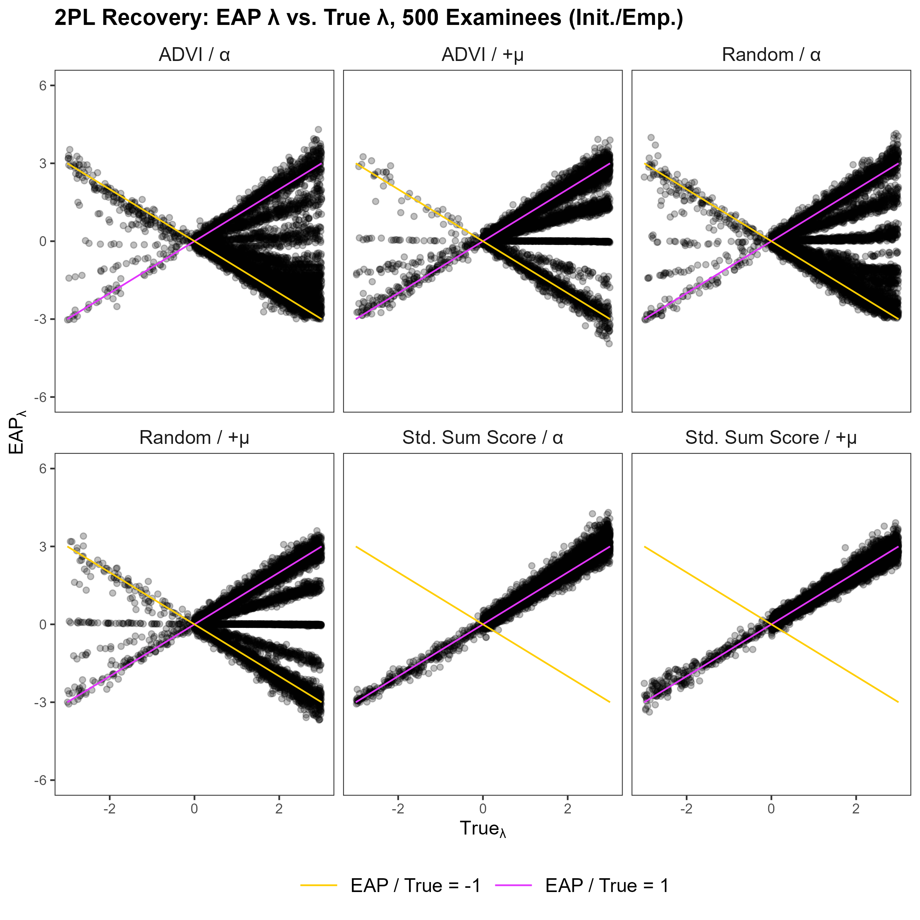
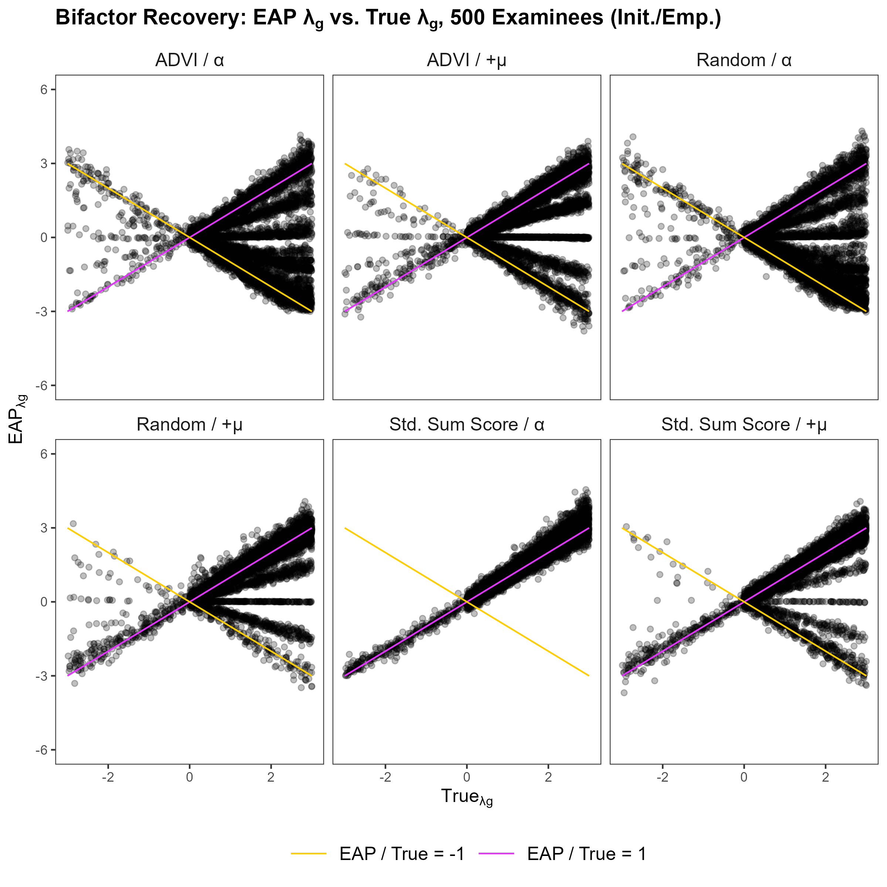


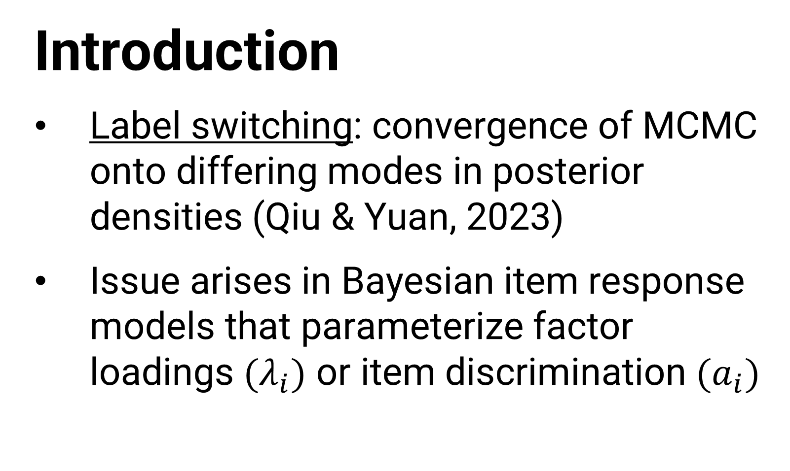
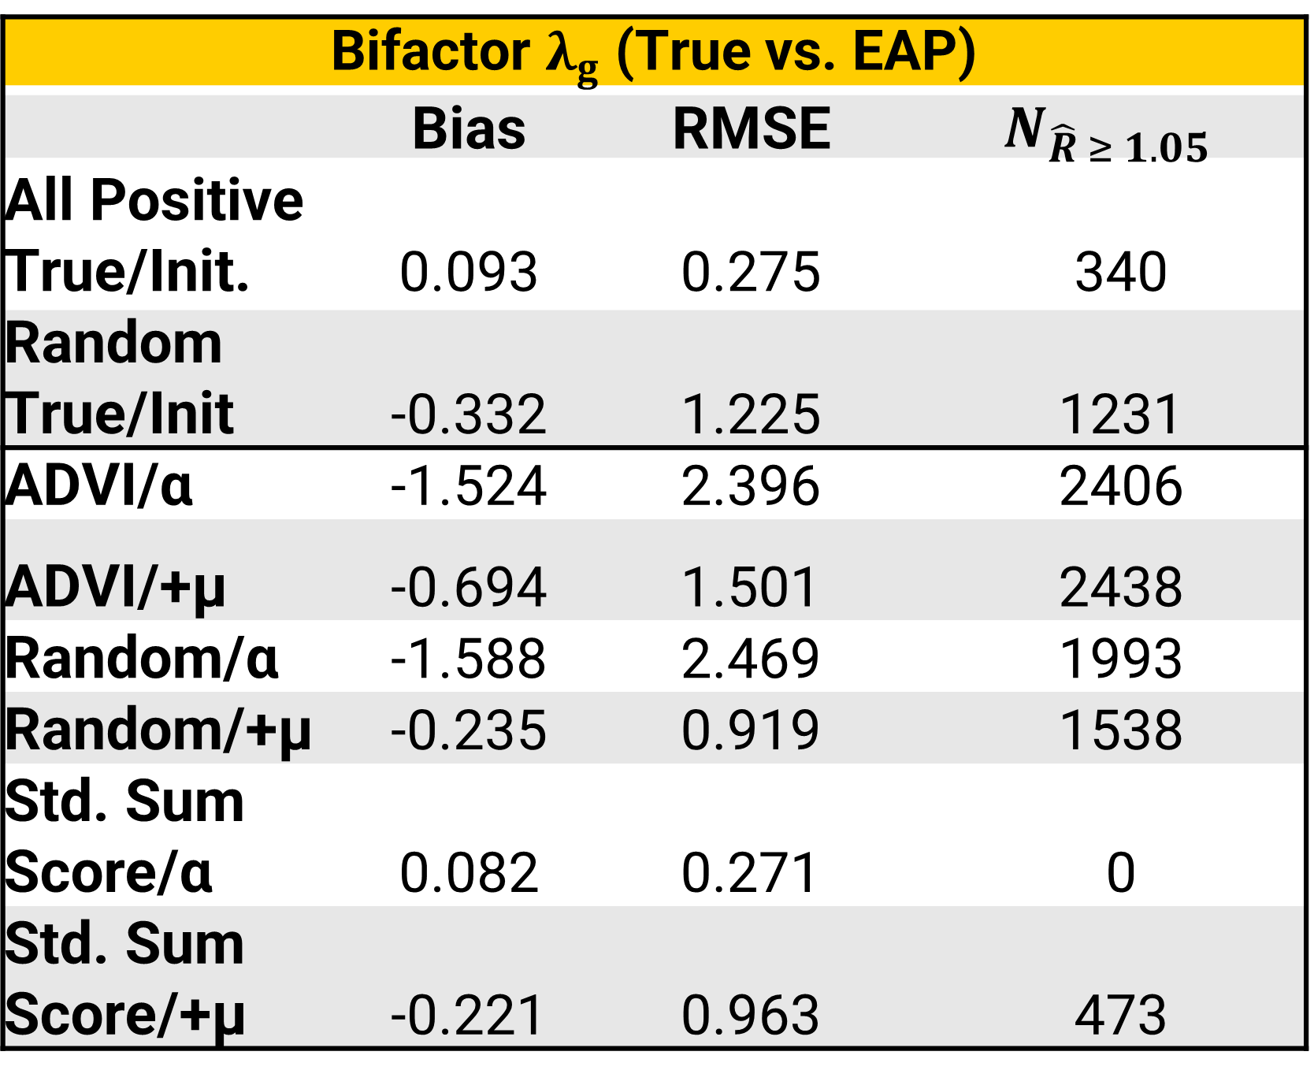
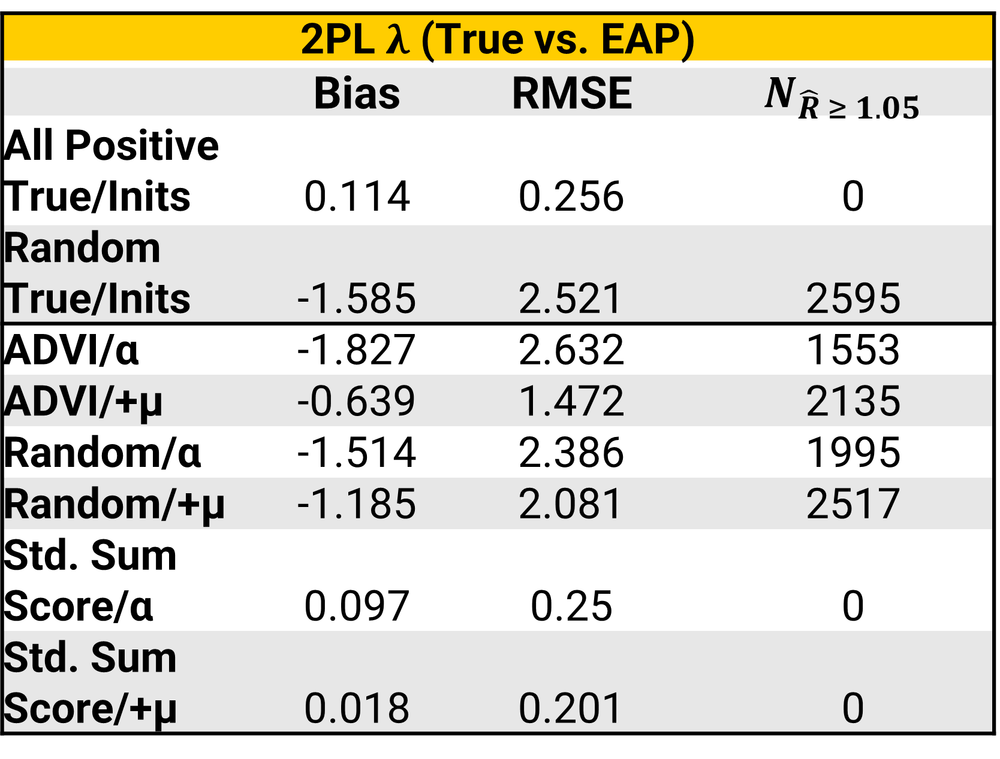
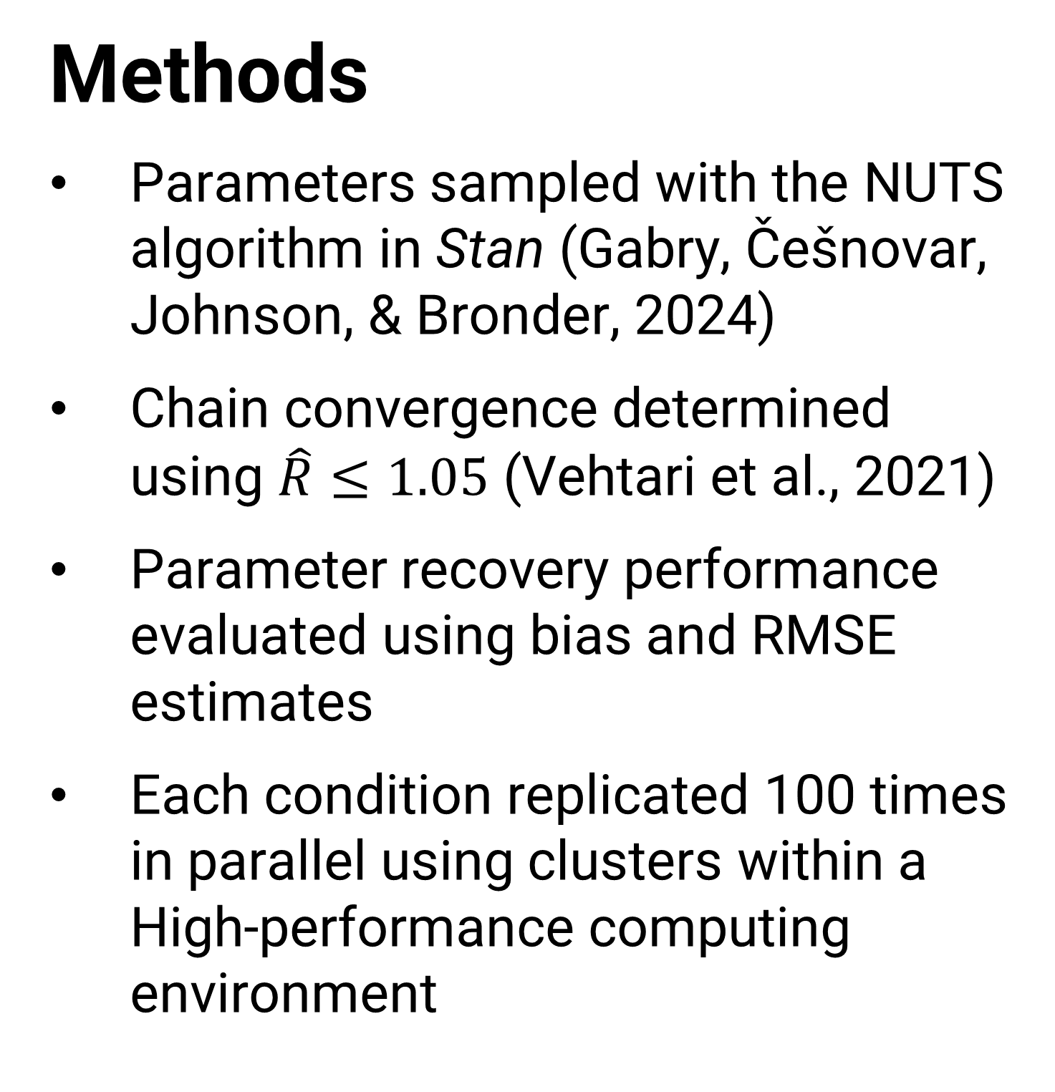
Evaluating solutions to the label-switching issue when estimating latent variable models with the NUTS algorithm
Nathan DePuy, Jonathan Templin
Introduction
Label switching: convergence of MCMC onto differing modes in posterior densities (Qiu & Yuan, 2023)
Issue arises in Bayesian item response models that parameterize factor loadings $(λ_{i})$ or item discrimination $(a_{i})$
Findings
2PL $λ$ (True vs. EAP)
 | Bias | RMSE | $$N_{\hat{R} ≥ 1.05}$$
All Positive True/Inits | 0.114 | 0.256 | 0
Random True/Inits | -1.585 | 2.521 | 2595
ADVI/α | -1.827 | 2.632 | 1553
ADVI/+μ | -0.639 | 1.472 | 2135
Random/α | -1.514 | 2.386 | 1995
Random/+μ | -1.185 | 2.081 | 2517
Std. Sum Score/α | 0.097 | 0.25 | 0
Std. Sum Score/+μ | 0.018 | 0.201 | 0
Methods
Parameters sampled with the NUTS algorithm in Stan (Gabry, Češnovar, Johnson, & Bronder, 2024)
Chain convergence determined using $\hat{R}≤1.05$ (Vehtari et al., 2021)
Parameter recovery performance evaluated using bias and RMSE estimates
Each condition replicated 100 times in parallel using clusters within a High-performance computing environment
Bifactor $λ_{g}$ (True vs. EAP)
 | Bias | RMSE | $$N_{\hat{R} ≥ 1.05}$$
All Positive True/Init. | 0.093 | 0.275 | 340
Random True/Init | -0.332 | 1.225 | 1231
ADVI/α | -1.524 | 2.396 | 2406
ADVI/+μ | -0.694 | 1.501 | 2438
Random/α | -1.588 | 2.469 | 1993
Random/+μ | -0.235 | 0.919 | 1538
Std. Sum Score/α | 0.082 | 0.271 | 0
Std. Sum Score/+μ | -0.221 | 0.963 | 473
Further Information
Scan the QR code below to access reproducible code, additional visualizations, and more on GitHub
References
View article and citations by scanning the QR code above

