Slide 1
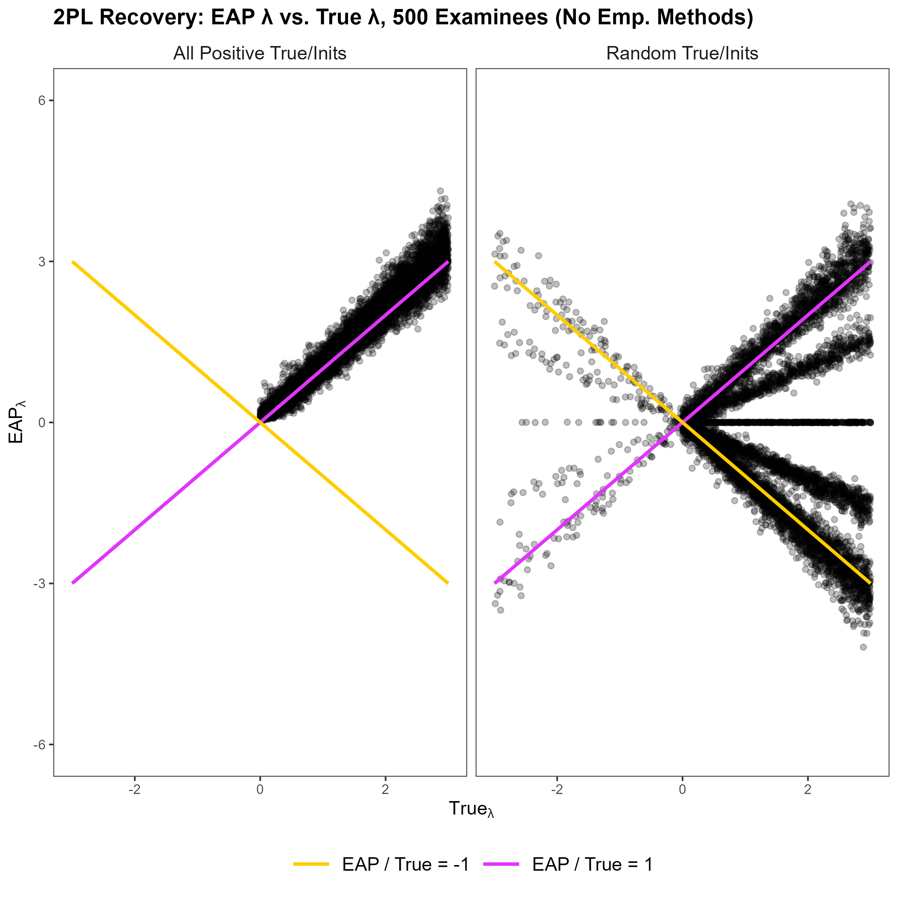
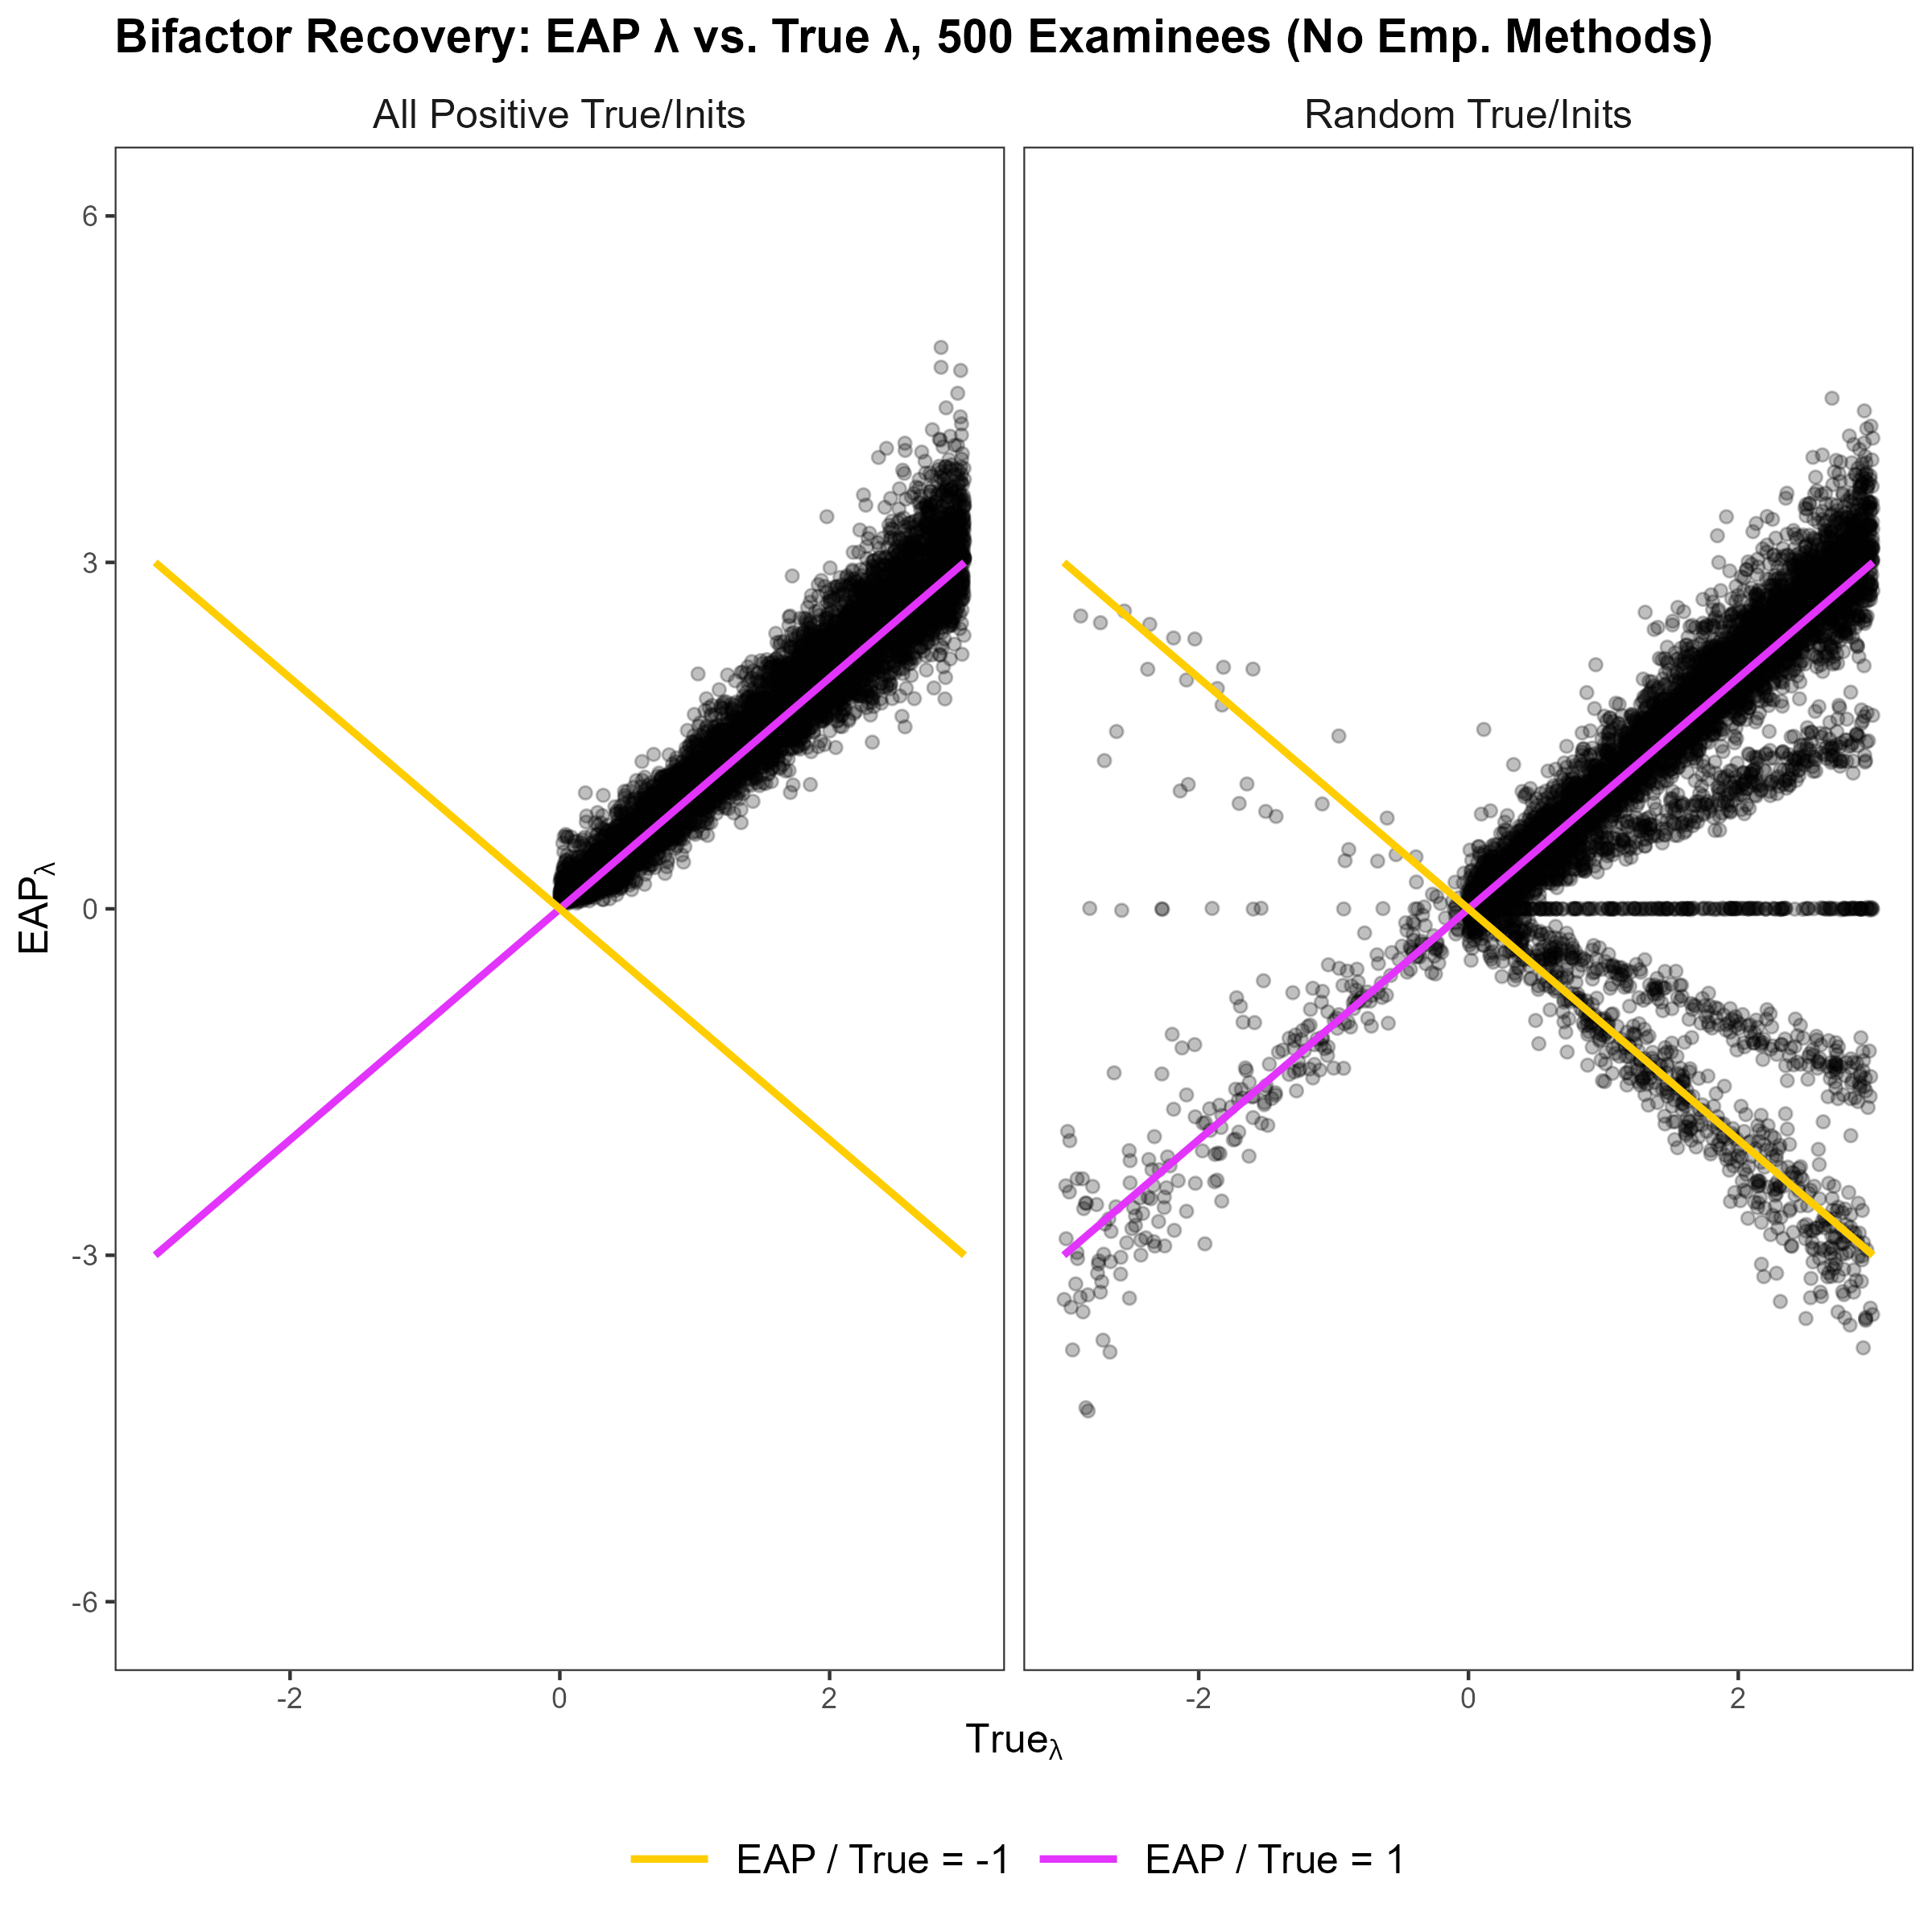
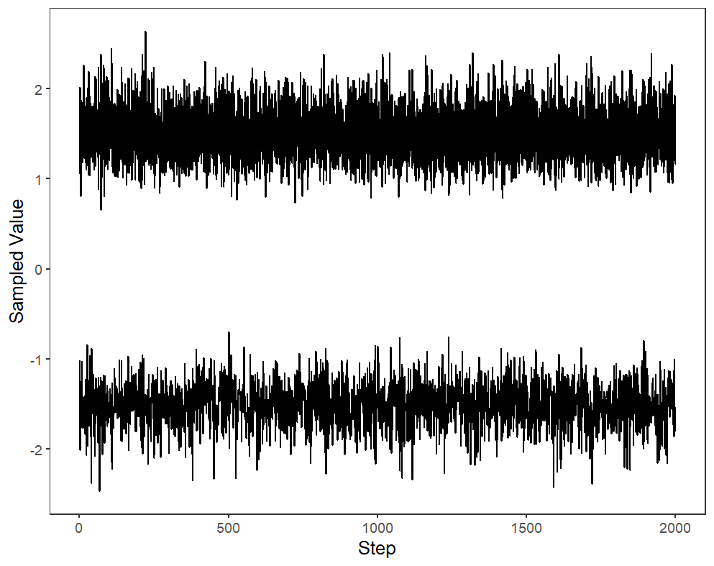
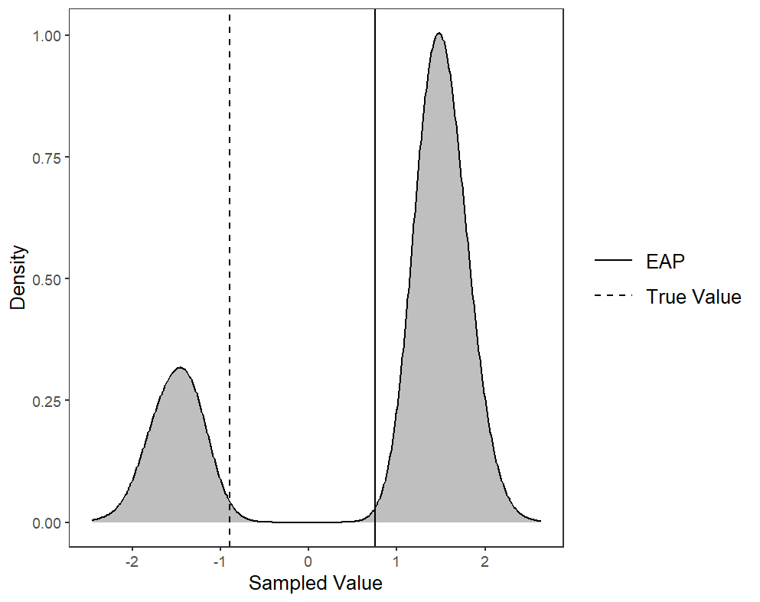
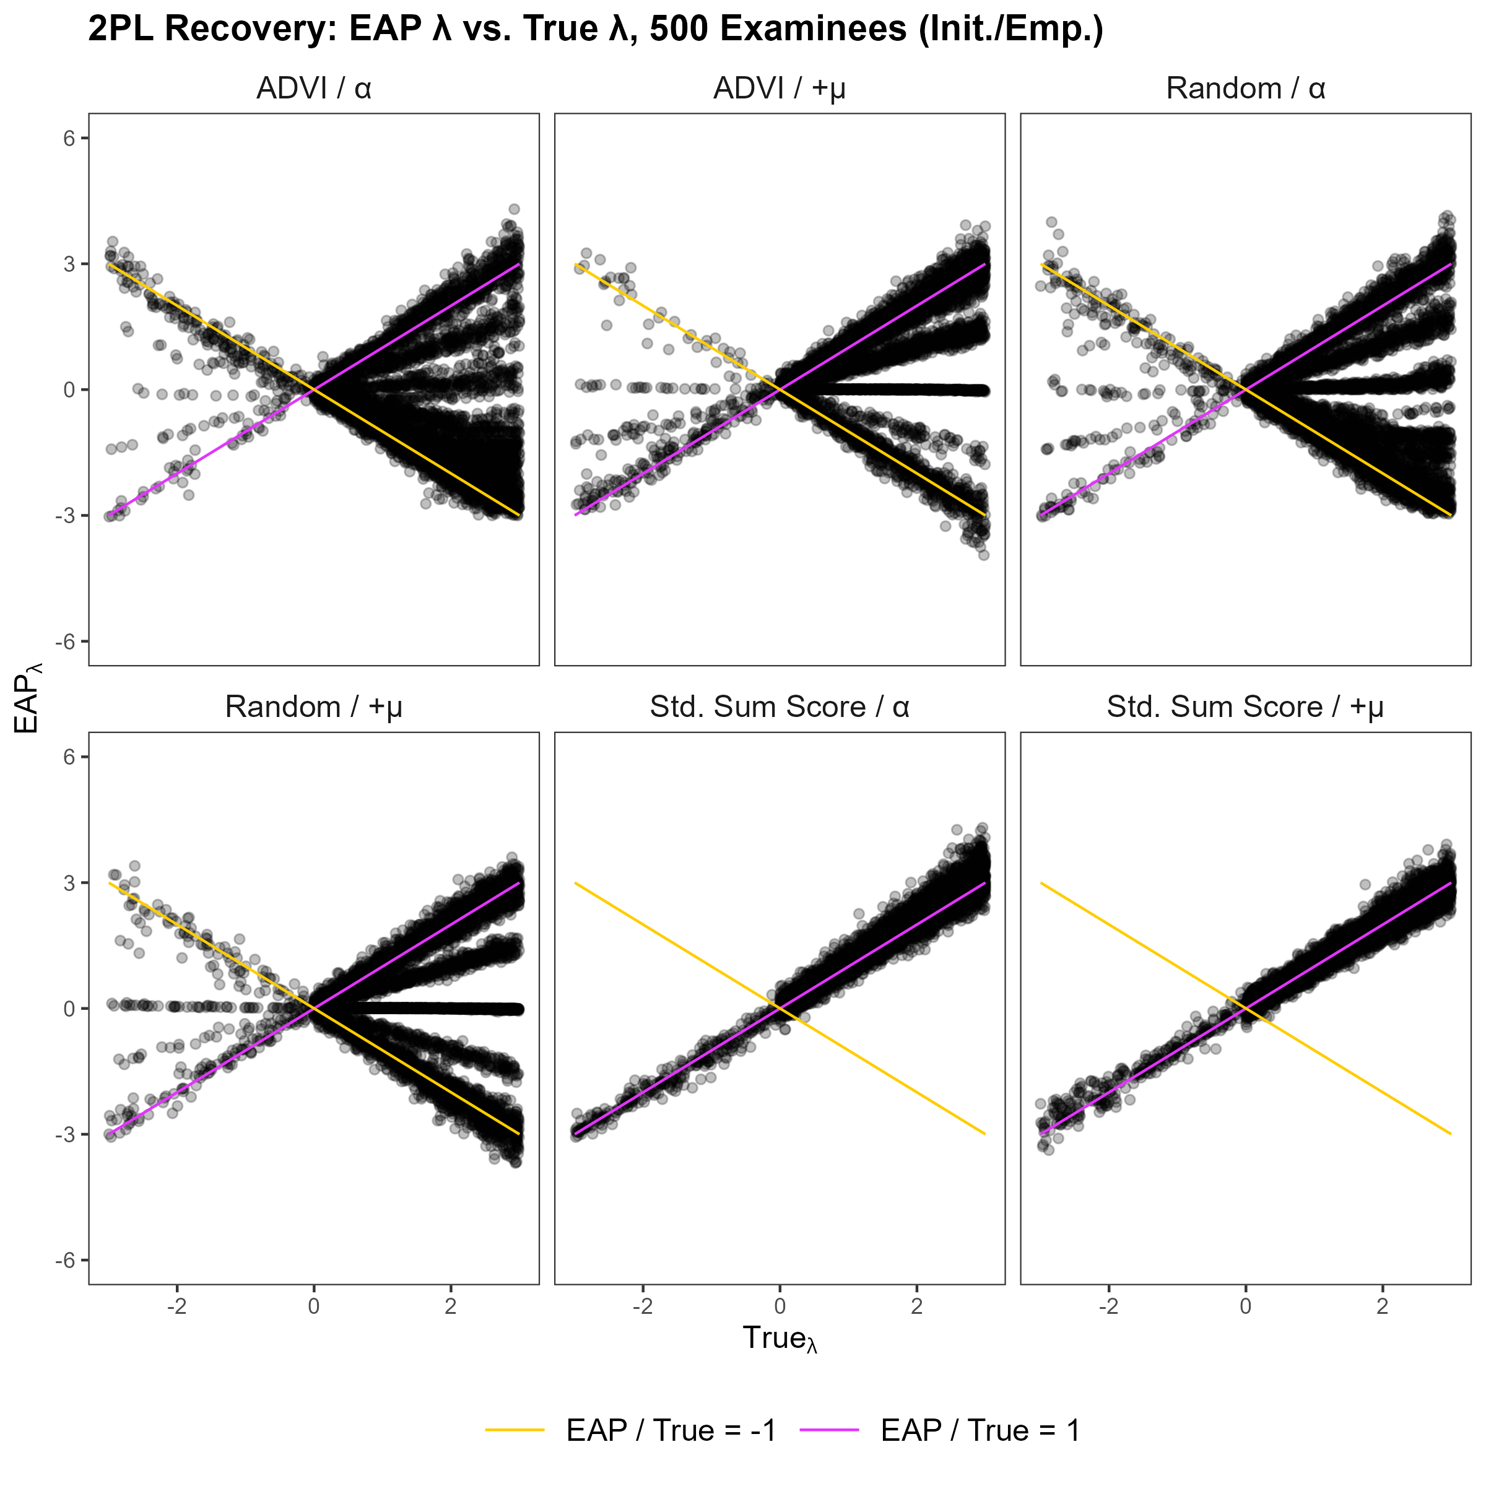
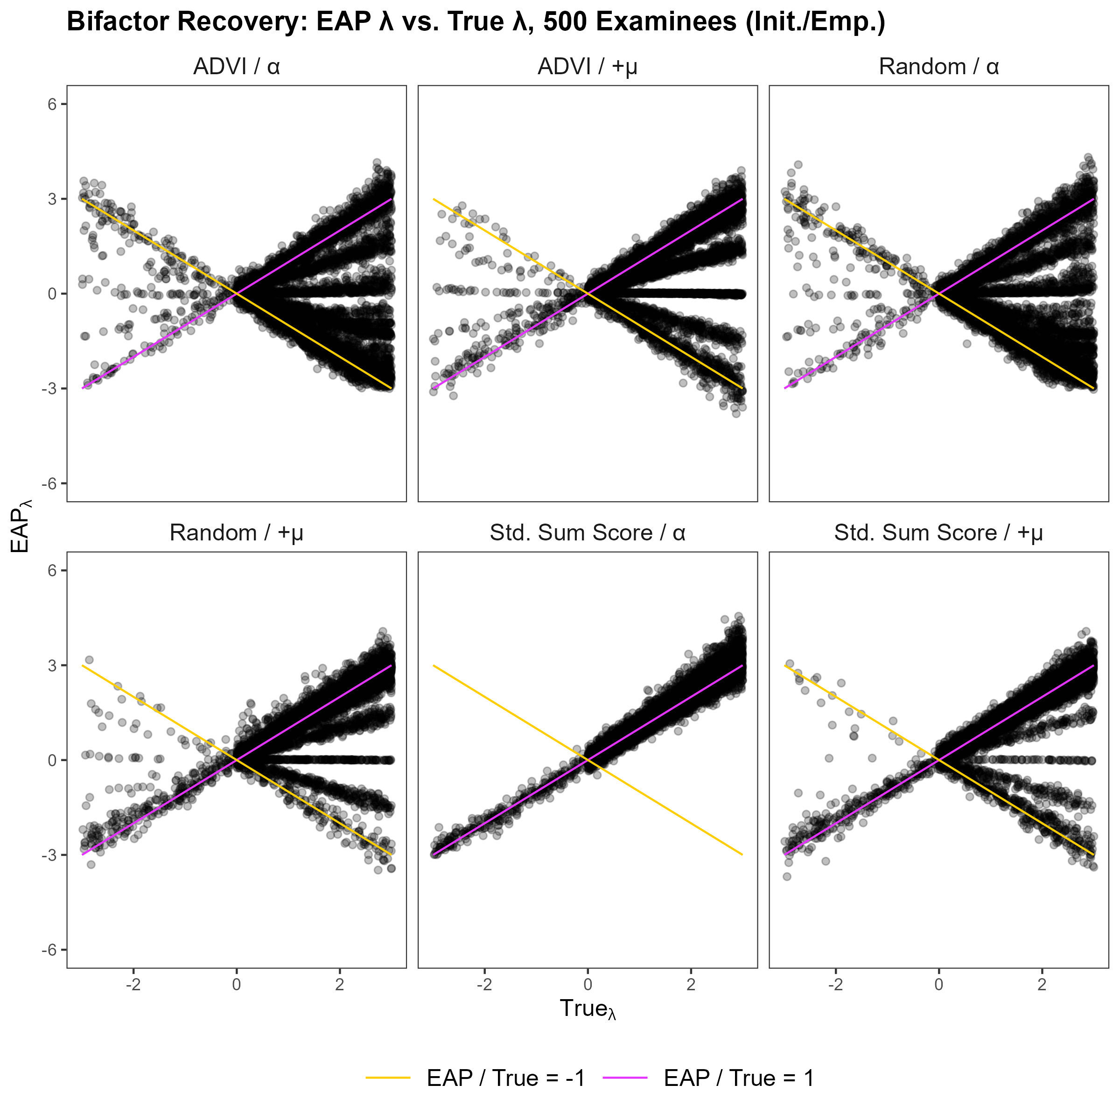


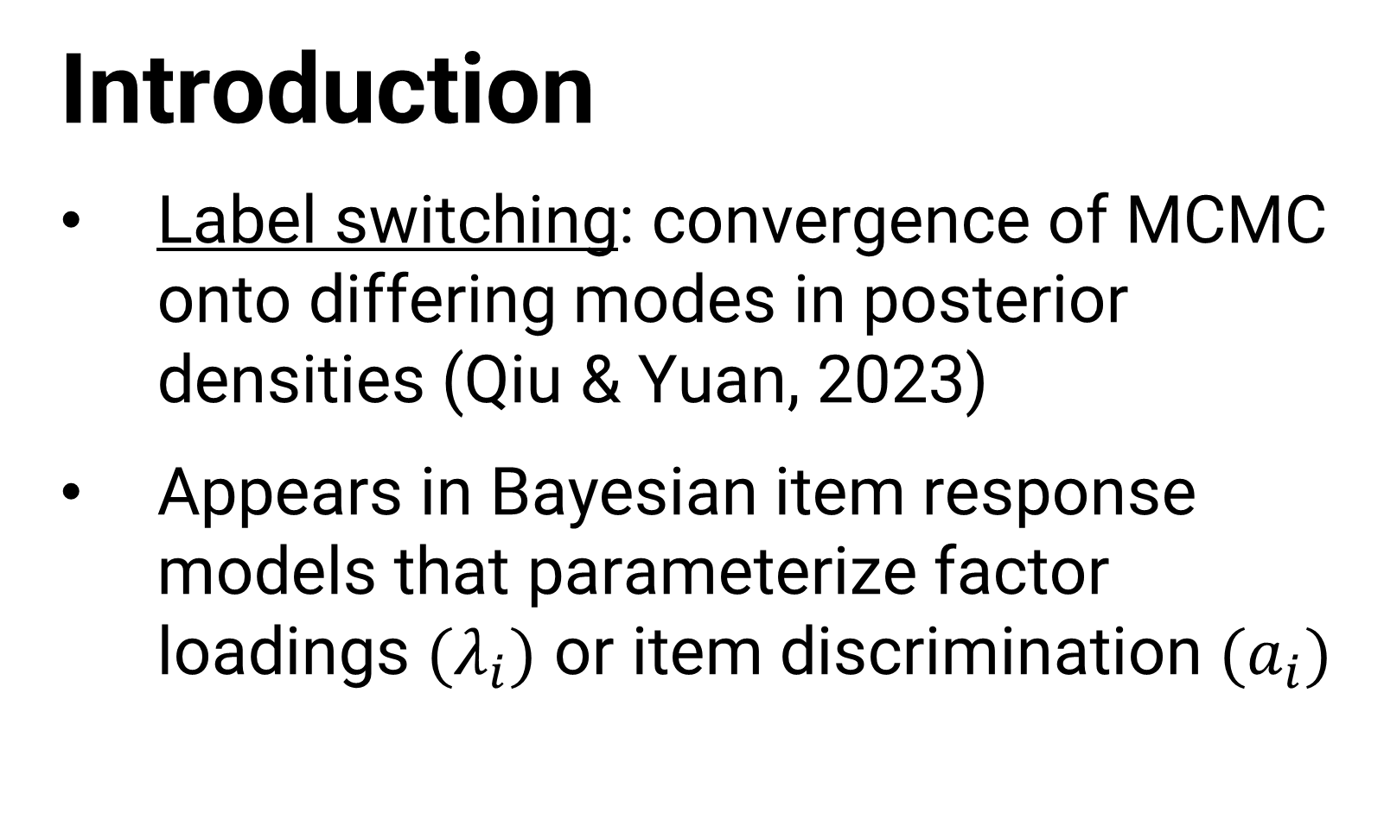
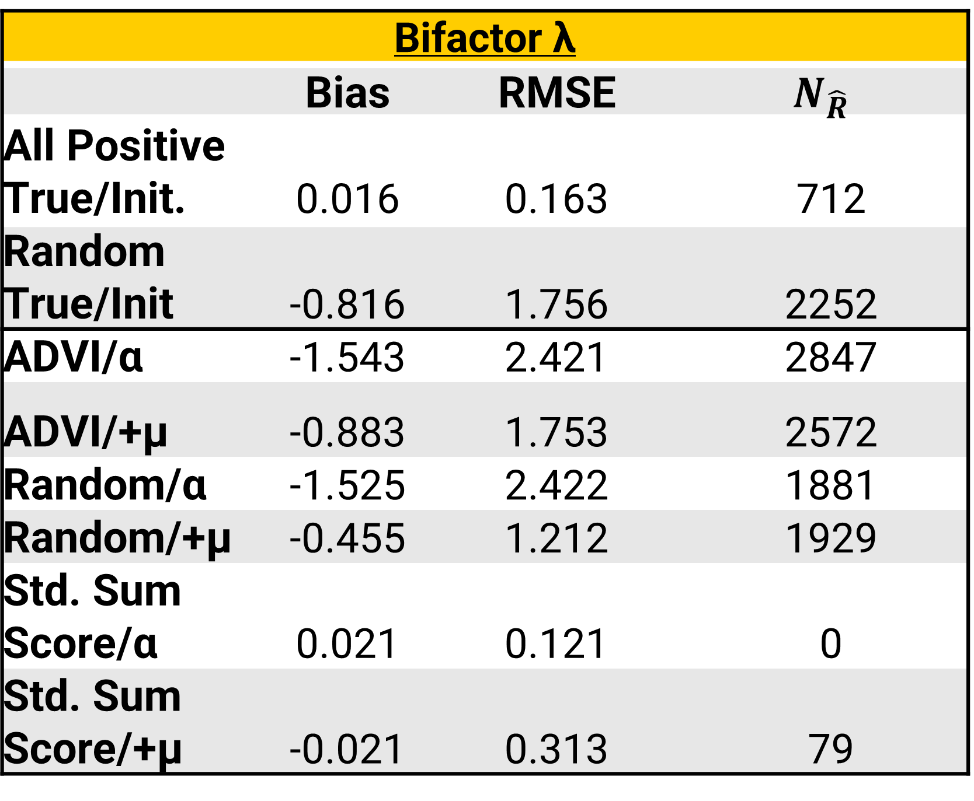
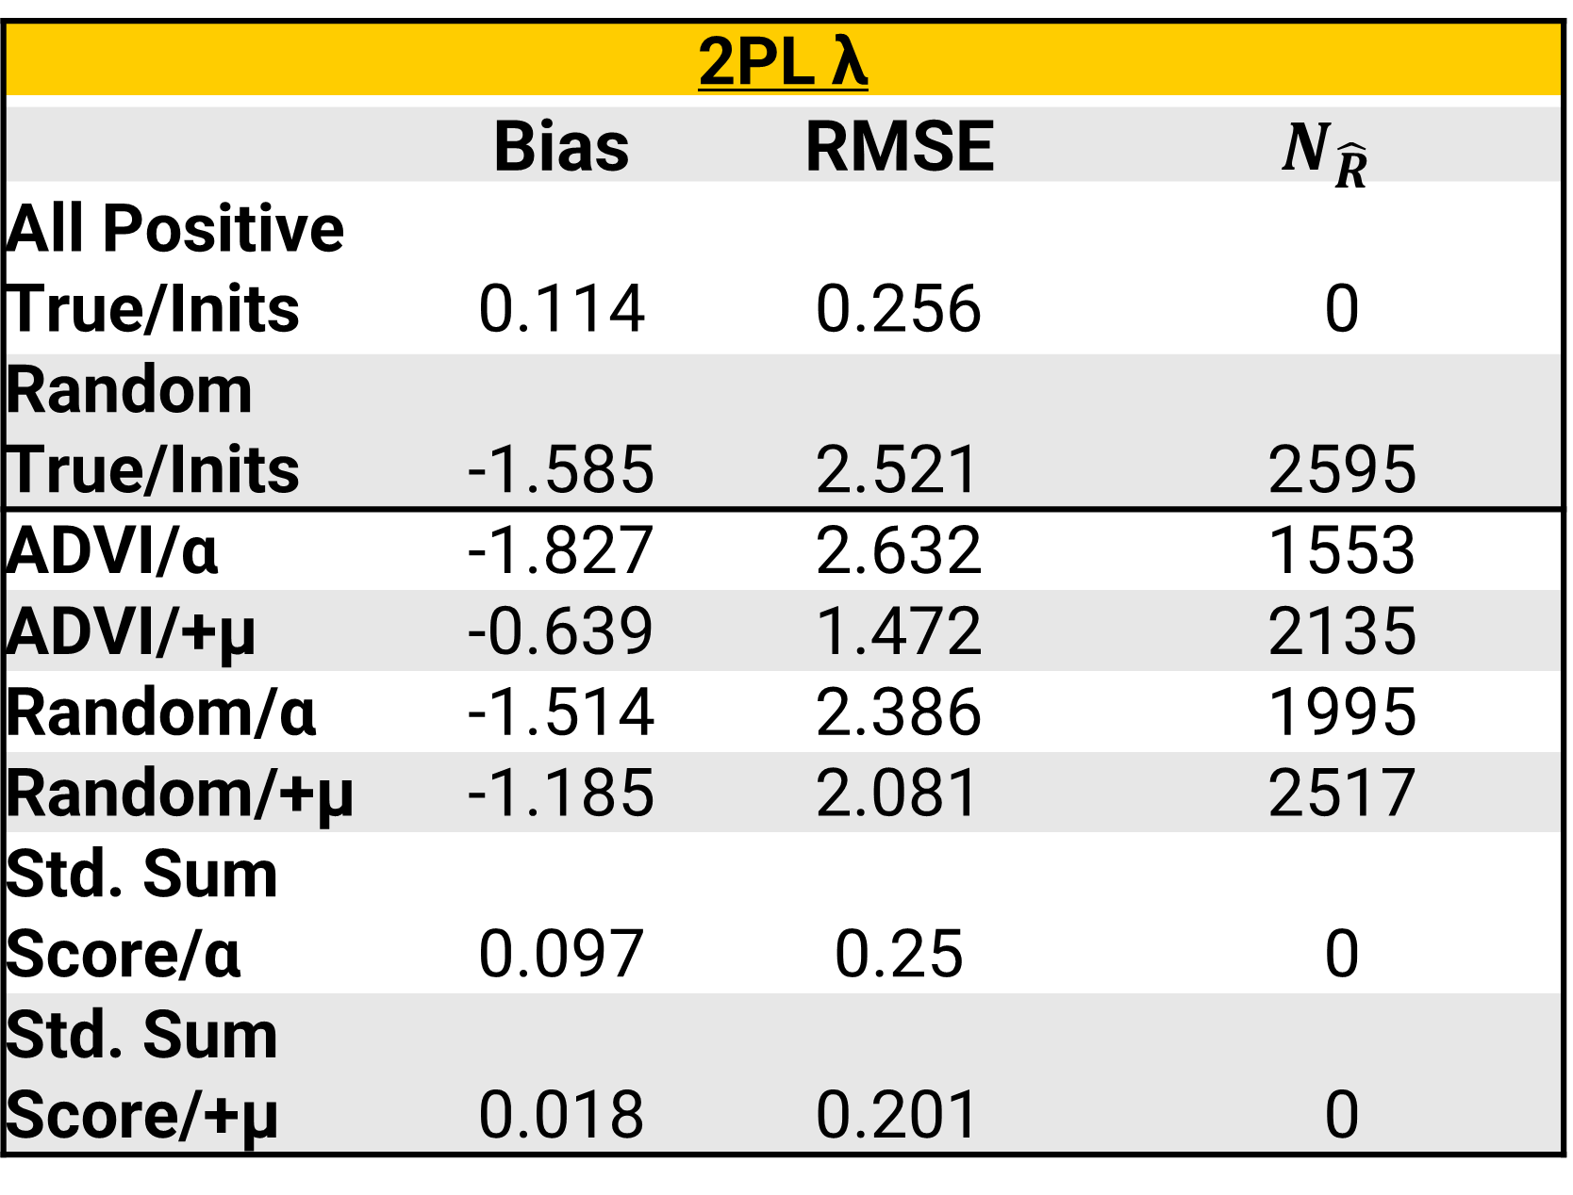
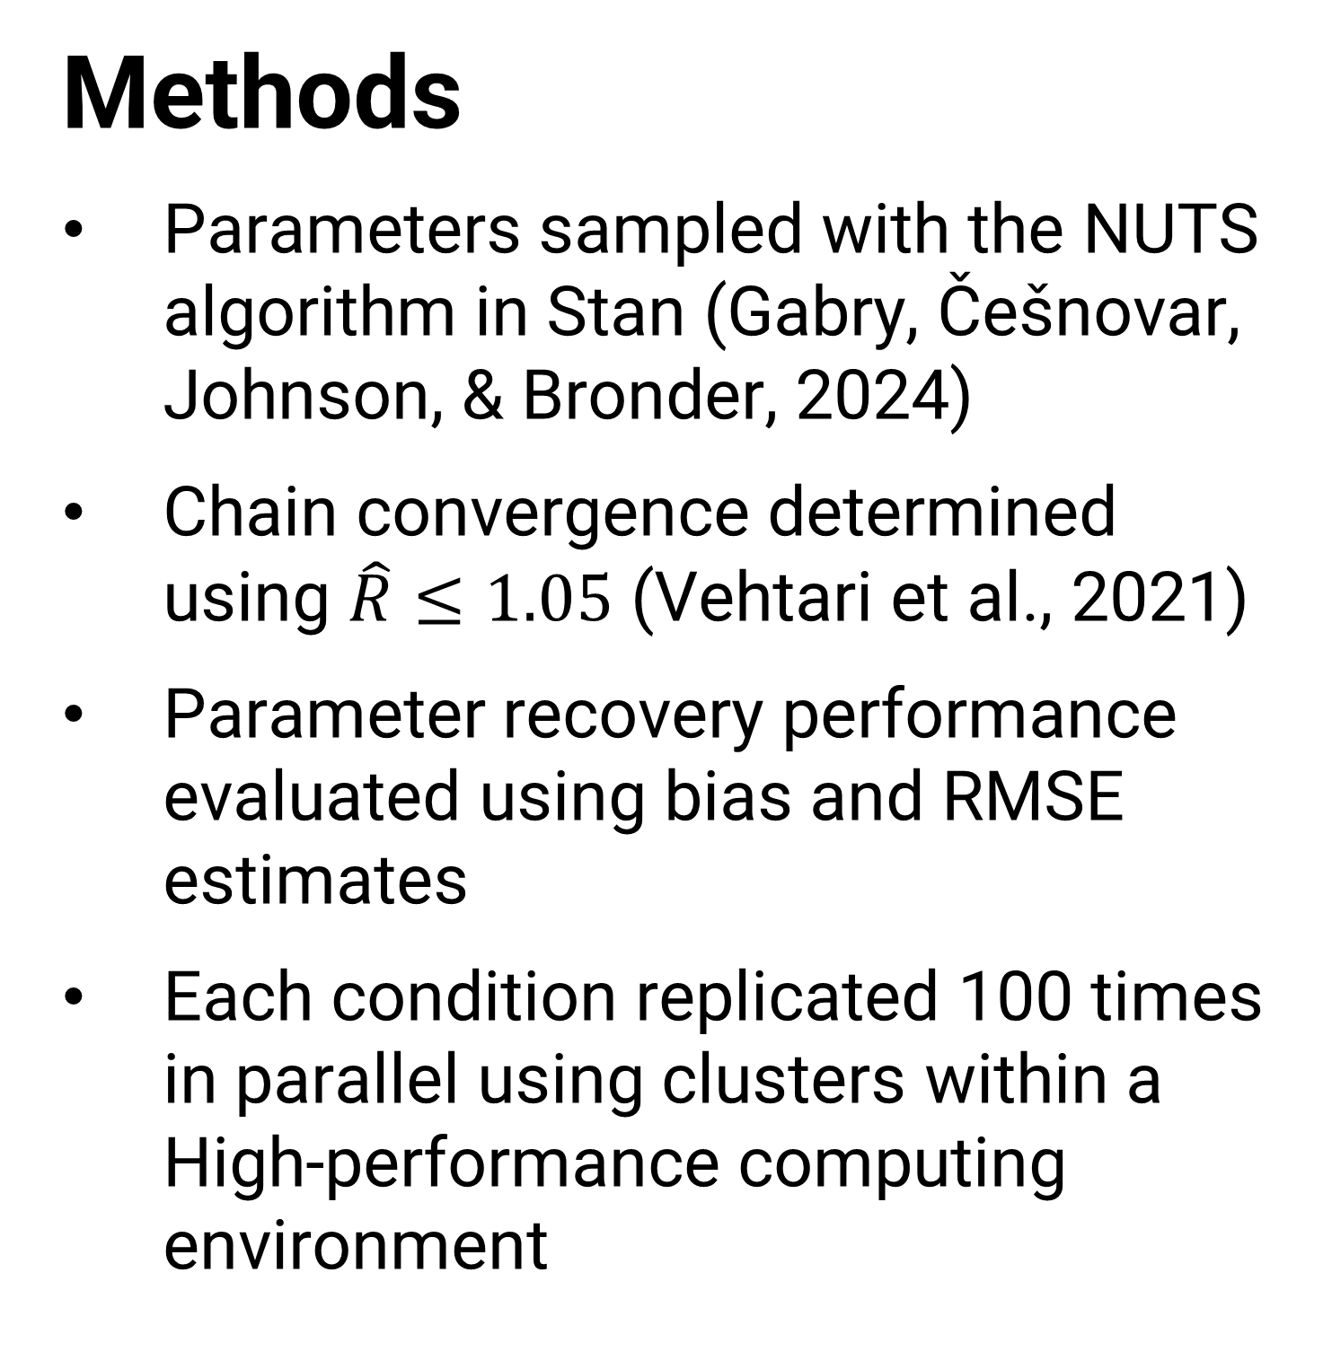
Evaluating solutions to the label-switching issue when estimating latent variable models with the NUTS algorithm
Nathan DePuy, Jonathan Templin
Introduction
Label switching: convergence of MCMC onto differing modes in posterior densities (Qiu & Yuan, 2023)
Appears in Bayesian item response models that parameterize factor loadings $(λ_{i})$ or item discrimination $(a_{i})$
Findings
2PL λ
 | Bias | RMSE | $$N_{\hat{R}}$$
All Positive True/Inits | 0.114 | 0.256 | 0
Random True/Inits | -1.585 | 2.521 | 2595
ADVI/α | -1.827 | 2.632 | 1553
ADVI/+μ | -0.639 | 1.472 | 2135
Random/α | -1.514 | 2.386 | 1995
Random/+μ | -1.185 | 2.081 | 2517
Std. Sum Score/α | 0.097 | 0.25 | 0
Std. Sum Score/+μ | 0.018 | 0.201 | 0
Methods
Parameters sampled with the NUTS algorithm in Stan (Gabry, Češnovar, Johnson, & Bronder, 2024)
Chain convergence determined using $\hat{R}≤1.05$ (Vehtari et al., 2021)
Parameter recovery performance evaluated using bias and RMSE estimates
Each condition replicated 100 times in parallel using clusters within a High-performance computing environment
Bifactor λ
 | Bias | RMSE | $$N_{\hat{R}}$$
All Positive True/Init. | 0.016 | 0.163 | 712
Random True/Init | -0.816 | 1.756 | 2252
ADVI/α | -1.543 | 2.421 | 2847
ADVI/+μ | -0.883 | 1.753 | 2572
Random/α | -1.525 | 2.422 | 1881
Random/+μ | -0.455 | 1.212 | 1929
Std. Sum Score/α | 0.021 | 0.121 | 0
Std. Sum Score/+μ | -0.021 | 0.313 | 79
Further Information
Scan the QR code below to access reproducible code, additional visualizations, and more on GitHub
References
View article and citations by scanning the QR code above

