Slide 1
Chef Cookbook Workflow
Testing your infrastructure code
Nathen Harvey - @nathenharvey

Slide 2
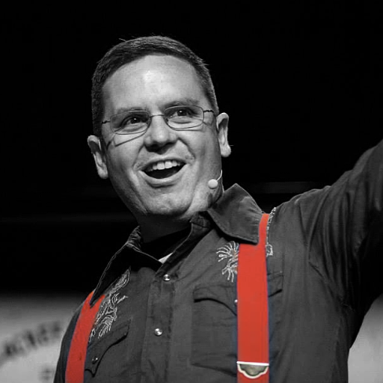

Nathen Harvey
VP, Community Development at Chef
Co-host of the Food Fight Show
Co-organizer of DevOpsDC meetup
Occasional farmer – http://bit.ly/farmer-nathen
Love Eggs – http://eggs.chef.io
@nathenharvey
nharvey@chef.io

Slide 3
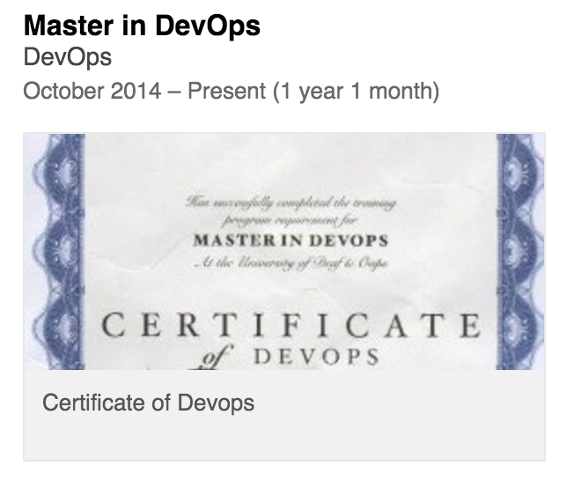
Nathen Harvey
VP, Community Development at Chef
Co-host of the Food Fight Show
Co-organizer of DevOpsDC meetup
Occasional farmer – http://bit.ly/farmer-nathen
Love Eggs – http://eggs.chef.io
@nathenharvey
nharvey@chef.io

Slide 4
Hello!
System Administrator?

Slide 5
Hello!
System Administrator?
Developer?

Slide 6
Hello!
System Administrator?
Developer?
DevOp?

Slide 7
Hello!
System Administrator?
Developer?
DevOp?
Business Person?

Slide 8
Are you experienced?
Experience with Infrastructure as Code or Configuration Management?

Slide 9
Are you experienced?
Experience with Infrastructure as Code or Configuration Management?
Experience with Chef?

Slide 10
Are you experienced?
Experience with Infrastructure as Code or Configuration Management?
Experience with Chef?
Experience writing automated tests?

Slide 11
Which version control system do your use?

Slide 12
Which version control system do your use?
cp foo foo.bak

Slide 13
Which version control system do your use?
cp foo foo.bak
cp foo{,.`date +%Y%m%d%H%M`}

Slide 14
Which version control system do your use?
cp foo foo.bak
cp foo{,.`date +%Y%m%d%H%M`}
cp foo{,.`date +%Y%m%d%H%M`-`$USER`}

Slide 15
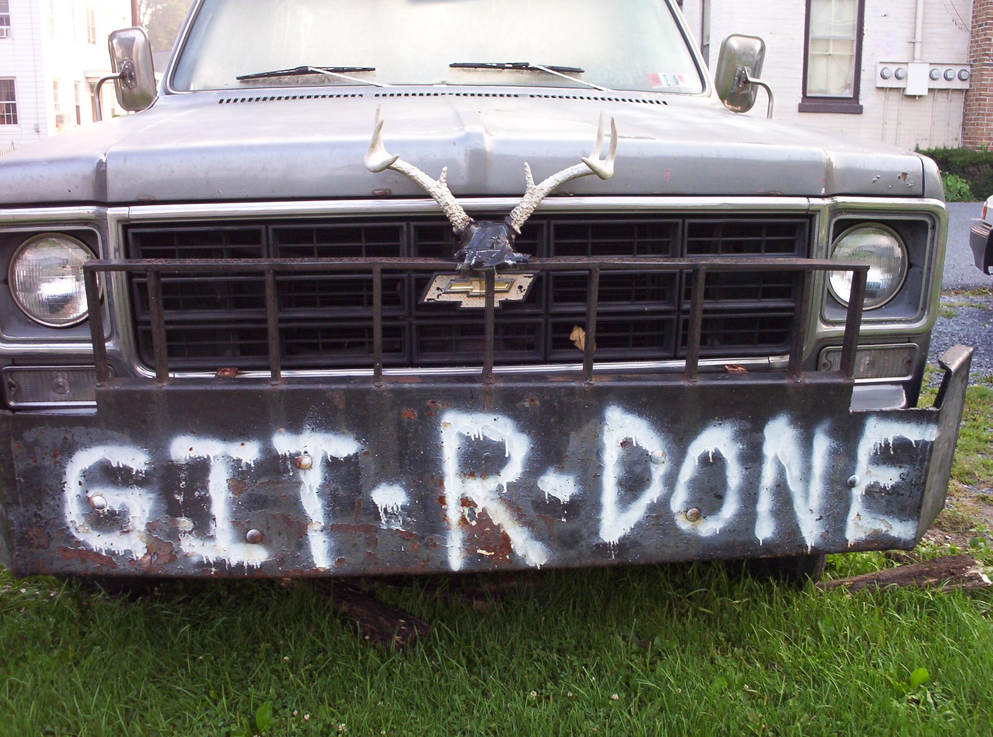

Slide 16
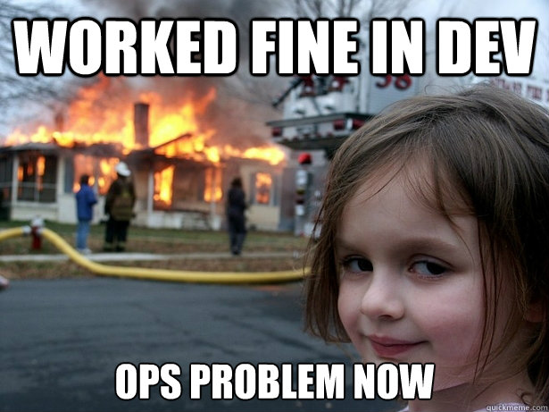
DevOps is a Two-Way Street
It’s great when developers care about
Uptime!
Scaling!
Deployment!
Put them on call! etc. etc. etc.
Notes:
The whole “How did devOps start” story
Dev would often throw stuff over the wall.
Pitchforks and torches, marched over and got them to care about care about these things

Slide 17

DevOps is a Two-Way Street
Operations also has as much or more to learn from developers
Notes:
It’s still Dev & Ops right.. So what can Ops learn from Dev.

Slide 18
Software Development Workflow
Write some code
Notes:
90s – first half of 2000s

Slide 19
Software Development Workflow
Write some code
<ad-hoc verification here>
Notes:
90s – first half of 2000s

Slide 20
Software Development Workflow
Write some code
<ad-hoc verification here>
Go to pre-production
Notes:
90s – first half of 2000s

Slide 21
Software Development Workflow
Write some code
<ad-hoc verification here>
Go to pre-production
<ad-hoc verification here>
Notes:
90s – first half of 2000s

Slide 22
Software Development Workflow
Write some code
<ad-hoc verification here>
Go to pre-production
<ad-hoc verification here>
Go to production
Notes:
90s – first half of 2000s

Slide 23
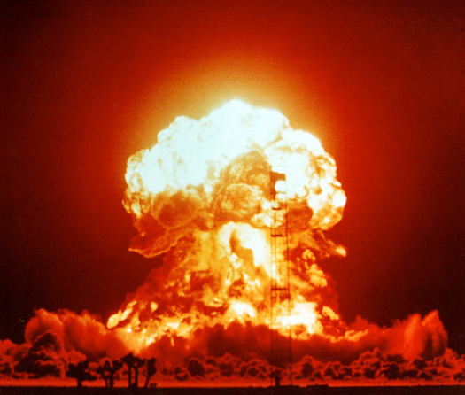
Software Development Workflow
Write some code
<ad-hoc verification here>
Go to pre-production
<ad-hoc verification here>
Go to production
Production failure
Notes:
90s – first half of 2000s

Slide 24

Software Development Workflow
Write some code
Write and run some unit tests
Go to pre-production
Run some integration/acceptance tests
Go to production
Lowered chance of production failure
Notes:
Junit and Selenium
By 2008ish I think most people got it
If there was an error in production you could write tests to avoid the same situation in the future.
You can mention that even sysadmins without Chef or any of this stuff do “integration/acceptance tests” even though they don’t know it today. Every time you’re on a server and do
/sbin/service httpd status
or
netstat -an |grep 80
or
telnet 127.0.0.1 80 (and check whether you get a 200 OK)
you’re doing “acceptance testing”. So why not formalize this?

Slide 25

Old Chef Cookbook Workflow
Write some cookbook code
<ad-hoc verification here>
Go to pre-production
<ad-hoc verification here
Go to production
Whoops, broke production

Slide 26

New Chef Cookbook Workflow
Write some cookbook code
Check for code correctness
Write and run some unit tests
Go to pre-production
Run some integration tests
Go to production

Slide 27
Chef Testing
Did chef-client complete successfully?
Did the recipe put the node in the desired state?
Are the resources properly defined?
Does the code following our style guide?

Slide 28
Tools of the Trade
Code correctness: Foodcritic, Rubocop
Unit tests: ChefSpec
Integration tests: Test Kitchen, ServerSpec, BATS
Notes:
These tools can be used for syntactical correctness. But in combination with a CI pipeline they can be used to enforce policy

Slide 29
What Questions Can I Answer For You?
Thank you!
@nathenharvey

