Slide 1
Edit Remote Files

Slide 2
Lab Setup
Our labs include a remote Linux-based workstation
The easiest way to edit files there is using a command line text editor such as
vim
emacs
nano

Slide 3
But…
This isn’t a class about how to use a command line text editor such as
vim
emacs
nano

Slide 4
Copying files to the remote workstation
You could copy files back-n-forth between your laptop and the workstation using scp
But that would be terribly inefficient and error-prone
You could synchronize the files using a version control system such as git
But that will require some additional setup

Slide 5
Edit remote files from your laptop
Your favorite graphical text editor probably supports editing remote files through a plugin
Let’s look at how to set this up in Atom

Slide 6
Objective
Edit remote files from your local workstation

Slide 7
Remote Sync with Atom

Slide 8
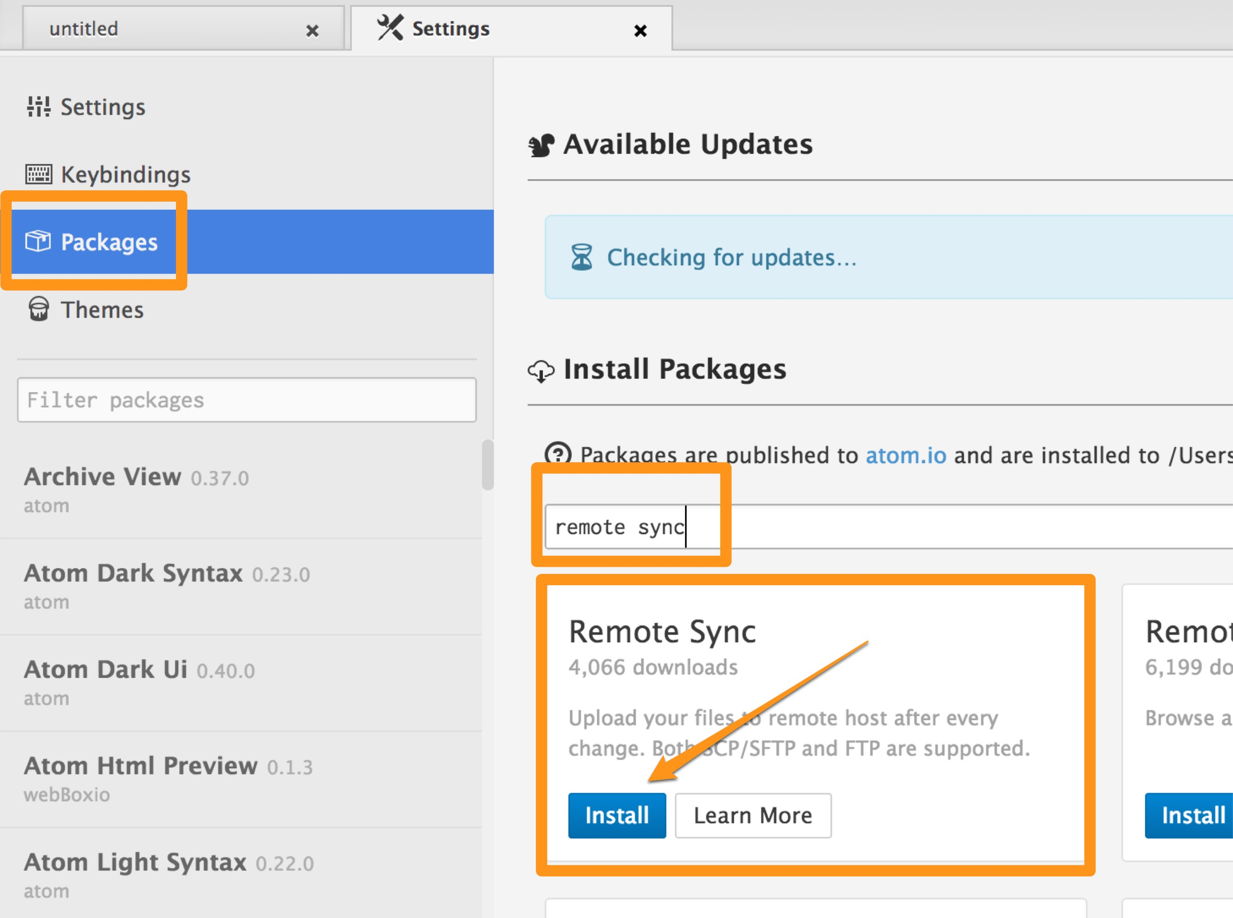
Install the Remote Sync Package

Slide 9
Open a Folder in Atom
Create a folder where you will store your work for this class. The folder can be empty for now.
Open the folder in Atom
File > Open … select the folder (Mac)
File > Open Folder … select the folder (Windows)

Slide 10
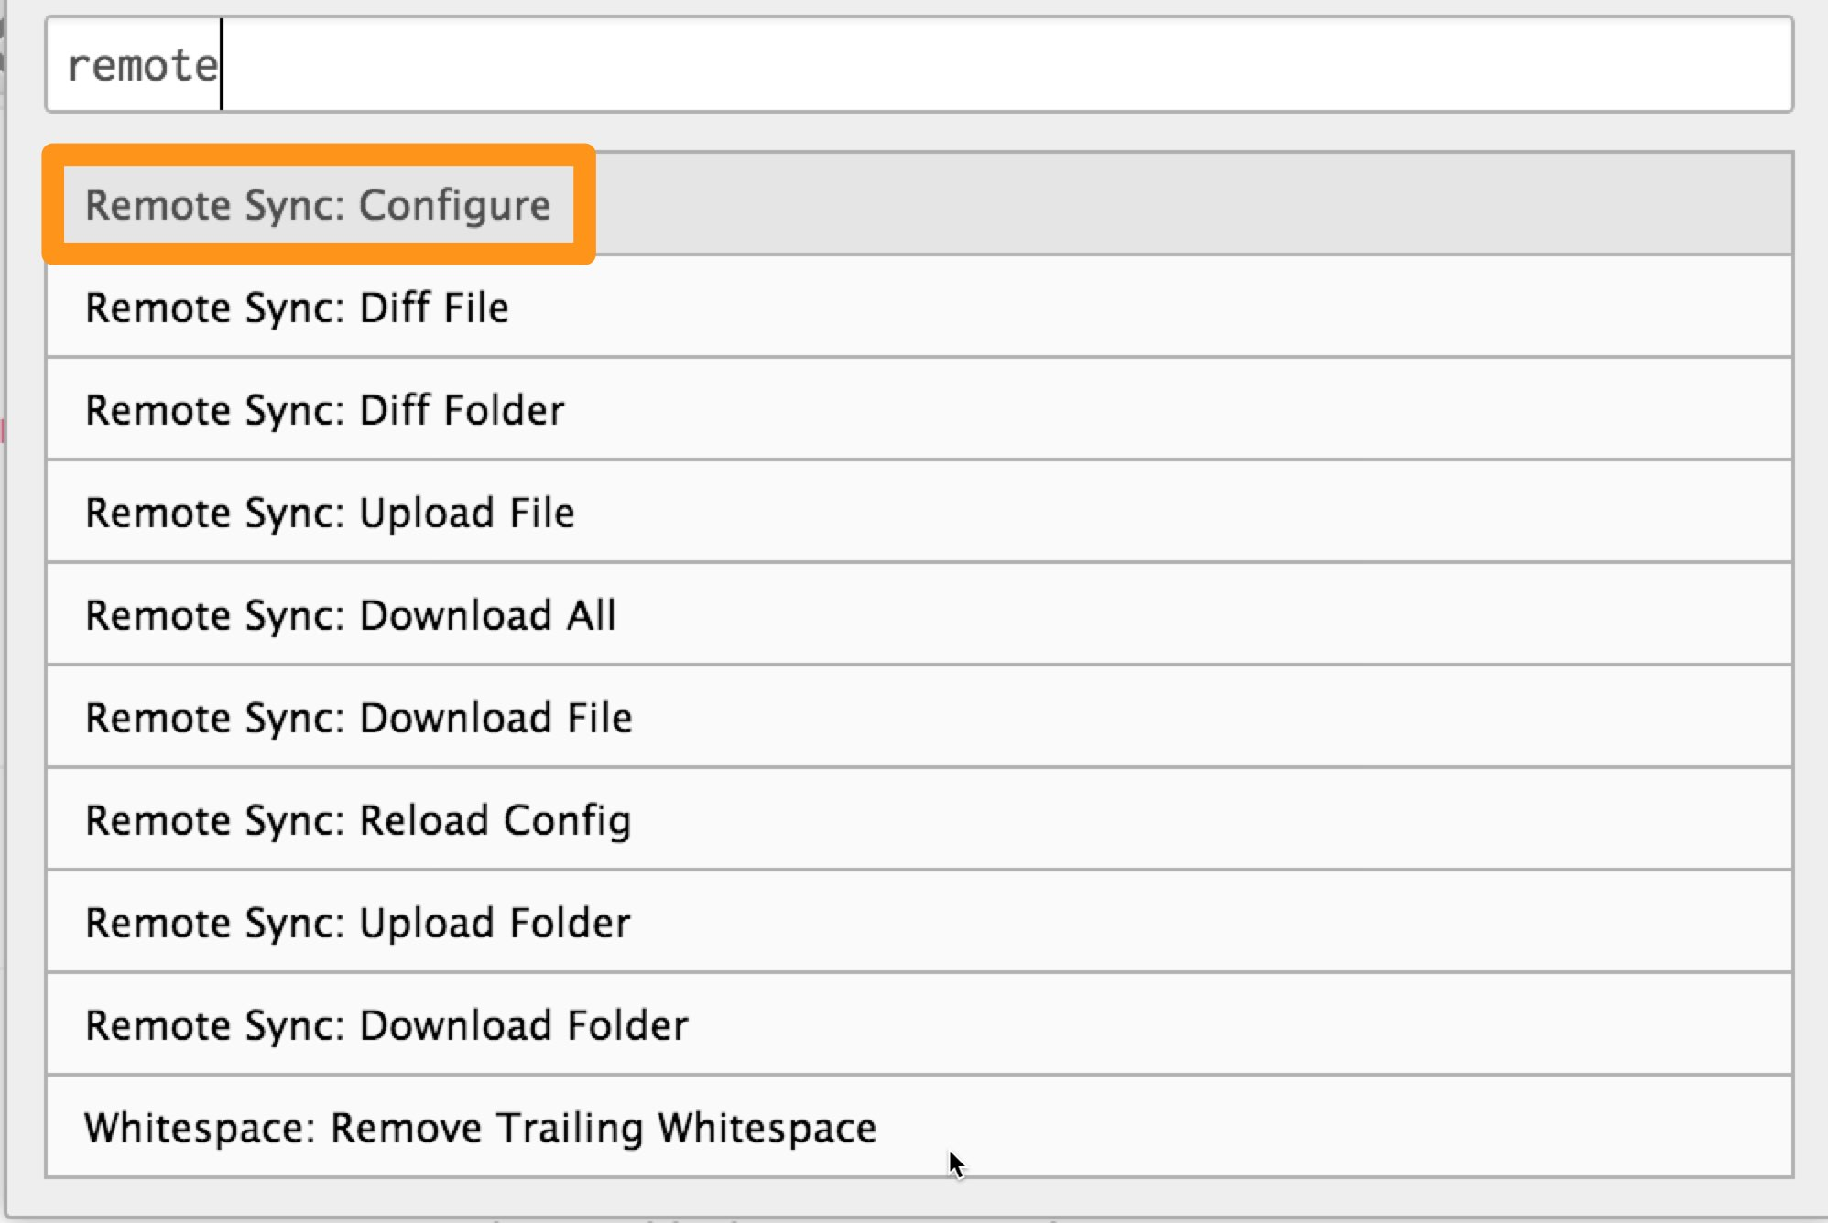
Remote Sync: Configure
cmd + shift + P on Mac
ctrl + shift + P on Windows
ctrl + shift + P on Linux

Slide 11
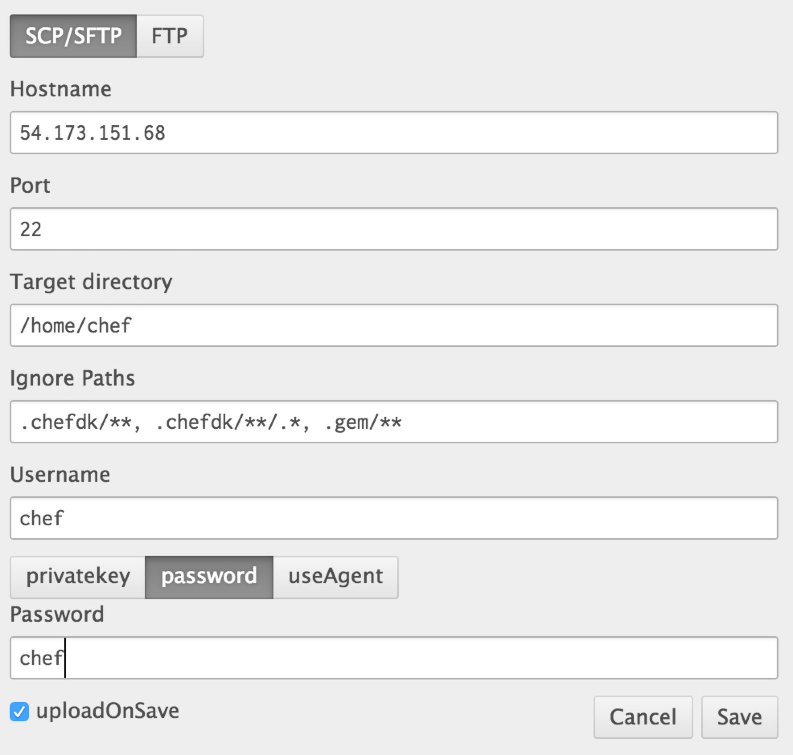
Configuration
Hostname
Your IP Address
Port
22
Target directory
/home/chef

Slide 12
Configuration
Ignore files
.chefdk/**,
.chefdk/**/.*,
.gem/**
.git/**

Slide 13
Configuration
Username
chef
Password
Click password button
Enter your password
uploadOnSave
Checked

Slide 14
Verify Configuration
.remote-sync.json
{
"transport": "scp",
"hostname": "THE_REMOTE_IP_ADDRESS",
"port": "22",
"username": "THE_USERNAME",
"password": "THE_PASSWORD",
"target": "/home/chef",
"ignore": [
".chefdk/**",
".chefdk/**/.*",
".gem/**",
".git/**"
],
"uploadOnSave": true
}

Slide 15
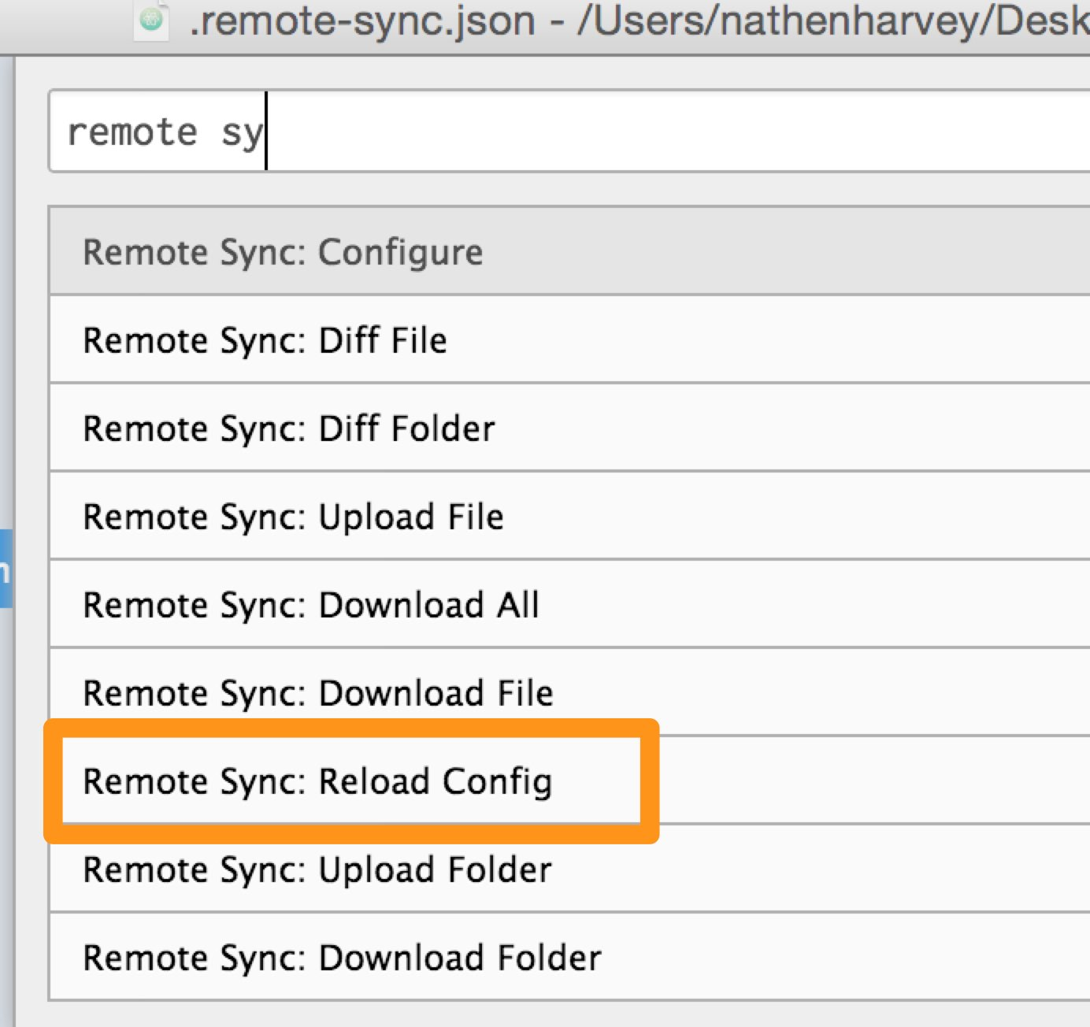
Reload the Configuration

Slide 16
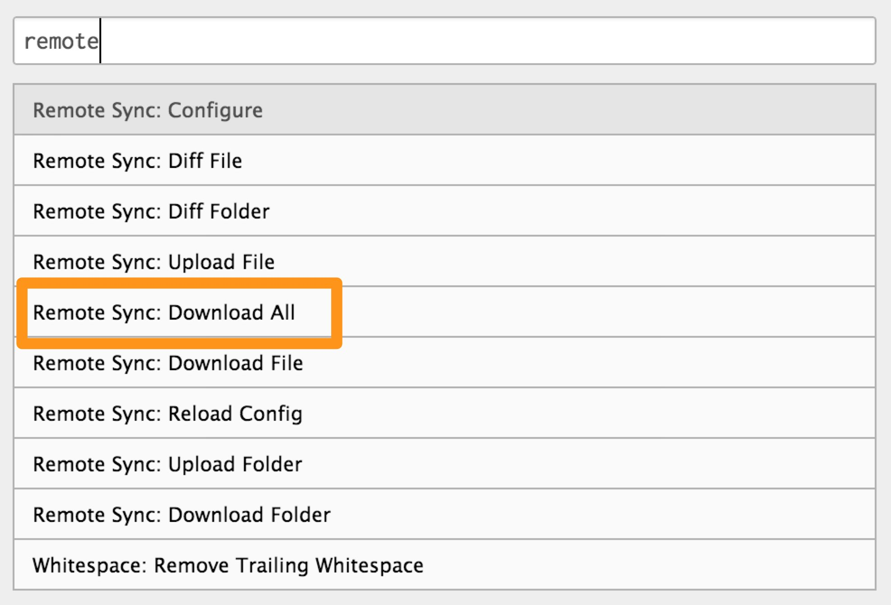
Remote Sync: Download All

Slide 17
Sync Chagnes
Local changes are automatically saved on the remote
Pull down new files using “Download All”

Slide 18
Manual Configuration
.remote-sync.json
{
"transport": "scp",
"hostname": "THE_REMOTE_IP_ADDRESS",
"port": "22",
"username": "THE_USERNAME",
"password": "THE_PASSWORD",
"target": "/home/chef",
"ignore": [
".chefdk/**",
".chefdk/**/.*",
".gem/**",
".git/**"
],
"uploadOnSave": true
}

