Slide 1
The Joy of Cooking
Whip up a Rails Environment with Chef
Nathen Harvey, CustomInk.com
@nathenharvey
https://github.com/nathenharvey/cooking-with-chef

Slide 2
Agenda
Infrastructure as Code
Introduction to Chef
Building a project in Chef
Provision a server for your Rails App
Additional resources

Slide 3
Infrastructure as Code
Enable the reconstruction of the business from nothing but
a source code repository
an application data backup
and bare metal resources
Jesse Robins, Opscode

Slide 4

Disposable Servers

Slide 5
Evolution of Server Provisioning
Just build it
Keep notes in server.txt
Migrate notes to wiki
Custom shell scripts (in git)
Systems integration framework

Slide 6
When should I use a systems integration framework?
After you outgrow Heroku

Slide 7
Which framework?
CFEngine?
Puppet?
Chef?

Slide 8
Wrong question!
YES – use a systems integration framework
YES – use one that works for your team
YES – this is a talk about Chef

Slide 9
Chef
Declarative – What, not how
Idempotent – Only take action if required
Convergent – Takes care of itself

Slide 10
Building a Chef Project
First, come up with your policy / specification
Abstract the resources in your spec

Slide 11
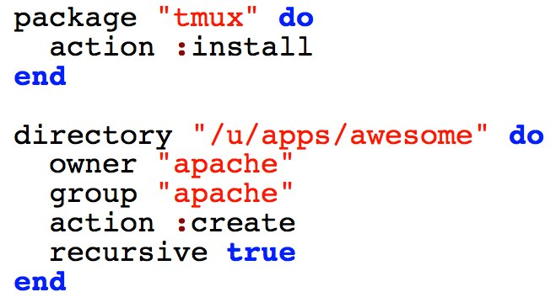
Resources

Slide 12
Building a Chef Project
First, come up with your policy / specification
Abstract the resources in your spec
Write recipes

Slide 13
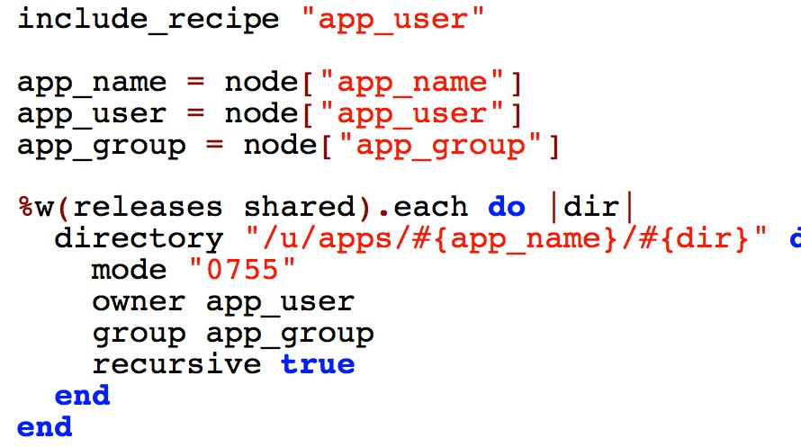
Recipes

Slide 14
Building a Chef Project
First, come up with your policy / specification
Abstract the resources in your spec
Write recipes
Package recipes in cookbooks

Slide 15
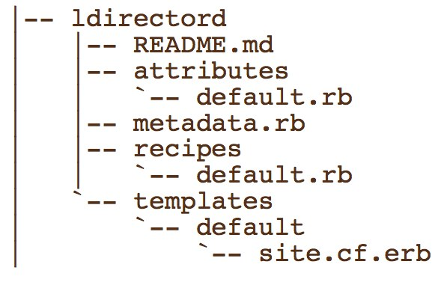
Cookbooks

Slide 16
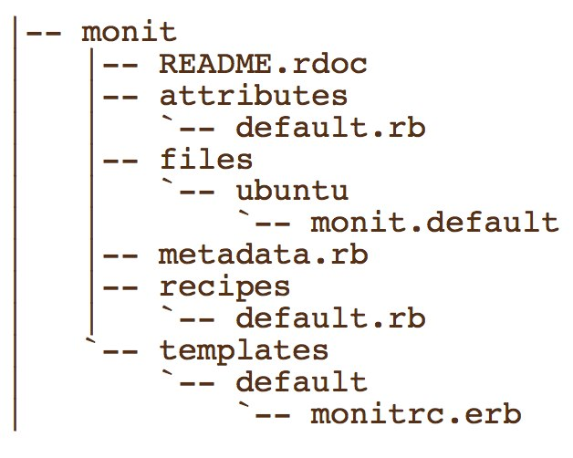
Cookbooks

Slide 17
Building a Chef Project
First, come up with your policy / specification
Abstract the resources in your spec
Write recipes
Package recipes in cookbooks
Apply recipes to nodes

Slide 18
Nodes
Representation of a host
runs the Chef client
has attributes
has a list of recipes to be applied

Slide 19
Building a Chef Project
First, come up with your policy / specification
Abstract the resources in your spec
Write recipes
Package recipes in cookbooks
Apply recipes to nodes
Group things into roles

Slide 20
Roles
mechanism for easily composing sets of functionality
have attributes and a list of recipes to be applied

Slide 21
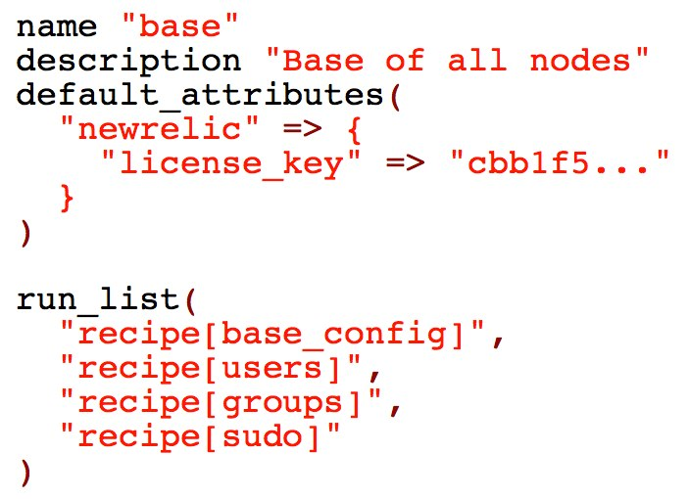
Roles

Slide 22
Building a Chef Project
First, come up with your policy / specification
Abstract the resources in your spec
Write recipes
Package recipes in cookbooks
Apply recipes to nodes
Group things into roles

Slide 23
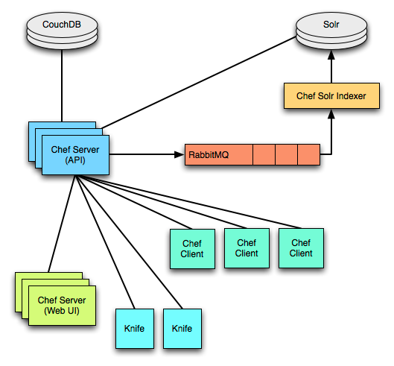
What is Chef?

Slide 24
What is Chef?
Server - API, search, Web UI
Client - chef-client
Command line tool - knife

Slide 25
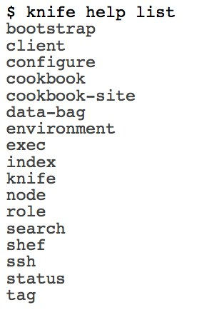
knife

Slide 26
What is Chef?
Server - API, search, Web UI
Client - chef-client
Command line tool - knife
Inspection library - ohai

Slide 27
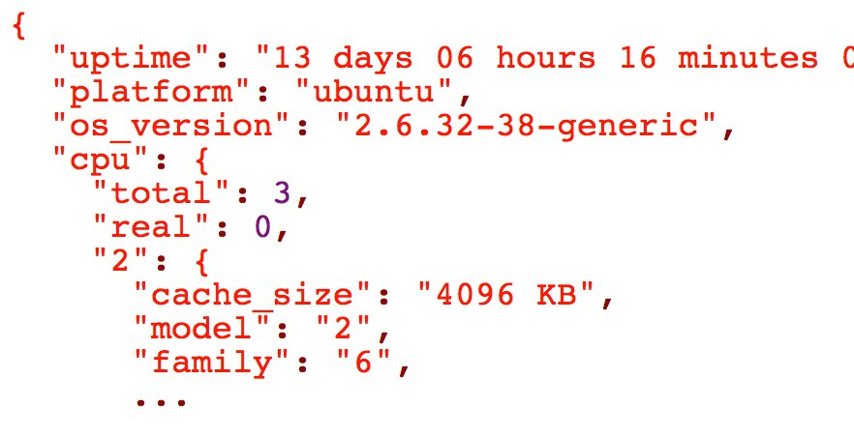
ohai
Collects detailed, extensible information about a host.

Slide 28
What is Chef?
Server - API, search, Web UI
Client - chef-client
Command line tool - knife
Inspection library - ohai
REPL - shef

Slide 29
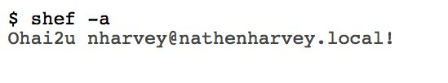
shef
The (poorly named) Chef REPL

Slide 30
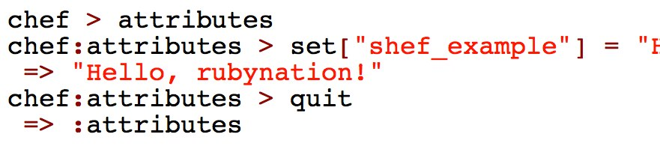
shef

Slide 31
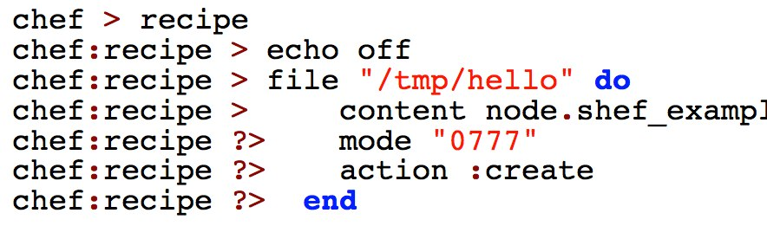
shef

Slide 32
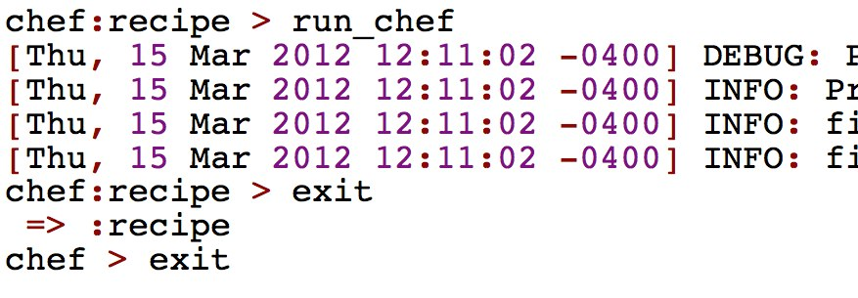
shef

Slide 33

shef

Slide 34
What is Chef?
Server - API, search, Web UI
Client - chef-client
Command line tool - knife
Inspection library - ohai
REPL - shef
Community

Slide 35
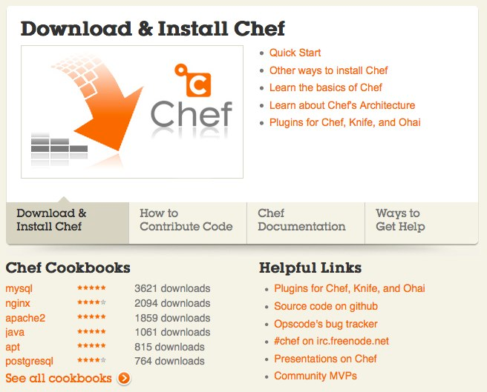
community.opscode.com

Slide 36
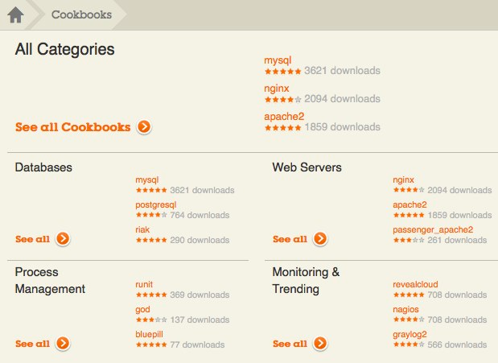
Community Site
Publish and share cookbooks

Slide 37
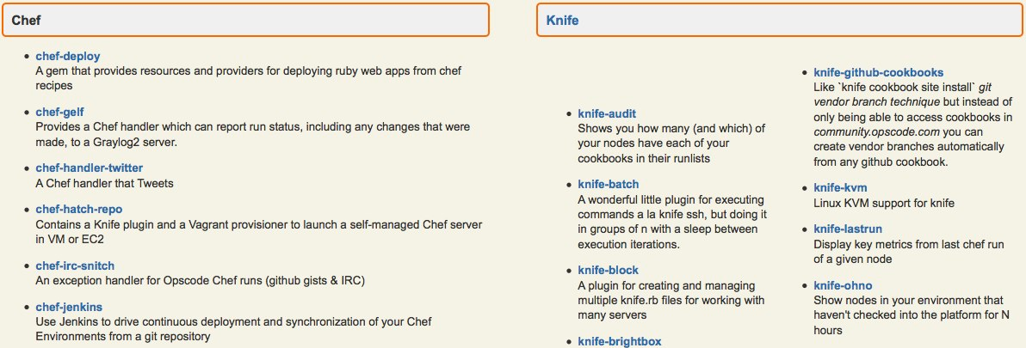
Community Site
Publish and share plugins for Chef, Knife, and Ohai

Slide 38
Chef Deployment Options
chef-solo
Chef Server
Hosted Chef
Private Chef

Slide 39
chef-solo
What you don't get:
central server
authentication
authorization
search indexes
persistent attributes

Slide 40
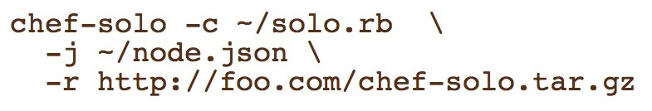
chef-solo
Execute cookbooks that are stored on disk or available at at URL

Slide 41
Chef Server
Open source
Run it yourself, wherever you like
Complicated to set-up and manage

Slide 42
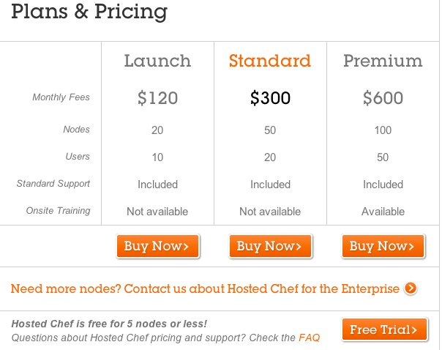
Hosted Chef
Best way to get started

Slide 43
Private Chef
Commercial offering
Managed by Opscode
Pricing
installation fee
service contract

Slide 44
Get started with Hosted Chef
Create a Hosted Chef account
Install and Update dependencies - ruby, ruby gems, ruby-dev and git-core
Install Chef and create directories needed
Connect to Hosted Chef

Slide 45
Client configuration
Get organization validation key
Generate knife config
Get a private key
Set-up chef-repo directory
Copy validation files and knife config to .chef

Slide 46
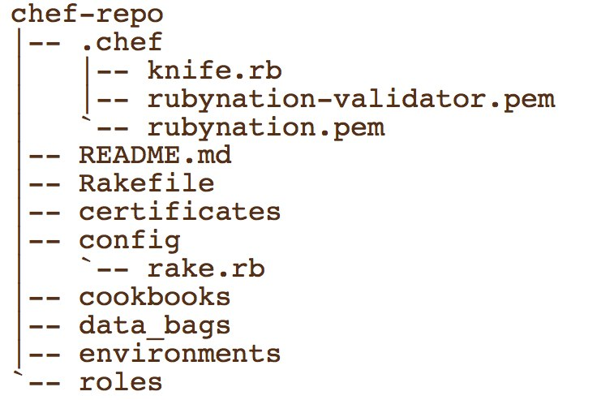
chef-repo directory

Slide 47

Verify setup

Slide 48

Provision a server
knife ec2 server create
knife rackspace server create
Vagrant

Slide 49
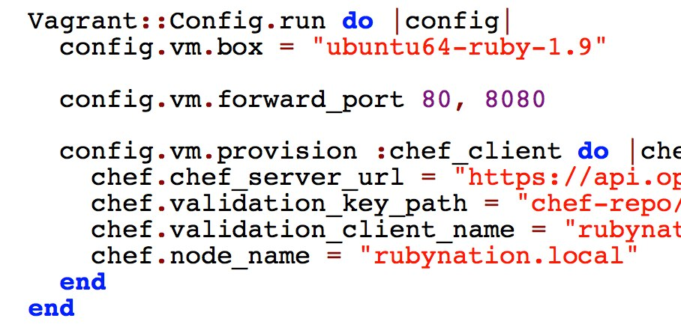
Vagrantfile

Slide 50
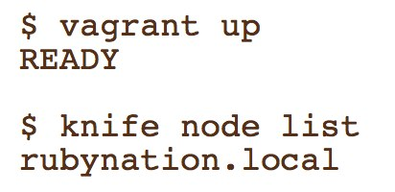
Launch Vagrant & Check In

Slide 51
Initial set-up steps
Register with hosted chef
Create a chef-repo
Install chef
Configure knife.rb
Configure Vagrant file
Register Vagrant instance with Chef hosted

Slide 52
Provision for Rails
Apache
Passenger
MySQL
Rails application

Slide 53
Add passenger_apache2 cookbook

Slide 54
Cookbook site install
A new "pristine copy" branch is created in git for tracking the upstream
All existing cookbooks are removed from the branch
The cookbook is downloaded from the cookbook site in tarball form
The downloaded cookbook is untarred, and its contents commited via git
The pristine copy branch is merged into the master branch

Slide 55

Add mysql cookbook

Slide 56
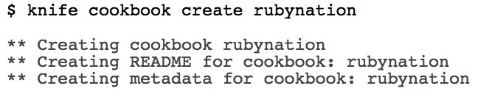
Create a Cookbook

Slide 57
Write our recipes
default.rb
web.rb
db.rb

Slide 58
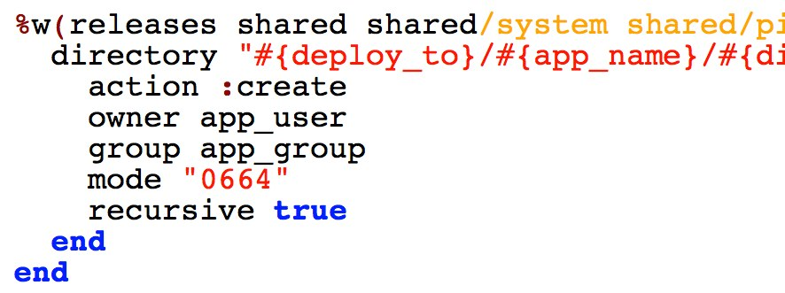
Web Recipe
Set-up some directories

Slide 59
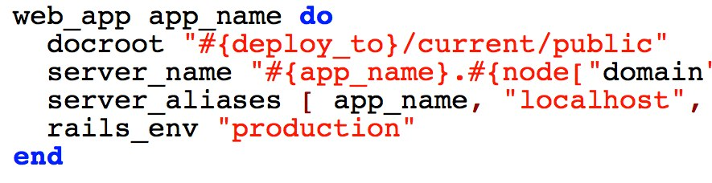
Web Recipe
Configure Apache / Passenger

Slide 60
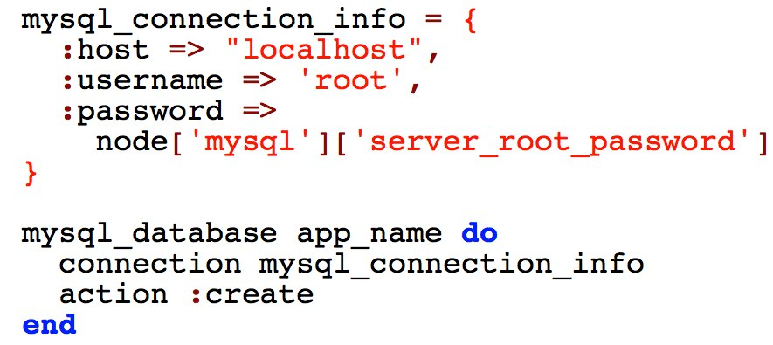
Database Recipe
Create the database

Slide 61
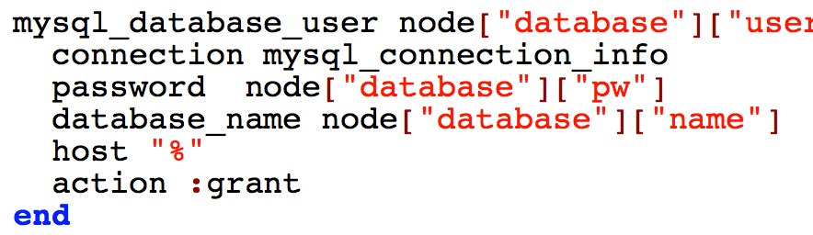
Database Recipe
Create the database user

Slide 62
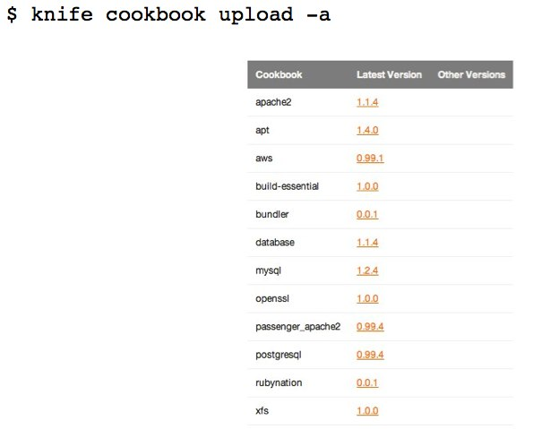
Upload cookbooks to Chef server

Slide 63
Create some roles
Group recipes together using roles
Apply roles to nodes
Our roles:
base_ubuntu
rubynation_web
rubynation_db

Slide 64
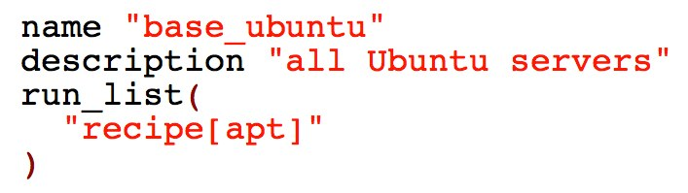
base_ubuntu Role

Slide 65
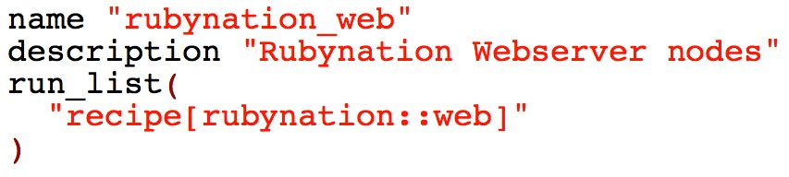
rubynation_web Role

Slide 66
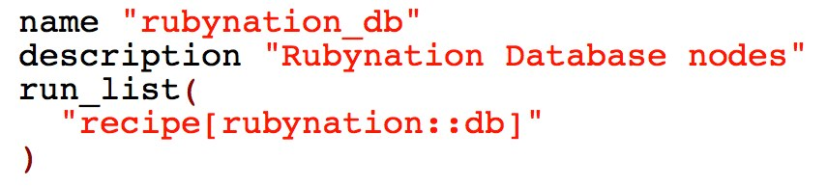
rubynation_db Role

Slide 67
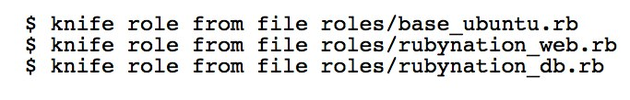
Upload the roles to the server

Slide 68
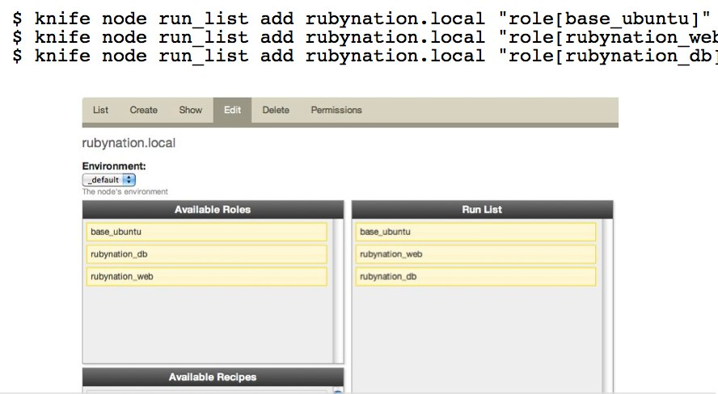
Assign the roles to our nodes

Slide 69
Run chef-client
Automatically
knife ssh
vagrant provision

Slide 70
Review
Server provisioned and communicating with the Chef API
Apache and Passenger installed with a default configuration
MySQL installed and running

Slide 71

Deploying with Capistrano
Without Chef:

Slide 72
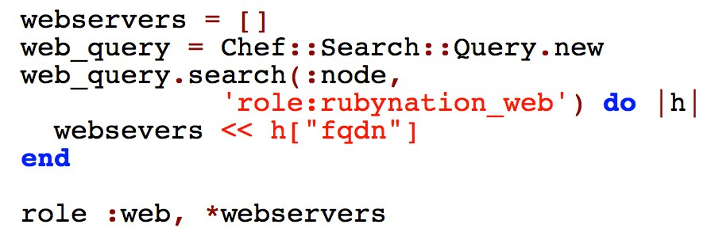
Deploying with Capistrano
With Chef search

Slide 73
But wait, there's more!
Encrypted databags
Environments
Lightweight Resources and Providers (LWRP)
Exception and report handlers

Slide 74
Want more?
http://community.opscode.com
http://wiki.opscode.com
Opscode Training Materials
#chef on irc.freenode.net

Slide 75

Want even more?
http://foodfightshow.org
Episode 5: Getting Started with Chef
ChefConf - May 15-17 in San Francisco

Slide 76
Shameless Plugs
DevOpsDC
Washington DC MongoDB Users Group
CustomInk Friday Tech Lunches

Slide 77
Find Me
@nathenharvey
http://nathenharvey.com
nharvey@customink.com

