Slide 1
Introduction to Testing Chef
Cookbook development workflow
DCAST – March 2015
https://github.com/nathenharvey/dcast-testing-infrastructure

Slide 2


Nathen Harvey
nharvey@chef.io
@nathenharvey
Co-organizer – DevOps DC
http://bit.ly/farmer-nathen (explicit)
http://bit.ly/farmer-nathen-sfw

Slide 3
What is Chef?
Leader in next generation of automation solutions
Leading the DevOps movement – Alignment between Infrastructure and Apps
Key partners: Amazon Web Services, Microsoft, IBM, HP, Accenture, PWC, VMWare
Offices in Seattle, San Francisco, Atlanta, and London
Notes:
Chef is all about taking advantage of the revolution in computing – to allow automation to take care of the boring stuff and let your employees focus on building your business
Software is eating the world – Every business is becoming a software business
John Deere – if you would have told them 50 years ago a tractor company would need to ship remote controlled combines that had wifi hotspots, they would have thought you were crazy.
Taxi’s – Random people with random cars disrupt an entire industry – all through software
How does this happen? By shipping more software, more quickly.
**Be careful about term DevOps** - change if necessary
Blocker always happens at handoff – devs are smart, IT is smart, but when you have one hand off to the other, you have problems
If Devs had their way, everything would always change
If IT had their way, everything would be infinitely stable (and never change)
Solution is to bring them together earlier, and get everyone running in the same direction
This is what Chef does
We’re not doing this alone
We’re working with the biggest names in cloud, services and technology
We’re growing really quickly
And we’re global

Slide 4



The New Face of Business
Chef is an automation and delivery platform born in the service of velocity and scale.
Infrastructure + applications
REQUIREMENTS
In the data center + in the cloud
Notes:
I mentioned how software is changing the world – this is how
Requirements come into your business
You walk through this process – build test, ship and run – and produce business improvements – but you’re not done
It’s not meaningful until it gets out to customers – via infrastructure and cloud/data center
Chef helps at each one of these steps
Helps you build, test ship and run
Helps you bring it to customers
Chef is automation and velocity

Slide 5
How Chef Works
1 | ▼ | windows_feature ‘IIS-WebServerRole’ do
2 |  | action :install
3 | ▲ | end
4
5 | ▼ | windows_feature ‘IIS-ASPNET’ do
6 |  | action :install
7 | ▲ | end
8
9 | ▼ | iis_pool ‘FooBarPool’do
10 |  | runtime_version “4.0”
11 |  | action :add
12 | ▲ | end
13
14 | ▼ | iis_site ‘FooBarLTDSite’do
15 |  | protocol :http
16 |  | port 80
17 |  | path “C:\\FooBarSite”
18 |  | action [:add, :start]
19 | ▲ | end
Define reusable resources and infrastructure state as code
Manages deployment and on-going automation
Community content available for all common automation tasks
1 | ▼ | package “httpd” do
2 |  | action :install
3 | ▲ | end
4
5 | ▼ | template “/etc/httpd/httpd.conf” do
6 |  | source “httpd.conf.erb”
7 |  | mode “0755”
8 |  | owner “root”
9 |  | group “root”
10 | ▲ | end
11
12 | ▼ | service “httpd” do
13 |  | action [:start, :enable]
14 |  | done
15
Notes:
You may have heard DevOps is complicated, that the tools require a lot of training
Let me show you what it looks like
The item on the left is clear as day – you install a webserver, you set the permissions, and then you start it.
No more complicated on Windows – you set a role, install a webserver, configure, and start it
Automation is not complicated and it documents everything!
Let’s say you’re doing an audit – can you tell me who the owner for your httpd instances are? Absolutely – written right there in code.
You don’t have to go find the person who installed it four years ago and understand what went on

Slide 6
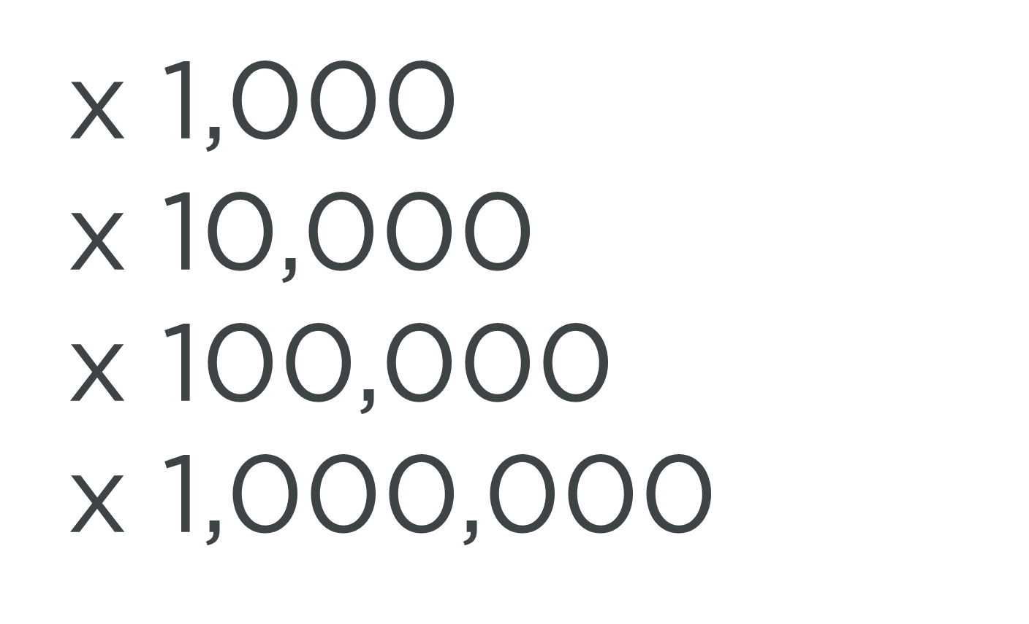
Chef Architecture
Policy
State
Code
Revision
Control
System
Automation
Server
Nodes
Notes:
Going one level deeper, here’s how Chef works
You implement your infrastructure as readable, simple code
You commit it to a revision control system (Git, SVN) so you can always go back and know what changed
Once you’re ready, you push that code to the Chef server – sets the policy.
Then every node checks back in and asks “Am I in compliance with my policy?” (once every 15 minutes by default)
Chef server says yes, or no, and here’s how to get there, and the node goes and updates itself according to its instructions
And you’re done – we do this for organizations who have MILLIONS of nodes running against Chef.

Slide 7
Continuous Delivery is the Business Transformation Engine
I can:
Deploy my app
Provision servers
Set up networks
Debug and fix
Measure and improve
AT ANY TIME!
IT
RELEASE
Commit Stage
Build unit test
Automated Acceptance Testing
Automated Capacity Testing
IT Infrastructure
PASS
PASS
PASS
BUSINESS
Business Innovation
Manual Testing
Show cases
Exploratory testing
Compliance Certification
I can ship my ideas AT ANY TIME!
RUN
PASS
Notes:
People sit on different continuums of continuous delivery
We can do any level of CD
Have a full deck we can dive into
Bring IT infrastructure and App together as a core benefit
Start on the left – you need change
Bring these requirements into building your app
Commit the changes
Go through automated acceptance testing
Then go through automated capacity testing
Have humans come in to review the tests at a manual phase
Then final compliance testing
Finally, manual decision to go/no-go
And goes out the door
This means two things
#1 You IT & Dev departments get unblocked
#2 Your business can respond to customers
Chef empowers everything you see here!

Slide 8
Resources
Fundamental building blocks

Slide 9
Resources
Piece of the system and its desired state

Slide 10
Resources - Package
Package that should be installed
package "mysql-server" do
action :install
end

Slide 11
Resources - Service
Service that should be running and restarted on reboot
service "iptables" do
action [ :start, :enable ]
end

Slide 12
Resources - Service
File that should be generated
file "/etc/motd" do
content "Property of Chef Software"
end

Slide 13
Resources - Cron
Cron job that should be configured
cron "restart webserver" do
hour '2'
minute '0'
command 'service httpd restart'
end

Slide 14
Resources - User
User that should be managed
user "nginx" do
comment "Nginx user <nginx@example.com>"
uid 500
gid 500
supports :manage_home => true
end

Slide 15
Resources - DSC
DSC resource that should be run
dsc_script 'emacs' do
code <<-EOH
Environment 'texteditor'
{
Name = 'EDITOR'
Value = 'c:\\emacs\\bin\\emacs.exe'
}
EOH
end

Slide 16
Resources – Registry Key
Registry key that should be created
registry_key "HKEY_LOCAL_MACHINE\\SOFTWARE\\Microsoft\\Windows\\CurrentVersion\\Policies\\System" do
values [{
:name => "EnableLUA",
:type => :dword,
:data => 0
}]
action :create
end

Slide 17
Test and Repair
Resources follow a test and repair model
package "vim"

Slide 18
Test and Repair
Resources follow a test and repair model
package "vim"
Is vim installed?
Test

Slide 19
Test and Repair
Resources follow a test and repair model
package "vim"
Is vim installed?
Test
Yes

Slide 20
Test and Repair
Resources follow a test and repair model
package "vim"
Is vim installed?
Test
Yes
Done

Slide 21
Test and Repair
Resources follow a test and repair model
package "vim"
Is vim installed?
Test
Yes
No
Done

Slide 22
Test and Repair
Resources follow a test and repair model
package "vim"
Is vim installed?
Test
Yes
No
Done
Install it

Slide 23
Test and Repair
Resources follow a test and repair model
package "vim"
Is vim installed?
Test
Yes
No
Repair
Done
Install it

Slide 24
Resources
package
template
service
directory
user
group
dsc_script
registry_key
powershell_script
cron
mount
route
…and more!
Notes:
Of course, there are lots of different types of resources that come with Chef
View them all on docs.chef.io/resources.html

Slide 25
Testing Chef Cookbooks

Slide 26
Our process
Write policy
Apply policy
Verify policy
Not bad for the simple case, will quickly get untenable

Slide 27
Faster Feedback
Speed-up the feedback loops with automated testing.
Have confidence in your changes before you run them in production

Slide 28
Chef Testing
Did chef-client complete successfully?
Did the recipe put the node in the desired state?
Are the resources properly defined?
Does the code follow our style guide?

Slide 29
Test-driving infrastructure
We are going to use a relatively simple scenario
We are going to explore many facets of testing
We are going to follow a test-first, test-driven model

Slide 30
Our Scenario
We want a custom home page available on the web.

Slide 31
Create an apache cookbook
chef generate cookbook apache
Compiling Cookbooks...
Recipe: code_generator::cookbook
* directory[/home/chef/chef-repo/cookbooks/apache] action create
- create new directory /home/chef/chef-repo/cookbooks/apache
- restore selinux security context
* template[/home/chef/chef-repo/cookbooks/apache/metadata.rb] action create_if_missing
- create new file /home/chef/chef-repo/cookbooks/apache/metadata.rb
- update content in file /home/chef/chef-repo/cookbooks/apache/metadata.rb from none to 4c0e2d
(diff output suppressed by config)
- restore selinux security context
* template[/home/chef/chef-repo/cookbooks/apache/README.md] action create_if_missing
- create new file /home/chef/chef-repo/cookbooks/apache/README.md
- update content in file /home/chef/chef-repo/cookbooks/apache/README.md from none to 5c3d3a
(diff output suppressed by config)
- restore selinux security context
* cookbook_file[/home/chef/chef-repo/cookbooks/apache/chefignore] action create
…

Slide 32
Create an apache cookbook
cd apache

Slide 33
Chef client success status
Requirements to verify chef-client success:
A target server running the same OS as production

Slide 34
Chef client success status
Requirements to verify chef-client success:
A target server running the same OS as production
A chef-client with access to the cookbook

Slide 35

Test Kitchen
Test harness to execute code on one or more platforms
Driver plugins to allow your code to run on various cloud and virtualization providers
Includes support for many testing frameworks
Included with ChefDK

Slide 36
Test Matrix
Two operating systems
ubuntu-12.04
centos-6.4

Slide 37
Test Matrix
Two operating systems
One recipe
 | default
ubuntu-12.04 | apache::default
centos-6.4 | apache::default

Slide 38
Test Matrix
Two operating systems
Two recipes
 | default | ssl
ubuntu-12.04 | apache::default | apache::ssl
centos-6.4 | apache::default | apache::ssl

Slide 39
Test Matrix
Three operating systems
Two recipes
 | default | ssl
ubuntu-12.04 | apache::default | apache::ssl
centos-6.4 | apache::default | apache::ssl
ubuntu-14.04 | apache::default | apache::ssl

Slide 40
Configuring the Kitchen
apache/.kitchen.yml
---
driver:
name: vagrant
provisioner:
name: chef_zero
platforms:
- name: ubuntu-12.04
- name: centos-6.4
suites:
- name: default
run_list:
- recipe[apache::default]
attributes:

Slide 41
.kitchen.yml
driver - virtualization or cloud provider
---
driver:
name: vagrant
provisioner:
name: chef_zero
platforms:
- name: ubuntu-12.04
- name: centos-6.4
suites:
- name: default
run_list:
- recipe[apache::default]
attributes:

Slide 42
.kitchen.yml
provisioner - application to configure the node
---
driver:
name: vagrant
provisioner:
name: chef_zero
platforms:
- name: ubuntu-12.04
- name: centos-6.4
suites:
- name: default
run_list:
- recipe[apache::default]
attributes:

Slide 43
.kitchen.yml
platforms - target operating systems
---
driver:
name: vagrant
provisioner:
name: chef_zero
platforms:
- name: ubuntu-12.04
- name: centos-6.4
suites:
- name: default
run_list:
- recipe[apache::default]
attributes:

Slide 44
.kitchen.yml
suites - target configurations
---
driver:
name: vagrant
provisioner:
name: chef_zero
platforms:
- name: ubuntu-12.04
- name: centos-6.4
suites:
- name: default
run_list:
- recipe[apache::default]
attributes:

Slide 45
.kitchen.yml
 | default
ubuntu-12.04 | apache::default
centos-6.4 | apache::default
---
driver:
name: vagrant
provisioner:
name: chef_zero
platforms:
- name: ubuntu-12.04
- name: centos-6.4
suites:
- name: default
run_list:
- recipe[apache::default]

Slide 46
.kitchen.yml
 | default | ssl
ubuntu-12.04 | apache::default | apache::ssl
centos-6.4 | apache::default | apache::ssl
---
driver:
name: vagrant
provisioner:
name: chef_zero
platforms:
- name: ubuntu-12.04
- name: centos-6.4
suites:
- name: default
run_list:
- recipe[apache::default]
- name: ssl
run_list:
- recipe[apache::ssl]

Slide 47
.kitchen.yml
 | default | ssl
ubuntu-12.04 | apache::default | apache::ssl
centos-6.4 | apache::default | apache::ssl
ubuntu-14.04 | apache::default | apache::ssl
---
driver:
name: vagrant
provisioner:
name: chef_zero
platforms:
- name: ubuntu-12.04
- name: centos-6.4
- name: ubuntu-14.04
suites:
- name: default
run_list:
- recipe[apache::default]
- name: ssl
run_list:
- recipe[apache::ssl]

Slide 48
.kitchen.yml
The configuration file for your Test Kitchen
driver – virtualization or cloud provider
provisioner – application to configure the node
platforms – target operating systems
suites – target configurations

Slide 49
Move to the apache cookbook directory
cd ~/chef-repo/cookbooks/apache

Slide 50
List the Test Kitchens
kitchen list
Instance Driver Provisioner Last Action
default-ubuntu-1204 Vagrant ChefZero <Not Created>
default-centos-65 Vagrant ChefZero <Not Created>

Slide 51
Create the kitchen
kitchen create
-----> Starting Kitchen (v1.3.1)
-----> Creating <default-centos-64>...
Step 0 : FROM centos:centos6
---> 68eb857ffb51
Step 1 : RUN yum clean all
---> Running in cdf3952a3f18
Loaded plugins: fastestmirror
Cleaning repos: base extras libselinux updates
Cleaning up Everything
---> b1cccd25ce55
Removing intermediate container cdf3952a3f18
Step 2 : RUN yum install -y sudo openssh-server openssh-clients which curl
---> Running in 9db69ace459d
Loaded plugins: fastestmirror

Slide 52
Use AWS for test instances
.kitchen.yml
---
driver:
name: ec2
aws_access_key_id: <%= ENV['AWS_ACCESS_KEY_ID'] %>
aws_secret_access_key: <%= ENV['AWS_SECRET_ACCESS_KEY'] %>
aws_ssh_key_id: <%= ENV['AWS_KEYPAIR_NAME'] %>
ssh_key: <%= ENV['AWS_KEY_PATH'] %>
availability_zone: <%= ENV['AWS_AVAILABILITY_ZONE'] %>
provisioner:
name: chef_zero
platforms:
# - name: ubuntu-12.04
- name: centos-6.4
suites:
- name: default
run_list:
- recipe[apache::default]
attributes:
Notes:
driver:
name: ec2
aws_access_key_id: <%= ENV['AWS_ACCESS_KEY_ID'] %>
aws_secret_access_key: <%= ENV['AWS_SECRET_ACCESS_KEY'] %>
aws_ssh_key_id: <%= ENV['AWS_KEYPAIR_NAME'] %>
ssh_key: <%= ENV['AWS_KEY_PATH'] %>
availability_zone: <%= ENV['AWS_AVAILABILITY_ZONE'] %>
%s/6.5/6.4

Slide 53
Chef client success status
Requirements to verify chef-client success:
A target server running the same OS as production
A chef-client with access to the cookbook

Slide 54
Go to the right place
cd ~/chef-repo/cookbooks/apache

Slide 55
Apply our policy
kitchen converge
-----> Starting Kitchen (v1.3.1)
-----> Converging <default-centos-64>...
Preparing files for transfer
Preparing dna.json
Resolving cookbook dependencies with Berkshelf 3.2.3...
Removing non-cookbook files before transfer
Preparing validation.pem
Preparing client.rb
-----> Installing Chef Omnibus (install only if missing)
downloading https://www.chef.io/chef/install.sh
to file /tmp/install.sh
trying curl...

Slide 56
Chef Testing
Did chef-client complete successfully?
Did the recipe put the node in the desired state?
Are the resources properly defined?
Does the code following our style guide?

Slide 57
Chef Testing
Did chef-client complete successfully?
Did the recipe put the node in the desired state?
Are the resources properly defined?
Does the code following our style guide?

Slide 58
Verifying node state
Serverspec

Slide 59
Chef Testing
Did chef-client complete successfully?
Did the recipe put the node in the desired state?
Are the resources properly defined?
Does the code following our style guide?

Slide 60
Manually inspect the test node
kitchen login
kitchen@localhost's password:

Slide 61
Manually inspect the test node
curl http://localhost
curl: (7) couldn't connect to host

Slide 62

Serverspec
Write tests to verify your servers
Not dependent on Chef
Defines many resource types
package, service, user, etc.
Works well with Test Kitchen
http://serverspec.org/

Slide 63
Move to the proper directory
cd ~/chef-repo/cookbooks/apache

Slide 64
Default location for tests
Test Kitchen will look in the test/integration directory for test-related files

Slide 65
Write a Serverspec test
test/integration/default/serverspec/default_spec.rb
require 'spec_helper'
describe 'apache::default' do
# Serverspec examples can be found at
# http://serverspec.org/resource_types.html
it 'does something' do
skip 'Replace this with meaningful tests'
end
end

Slide 66
Generic Expectation Form
describe "<subject>" do
it "<description>" do
expect(thing).to eq result
end
end
Notes:
TODO: Use proper syntax / terms

Slide 67
Run the serverspec test
kitchen verify
apache::default
does something (PENDING: Replace this with meaningful tests)
Pending: (Failures listed here are expected and do not affect your suite's status)
1) apache::default does something
# Replace this with meaningful tests
# /tmp/busser/suites/serverspec/default_spec.rb:8
Finished in 0.00113 seconds (files took 1.16 seconds to load)
1 example, 0 failures, 1 pending
Finished verifying <default-centos-64> (0m9.16s).
-----> Kitchen is finished. (0m10.67s)

Slide 68
How would you test our criteria?
We want a custom home page available on the web.

Slide 69
What is success?
Package is installed?
Page is displayed?
What else?

Slide 70
Verify package is installed
test/integration/default/serverspec/default_spec.rb
require 'serverspec'
set :backend, :exec
describe "apache" do
it "is awesome" do
expect(true).to eq true
end
it "is installed" do
expect(package("httpd")).to be_installed
end
end
Notes:
add the it stanzas for the rest of the things and see them in a pending state
describe 'apache' do
…
it "is running"
it "is configured to run when the server reboots"
it "displays our home page"
it "returns a proper response code"
it "is listening on the proper port"
end

Slide 71
Exercise the test
kitchen verify
apache
is awesome
is installed (FAILED - 1)
Failures:
1) apache is installed
Failure/Error: expect(package("httpd")).to be_installed
expected Package "httpd" to be installed
/bin/sh -c rpm\ -q\ httpd
package httpd is not installed

Slide 72
Test is failing, make it pass
Test-driven development involves
Write a test to verify something is working
Watch the test fail
Write just enough code to make the test pass
Repeat

Slide 73
Update our cookbook
~/chef-reop/cookbooks/apache/recipes/default.rb
package "httpd"

Slide 74
Converge the node again
kitchen converge
-----> Converging <default-centos-64>...
Preparing files for transfer
Resolving cookbook dependencies with Berkshelf 3.1.5...
Removing non-cookbook files before transfer
Transfering files to <default-centos-64>
[2014-11-10T09:20:26+00:00] INFO: Starting chef-zero on host localhost, port 8889 with repository at repository at /tmp/kitchen
One version per cookbook
[2014-11-10T09:20:26+00:00] INFO: Forking chef instance to converge...
Starting Chef Client, version 11.16.4
[2014-11-10T09:20:27+00:00] INFO: *** Chef 11.16.4 ***
[2014-11-10T09:20:27+00:00] INFO: Chef-client pid: 571
...

Slide 75
Exercise the test
kitchen verify
apache
is awesome
is installed
Finished in 0.48165 seconds (files took 1.05 seconds to load)
2 examples, 0 failures
Finished verifying <default-centos-64> (0m5.64s).
-----> Kitchen is finished. (0m11.84s)

Slide 76
What else will you test?
Is the service running?
Is the port accessible?
Is the expected content being served?
Make sure everything works from a fresh kitchen, too!
Notes:
As the students answer the questions add tests to your serverspec. It might look something like this which will work and show the tests a “pending”
describe 'apache' do
it "is awesome" do
expect(true).to eq true
end
it "is installed" do
expect(package "httpd").to be_installed
end
it "is running"
it "is configured to run when the server reboots"
it "displays our home page"
it "returns a proper response code"
it "is listening on the proper port"
end

Slide 77
Extend the Serverspec test
test/integration/default/serverspec/default_spec.rb
describe 'apache' do
it "is installed" do
expect(package 'httpd').to be_installed
end
it "is running" do
expect(service 'httpd').to be_running
end
it "is listening on port 80" do
expect(port 80).to be_listening
end
it "displays a custom home page" do
expect(command("curl localhost").stdout).to match /hello/
end
end

Slide 78
Verify the kitchen
kitchen verify
apache
is installed
is running
is listening on port 80
displays a custom home page
Finished in 0.3968 seconds
4 examples, 0 failures
Finished verifying <default-centos-64> (0m4.25s).

Slide 79
Kitchen Workflow
kitchen create
kitchen converge
kitchen verify
kitchen destroy
All at once with kitchen test

Slide 80
Chef Testing
Did chef-client complete successfully?
Did the recipe put the node in the desired state?
Are the resources properly defined?
Does the code following our style guide?

Slide 81
Even Faster Feedback
ChefSpec

Slide 82
Chef Testing
Did chef-client complete successfully?
Did the recipe put the node in the desired state?
Are the resources properly defined?
Does the code following our style guide?

Slide 83
This is too slow!
To test our code, we need to spin up a test kitchen, converge a node, execute some tests.
Our simple test case takes about 2 minutes to fully execute.

Slide 84
Properly configured resources
We need a way to verify that the resources in our recipes are properly configured
We want to get faster feedback

Slide 85
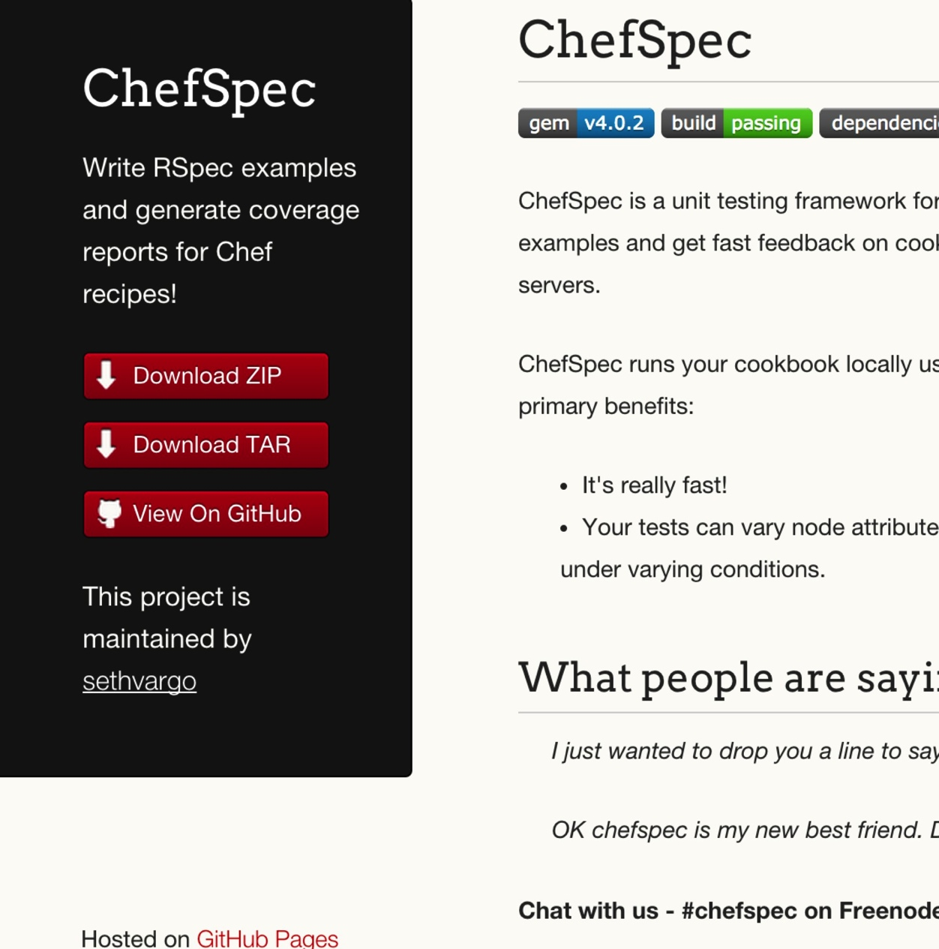
ChefSpec
Test before you converge
Get feedback on cookbook changes without the need for target servers
http://sethvargo.github.io/chefspec/

Slide 86
Write a ChefSpec test
spec/unit/default.rb
require 'spec_helper'
describe 'apache::default' do
context 'When all attributes are default, on an unspecified platform' do
let(:chef_run) do
runner = ChefSpec::ServerRunner.new
runner.converge(described_recipe)
end
it 'converges successfully' do
chef_run # This should not raise an error
end
end
end

Slide 87
Run the ChefSpec tests
rspec spec
.
Finished in 0.00865 seconds (files took 5.5 seconds to load)
1 example, 0 failures

Slide 88
Chef Testing
Did chef-client complete successfully?
Did the recipe put the node in the desired state?
Are the resources properly defined?
Does the code following our style guide?

Slide 89
Clean code
Follow best practices, avoid mistakes

Slide 90

Foodcritic
Check cookbooks for common problems
Style, correctness, deprecations, etc.
Included with ChefDK
http://www.foodcritic.io/

Slide 91
Change our recipe
recipes/default.rb
package_name = "httpd"
package "#{package_name}"
service "httpd" do
action :start
end
template "/var/www/html/index.html" do
source "index.html.erb"
end

Slide 92
Run Foodcritic
foodcritic .
FC002: Avoid string interpolation where not required: ./recipes/default.rb:7

Slide 93
Chef Testing
Did chef-client complete successfully?
Did the recipe put the node in the desired state?
Are the resources properly defined?
Does the code following our style guide?

Slide 94

ChefConf
http://chefconf.com

Slide 95
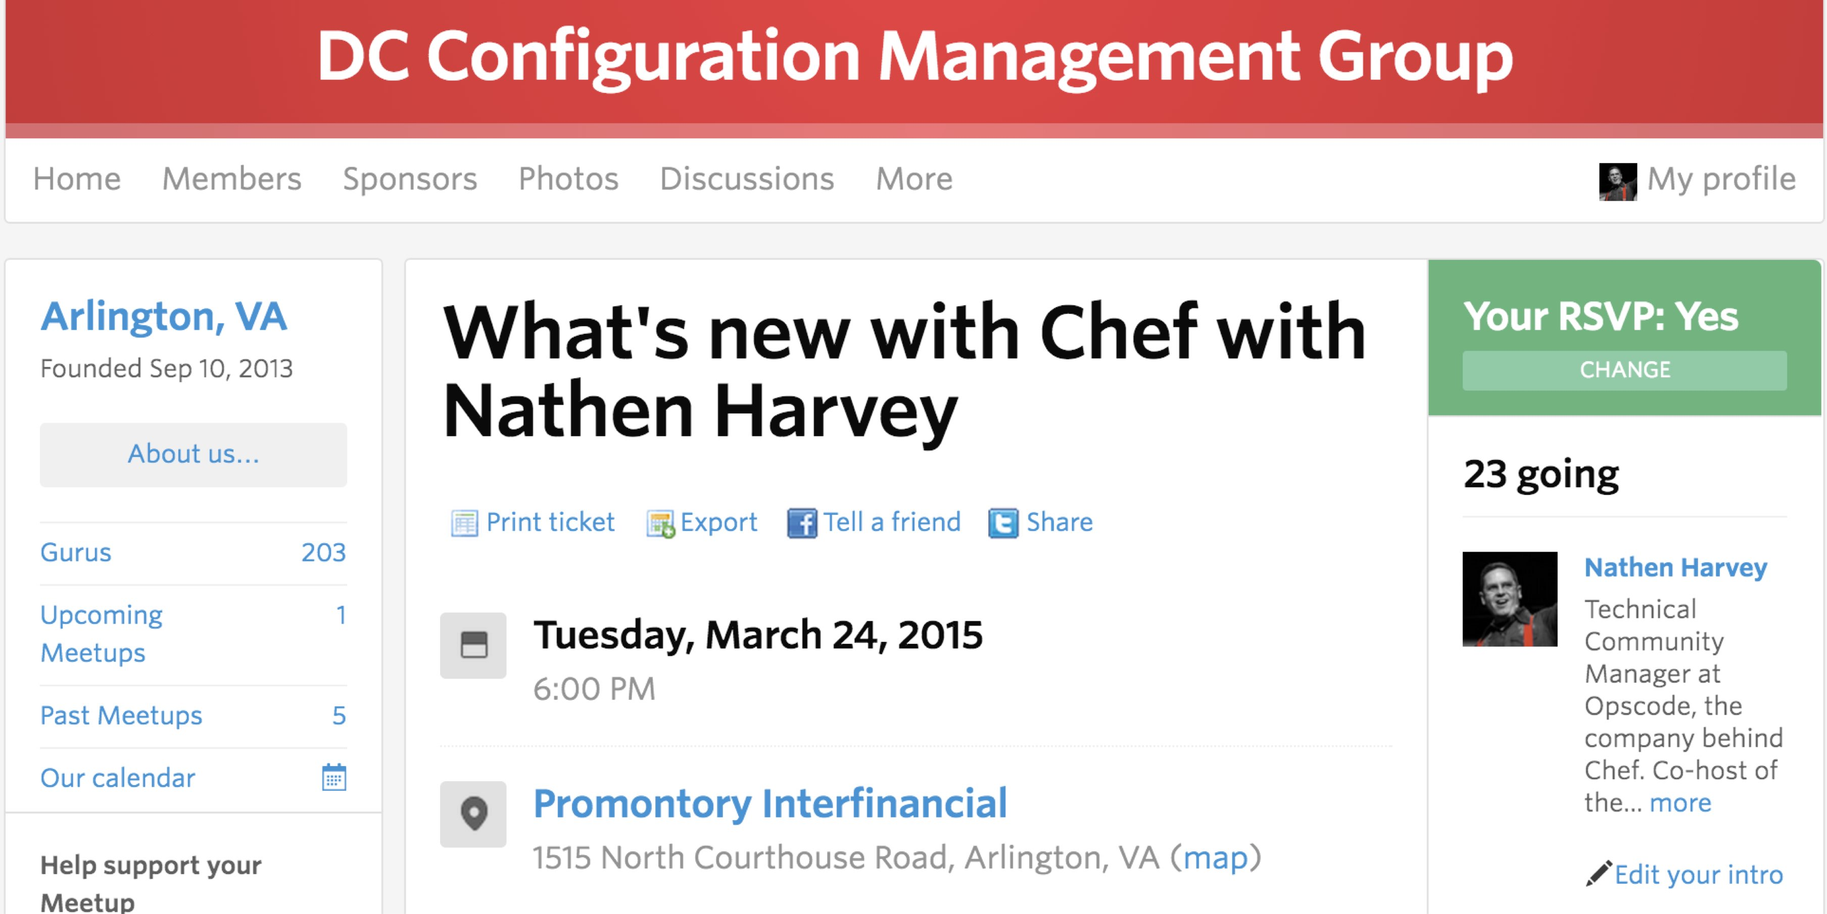
DC Configuration Management Group
http://www.meetup.com/DC-Configuration-Management-Group/events/220951825/

Slide 96
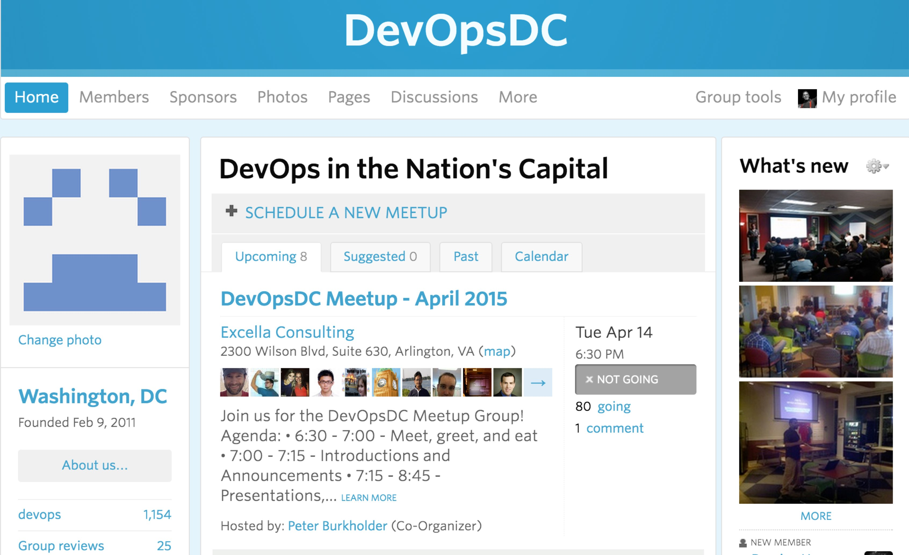
DevOps DC Meetup
http://www.meetup.com/DevOpsDC/

Slide 97
Upcoming Chef Training
Chef Intermediate Topics – April 28-29
Chef Fundamentals – April 30-May 1
Discount code: MEETUP

Slide 98

DevOpsDays DC
June 11-12
USPTO, Alexandria
Now Open
Registration
CFP
Sponsorships
http://www.devopsdays.org/events/2015-washington-dc/

Slide 99
Thank you!
What questions can I answer for you?
nharvey@chef.io
@nathenharvey
http://bit.ly/farmer-nathen (explicit)
http://bit.ly/farmer-nathen-sfw

