Slide 1
Continuous Compliance
Chef Automate and InSpec Profiles

Slide 2
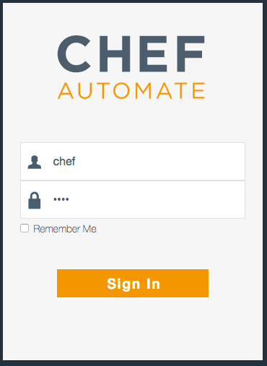
Login to Chef Automate
URL_OF_AUTOMATE_SERVER
Uses a self-signed certificate in this lab
Username: chef
Password: chef
Notes:
>>> INSTRUCTOR NOTE:
Insert the URL of the Chef Automate Server
Walk participants through accepting the self-signed certificate

Slide 3
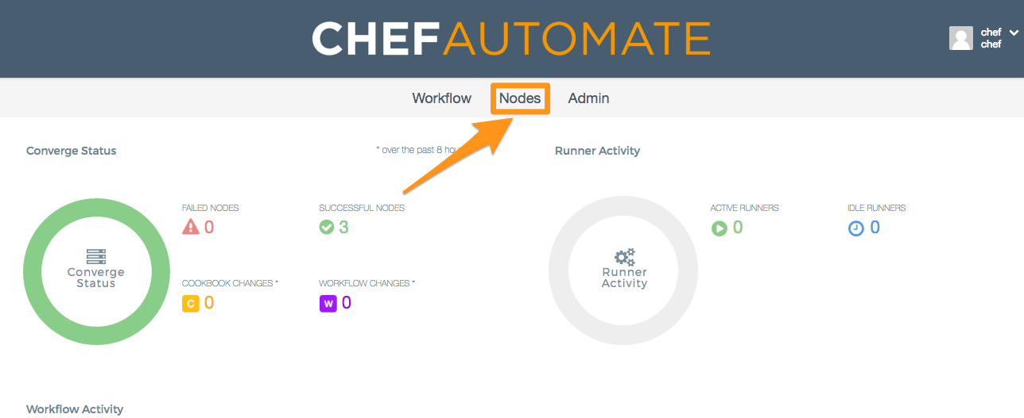
Browse to your node

Slide 4
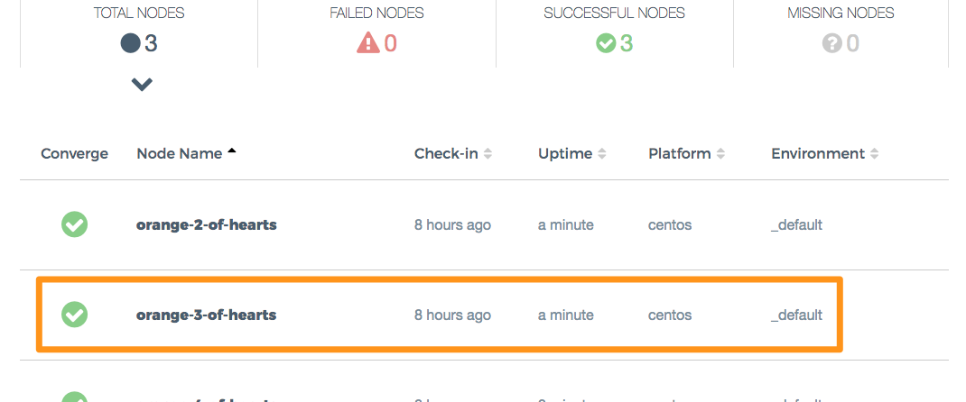
Browse to your node
Notes:
>>> INSTRUCTOR NOTE – You might want to use the orange 3 of hearts as your card, or at least, the 3 of hearts
The slides will use the orange 3 of hearts

Slide 5
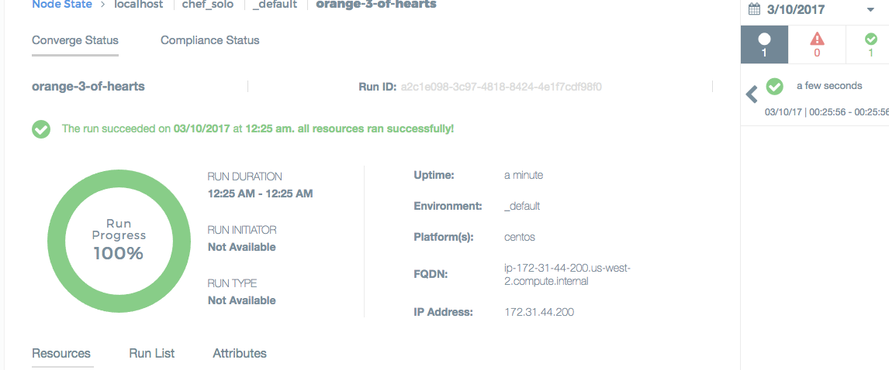
View details of your node
Notes:
>>> INSTRUCTOR NOTE – Simply browse around and show off some of the features of Automate

Slide 6
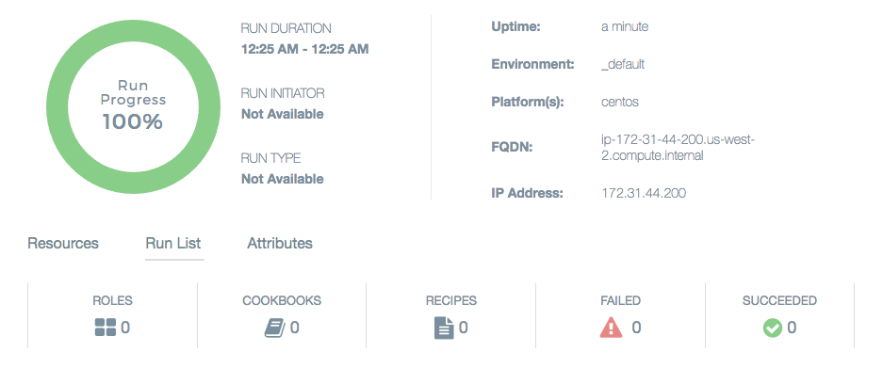
View details of your node
Notes:
>>> INSTRUCTOR NOTE – Simply browse around and show off some of the features of Automate

Slide 7
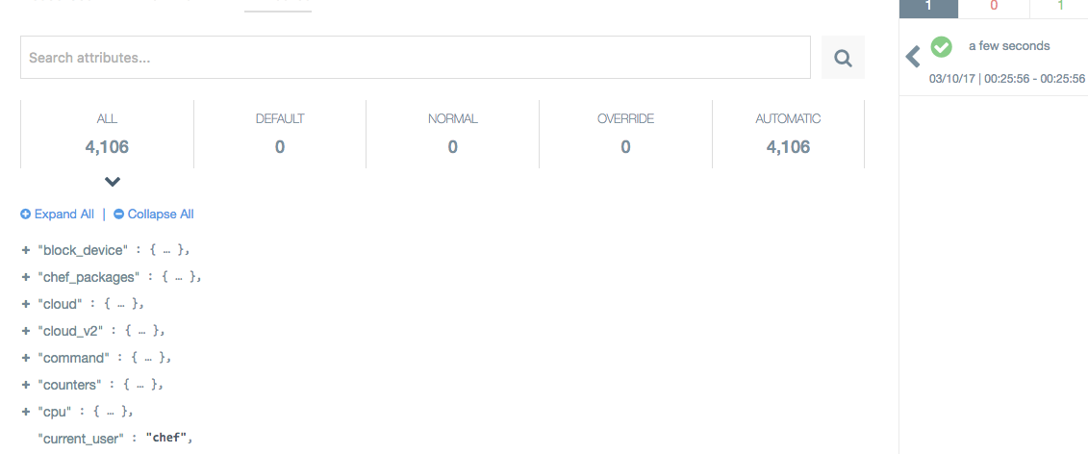
View details of your node
Notes:
>>> INSTRUCTOR NOTE – Simply browse around and show off some of the features of Automate

Slide 8
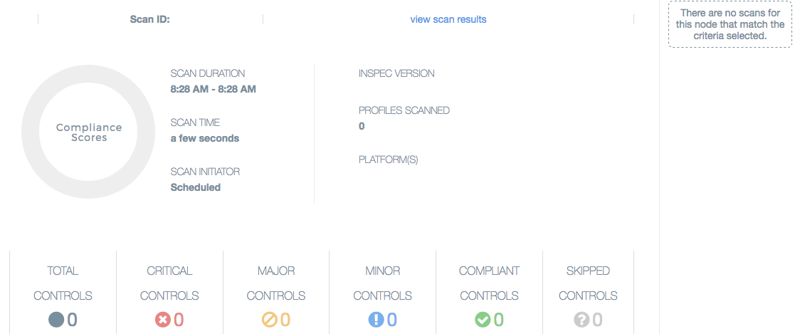
View details of your node
Notes:
>>> INSTRUCTOR NOTE – Simply browse around and show off some of the features of Automate

Slide 9
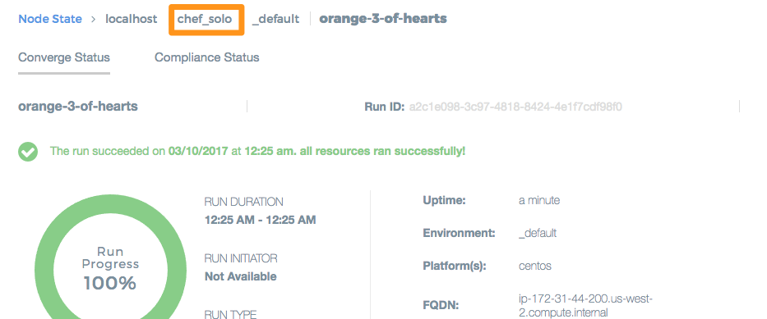
The node uses chef solo
Notes:
>>> INSTRUCTOR NOTE – Point out that we’re using Chef Solo. We’re going to run the node again, this time with a profile

Slide 10
Chef Automate – Node View
View aggregate status of your infrastructure
Overall & trend views of converge status
Overall & trend views of compliance status
Filter & search options
View details of any node
Status of converged resources
Run List applied to the node
Attributes of the node

Slide 11
Chef Solo
Executes chef-client without relying on a Chef server to provide configuration policies (cookbooks, environments, etc.)
https://docs.chef.io/chef_solo.html

Slide 12
Chef Solo
Local directory for configuration policy
Or a URL from which a .tar.gz file can be downloaded
Node objects stored as a local JSON file
Attribute data stored in a JSON file
Local or remote
Does not pull from a Chef Server
Can be configured to send data to a Chef Server
Notes:
Describe some of the differences between chef-client and chef-solo
Next, we’ll look at our own chef-solo setup

Slide 13
Chef Client – Local Mode
Local mode is a way to run the chef-client against the chef-repo on a local machine as if it were running against the Chef server.
https://docs.chef.io/ctl_chef_client.html#run-in-local-mode
Notes:
Chef Client is local mode acts in a very similar way to chef-solo. The Automate server does not distinguish between chef-solo and chef-client --local-mode

Slide 14
Go home
cd ~

Slide 15
Run chef-client in local mode
sudo chef-client --local-mode
[2017-03-10T14:05:49+00:00] INFO: Forking chef instance to converge...
Starting Chef Client, version 12.18.31
...
Converging 0 resources
[2017-03-10T14:05:51+00:00] INFO: Chef Run complete in 0.19413018 seconds
Running handlers:
[2017-03-10T14:05:51+00:00] INFO: Running report handlers
Running handlers complete
[2017-03-10T14:05:51+00:00] INFO: Report handlers complete
Chef Client finished, 0/0 resources updated in 01 seconds
Notes:
Review the output with participants
There is no run list, so no resources are updated

Slide 16
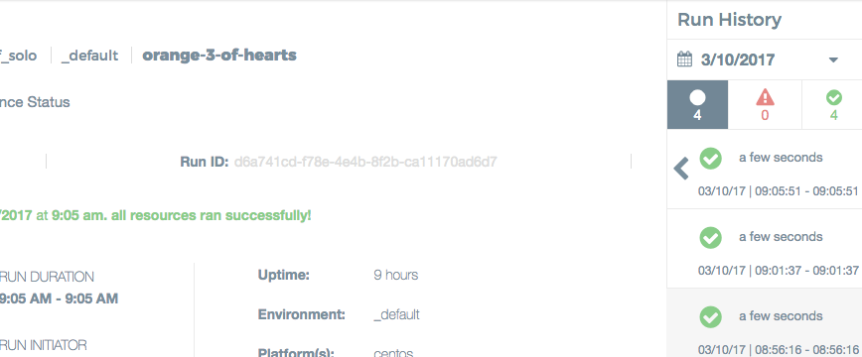
Check the converge status in Automate

Slide 17
Run with additional parameters
sudo chef-client --local-mode -j config.json -r "recipe[audit::default]"
[2017-03-10T14:10:34+00:00] INFO: Forking chef instance to converge...
Starting Chef Client, version 12.18.31
[2017-03-10T14:10:34+00:00] INFO: *** Chef 12.18.31 ***
...
[2017-03-10T14:10:40+00:00] INFO: Chef Run complete in 4.10402964 seconds
Running handlers:
[2017-03-10T14:10:40+00:00] INFO: Running report handlers
[2017-03-10T14:10:40+00:00] WARN: Format is json
[2017-03-10T14:10:40+00:00] INFO: Initialize InSpec
[2017-03-10T14:10:40+00:00] INFO: Running tests from: [{:name=>"ssh", :path=>"/home/chef/profiles/ssh"}]
[2017-03-10T14:10:40+00:00] INFO: Reporting to chef-visibility
...
Running handlers complete
[2017-03-10T14:10:40+00:00] INFO: Report handlers complete
Chef Client finished, 1/2 resources updated in 06 seconds

Slide 18
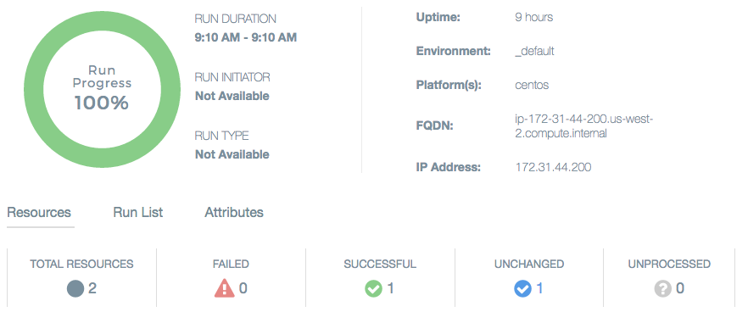
Check the converge status in Automate

Slide 19
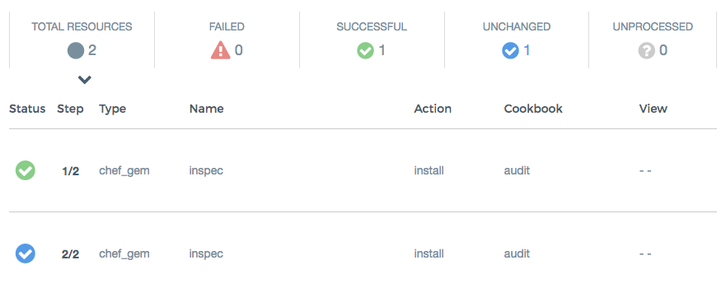
Check the converge status in Automate

Slide 20
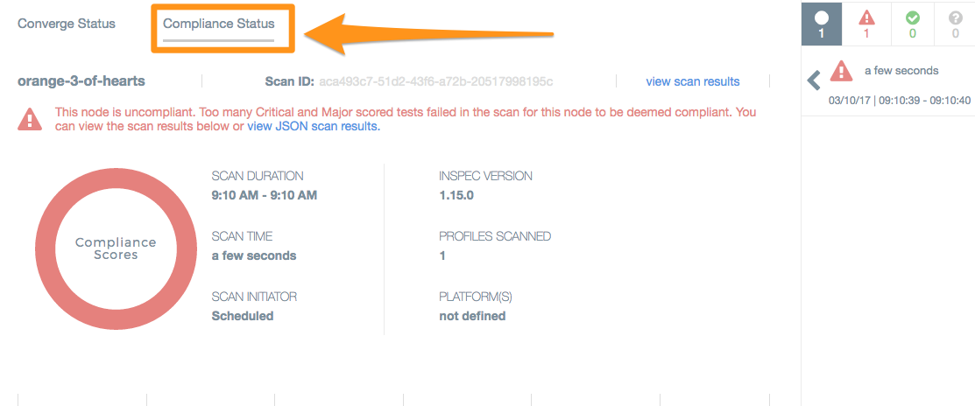
Check the compliance status in Automate

Slide 21
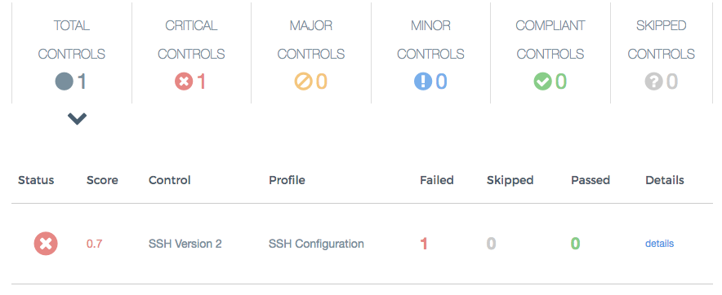
Check the compliance status in Automate

Slide 22
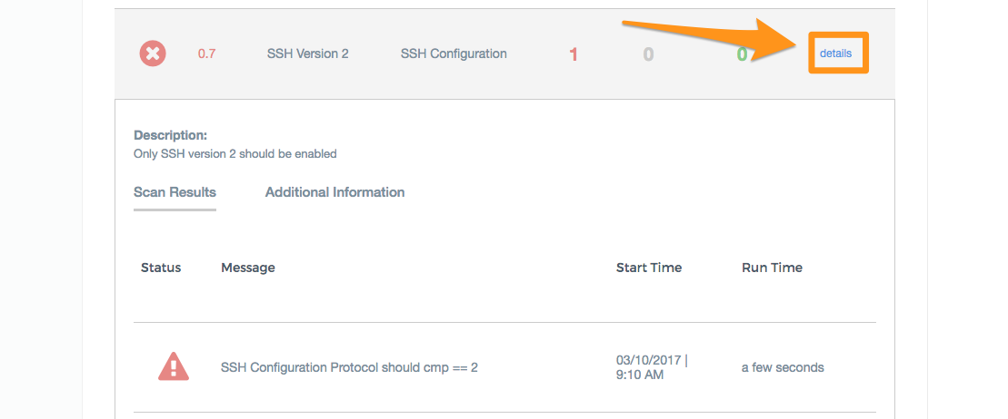
View details of the failing control

Slide 23
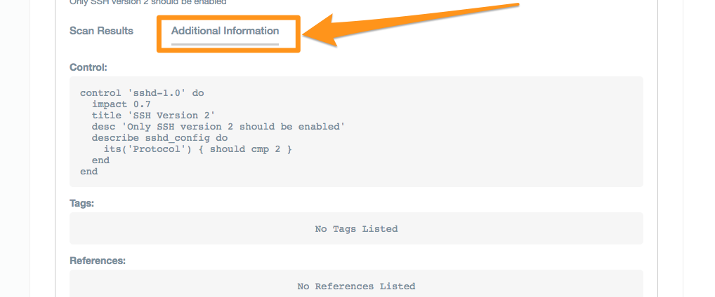
View details of the failing control

Slide 24
Review the set-up
tying it all together

Slide 25
Go home
cd ~

Slide 26
List contents
ls
Berksfile config.json firstname-lastname profiles
Berksfile.lock cookbooks nodes

Slide 27
List cookbooks
ls cookbooks
audit compat_resource

Slide 28
Audit Cookbook
Install InSpec
Run InSpec profiles
Report results to Chef Compliance or Chef Visibility

Slide 29
Compat Resource Cookbook
Adds functionality introduced in the latest chef-client releases to any chef-client from 12.1 onwards.
Includes
Custom Resource functionality
notification improvements
new resources added to core chef
Allows for these new resources in cookbooks without requiring the very latest Chef client release.

Slide 30
config.json
cat config.json
{
"audit": {
"collector": "chef-visibility",
"inspec_version": "1.15.0",
"profiles": [
{
"name": "ssh",
"path": "/home/chef/profiles/ssh"
}
]
}
}
Notes:
Node-specific attributes are specified in a JSON file.
These attributes are used by the audit cookbook.

Slide 31
Local Profiles
tree profiles
profiles/
└── ssh
├── controls
│ └── ssh.rb
├── inspec.lock
└── inspec.yml
2 directories, 3 files

Slide 32
Run Locally with InSpec
inspec exec profiles/ssh
Profile: SSH Configuration (ssh)
Version: 0.1.0
Target: local://
× sshd-1.0: SSH Version 2 (
expected: 2
got:
(compared using `cmp` matcher)
)
× SSH Configuration Protocol should cmp == 2
expected: 2
got:
(compared using `cmp` matcher)
Profile Summary: 0 successful, 1 failures, 0 skipped
Test Summary: 0 successful, 1 failures, 0 skipped

Slide 33
Next Steps
Remediate the failing control
Run the audit cookbook to verify the remediation
View the compliant node in Automate

Slide 34
Remediate the Failing Control

Slide 35
Fix your ssh configuration on your own
Write a cookbook to manage SSH
Manually update the SSH configuration
Notes:
Depending on time and experience with Chef you can do either thing next

Slide 36
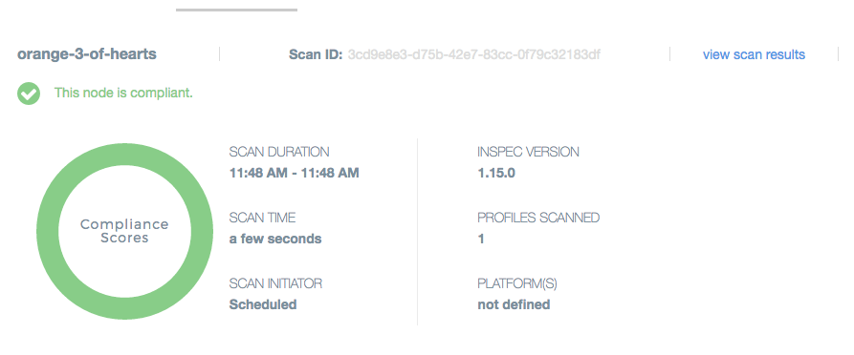
Verify Compliance Status in Automate

Slide 37
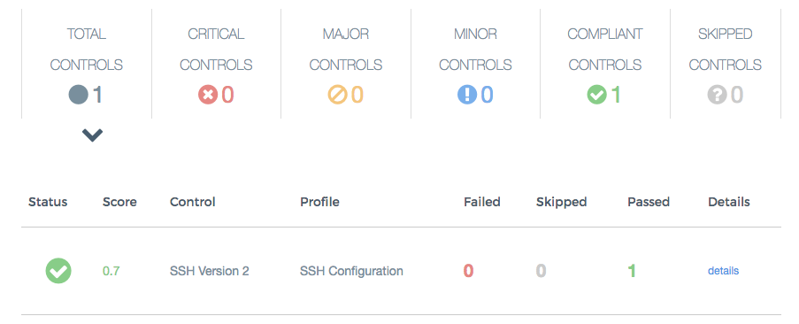
Verify Compliance Status in Automate

