Slide 1
InSpec for Integration Testing

Slide 2
Simple Web Server Cookbook
The Apache web server should be running
The Apache web server should be listening on the default port
The Apache web server should be configured to start on boot

Slide 3
Create a directory for cookbooks
$ mkdir -p ~/cookbooks

Slide 4
Move into the directory for cookbooks
$ cd ~/cookbooks

Slide 5
Generate an apache cookbook
$ chef generate cookbook apache
Generating cookbook apache
- Ensuring correct cookbook file content
- Committing cookbook files to git
- Ensuring delivery configuration
- Ensuring correct delivery build cookbook content
- Adding delivery configuration to feature branch
- Adding build cookbook to feature branch
- Merging delivery content feature branch to master
Your cookbook is ready. Type `cd apache` to enter it.
There are several commands you can run to get started locally developing and testing your cookbook.
Type `delivery local --help` to see a full list.
Why not start by writing a test? Tests for the default recipe are stored at:
test/smoke/default/default_test.rb
If you'd prefer to dive right in, the default recipe can be found at:
recipes/default.rb

Slide 6
Move into the apache cookbook’s directory
$ cd ~/cookbooks/apache
Generating cookbook apache
- Ensuring correct cookbook file content
- Committing cookbook files to git
- Ensuring delivery configuration
- Ensuring correct delivery build cookbook content
- Adding delivery configuration to feature branch
- Adding build cookbook to feature branch
- Merging delivery content feature branch to master
Your cookbook is ready. Type `cd apache` to enter it.
There are several commands you can run to get started locally developing and testing your cookbook.
Type `delivery local --help` to see a full list.
Why not start by writing a test? Tests for the default recipe are stored at:
test/smoke/default/default_test.rb
If you'd prefer to dive right in, the default recipe can be found at:
recipes/default.rb

Slide 7

Remember…
Infrastructure policies need testing
↳ Linting
↳ Static Analysis
↳ Unit Testing
↳ Integration Testing ↳ Compliance Testing
“Infrastructure as Code” should be tested like ANY other codebase.
Notes:
We will be focused on Integration Testing for now

Slide 8
Remember…
Infrastructure policies need testing
↳ Linting
↳ Static Analysis
↳ Unit Testing
↳ Integration Testing ↳ Compliance Testing
“Infrastructure as Code” should be tested like ANY other codebase.
Notes:
We will be focused on Integration Testing for now

Slide 9
Test-driven Development
Write a test, watch it fail
Write some code
Write and run more tests
Code review
Delivery pipeline to production
Lowered chance of production failure
Add a test
pass
Run the tests
fail
Make a little change
pass
[development continues]
fail
Run the tests
pass
[development stops]

Slide 10
Software Testing and Why it Matters
more time
more time
manual
tests
automated
API tests
automated
GUI tests
automated unit tests
automated
integration tests
integration
tests
less time
less time
automated
GUI tests
unit
tests
manual session based tests
automated
component tests
quantity
quantity
Testing builds safety through feedback loops
Inexpensive experiments to provide validation
Reduces risk
Optimize Testing: Do more of the inexpensive testing first!

Slide 11
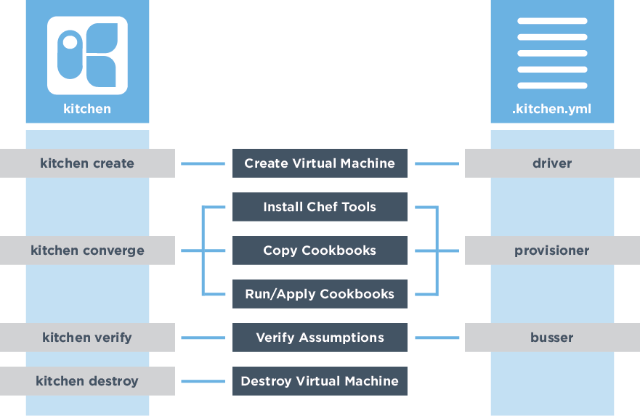



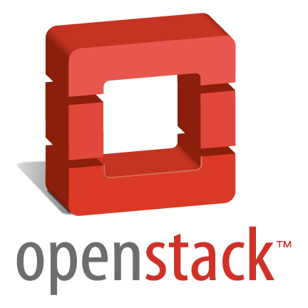
How do we write and test our intended change?
Notes:
So, where do we begin the process of updating the automation code responsible for our Production web servers? Using our local development environment, specifically Test Kitchen, we have the ability to reproduce the security failure. Test Kitchen enables us to write and test our intended infrastructure changes in isolation, including our level of compliance, before sharing them with peers or committing them to source control.
Test Kitchen can leverage various types of cloud environments (private or public), a simple virtualization environment, or Docker containers for such testing.
**Go back to the demo talk track**

Slide 12
What can delivery local do?
$ delivery local --help
delivery-local
Run Delivery phases on your local workstation.
USAGE:
delivery local [FLAGS] <phase>
FLAGS:
-h, --help Prints help information
--no-spinner Disable the spinner
--non-interactive Disable cli interactions
-V, --version Prints version information
ARGS:
<phase> Delivery phase to execute [values: unit, lint, syntax, provision, deploy, smoke, cleanup]

Slide 13
Test Kitchen
Delivery
kitchen list
kitchen create
kitchen converge
kitchen verify
kitchen destroy
kitchen test
kitchen login
[No matching delivery command]
delivery local provision
delivery local deploy
delivery local smoke
delivery local cleanup
[No matching delivery command]
[No matching delivery command]
~/cookbooks/apache/.delivery/project.toml

Slide 14
Update the Kitchen Configuration
~/cookbooks/apache/.kitchen.yml
---
driver:
name: vagrant
name: docker
use_sudo: false

Slide 15
Update the Kitchen Configuration
~/cookbooks/apache/.kitchen.yml
platforms:
- name: ubuntu-16.04
- name: centos-7.2
- name: centos-6.8

Slide 16
Final .kitchen.yml
~/cookbooks/apache/.kitchen.yml
---
driver:
name: docker
use_sudo: false
provisioner:
name: chef_zero
# You may wish to disable always updating cookbooks in CI or other testing environments.
# For example:
# always_update_cookbooks: <%= !ENV['CI'] %>
always_update_cookbooks: true
verifier:
name: inspec
platforms:
- name: centos-6.8
suites:
- name: default
run_list:
- recipe[apache::default]
verifier:
inspec_tests:
- test/smoke/default
attributes:

Slide 17
List Kitchen Instances
$ kitchen list
Instance Driver Provisioner Verifier Transport Last Action Last Error
default-centos-68 Docker ChefZero Inspec Ssh <Not Created> <None>

Slide 18
Run the integration tests
$ delivery local smoke
Chef Delivery
Running Smoke Phase
-----> Starting Kitchen (v1.14.2)
-----> Creating <default-centos-68>...
Sending build context to Docker daemon 193.5 kB
Step 1 : FROM centos:centos7
...
-----> Verifying <default-centos-68>...
Loaded
Target: ssh://kitchen@localhost:32768
User root
✔ should exist
↺ This is an example test, replace with your own test.
Port 80
✔ should not be listening
↺ This is an example test, replace with your own test.
Test Summary: 2 successful, 0 failures, 2 skipped
Finished verifying <default-centos-68> (0m0.45s).
-----> Kitchen is finished. (1m4.44s)

Slide 19
Integration Testing – Add tests
describe package 'httpd' do
it { should be_installed }
end
describe service 'httpd' do
it { should be_running }
it { should be_enabled }
end
describe port(80) do
it { should be_listening }
end
Add a test
pass
Run the tests
fail
Make a little change
pass
[development continues]
fail
Run the tests
pass
[development stops]

Slide 20
Resource: package
describe package('name') do
it { should be_installed }
end
where
('name') must specify the name of a package, such as 'nginx'
be_installed is a valid matcher for this resource
Use the package resource to test if the named package and/or package version is installed on the system.

Slide 21
Resource: service
describe service('service_name') do
it { should be_installed }
it { should be_enabled }
it { should be_running }
end
Use the service resource to test if the named service is installed, running and/or enabled.

Slide 22
Resource: port
describe port(514) do
it { should be_listening }
end
Use the port InSpec audit resource to test basic port properties, such as port, process, if it’s listening.

Slide 23
Run the Integration Test
$ delivery local smoke
System Package
∅ httpd should be installed
expected that `System Package httpd` is installed
Service httpd
∅ should be running
expected that `Service httpd` is running
∅ should be enabled
expected that `Service httpd` is enabled
Port 80
∅ should be listening
expected `Port 80.listening?` to return true, got false
Test Summary: 0 successful, 4 failures, 0 skipped

Slide 24
Integration Testing – Make a change
package 'httpd' do
action :install
end
service 'httpd' do
action [ :start, :enable ]
end
Add a test
pass
Run the tests
fail
Make a little change
pass
[development continues]
fail
Run the tests
pass
[development stops]

Slide 25
Apply the change
$ delivery local deploy
Chef Delivery
Running Deploy Phase
-----> Starting Kitchen (v1.14.2)
-----> Converging <default-centos-68>...
Preparing files for transfer
Preparing dna.json
Resolving cookbook dependencies with Berkshelf 5.2.0...
...
Recipe: apache::default
* yum_package[httpd] action install
- install version 2.2.15-56.el6.centos.3 of package httpd
* service[httpd] action start
- start service service[httpd]
* service[httpd] action enable
- enable service service[httpd]
Running handlers:
Running handlers complete
Chef Client finished, 3/3 resources updated in 06 seconds
Finished converging <default-centos-68> (0m11.54s).
-----> Kitchen is finished. (0m12.42s)

Slide 26
Run the Integration Test
$ delivery local smoke
System Package
✔ httpd should be installed
Service httpd
✔ should be running
✔ should be enabled
Port 80
✔ should be listening
Test Summary: 4 successful, 0 failures, 0 skipped
Finished verifying <default-centos-68> (0m0.58s).
-----> Kitchen is finished. (0m1.46s)

Slide 27
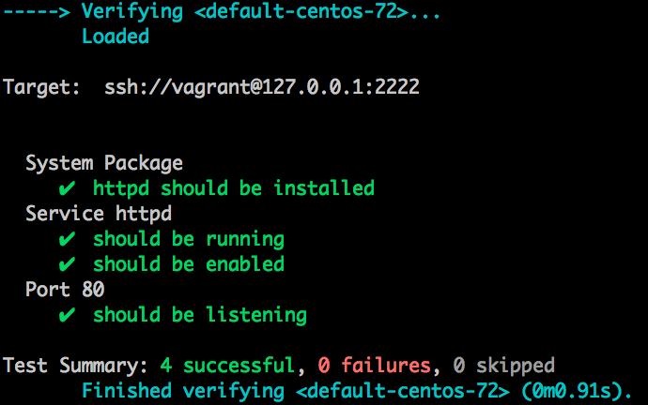
Integration Testing – Run the tests
Add a test
pass
Run the tests
fail
Make a little change
pass
[development continues]
fail
Run the tests
pass
[development stops]
Notes:
Static screen shot

Slide 28
Simple Web Server Cookbook
The Apache web server should be running
The Apache web server should be listening on the default port
The Apache web server should be configured to start on boot

Slide 29
Software Testing and Why it Matters
more time
more time
manual
tests
automated
API tests
automated
GUI tests
automated unit tests
automated
integration tests
integration
tests
less time
less time
automated
GUI tests
unit
tests
manual session based tests
automated
component tests
quantity
quantity
Testing builds safety through feedback loops
Inexpensive experiments to provide validation
Reduces risk
Optimize Testing: Do more of the inexpensive testing first!

Slide 30
Additional Testing
What command would you use to complete lint testing?
What command would you use to complete syntax testing?
What command would you run to complete unit tests?
What additional kitchen-related commands should we run?
How would you InSpec exec your tests over the docker protocol?
Notes:
runner = ChefSpec::ServerRunner.new(:platform => 'centos', :version => '6.8')
inspec exec ssh -t docker://65280217fe65

Slide 31
Objectives
Execute an InSpec test on a local machine
Execute an InSpec test on a remote machine
Generate an InSpec profile
Add InSpec-based integration test to a Chef cookbook
Run InSpec-based integrations tests during Chef cookbook development
List additional resources and places to look for support with InSpec

