Slide 1
InSpec
Compliance as Code

Slide 2

InSpec is compliance as code – a human-readable language for automating the continuous testing and compliance auditing of your entire infrastructure.

Slide 3

Compliance as Code
ACCELERATED CYCLE
ROLE OF THE COMPLIANCE OFFICER
Manual Compliance
Compliance at Velocity
Separate certification & testing
INFRASTRUCTURE
AS CODE
Common language for describing & applying policy
Reactive engagement
Proactive engagement
Checking implementations by hand
Expressing policy as testable code
POLICY
AS CODE
PRACTICE
AS CODE
Short term compliance
Long term process improvement
Compliance at velocity
One language, One workflow

Slide 4
SSH Control
SSH supports two different protocol versions. The original version, SSHv1, was subject to a number of security issues. Please use SSHv2 instead to avoid these.

Slide 5
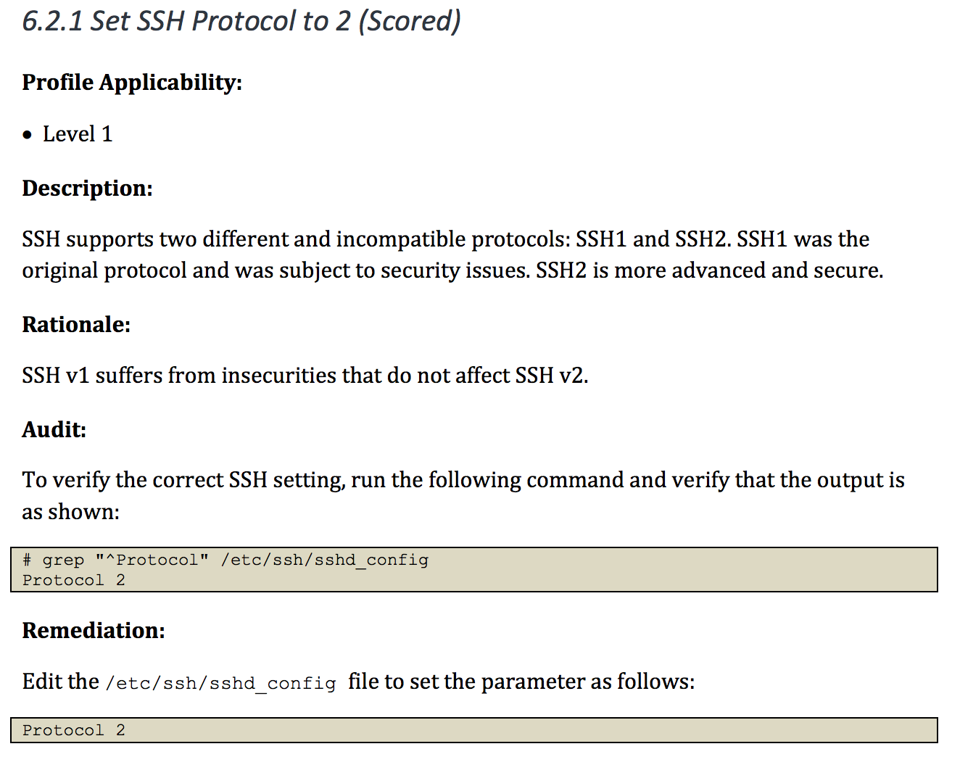
Mapping Compliance Document to InSpec
control 'ssh-6.2.1' do
title 'Set SSH Protocol to 2'
end

Slide 6
Mapping Compliance Document to InSpec
control 'ssh-6.2.1' do
title 'Set SSH Protocol to 2'
desc "
SSH supports two different ...
"
end

Slide 7
Mapping Compliance Document to InSpec
control 'ssh-6.2.1' do
title 'Set SSH Protocol to 2'
desc "
SSH supports two different ...
"
describe sshd_config do
its('Protocol') { should cmp('2') }
end
end

Slide 8
Mapping Compliance Document to InSpec
control 'ssh-6.2.1' do
impact 1.0
title 'Set SSH Protocol to 2'
desc "
SSH supports two different ...
"
describe sshd_config do
its('Protocol') { should cmp('2') }
end
end

Slide 9
Differences in verifying compliance policy
DOCUMENTATION
SSH supports two different protocol versions. The original version, SSHv1, was subject to a number of security issues. Please use SSHv2 instead to avoid these.
SCRIPTING TOOLS
COMPLIANCE LANGUAGE
> grep "^Protocol" /etc/ssh/sshd_config | sed 's/Protocol //'
2
control 'ssh-1234' do
impact 1.0
title 'Server: Set protocol version to SSHv2'
desc "
Set the SSH protocol version to 2. Don't use legacy
insecure SSHv1 connections anymore...
"
describe sshd_config do
its('Protocol') { should eq 2 }
end
end
COMPLIANCE LANGUAGE
describe sshd_config do
its('Protocol') { should eq 2 }
end

Slide 10





InSpec
ONE LANGUAGE
InSpec for Windows
control 'windows-base-201' do
impact 1.0
title 'Strong Windows NTLMv2 Authentication Enabled; Weak LM
Disabled'
desc '
@link: http://support.microsoft.com/en-us/kb/823659
'
describe registry_key
('HKLM\System\CurrentControlSet\Control\Lsa') do
it { should exist }
its('LmCompatibilityLevel') { should eq 4 }
end
end

Slide 11
InSpec
ONE LANGUAGE
Baremetal
VMs
Containers

Slide 12
Different ways to run InSpec
No ruby/agent on the node
No ruby/agent on the node
no SSH/agent in the container
Test your machine locally
> inspec exec test.rb
Test a machine remotely via SSH
> inspec exec test.rb -i identity.key -t ssh://root@172.17.0.1
Test a machine remotely via WinRM
> inspec exec test.rb -t winrm://Admin@192.168.1.2 --password super
Test Docker Container
> inspec exec test.rb -t docker://5cc8837bb6a8

Slide 13
InSpec
ONE LANGUAGE
Database Testing
Baremetal
VMs
Containers
Databases
API endpoints (e.g. cloud)
describe mysql_session.query("SELECT user,host FROM mysql.user WHERE host = '%'") do
its(:stdout) { should be empty }
end
Cloud Provider Testing
security_groups.each do |security_group|
describe security_group do
it { should_not have_inbound_rule().with_source('0.0.0.0/0') }
end
end

Slide 14



InSpec
ONE WORKFLOW
Security meets operations
COMPLIANCE
SECURITY
DEVOPS

Slide 15




InSpec
Each team uses separate tools
Unified language
COMPLIANCE
COMPLIANCE
SECURITY
DEVOPS
SECURITY
DEVOPS

Slide 16
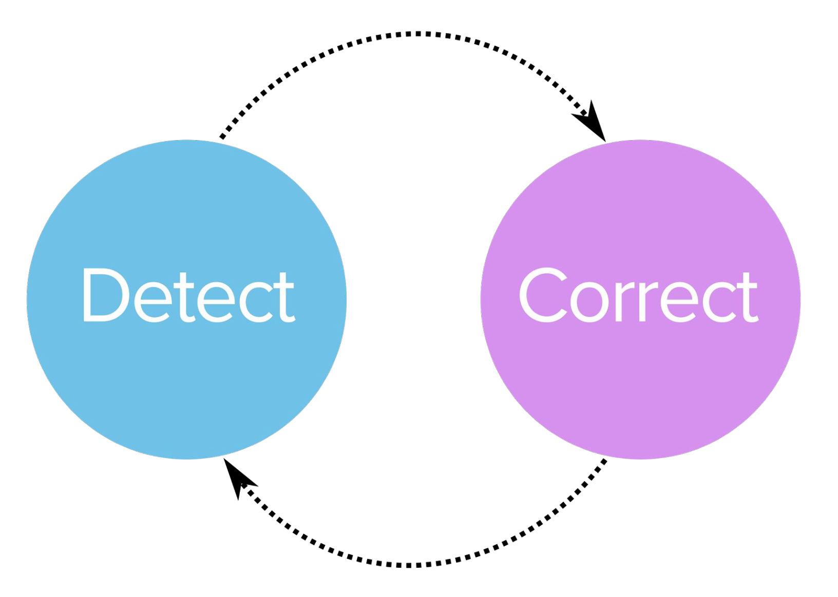
Continuous Workflow
Detect
Correct

Slide 17






InSpec
Turn security and compliance into code
PART OF A PROCESS OF CONTINUOUS COMPLIANCE
Translate compliance into Code
Clearly express statements of policy
Move risk to build/test from runtime
Find issues early
Write code quickly
Run code anywhere
Inspect machines, data, and APIs
Scan for Compliance
Build & Test Locally
Build & Test CI/CD
Remediate
Verify
A SIMPLE EXAMPLE OF AN INSPEC CIS RULE
control ‘cis-1.4.1’ do
title ‘1.4.1 Enable SELinux in /etc/grub.conf’
desc ‘
Do not disable SELinux and enforcing in your GRUB configuration. These are important security features that prevent attackers from escalating their access to your systems. For reference see …
‘
impact 1.0
expect(grub_conf.param ‘selinux’).to_not eq ‘0’
expect(grub_conf.param ‘enforcing’).to_not eq ‘0’
end

