Slide 1
InSpec CLI
Command Line Interface

Slide 2
Objectives
Create and execute a simple compliance check

Slide 3
Ensure SSH Protocol is set to 2
Review the Center for Internet Security control
Create an InSpec profile to verify the control
Execute the InSpec profile to determine current system state

Slide 4

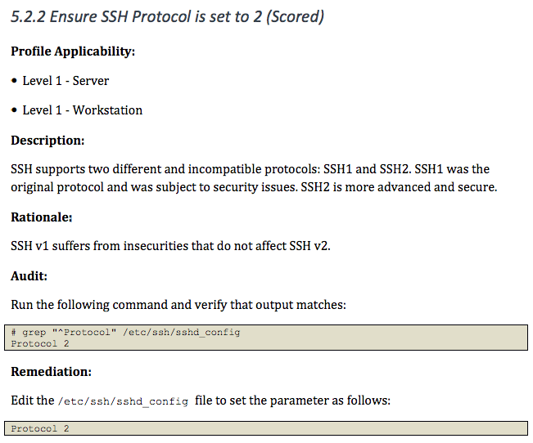
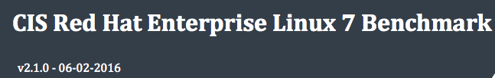
Compliance Mandate

Slide 5
Run InSpec
$ inspec
Commands:
inspec archive PATH # archive a profile to tar.gz (default) or zip
inspec artifact SUBCOMMAND ... # Sign, verify and install artifacts
inspec check PATH # verify all tests at the specified PATH
inspec compliance SUBCOMMAND ... # Chef Compliance commands
inspec detect # detect the target OS
inspec env # Output shell-appropriate completion configuration
inspec exec PATHS # run all test files at the specified PATH.
inspec help [COMMAND] # Describe available commands or one specific command
inspec init TEMPLATE ... # Scaffolds a new project
inspec json PATH # read all tests in PATH and generate a JSON summary
inspec shell # open an interactive debugging shell
inspec supermarket SUBCOMMAND ... # Supermarket commands
inspec vendor PATH # Download all dependencies and generate a lockfile in a `vendor` directory
inspec version # prints the version of this tool
Options:
l, [--log-level=LOG_LEVEL] # Set the log level: info (default), debug, warn, error
[--log-location=LOG_LOCATION] # Location to send diagnostic log messages to. (default: STDOUT or STDERR)
[--diagnose], [--no-diagnose] # Show diagnostics (versions, configurations)

Slide 6
Questions
What version of InSpec is installed?
What type(s) of projects with inspec init generate?

Slide 7
Build scaffold for an ssh profile
$ inspec init profile ssh
Create new profile at /home/ec2-user/ssh
* Create file README.md
* Create directory controls
* Create file controls/example.rb
* Create file inspec.yml
* Create directory libraries

Slide 8
Open the example control
/home/ec2-user/ssh/controls/example.rb
# encoding: utf-8
# copyright: 2015, The Authors
# license: All rights reserved
title 'sample section'
# you can also use plain tests
describe file('/tmp') do
it { should be_directory }
end
# you add controls here
control 'tmp-1.0' do # A unique ID for this control
impact 0.7 # The criticality, if this control fails.
title 'Create /tmp directory' # A human-readable title
desc 'An optional description...'
describe file('/tmp') do # The actual test
it { should be_directory }
end
end

Slide 9
Execute the example control
$ inspec exec ssh
Profile: InSpec Profile (ssh)
Version: 0.1.0
Target: local://
✔ tmp-1.0: Create /tmp directory
✔ File /tmp should be directory
File /tmp
✔ should be directory
Profile Summary: 1 successful, 0 failures, 0 skipped
Test Summary: 2 successful, 0 failures, 0 skipped

Slide 10
Rename the example control
$ mv ~/ssh/controls/example.rb ~/ssh/controls/server.rb

Slide 11
Rewrite the control
/home/ec2-user/ssh/controls/example.rb
# 5.2.2 Ensure SSH Protocol is set to 2
#
# grep "^Protocol" /etc/ssh/sshd_config
# Protocol 2
#
describe file('/etc/ssh/sshd_config') do
its('content') { should match /^Protocol 2/ }
end

Slide 12
Execute the control
$ inspec exec ssh
Profile: InSpec Profile (ssh)
Version: 0.1.0
Target: local://
File /etc/ssh/sshd_config
∅ content should match /^Protocol 2/
expected "# This config file was generated by Chef\n\n# $OpenBSD: sshd_config,v 1.93 2014/01/10 05:59:19...XMODIFIERS\n\n# override default of no subsystems\nSubsystem sftp /usr/libexec/openssh/sftp-server" to match /^Protocol 2/
Diff:
@@ -1,2 +1,78 @@
-/^Protocol 2/
+# This config file was generated by Chef
...
+Subsystem sftp /usr/libexec/openssh/sftp-server
Test Summary: 0 successful, 1 failures, 0 skipped

Slide 13
Wait a minute…
Where did its('content') come from?
What other file attributes can we write tests for?
Where does one go to find out more information about these resources?

Slide 14
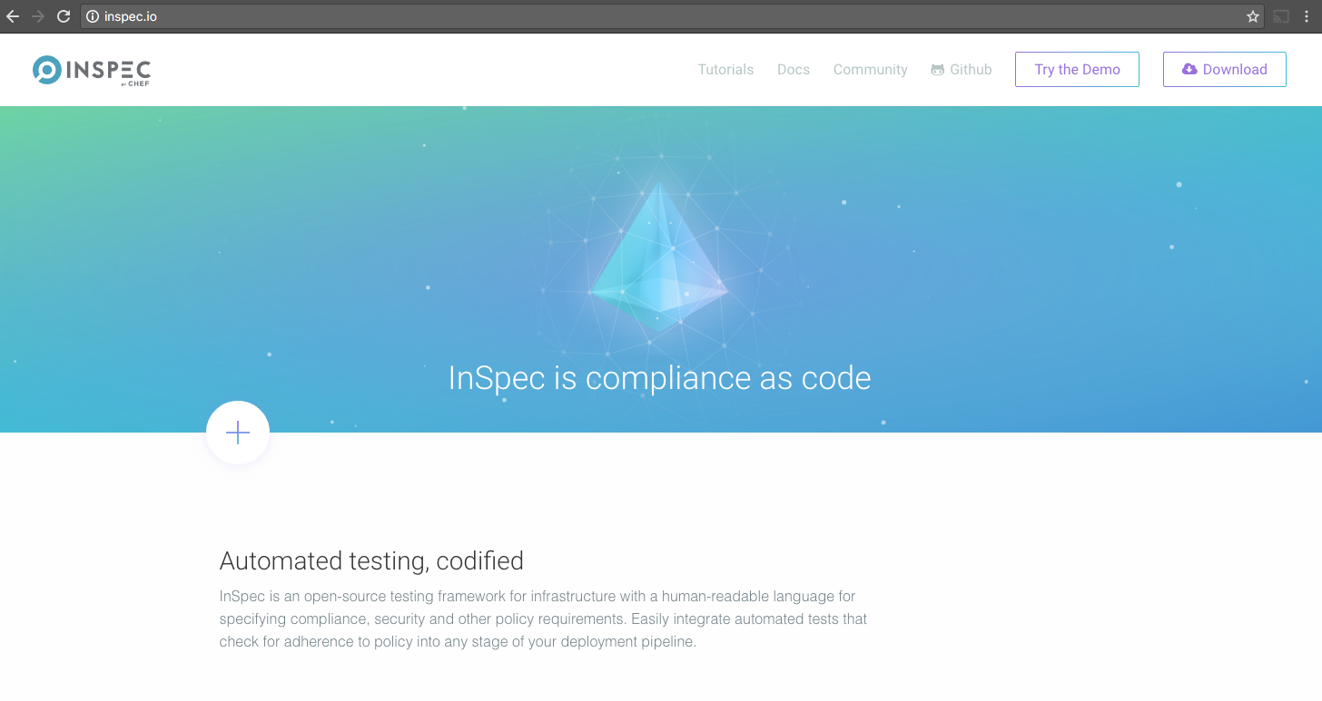

Slide 15
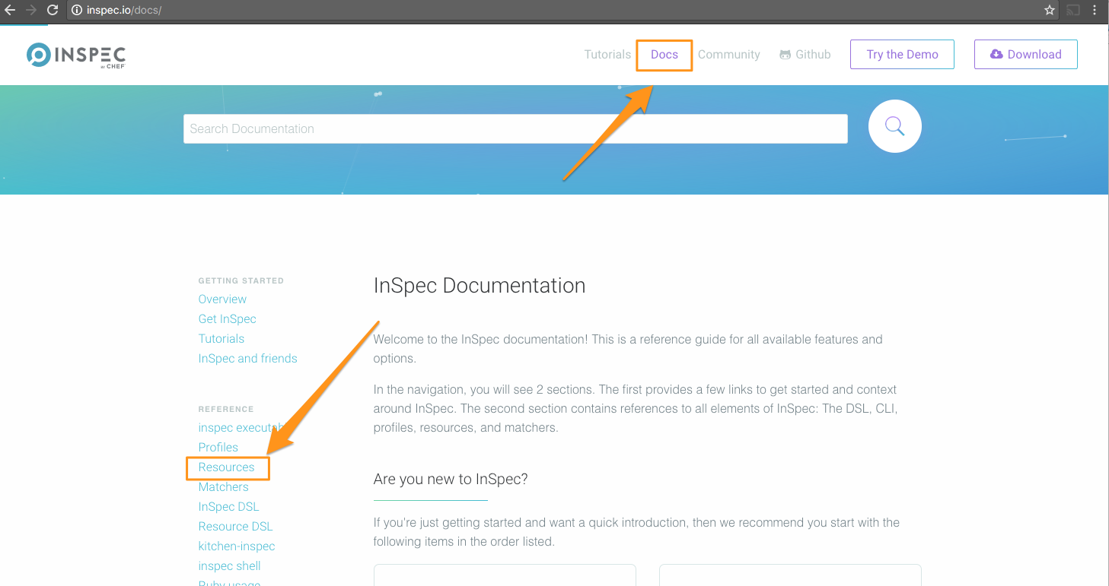

Slide 16
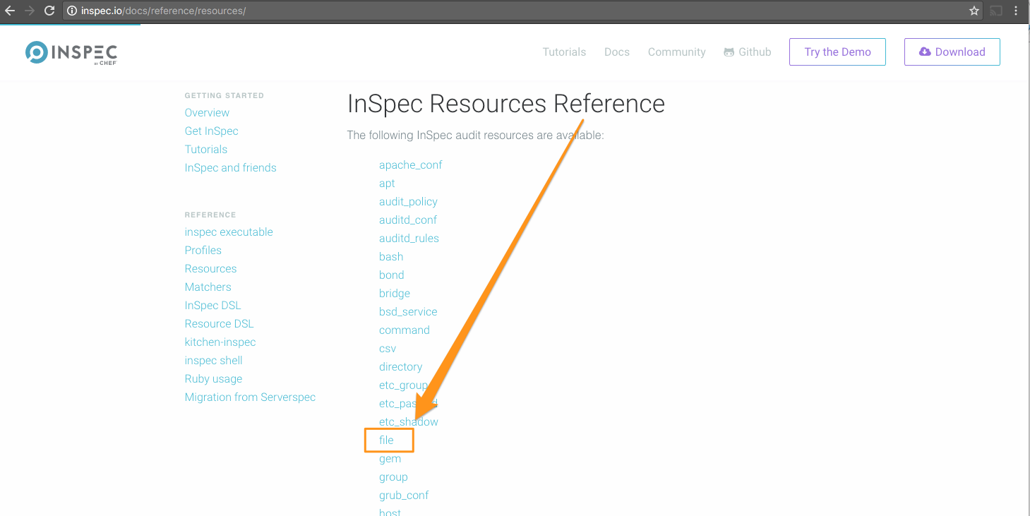

Slide 17
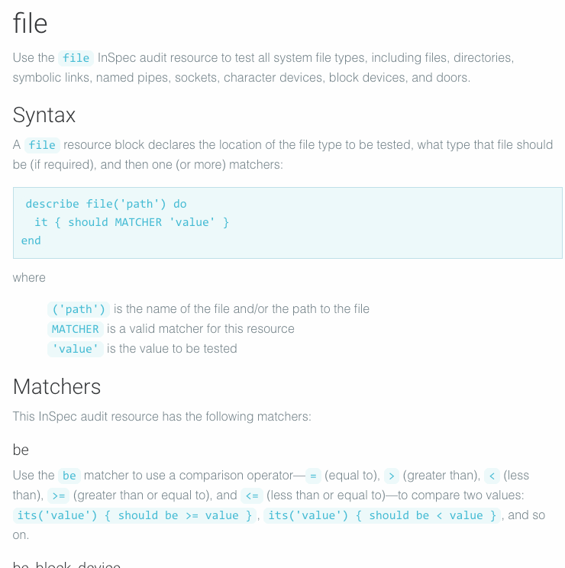

Slide 18
File Resource
describe file('path') do
it { should MATCHER 'value' }
end
Use the file resource to test all system file types, including files, directories, symbolic links, named pipes, sockets, character devices, block devices, and doors.

Slide 19
Test if a file exists
describe file('/tmp') do
it { should exist }
end

Slide 20
Test if a path is a directory
describe file('/tmp') do
its('type') { should eq :directory }
it { should be_directory }
end

Slide 21
Content Matcher
describe file('/etc/ssh/sshd_config') do
its('content') { should match /^Protocol 2/ }
end
The content matcher tests if contents in the file match the value specified in a regular expression. The values of the content matcher are arbitrary and depend on the file type being tested and also the type of information that is expected to be in that file

Slide 22
Ensure SSH Protocol is set to 2
Review the Center for Internet Security control
Create an InSpec profile to verify the control
Execute the InSpec profile to determine current system state

Slide 23
There are some problems!
Location of the SSH server configuration is hard-coded
Regular expressions are difficult

Slide 24
Refactor our control
Use a different resource

Slide 25
Which resource
Is there a better resource that we could use?
What might a refactored test look like?

Slide 26
Refactored Control
/home/ssh/controls/server.rb
describe sshd_config do
its('Protocol') { should cmp 2 }
end

Slide 27
Resource: sshd_config
describe sshd_config('path') do
its('name') { should include('foo') }
end
where
name is a configuration setting in sshd_config
('path') is the non-default /path/to/sshd_config
{ should include('foo') } tests the value of name as read from sshd_config versus the value declared in the test
Use the sshd_config resource to test configuration data for the OpenSSH daemon located at /etc/ssh/sshd_config on Linux and Unix platforms.

Slide 28
Execute the control
$ inspec exec ssh
SSH Configuration
∅ Protocol should cmp == 2
expected: 2
got:
(compared using `cmp` matcher)
Test Summary: 0 successful, 1 failures, 0 skipped

Slide 29
Refactor our control
Use a different resource

Slide 30
Execute profile on a remote machine
Execute your ssh profile against the instructor’s machine

Slide 31
Different ways to run InSpec
No ruby/agent on the node
No ruby/agent on the node
no SSH/agent in the container
Test your machine locally
> inspec exec test.rb
Test a machine remotely via SSH
> inspec exec test.rb -i identity.key -t ssh://root@172.17.0.1
Test a machine remotely via WinRM
> inspec exec test.rb -t winrm://Admin@192.168.1.2 --password super
Test Docker Container
> inspec exec test.rb -t docker://5cc8837bb6a8

Slide 32
Execute the control
$ inspec exec ssh -t ssh://ec2-35-156-226-39.eu-central-1.compute.amazonaws.com --user=chef --password=chef
SSH Configuration
∅ Protocol should cmp == 2
expected: 2
got:
(compared using `cmp` matcher)
Test Summary: 0 successful, 1 failures, 0 skipped

Slide 33
Execute profile on a remote machine
Execute your ssh profile against the instructor’s machine

Slide 34
Enrich our profile
Add additional metadata to our control

Slide 35
Compliance Mandate

Slide 36
Server Control
/home/ssh/controls/server.rb
describe sshd_config do
its('Protocol') { should cmp 2 }
end

Slide 37
Enriched Server Control
/home/ssh/controls/server.rb
control '5.2.2' do
impact 1.0
title 'Ensure SSH Protocol is set to 2'
desc <<-EOF
SSH supports two different and incompatible protocols: SSH1 and SSH2.
SSH1 was the original protocol and was subject to security issues.
SSH2 is more advanced and secure.
SSH v1 suffers from insecurities that do not affect SSH v2.
EOF
tag 'ssh', 'sshd', 'server', 'workstation'
ref 'SSH Protocol', url: 'https://access.redhat.com/documentation/en-US/Red_Hat_Enterprise_Linux/7/html/System_Administrators_Guide...'
describe sshd_config do
its('Protocol') { should cmp 2 }
end
end

Slide 38
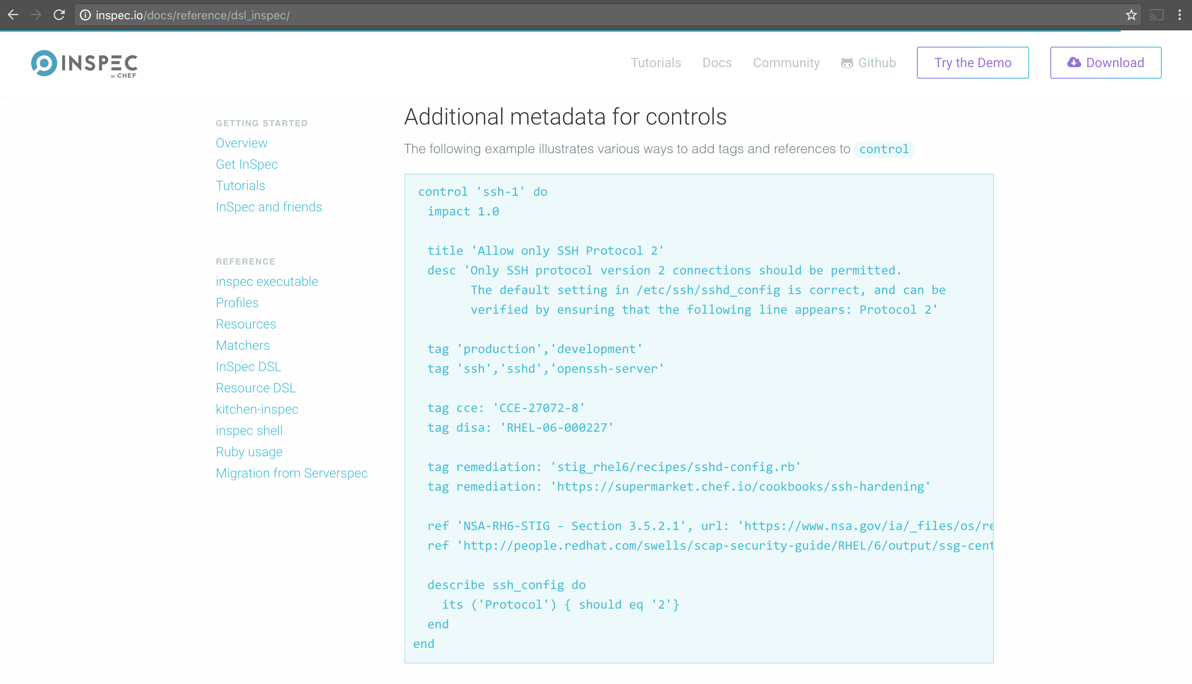

Slide 39
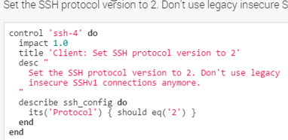
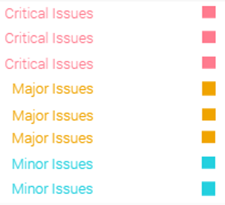
Compliance Profile Severity Mapping
The table below shows the current mapping of Compliance Profile impact numbering to severity.
Impact Numbering | Severity Designation
0.7 - 1.0 | Critical Issues
0.4 - <0.7 | Major Issues
0 - <0.4 | Minor Issues
https://nvd.nist.gov/cvss.cfm
Notes:
Here is the current mapping of Compliance Profile impact numbering to severity.
The image at the top-right shows a Compliance Profile's impact numbering.
The table at the bottom-left shows the current mapping of Compliance Profile impact numbering to severity.
The image at the bottom-right is an example of the severities listed in the reports in the Compliance web UI.
The mapping is currently analogous to the Common Vulnerability Scoring System (CVSS) framework, which can be viewed via the link at the bottom of this slide.
This mapping will be made configurable in the future.

Slide 40
Execute the control
$ inspec exec ssh
× 5.2.2: Ensure SSH Protocol is set to 2 (
expected: 2
got:
(compared using `cmp` matcher)
)
× SSH Configuration Protocol should cmp == 2
expected: 2
got:
(compared using `cmp` matcher)

Slide 41
Enrich our profile
Add additional metadata to our control

Slide 42
Objectives
Execute an InSpec test on a local machine
Execute an InSpec test on a remote machine
Generate an InSpec profile
Add InSpec-based integration test to a Chef cookbook
Run InSpec-based integrations tests during Chef cookbook development
List additional resources and places to look for support with InSpec

