Slide 1
Remediate Failing SSH Control

Slide 2
Simple SSH Cookbook
A server recipe to manage the sshd_config file
Local test environment configured

Slide 3
Move to the cookbooks directory
cd ~/cookbooks

Slide 4
Generate an ssh cookbook
chef generate cookbook ssh
Generating cookbook ssh
- Ensuring correct cookbook file content
- Committing cookbook files to git
- Ensuring delivery configuration
- Ensuring correct delivery build cookbook content
- Adding delivery configuration to feature branch
- Adding build cookbook to feature branch
- Merging delivery content feature branch to master
Your cookbook is ready. Type `cd ssh` to enter it.
There are several commands you can run to get started locally developing and testing your cookbook.
Type `delivery local --help` to see a full list.
Why not start by writing a test? Tests for the default recipe are stored at:
test/smoke/default/default_test.rb
If you'd prefer to dive right in, the default recipe can be found at:
recipes/default.rb

Slide 5
Add a server recipe to the ssh cookbook
chef generate recipe ssh server
Recipe: code_generator::recipe
* directory[./ssh/spec/unit/recipes] action create (up to date)
* cookbook_file[./ssh/spec/spec_helper.rb] action create_if_missing (up to date)
* template[./ssh/spec/unit/recipes/server_spec.rb] action create_if_missing
- create new file ./ssh/spec/unit/recipes/server_spec.rb
- update content in file ./ssh/spec/unit/recipes/server_spec.rb from none to d14960
(diff output suppressed by config)
* directory[./ssh/test/smoke/default] action create (up to date)
* template[./ssh/test/smoke/default/server.rb] action create_if_missing
- create new file ./ssh/test/smoke/default/server.rb
- update content in file ./ssh/test/smoke/default/server.rb from none to aa8bba
(diff output suppressed by config)
* template[./ssh/recipes/server.rb] action create
- create new file ./ssh/recipes/server.rb
- update content in file ./ssh/recipes/server.rb from none to 18f24e
(diff output suppressed by config)

Slide 6
Add a template to the cookbook
chef generate template ssh sshd_config -s /etc/ssh/sshd_config
Recipe: code_generator::template
* directory[./ssh/templates/default] action create
- create new directory ./ssh/templates/default
* file[./ssh/templates/sshd_config.erb] action create
- create new file ./ssh/templates/sshd_config.erb
- update content in file ./ssh/templates/sshd_config.erb from none to a16b11
(diff output suppressed by config)

Slide 7
Server Recipe
~/cookbooks/ssh/recipes/server.rb
template '/etc/ssh/sshd_config' do
source 'sshd_config.erb'
owner 'root'
group 'root'
mode '0600'
end

Slide 8


Remember…
Infrastructure policies need testing
↳ Linting
↳ Static Analysis
↳ Unit Testing
↳ Integration Testing ↳ Compliance Testing
"Infrastructure as Code" should be tested like ANY other codebase.

Slide 9
Test-driven Development
Write a test, watch it fail
Write some code
Write and run more tests
Code review
Delivery pipeline to production
Lowered chance of production failure
Add a test
pass
Run the tests
fail
Make a little change
pass
[development continues]
fail
Run the tests
pass
[development stops]

Slide 10
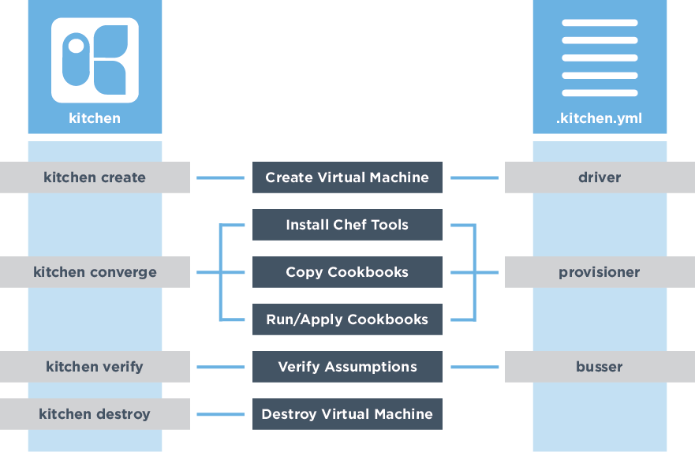




Testing the change

Slide 11
Test Kitchen Configuration (1 of 3)
~/cookbooks/ssh/.kitchen.yml
---
driver:
name: vagrant
name: docker
...
-
+
Notes:
Switch the driver to docker

Slide 12
Test Kitchen Configuration (2 of 3)
~/cookbooks/ssh/.kitchen.yml
...
platforms:
- name: ubuntu-16.04
- name: centos-7.2
- name: centos-7.3
...
-
-
+
Notes:
Update the platform, we’ll just check CentOS 7.3

Slide 13
Test Kitchen Configuration (3 of 3)
~/cookbooks/ssh/.kitchen.yml
suites:
- name: default
- name: server
run_list:
- recipe[ssh::default]
- recipe[ssh::server]
verifier:
inspec_tests:
- test/smoke/default
- /home/chef/profiles/ssh
attributes:
-
+
-
+
-
+
Notes:
Update the platform, we’ll just check CentOS 7.3

Slide 14
Move to the cookbook’s directory
cd ~/cookbooks/ssh

Slide 15
List the kitchens
kitchen list
Instance Driver Provisioner Verifier Transport Last Action Last Error
server-centos-73 Docker ChefZero Inspec Ssh <Not Created> <None>

Slide 16
Converge
kitchen converge
-----> Starting Kitchen (v1.15.0)
...
-----> Creating <server-centos-73>...
Sending build context to Docker daemon 227.8 kB
Sending build context to Docker daemon
Step 0 : FROM centos:centos7
...
Running handlers:
[2017-03-12T02:26:16+00:00] INFO: Running report handlers
Running handlers complete
[2017-03-12T02:26:16+00:00] INFO: Report handlers complete
Chef Client finished, 1/1 resources updated in 01 seconds
Finished converging <server-centos-73> (0m23.54s).
-----> Kitchen is finished. (1m0.39s)

Slide 17
Test-driven Development
Add a test
pass
Run the tests
fail
Make a little change
pass
[development continues]
fail
Run the tests
pass
[development stops]
Notes:
Technically, we haven’t written any tests just yet. However, one could argue that a passing ‘kitchen converge’ is, itself, a worthwhile test.
By setting up test kitchen we’ve not added a test, run the test, seen the tests pass. But we’re not done so it’s time to restart the loop.

Slide 18
Verify the Kitchen
kitchen verify
-----> Verifying <server-centos-73>...
Loaded
Target: ssh://kitchen@localhost:32771
× sshd-1.0: SSH Version 2 (
expected: 2
got:
(compared using `cmp` matcher)
)
× SSH Configuration Protocol should cmp == 2
expected: 2
got:
(compared using `cmp` matcher)
Profile Summary: 0 successful, 1 failures, 0 skipped
Test Summary: 0 successful, 1 failures, 0 skipped

Slide 19
Test-driven Development
Add a test
pass
Run the tests
fail
Make a little change
Notes:
Technically, we haven’t written any tests just yet. However, one could argue that a passing ‘kitchen converge’ is, itself, a worthwhile test.
By setting up test kitchen we’ve not added a test, run the test, seen the tests pass. But we’re not done so it’s time to restart the loop.

Slide 20
Edit the SSH Configuration Template
~/cookbooks/ssh/templates/sshd_config.erb
#ListenAddress 0.0.0.0
#ListenAddress ::
# The default requires explicit activation of protocol 1
#Protocol 2
Protocol 2
# HostKey for protocol version 1
-
+

Slide 21
Test-driven Development
Add a test
pass
Run the tests
fail
Make a little change
pass
[development continues]
fail
Run the tests
pass
[development stops]
Notes:
Technically, we haven’t written any tests just yet. However, one could argue that a passing ‘kitchen converge’ is, itself, a worthwhile test.
By setting up test kitchen we’ve not added a test, run the test, seen the tests pass. But we’re not done so it’s time to restart the loop.

Slide 22
Converge
kitchen converge
-----> Starting Kitchen (v1.15.0)
...
-----> Converging <server-centos-73>...
...
# The default requires explicit activation of protocol 1
-#Protocol 2
+Protocol 2
# HostKey for protocol version 1
...
Running handlers:
[2017-03-12T02:32:32+00:00] INFO: Running report handlers
Running handlers complete
[2017-03-12T02:32:32+00:00] INFO: Report handlers complete
Chef Client finished, 1/1 resources updated in 01 seconds
Finished converging <server-centos-73> (0m16.32s).
-----> Kitchen is finished. (0m17.34s)

Slide 23
Verify the Kitchen
kitchen verify
-----> Starting Kitchen (v1.15.0)
...
-----> Verifying <server-centos-73>...
Loaded
Target: ssh://kitchen@localhost:32771
✔ sshd-1.0: SSH Version 2
✔ SSH Configuration Protocol should cmp == 2
Profile Summary: 1 successful, 0 failures, 0 skipped
Test Summary: 1 successful, 0 failures, 0 skipped
Finished verifying <server-centos-73> (0m0.22s).
-----> Kitchen is finished. (0m1.27s)

Slide 24
Test-driven Development
Add a test
pass
Run the tests
fail
Make a little change
pass
[development continues]
fail
Run the tests
pass
[development stops]
Notes:
We’ve completed the cycle. But are we done?

Slide 25
Test the Kitchen (1of 2)
kitchen test
-----> Starting Kitchen (v1.15.0)
...
-----> Cleaning up any prior instances of <server-centos-73>
-----> Destroying <server-centos-73>...
...
-----> Testing <server-centos-73>
-----> Creating <server-centos-73>...
...
-----> Creating <server-centos-73>...
...
Finished creating <server-centos-73> (0m0.60s).
-----> Converging <server-centos-73>...
...

Slide 26
Test the Kitchen (2 of 2)
kitchen test
-----> Installing Chef Omnibus (install only if missing)
...
-----> Setting up <server-centos-73>...
Finished setting up <server-centos-73> (0m0.00s).
-----> Verifying <server-centos-73>...
...
Profile Summary: 1 successful, 0 failures, 0 skipped
Test Summary: 1 successful, 0 failures, 0 skipped
Finished verifying <server-centos-73> (0m0.51s).
-----> Destroying <server-centos-73>...
...
-----> Kitchen is finished. (0m25.18s)

Slide 27
What’s next?
Test-driven development cycle is complete
Deploy the change

Slide 28
Remediate with Chef
sudo run_chef "recipe[ssh::server],recipe[audit::default]"
[2017-03-10T16:48:02+00:00] INFO: Forking chef instance to converge...
Starting Chef Client, version 12.18.31
...
Synchronizing Cookbooks:
- ssh (0.1.0)
- audit (2.4.0)
- compat_resource (12.16.3)
...
-#Protocol 2
+Protocol 2
...
[2017-03-10T16:48:05+00:00] INFO: Chef Run complete in 1.248588588 seconds
Running handlers:
...
[2017-03-10T16:48:05+00:00] INFO: Report handlers complete
Chef Client finished, 1/3 resources updated in 03 seconds
Notes:
sudo chef-client --local-mode -j config.json -r "recipe[ssh::server],recipe[audit::default]"

Slide 29
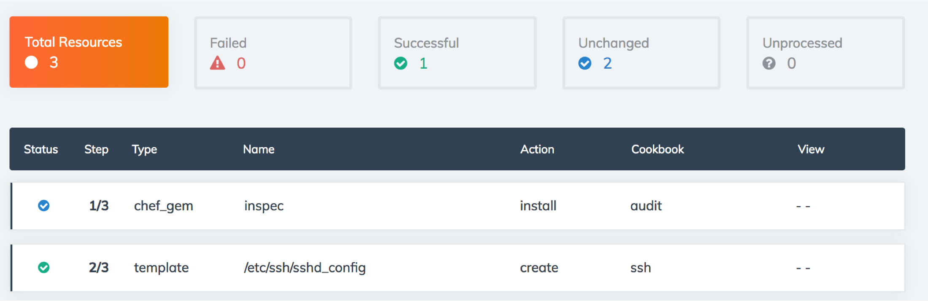
Verify Converge Status in Automate

Slide 30
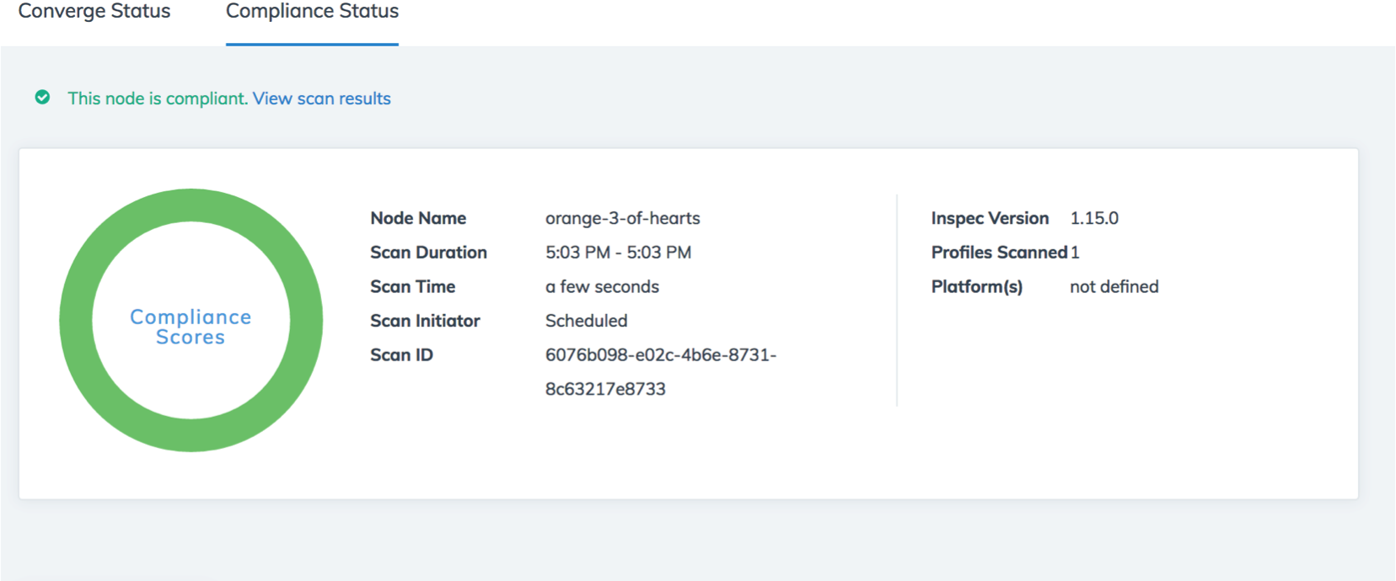
Verify Compliance Status in Automate

Slide 31
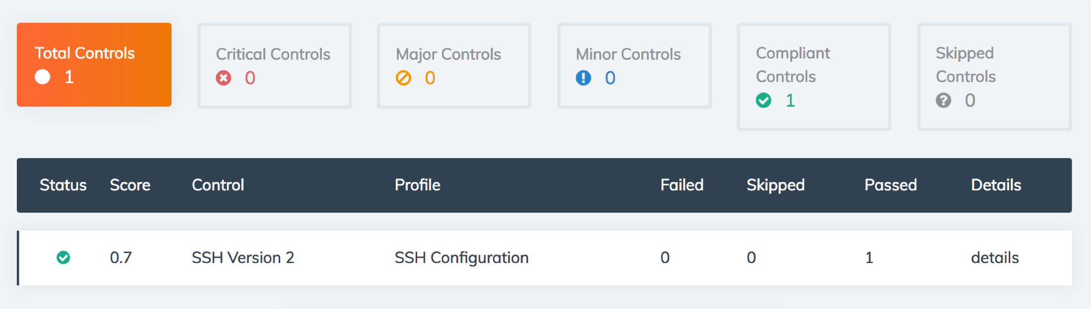
Verify Compliance Status in Automate

