Slide 1
Continuous Compliance

Slide 2
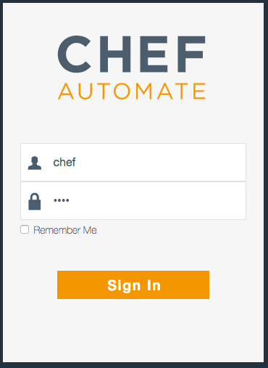
Login to Chef Automate
URL_OF_AUTOMATE_SERVER
Uses a self-signed certificate in this lab
Username: chef
Password: chef
Notes:
>>> INSTRUCTOR NOTE:
Insert the URL of the Chef Automate Server
Walk participants through accepting the self-signed certificate

Slide 3
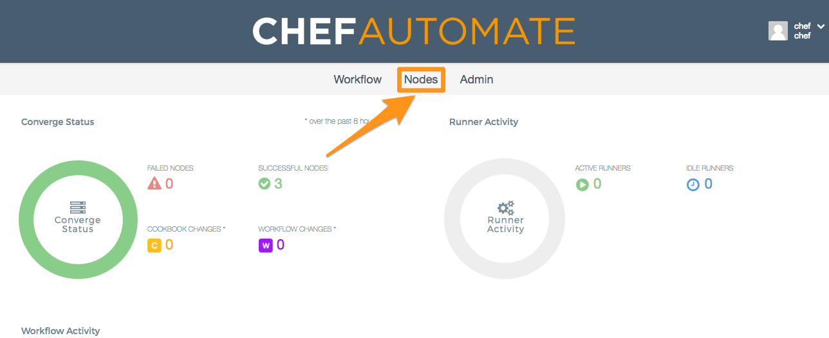
Browse to your node

Slide 4
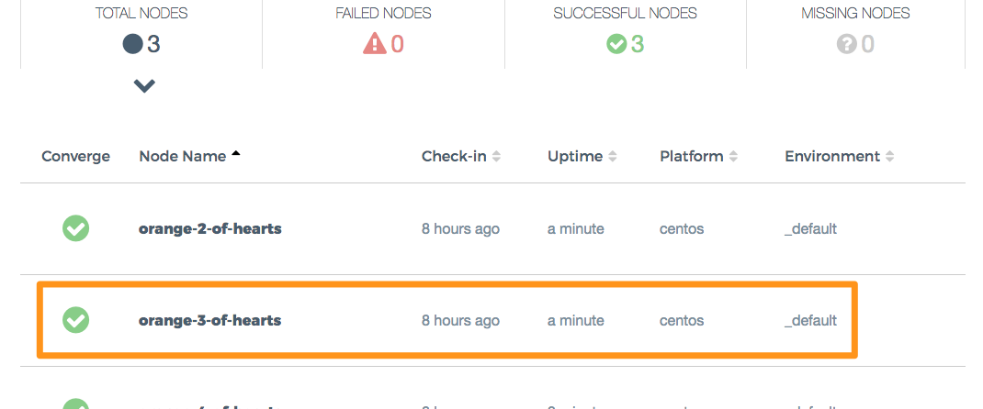
Browse to your node
Notes:
>>> INSTRUCTOR NOTE – You might want to use the orange 3 of hearts as your card, or at least, the 3 of hearts
The slides will use the orange 3 of hearts

Slide 5
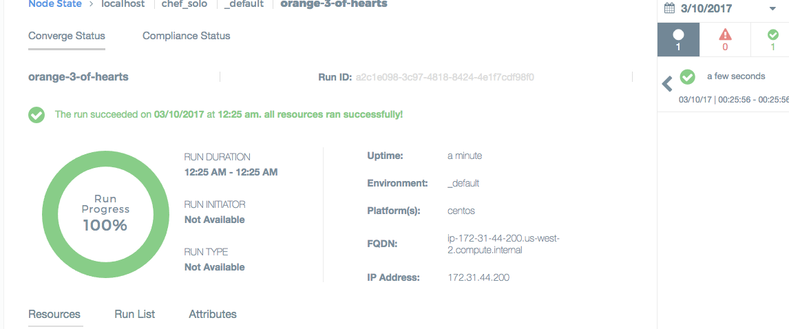
View details of your node
Notes:
>>> INSTRUCTOR NOTE – Simply browse around and show off some of the features of Automate

Slide 6
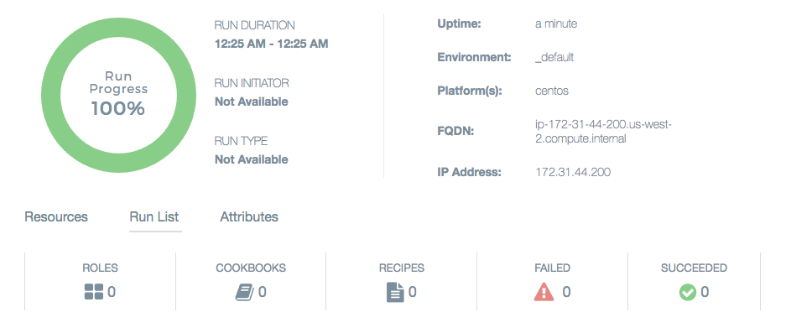
View details of your node
Notes:
>>> INSTRUCTOR NOTE – Simply browse around and show off some of the features of Automate

Slide 7
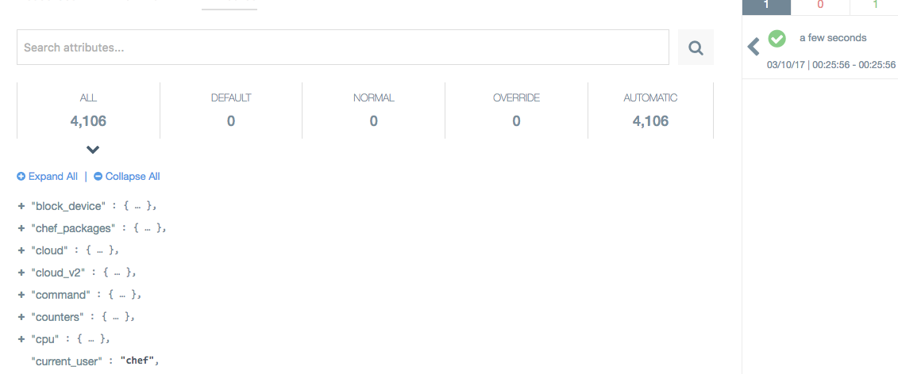
View details of your node
Notes:
>>> INSTRUCTOR NOTE – Simply browse around and show off some of the features of Automate

Slide 8
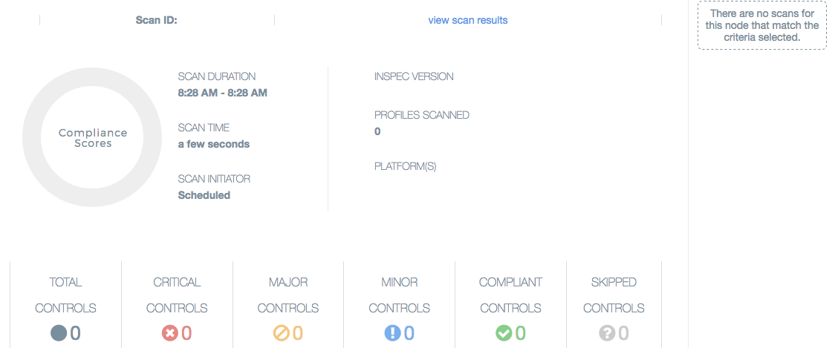
View details of your node
Notes:
>>> INSTRUCTOR NOTE – Simply browse around and show off some of the features of Automate

Slide 9
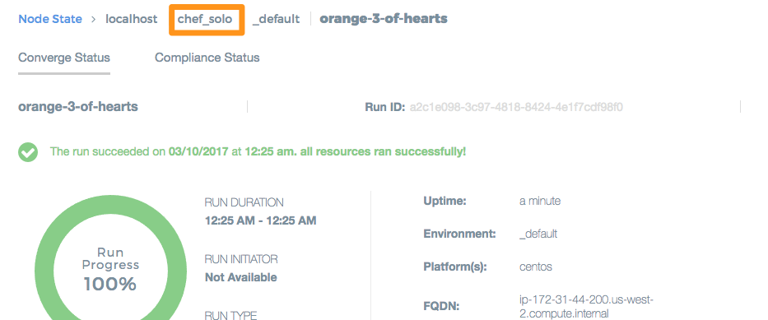
The node uses chef solo
Notes:
>>> INSTRUCTOR NOTE – Point out that we’re using Chef Solo. We’re going to run the node again, this time with a profile

Slide 10
Chef Automate – Node View
View aggregate status of your infrastructure
Overall & trend views of converge status
Overall & trend views of compliance status
Filter & search options
View details of any node
Status of converged resources
Run List applied to the node
Attributes of the node

Slide 11
Chef Solo
Executes chef-client without relying on a Chef server to provide configuration policies (cookbooks, environments, etc.)
https://docs.chef.io/chef_solo.html

Slide 12
Chef Solo
Local directory for configuration policy
Or a URL from which a .tar.gz file can be downloaded
Node objects stored as a local JSON file
Attribute data stored in a JSON file
Local or remote
Does not pull from a Chef Server
Can be configured to send data to a Chef Server
Notes:
Describe some of the differences between chef-client and chef-solo
Next, we’ll look at our own chef-solo setup

Slide 13
Chef Client – Local Mode
Local mode is a way to run the chef-client against the chef-repo on a local machine as if it were running against the Chef server.
https://docs.chef.io/ctl_chef_client.html#run-in-local-mode
Notes:
Chef Client is local mode acts in a very similar way to chef-solo. The Automate server does not distinguish between chef-solo and chef-client --local-mode

Slide 14
Go home
cd ~

Slide 15
Run chef-client in local mode
sudo chef-client --local-mode
[2017-03-10T14:05:49+00:00] INFO: Forking chef instance to converge...
Starting Chef Client, version 12.18.31
...
Converging 0 resources
[2017-03-10T14:05:51+00:00] INFO: Chef Run complete in 0.19413018 seconds
Running handlers:
[2017-03-10T14:05:51+00:00] INFO: Running report handlers
Running handlers complete
[2017-03-10T14:05:51+00:00] INFO: Report handlers complete
Chef Client finished, 0/0 resources updated in 01 seconds
Notes:
Review the output with participants
There is no run list, so no resources are updated

Slide 16
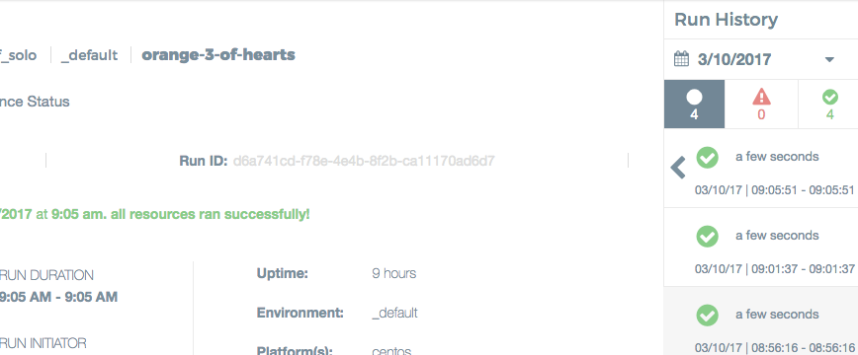
Check the converge status in Automate

Slide 17
Run with additional parameters
sudo chef-client --local-mode -j config.json -r "recipe[audit::default]"
[2017-03-10T14:10:34+00:00] INFO: Forking chef instance to converge...
Starting Chef Client, version 12.18.31
[2017-03-10T14:10:34+00:00] INFO: *** Chef 12.18.31 ***
...
[2017-03-10T14:10:40+00:00] INFO: Chef Run complete in 4.10402964 seconds
Running handlers:
[2017-03-10T14:10:40+00:00] INFO: Running report handlers
[2017-03-10T14:10:40+00:00] WARN: Format is json
[2017-03-10T14:10:40+00:00] INFO: Initialize InSpec
[2017-03-10T14:10:40+00:00] INFO: Running tests from: [{:name=>"ssh", :path=>"/home/chef/profiles/ssh"}]
[2017-03-10T14:10:40+00:00] INFO: Reporting to chef-visibility
...
Running handlers complete
[2017-03-10T14:10:40+00:00] INFO: Report handlers complete
Chef Client finished, 1/2 resources updated in 06 seconds

Slide 18
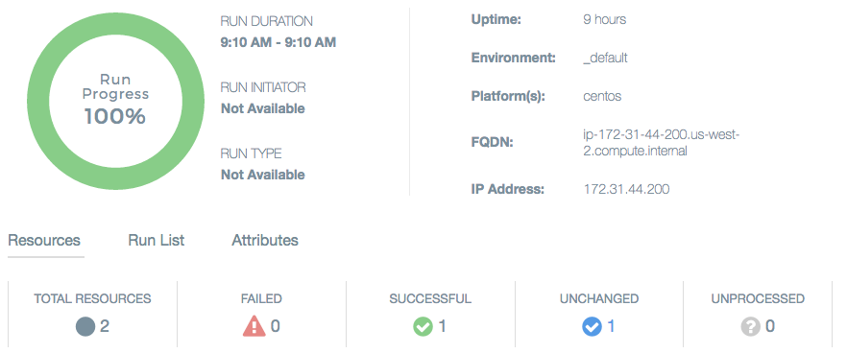
Check the converge status in Automate

Slide 19
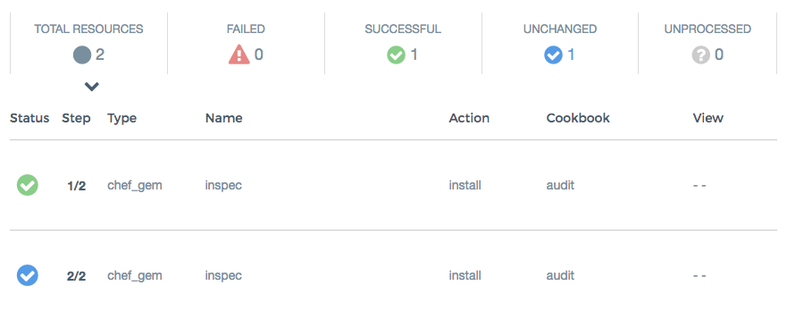
Check the converge status in Automate

Slide 20
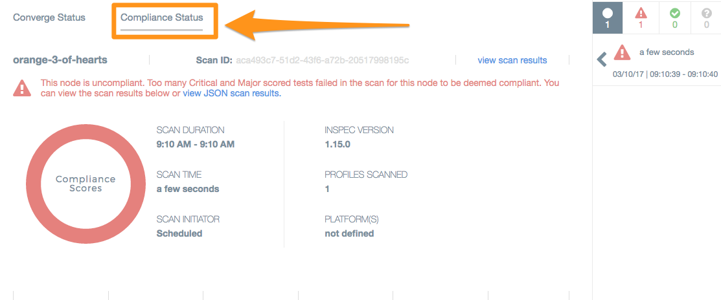
Check the compliance status in Automate

Slide 21
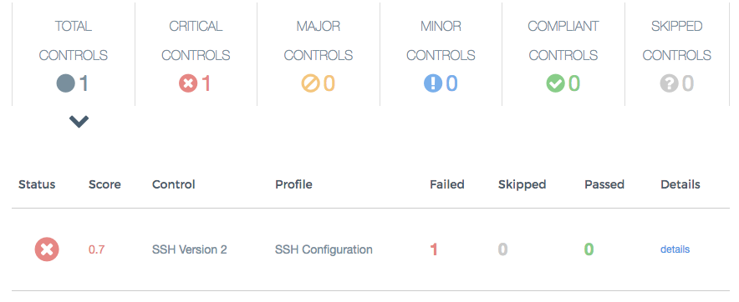
Check the compliance status in Automate

Slide 22
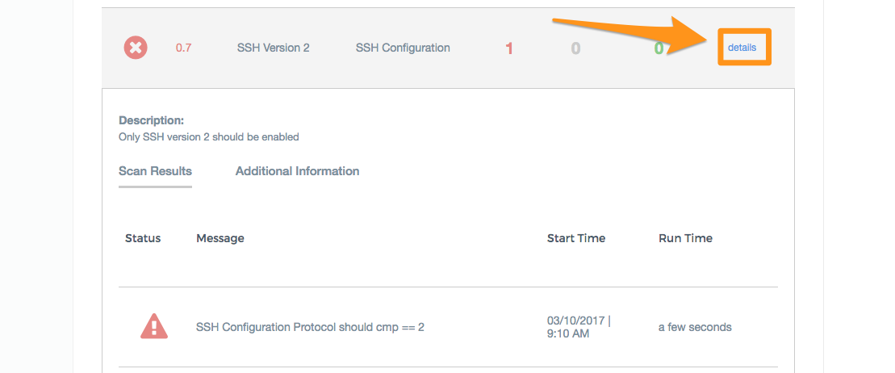
View details of the failing control

Slide 23
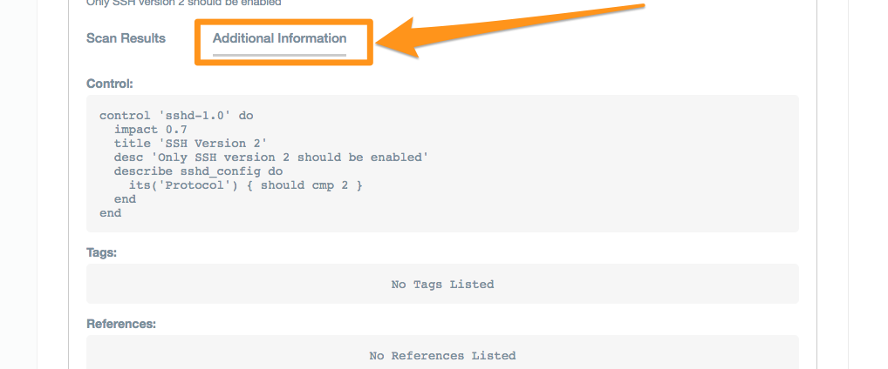
View details of the failing control

Slide 24
Review our set-up

Slide 25
Go home
cd ~

Slide 26
List contents
ls
Berksfile config.json local-mode-cache profiles
Berksfile.lock cookbooks nodes

Slide 27
config.json
cat config.json
{
"audit": {
"collector": "chef-visibility",
"inspec_version": "1.15.0",
"profiles": [
{
"name": "ssh",
"path": "/home/chef/profiles/ssh"
}
]
}
}

Slide 28
Audit Cookbook
Installs InSpec
Executes compliance profiles
Uses a report handler to send data to Chef Automate

Slide 29
Local Profiles
tree profiles
profiles/
└── ssh
├── controls
│ └── ssh.rb
├── inspec.lock
└── inspec.yml
2 directories, 3 files

Slide 30
Run Locally with InSpec
inspec exec profiles/ssh
Profile: SSH Configuration (ssh)
Version: 0.1.0
Target: local://
× sshd-1.0: SSH Version 2 (
expected: 2
got:
(compared using `cmp` matcher)
)
× SSH Configuration Protocol should cmp == 2
expected: 2
got:
(compared using `cmp` matcher)
Profile Summary: 0 successful, 1 failures, 0 skipped
Test Summary: 0 successful, 1 failures, 0 skipped

Slide 31
Remediate the Failing Control

Slide 32
Fix your ssh configuration on your own
Write a cookbook to manage SSH
Manually update the SSH configuration
Notes:
Depending on time and experience with Chef you can do either thing next

Slide 33
Remediate with Chef
sudo chef-client --local-mode -j config.json -r "recipe[ssh::server],recipe[audit::default]"
[2017-03-10T16:48:02+00:00] INFO: Forking chef instance to converge...
Starting Chef Client, version 12.18.31
...
Synchronizing Cookbooks:
- ssh (0.1.0)
- audit (2.4.0)
- compat_resource (12.16.3)
...
-#Protocol 2
+Protocol 2
...
[2017-03-10T16:48:05+00:00] INFO: Chef Run complete in 1.248588588 seconds
Running handlers:
...
[2017-03-10T16:48:05+00:00] INFO: Report handlers complete
Chef Client finished, 1/3 resources updated in 03 seconds

Slide 34
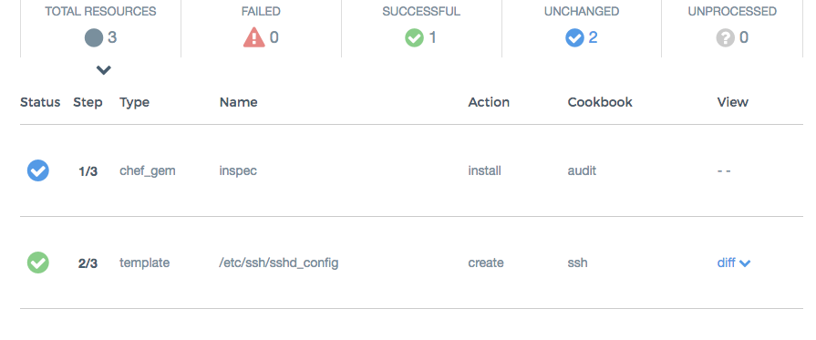
Verify Converge Status in Automate

Slide 35
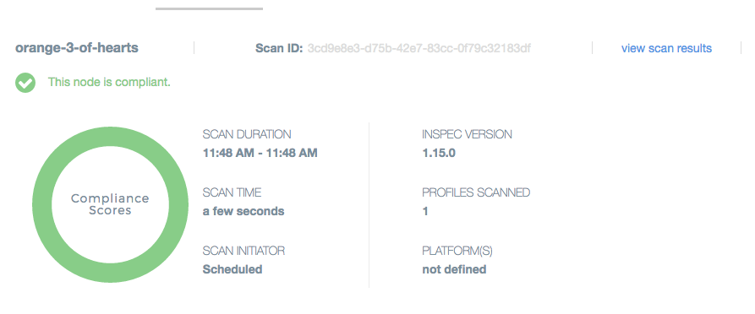
Verify Compliance Status in Automate

Slide 36
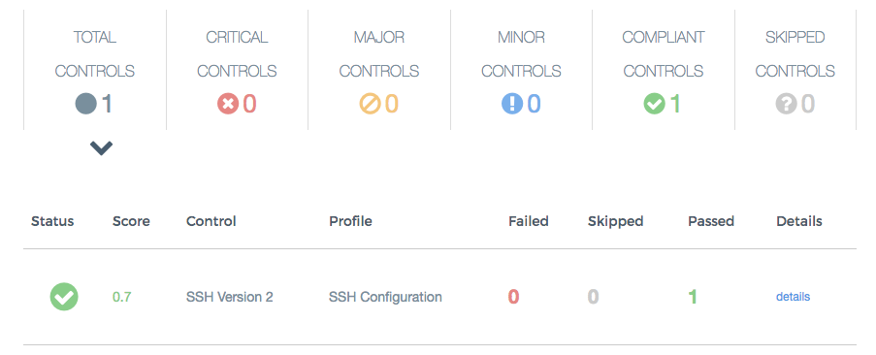
Verify Compliance Status in Automate

