Slide 1
Chef Cookbook Workflow
Testing your infrastructure code
Nathen Harvey - @nathenharvey

Slide 2
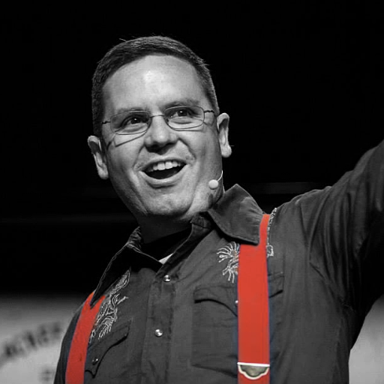

Instructor
Nathen Harvey
Community Director, Chef
Co-host of the Food Fight Show
Co-organizer of DevOpsDC

Slide 3
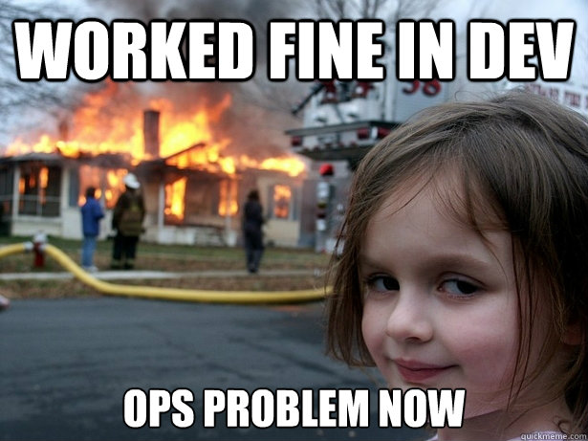
DevOps is a Two-Way Street
It’s great when developers care about
Uptime!
Scaling!
Deployment!
Put them on call! etc. etc. etc.
Notes:
The whole “How did devOps start” story
Dev would often throw stuff over the wall.
Pitchforks and torches, marched over and got them to care about care about these things

Slide 4

DevOps is a Two-Way Street
Operations also has as much or more to learn from developers as well
Notes:
It’s still Dev & Ops right.. So what can Ops learn from Dev.

Slide 5
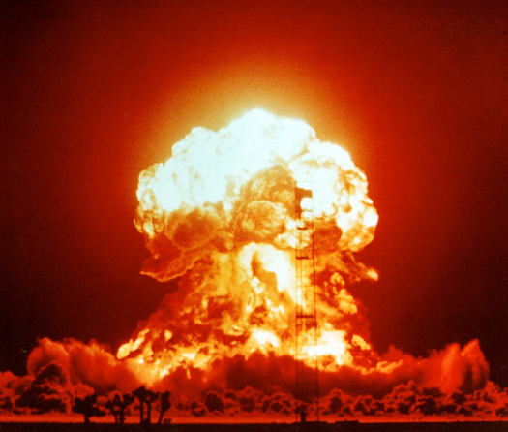
Software Development Workflow
Write some code
<ad-hoc verification here>
Go to pre-production
<ad-hoc verification here>
Go to production
Production failure
Notes:
90s – first half of 2000s

Slide 6

Software Development Workflow
Write some code
Write and run some unit tests
Go to pre-production
Run some integration/acceptance tests
Go to production
Lowered chance of production failure
Notes:
Junit and Selenium
By 2008ish I think most people got it
If there was an error in production you could write tests to avoid the same situation in the future.
You can mention that even sysadmins without Chef or any of this stuff do “integration/acceptance tests” even though they don’t know it today. Every time you’re on a server and do
/sbin/service httpd status
or
netstat -an |grep 80
or
telnet 127.0.0.1 80 (and check whether you get a 200 OK)
you’re doing “acceptance testing”. So why not formalize this?

Slide 7

Old Chef Cookbook Workflow
Write some cookbook code
<ad-hoc verification here>
Go to pre-production
<ad-hoc verification here
Go to production
Whoops, broke production

Slide 8

New Chef Cookbook Workflow
Write some cookbook code
Check for code correctness
Write and run some unit tests
Go to pre-production
Run some integration tests
Go to production

Slide 9
Chef Testing
Did chef-client complete successfully?
Did the recipe put the node in the desired state?
Are the resources properly defined?
Does the code following our style guide?

Slide 10
Tools of the Trade
Code correctness: Foodcritic, Rubocop
Unit tests: ChefSpec
Integration tests: Test Kitchen, ServerSpec, BATS
Notes:
These tools can be used for syntactical correctness. But in combination with a CI pipeline they can be used to enforce policy

Slide 11

Chef Community Summit – Seattle Seattle Sheraton - October 14th & 15th
Why your participation matters
Influence the path of the Chef roadmap
Contribute to the formation of best practices and the avenues to best share them
Share your experiences transforming your business
Demonstrate your DevOps Kung Fu
Network with awesome engineers in the Community
Engage with a community of people actively using Chef to automate their workflow
Discuss “what keeps you up at night” with a passionate engaged audience
Meet with CHEF engineers IRL
**Use the code MEETUP and save 20%

Slide 12
What Questions Can I Answer For You?
Thank you!
@nathenharvey

