Slide 1
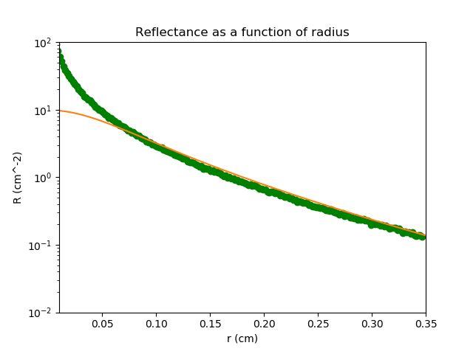

g = 0.8
mu_a = 1 / cm^2
mu_s* = 10 / cm^2
Bins = 200
Aantal =
1.000.000

Slide 2
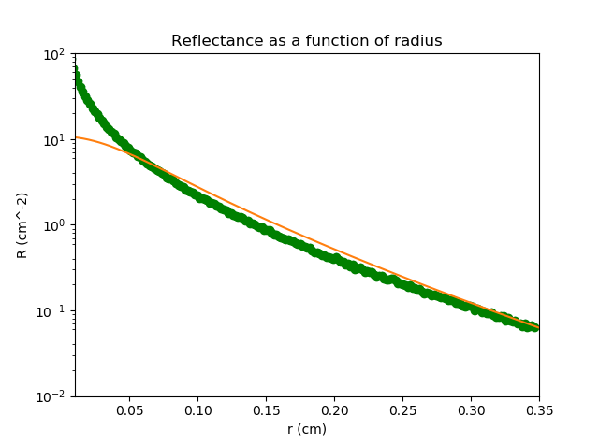
g = 0.8
mu_a = 2 / cm^2
mu_s* = 10 / cm^2
Bins = 200
Aantal =
1.000.000

Slide 3
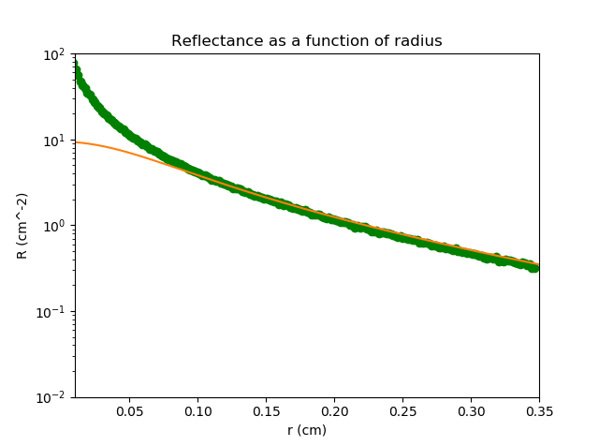
g = 0.8
mu_a = 0.1 / cm^2
mu_s* = 10 / cm^2
Bins = 200
Aantal =
1.000.000

Slide 4
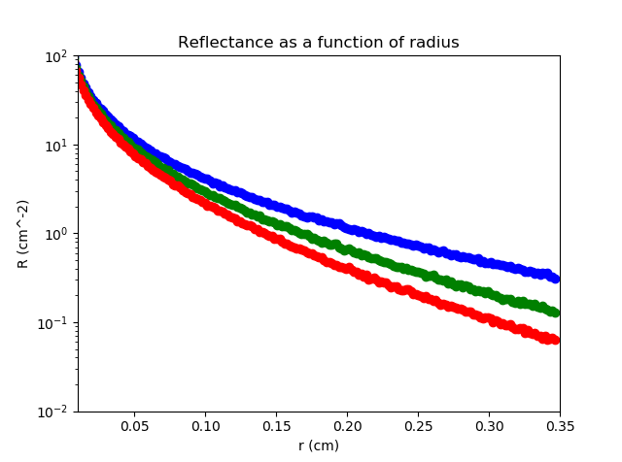
g = 0.8
mu_s* = 10 / cm^2
Bins = 200
Aantal =
1.000.000
blue =>
mua = 0.1 / cm^2
green =>
mua = 1 / cm^2
red =>
mua = 2 / cm^2

Slide 5
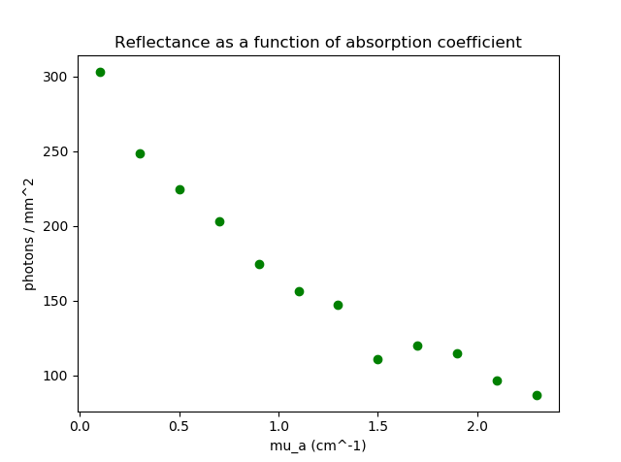
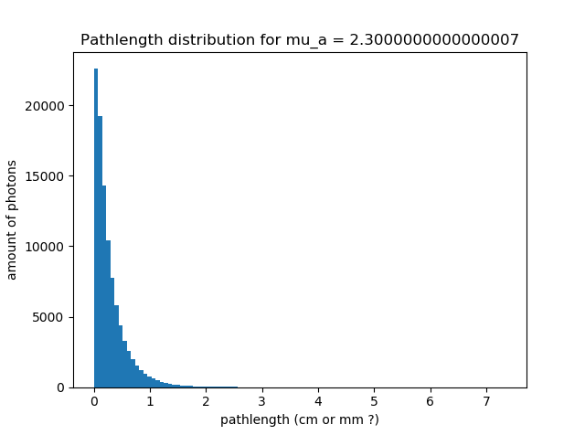
g = 0.8
r = 0.2 cm
mu_s* = 10 / cm^2
Aantal = 100.000

Slide 6
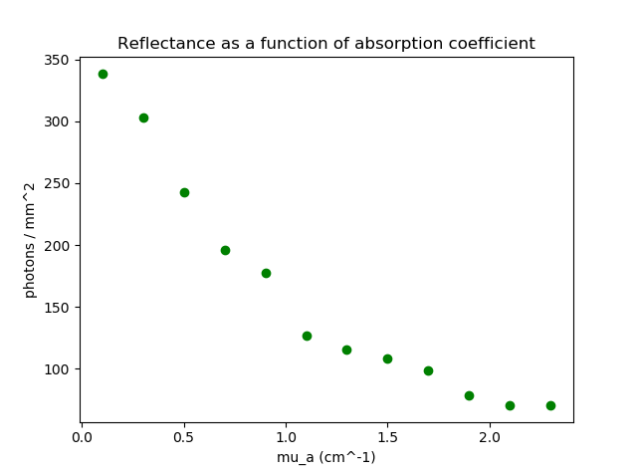

g = 0.8
r = 0.3 cm
mu_s* = 10 / cm^2
Aantal = 200.000

Slide 7
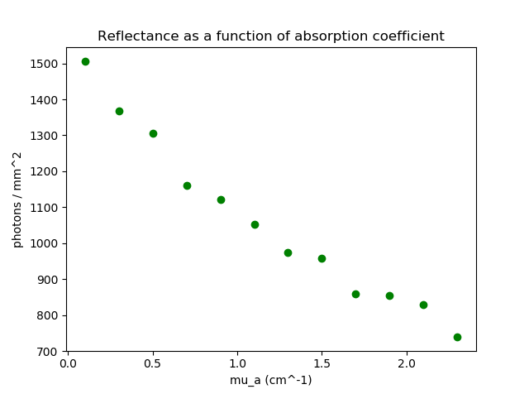
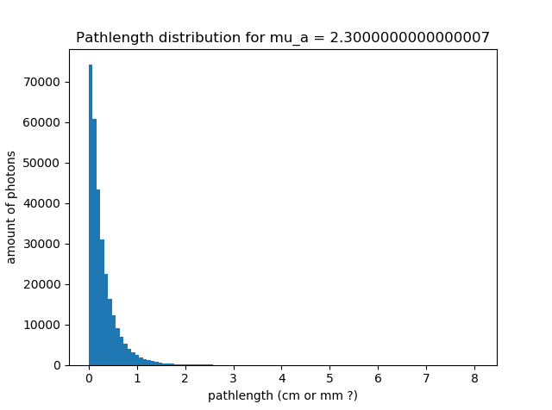
g = 0.8
r = 0.1 cm
mu_s* = 10 / cm^2
Aantal = 300.000

Slide 8
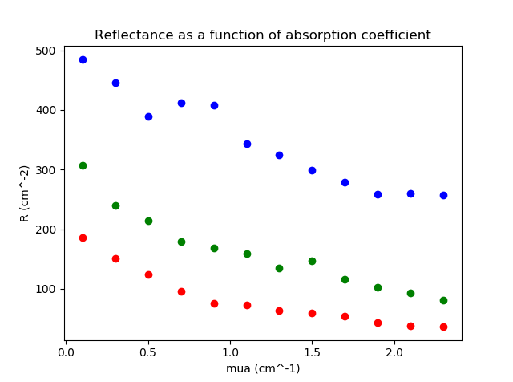
g = 0.8
mu_s* = 10 / cm^2
Aantal = 100.000
blue => r = 0.1 cm
green => r = 0.2 cm
red => r = 0.3 cm

