Slide 1
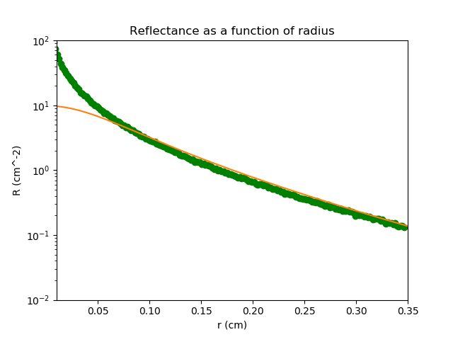

g = 0.8
mu_a = 1
mu_s* = 10
Bins = 200
Aantal =
1.000.000

Slide 2
g = 0.8
mu_a = 2
mu_s* = 10
Bins = 200
Aantal =
1.000.000

