Slide 1
SERVLETS

Slide 2
What is a Servlet?
A Servlet is a Java program that runs on a web server.
It is used to create dynamic web applications.
It handles client requests and sends responses.
Example: When a user submits a login form, the servlet processes the request.

Slide 3
Why Servlets are Used
Platform Independent (Java based)
High performance
Handles multiple requests
Secure
Used to build dynamic websites

Slide 4
Servlet Architecture
Servlet architecture shows how request and response flow between client and server.
Process:
Client sends request
Web server receives request
Servlet container processes request
Servlet generates response
Response sent back to browser

Slide 5
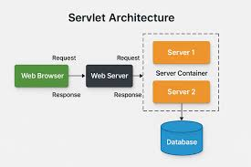

Slide 6
Servlet Life Cycle
Servlet lifecycle has 3 main methods:
init()
Called when servlet is loaded
service()
Handles client requests
destroy()
Called when servlet is removed

Slide 7
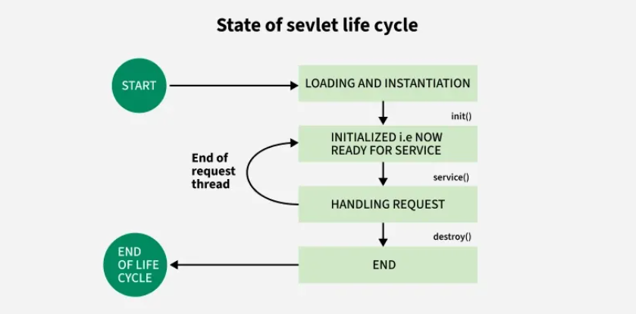

Slide 8
Types of Servlets
GenericServlet
Protocol independent
Used for general requests
HttpServlet
Used for HTTP protocol
Mostly used in web applications
Important methods:
doGet()
doPost()

Slide 9
Advantages of Servlets
High performance
Platform independent
Secure
Scalable
Easy database connectivity

Slide 10
Applications of Servlets
Login Authentication Systems
Online Registration Forms
E-Commerce Websites
Banking Applications
Dynamic web Pages

