Slide 1

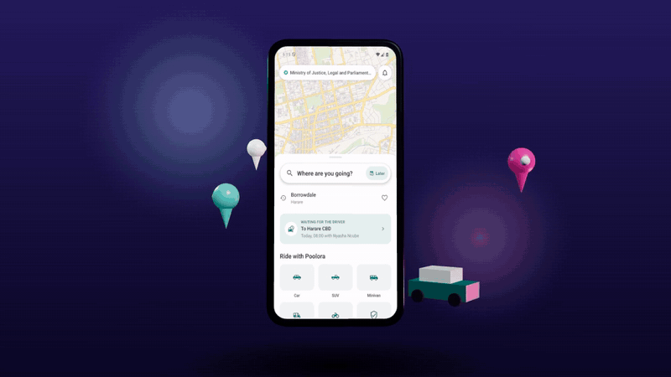
Poolora
Share the ride. Split the cost. Travel safer.
Carpooling for Zimbabwe, starting in Harare
N. M. Sibanda, founder
nathimike102@icloud.com
Notes:
Poolora is a carpooling app for Zimbabwe: drivers already making a trip sell their empty seats, riders book and pay by EcoCash or card. Built and tested; launching in Harare.

Slide 2




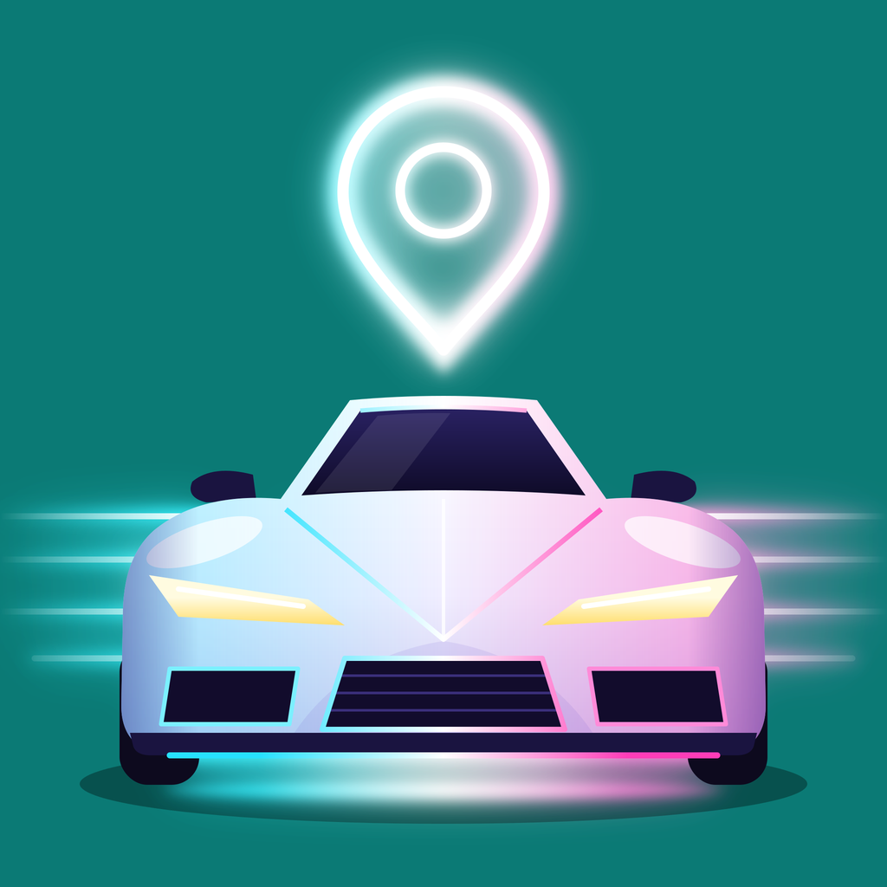
Getting around Harare today
Cheap options are crowded or unsafe; safe options are expensive; private cars run half empty.
Crowded public transport
Taxi apps cost more
ZUPCO charges US$0.50 up to 20 km but cannot meet demand, so private kombis and unlicensed "mushikashika" fill the gap.
inDrive, Vaya and others charge about US$2–4 for 5 km, several times a kombi fare, and drivers are raising prices.
Empty seats
Safety and trust
Petrol is about US$2.06 a litre, yet most cars on commute routes carry one person. The seats beside them go unused.
Informal lifts have no verified drivers, no record of the trip and no quick way to get help.
2
Poolora · Zimbabwe launch · 2026
Notes:
Harare commuters have cheap but crowded buses and kombis, or taxi apps that cost several times more. Fuel is over two dollars a litre, and most private cars on commute routes carry only the driver. Figures are from September 2026; sources are at the end.

Slide 3
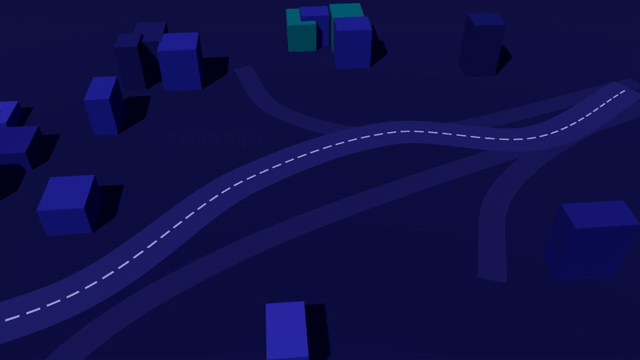



One platform, three kinds of pooling
Drivers who are making the trip anyway sell their empty seats and boot space.
Ride pooling
Book a seat in a car, SUV, minivan, auto or on a bike going your way. US$1 for a 15 km commute.
Parcel pooling
Send a parcel with a driver already on the route; the recipient hands over a delivery code.
Trip pooling
Plan a group trip, find partners, vote on activities and split costs to the cent.
3
Poolora · Zimbabwe launch · 2026
Notes:
The animation shows the idea: three solo trips become one shared car. Poolora pools three things: seats in cars already making a trip, parcel space, and group trips.

Slide 4





How a shared ride works
From posting a ride to rating it, in five steps.
1
2
3
4
5
Driver posts
Rider searches
Books and pays
Rides live
Rates and settles
Route, time (at least 2 h ahead), up to 3 stops, seats and a price within the suggested range
Matched anywhere along the route, ranked by distance, time, rating and reliability
EcoCash, OneMoney, InnBucks, card or wallet. Unpaid requests close after 15 min
Driver arrives, picks up, drops off; live map, SOS and check-ins throughout
Both rate each other; the driver's share (fare less 15%) goes to their wallet
4
Poolora · Zimbabwe launch · 2026
Notes:
The whole ride in five steps. Payment is taken when the rider books; the driver accepts, and the driver is paid when the rider is dropped off.

Slide 5
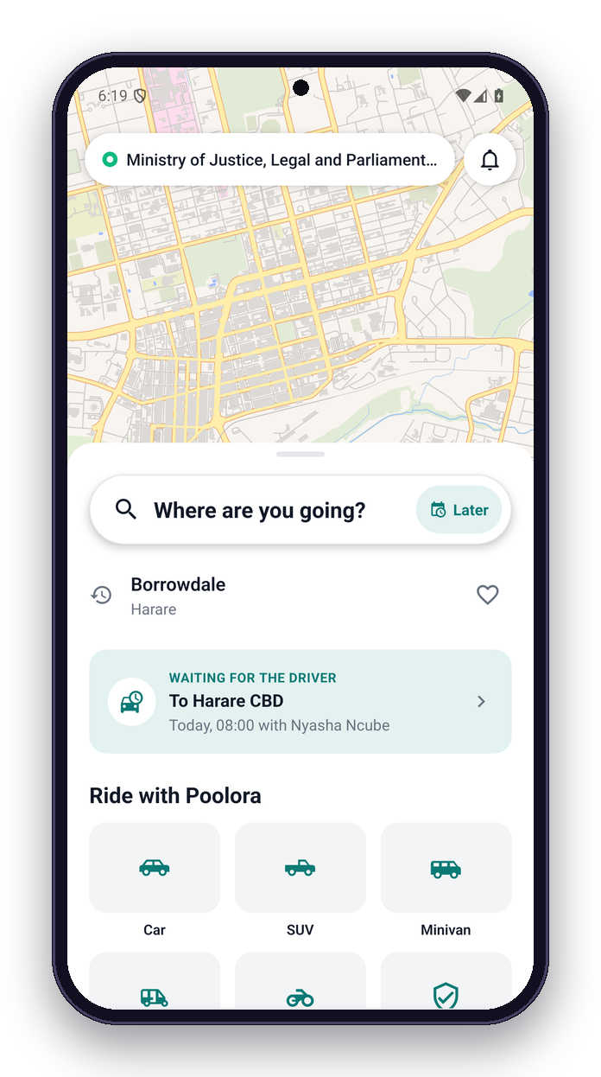
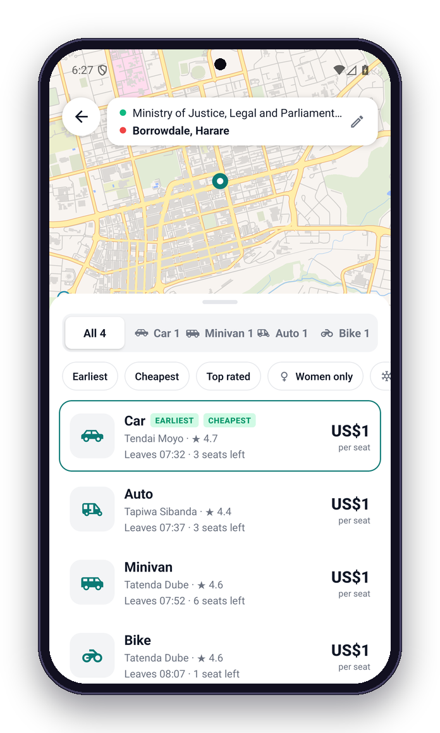
Find a ride
Search from where you are; results show every kind of vehicle going your way.
Search any place in Zimbabwe (OpenStreetMap)
Filter by vehicle; sort by time, price or rating
Seat prices in US dollars; US$1 for about 11 km
Car, SUV and bakkie, minivan, auto (tuk-tuk), bike
5
Poolora · Zimbabwe launch · 2026
Notes:
The rider home screen on a Harare map, with the five vehicle classes. Searching Borrowdale lists every ride passing that way: car, minivan, auto and bike, with price, time and seats left.

Slide 6
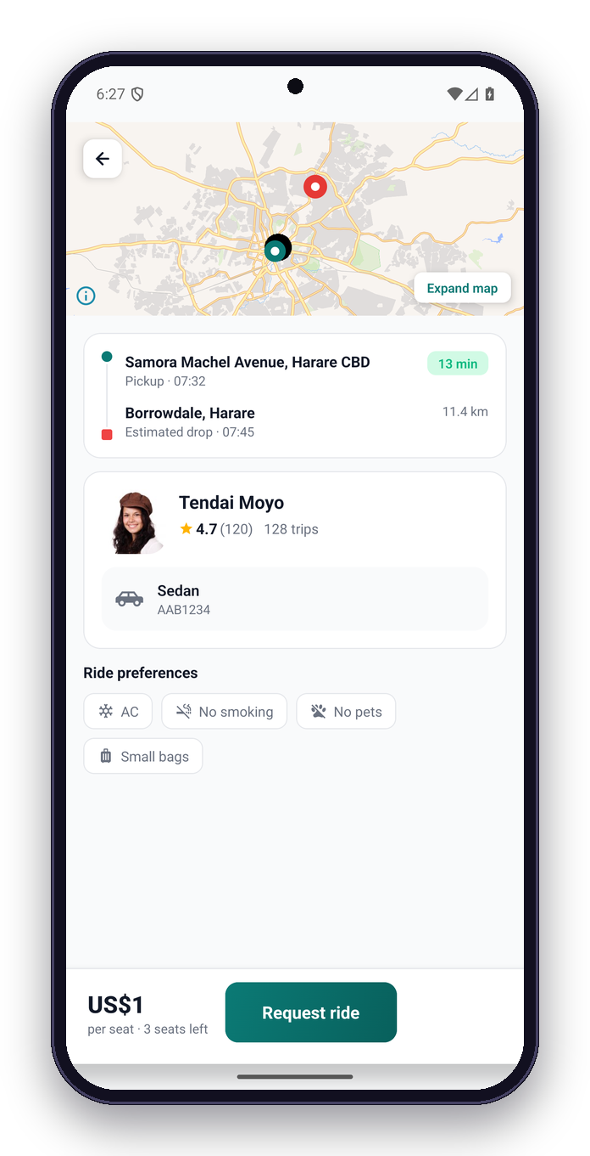
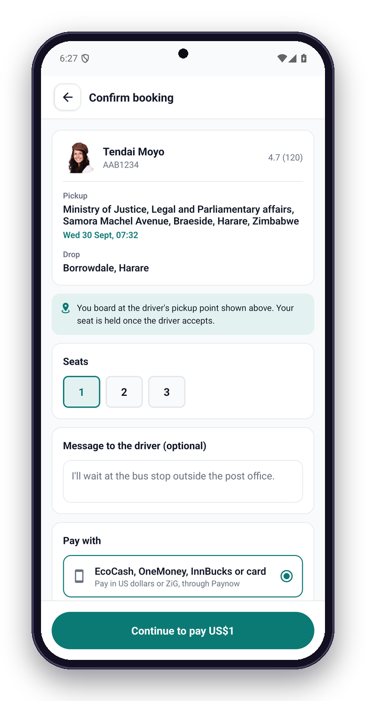
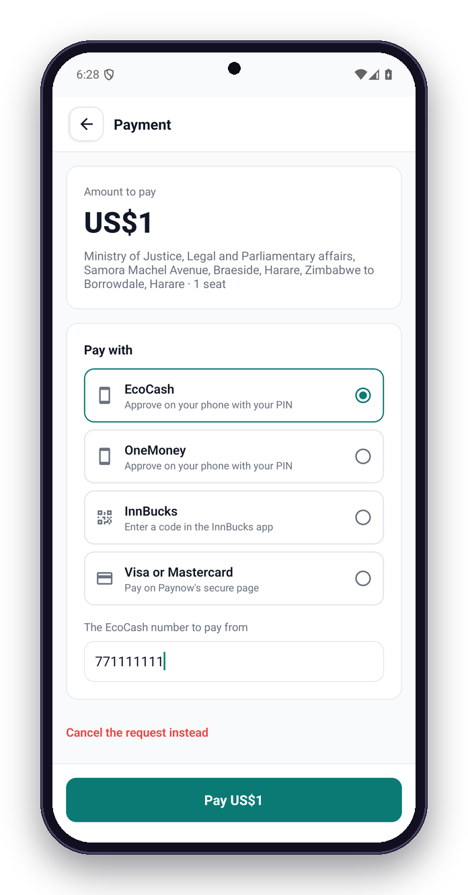
Book and pay
See the driver and the route, choose seats, pay by mobile money or card through Paynow.
Verified driver, rating and trips
EcoCash, OneMoney, InnBucks or card, in US$ or ZiG
6
Poolora · Zimbabwe launch · 2026
Notes:
Ride details show the driver, rating, vehicle and route. Booking takes a message for the driver and the payment method. Payment goes through Paynow: EcoCash and OneMoney push a PIN prompt to the phone, InnBucks gives a code, cards open Paynow's secure page.

Slide 7
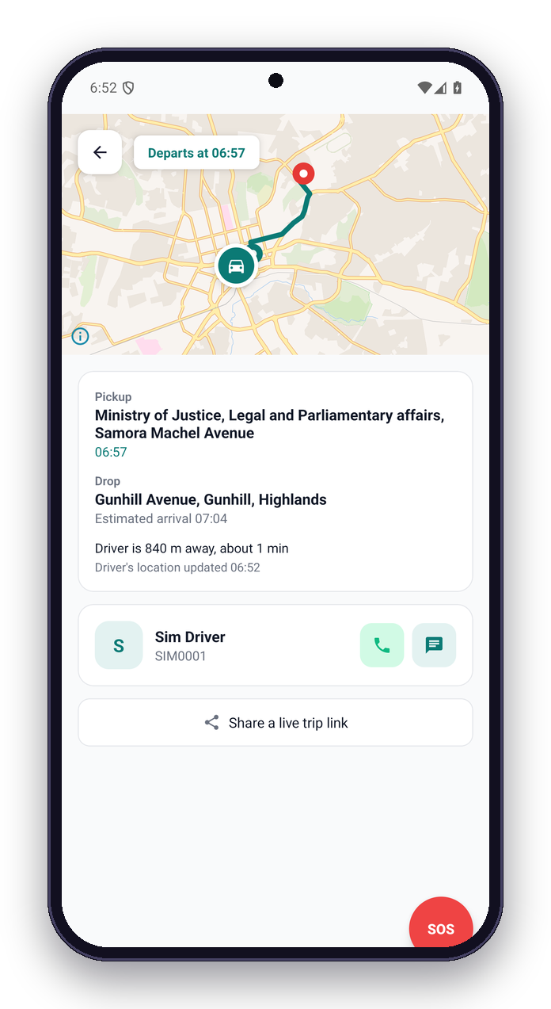
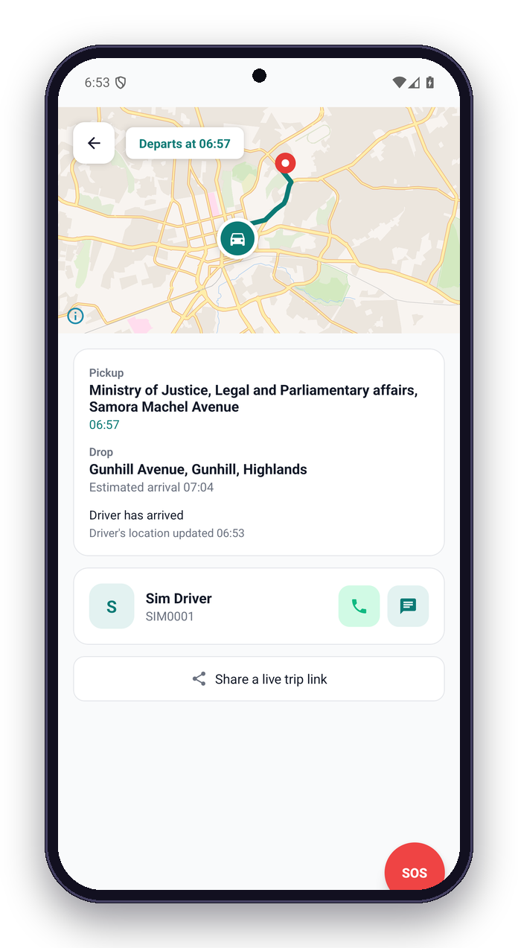
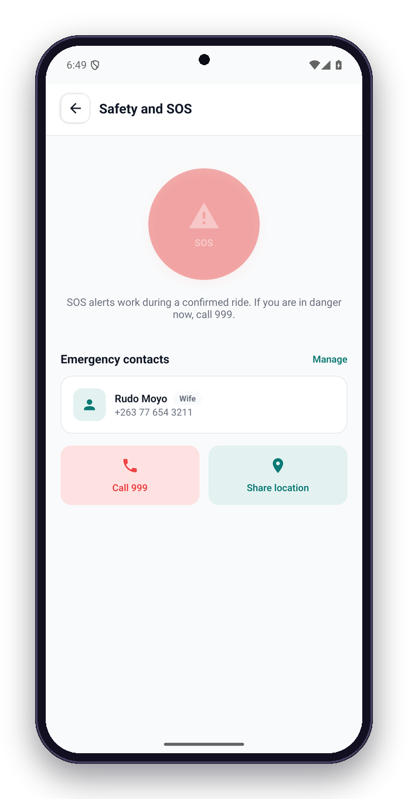
On the road
Follow the car live; the rider sees each step and can raise an SOS at any time.
Contacts get a live-location link
Live distance and time to pickup
7
Poolora · Zimbabwe launch · 2026
Notes:
A simulated ride in Harare: the app shows the car approaching, then "Driver has arrived". The SOS screen alerts the safety team and emergency contacts; 999 is one tap away.

Slide 8
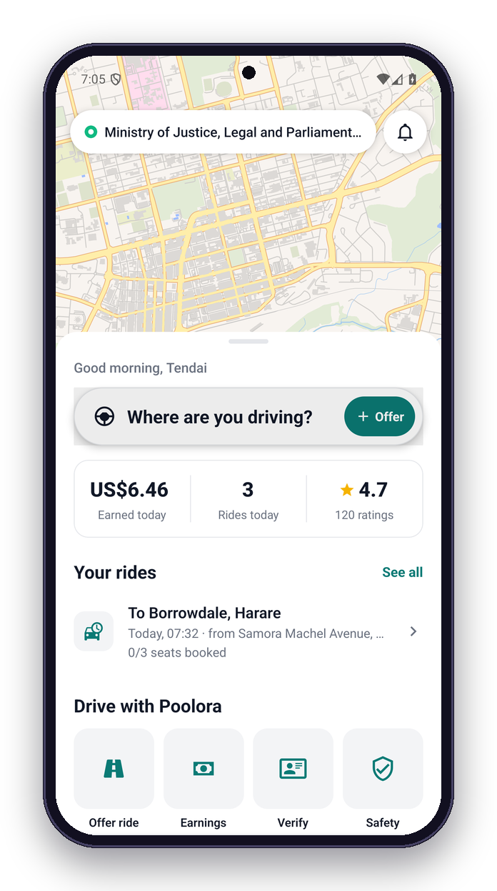
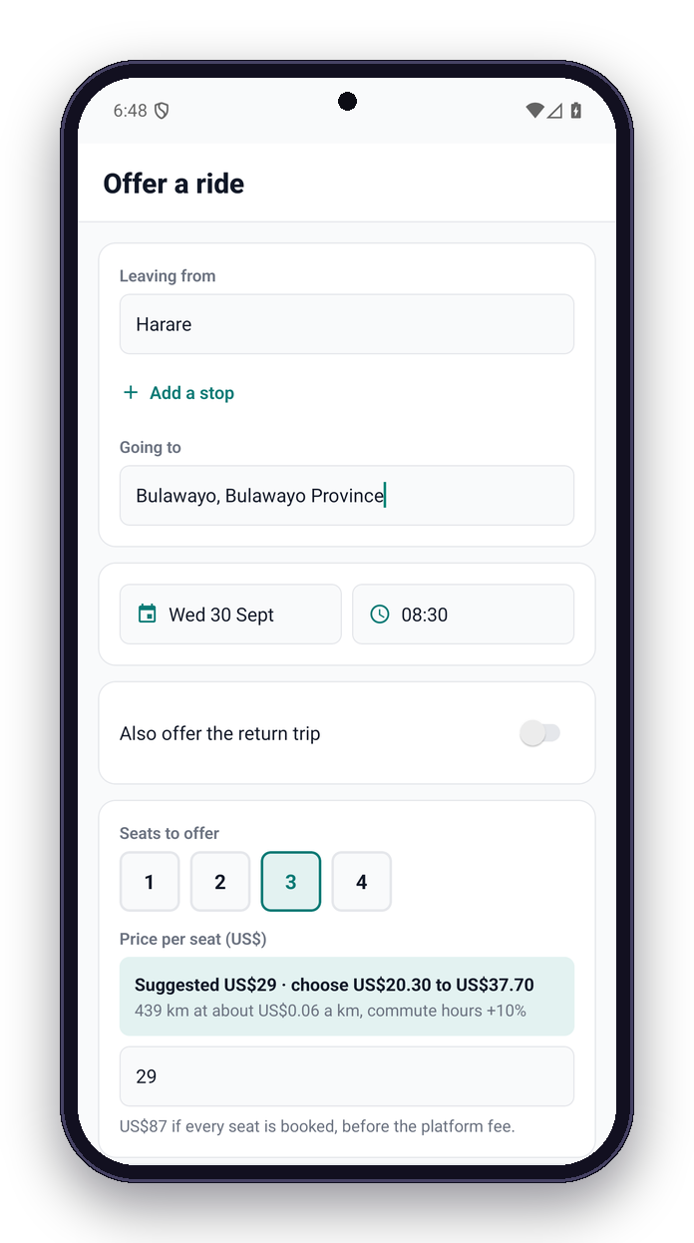
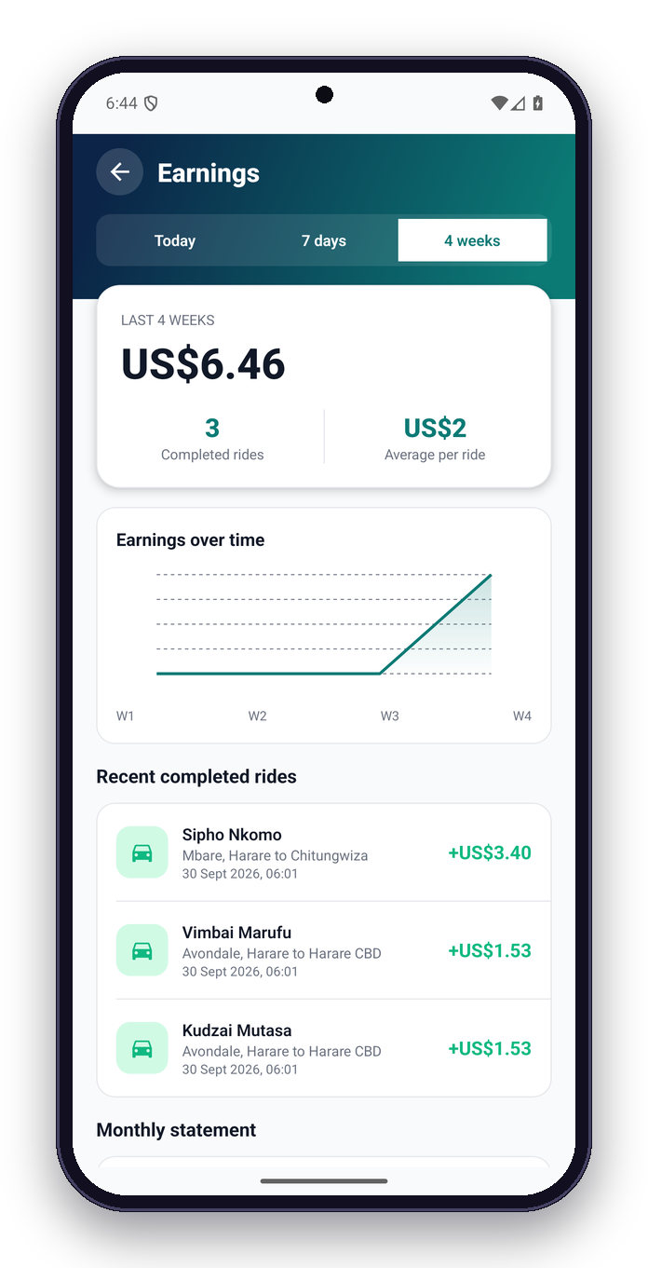
Drive and earn
Post a ride in a minute; Poolora suggests a fair price and shows what the trip earns.
Earnings by day, week and month
Suggested price and the allowed range
8
Poolora · Zimbabwe launch · 2026
Notes:
Drivers see today's earnings and upcoming rides. Posting Harare to Bulawayo suggests US$26.50 a seat off-peak (US$29 in commute hours) from the route distance and vehicle; the driver can choose within 30%.

Slide 9
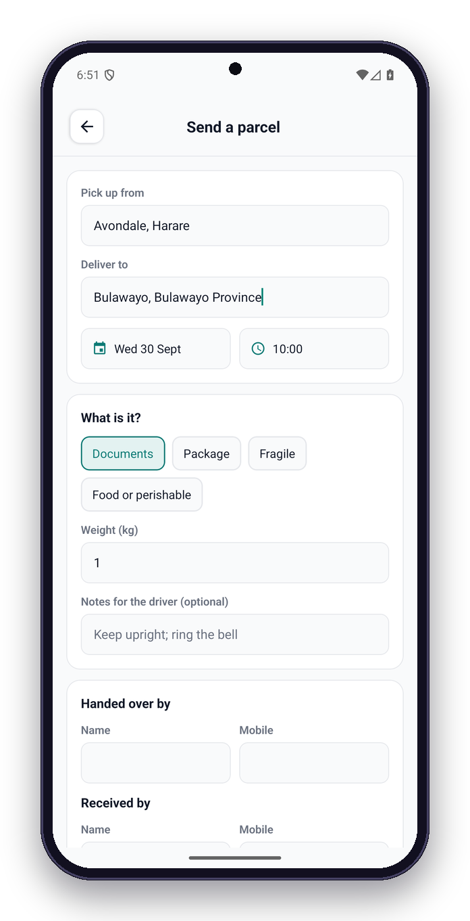
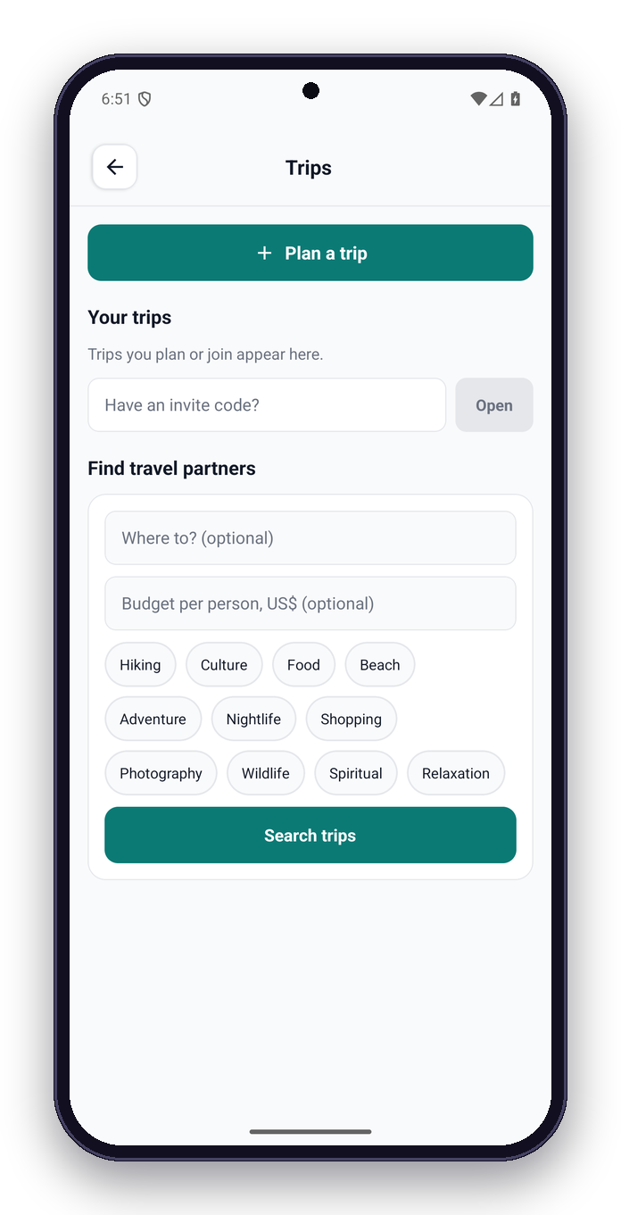
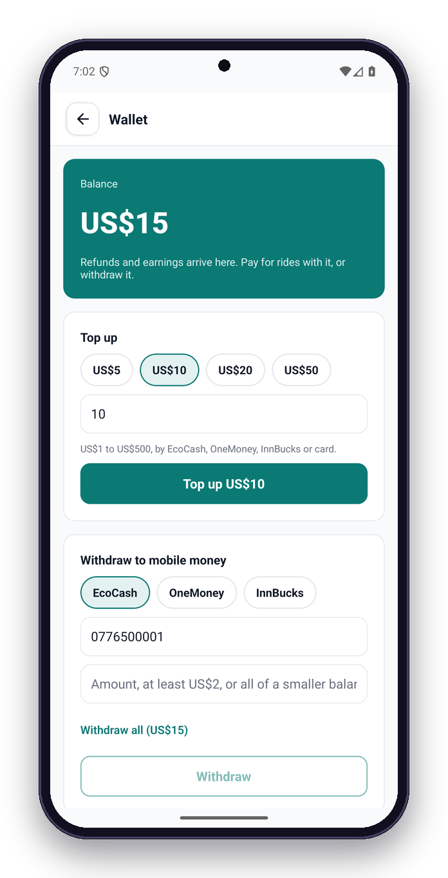
More than rides
Parcels travel with drivers already on the route; groups plan trips together; one wallet for everything.
Photo proof at pickup and delivery; delivery code
Withdraw US$2–US$1000 to mobile money
9
Poolora · Zimbabwe launch · 2026
Notes:
Parcels are priced like a motorbike courier in town (about US$5.50 for 10 km) and near Zimpost between cities (about US$16 for 5 kg Harare to Bulawayo), with photo proof and a delivery code. Group trips match partners by interests, dates and budget. The wallet takes refunds and earnings and withdraws to mobile money.

Slide 10
Fair prices, set against what people pay now
price = distance × rate(vehicle) × commute hours (+10%, not on public holidays) × surge (+20–50%) · drivers choose within ±30%
Commuting in Harare
Harare to Bulawayo (439 km)
ZUPCO bus, up to 20 km
US$0.50
Ordinary bus
US$15
Kombi
US$0.50–1
Poolora seat, car
US$26.50
Poolora seat, 15 km (car)
US$1
Poolora seat, minivan
US$28.50
Taxi app, 5 km
US$2–4
CityLink luxury coach
US$35
Rates a seat per km: bike US$0.04 · auto US$0.045 · hatchback US$0.05 · sedan US$0.06 · minivan US$0.065 · bakkie US$0.07 · SUV US$0.075. Never below US$1 or outside US$0.02–US$0.20 a km. Off-peak examples from the pricing code; market fares September 2026.
10
Poolora · Zimbabwe launch · 2026
Notes:
Seat prices come from the route distance and a per-kilometre rate for the vehicle, about a car's running cost shared between riders, plus 10% in commute hours and a surge only when the demand forecast is high. A 15 km commute costs about a dollar, like a kombi; Harare to Bulawayo sits between the ordinary bus and the luxury coach.

Slide 11
How the money works
Riders pay the seat price, no booking fee. Poolora keeps 15% of completed fares; drivers keep the rest.
A daily commute, 15 km
Harare to Bulawayo, 439 km
3 seats × US$1
US$3
3 seats × US$26.50
US$79.50
Poolora (15%)
−US$0.45
Poolora (15%)
−US$11.93
Driver keeps
US$2.55
Driver keeps
US$67.58
Fuel, 15 km at 7 L/100 km
US$2.16
Fuel, 439 km at 7 L/100 km
US$63.30
Fuel at US$2.06 a litre (ZERA, September 2026). For comparison, inDrive is reported to take about 12%; Kenya caps e-hailing commission at 18%.
11
Poolora · Zimbabwe launch · 2026
Notes:
Riders pay the seat price with no booking fee. Poolora keeps 15% of completed fares; the rest goes to the driver. On a full intercity trip the fares cover the driver's fuel, which is what makes drivers post rides.

Slide 12

Cancellations and refunds
Clear rules shown before the rider confirms; refunds land in the wallet at once.
Departure →
100% back
50% back
0% back
24 h or more before
2–24 h before
Under 2 h
Free for 30 minutes after the driver accepts, while the ride is 1 hour or more away
Safety built in
Everything back before the driver accepts, if the driver cancels, or if the driver moves the time
Verified drivers: licence, registration book, insurance
SOS to our safety desk and your contacts
Live trip link, route-deviation alerts, check-ins
Adults only (18+), masked phone numbers
No-show: the driver waits 10 minutes at the pickup; then the fare goes to the driver, less the fee
Refunds go to the Poolora wallet at once and can be withdrawn to EcoCash, OneMoney or InnBucks
12
Poolora · Zimbabwe launch · 2026
Notes:
Refunds follow simple rules: before the driver accepts, everything comes back; 30 minutes after acceptance it is still free if the ride is an hour or more away; then 100% from 24 hours, 50% from 2 hours, nothing after. Driver cancellations and changed times always refund in full. Paynow cannot refund, so money comes back to the wallet and can be withdrawn to mobile money.

Slide 13
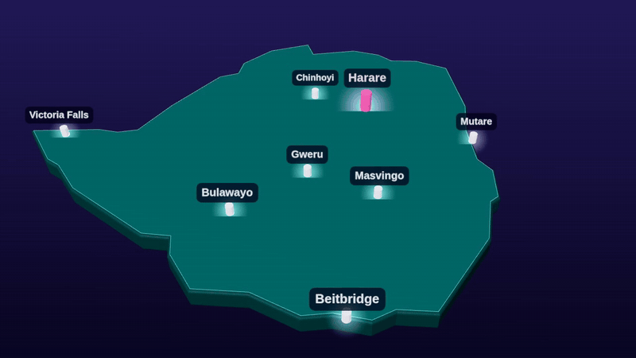




Built for Zimbabwe first
Everything country-specific lives in one market registry; a new country is an entry, not a rewrite.
US dollars, ZiG when enabled; EcoCash, OneMoney, InnBucks and cards through Paynow
+263 numbers (Econet, NetOne, Telecel), shown as +263 77 123 4567
13 public holidays, Easter and Heroes' Day included, feed the demand forecast
Harare time (CAT) everywhere, 24-hour clock
Emergency 999, police 995, ambulance 994
Car, SUV and bakkie, minivan, auto (tuk-tuk), bike; Zimbabwe number plates
13
Poolora · Zimbabwe launch · 2026
Notes:
Everything country-specific lives in one market registry: time zone, phone format, currency, emergency numbers, map bounds and now the public holidays. Zimbabwe is the first entry; another country is a new entry plus its payment provider.

Slide 14
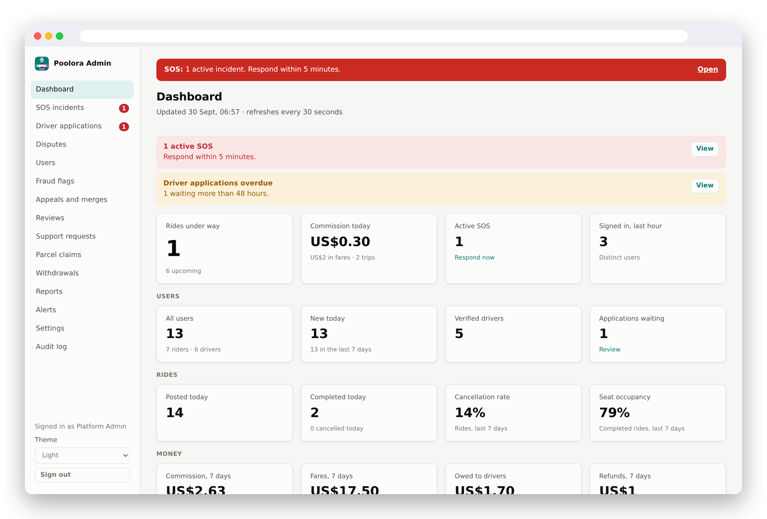
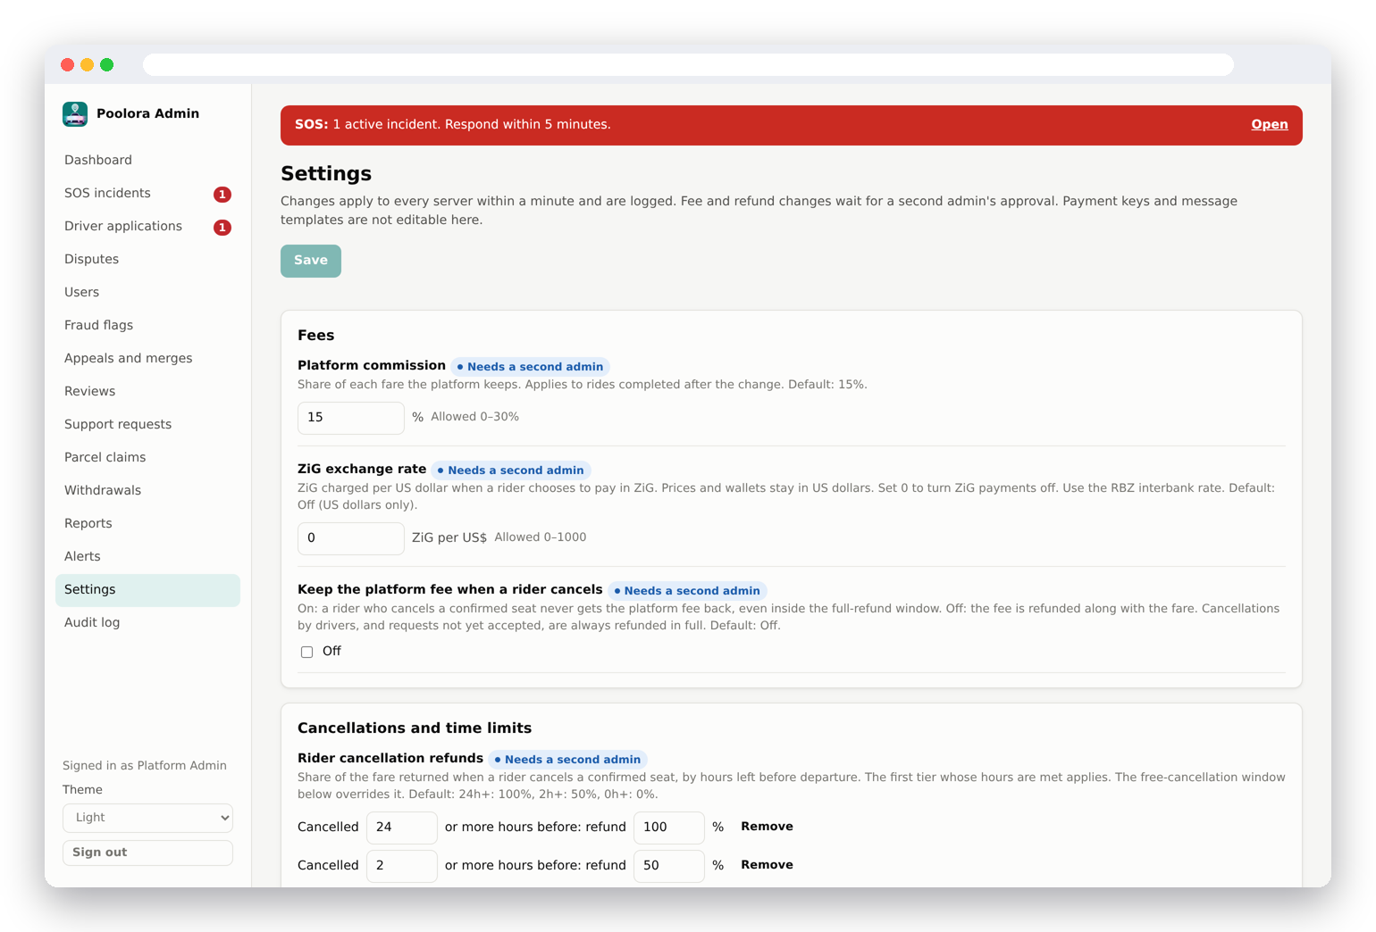
Running the service
Live figures, SOS desk, driver checks, disputes, payouts and settings; every change is logged.
Settings such as fees and refund tiers need a second admin's approval and can be reverted for 24 hours.
14
Poolora · Zimbabwe launch · 2026
Notes:
The web dashboard is how the team runs the service: live figures, SOS incidents, driver applications, disputes, payouts, and settings such as the refund tiers, each change logged and critical ones needing a second admin.

Slide 15

Where we are
The product is built and tested; launch depends on licences, live payments and the new e-hailing rules.
Done
Before launch
Rider and driver app, admin web, website
POTRAZ data controller licence and a Data Protection Officer
Paynow payments (test mode), wallet and withdrawals
Lawyer's review of the terms and privacy policy
Live tracking, SOS, check-ins, trip sharing
Paynow live mode and a business mobile money account
Parcels and group trips
A Zimbabwe support number (today +91)
In-app support assistant (Claude)
Align with the e-hailing regulations (transition ends about February 2027)
Account closure, 18+, per-user rate limits
Next markets through the market registry
15
Poolora · Zimbabwe launch · 2026
Notes:
What is done and what is left before real users. The legal and payment items are paperwork, not code. The e-hailing regulations are being written during a five-month transition from 8 September 2026.

Slide 16
Let's move Harare together
Partners: fleet owners, employers and campuses with commute routes
Payments and mobile money: live Paynow and payout accounts
Advisers on POTRAZ and the e-hailing regulations
N. M. Sibanda, founder
nathimike102@icloud.com
+91 90322 32881
16
Poolora · Zimbabwe launch · 2026
Notes:
Close with the ask and contact details.

Slide 17
Sources
Market figures checked in September 2026. Poolora figures are read from the code when the deck is built.
Zimpricecheck, "Urban ZUPCO, intercity bus fare and transport costs", 29 Sept 2026 · zimpricecheck.com
CityLink Luxury Coaches, routes and fares · citylinkcoaches.co.zw
ZERA fuel prices via GlobalPetrolPrices, 17 Sept 2026 · globalpetrolprices.com/Zimbabwe
NewsDay, "Adjust to our ride fares or walk, inDrive drivers tell Zimboz" · newsday.co.zw
Equity Axis, "Zimbabwe gives inDrive, Tap & Go and Bolt five months…", Sept 2026 · equityaxis.net
Things to Do in Zimbabwe, "Taxis & rideshare in Zimbabwe (2026)" · thingstodoinzimbabwe.com
NewZimbabwe, "Kombis now demanding fares in US dollars" · newzimbabwe.com
inDrive help, "How to cancel a ride" · indrive.com; BlaBlaCar carpool cancellation policy · blablacar.com
Zimbabwe outline: Natural Earth via johan/world.geo.json (public domain)
17
Poolora · Zimbabwe launch · 2026
Notes:
Where the market figures came from. Prices change often; these were checked in September 2026.

