Slide 1

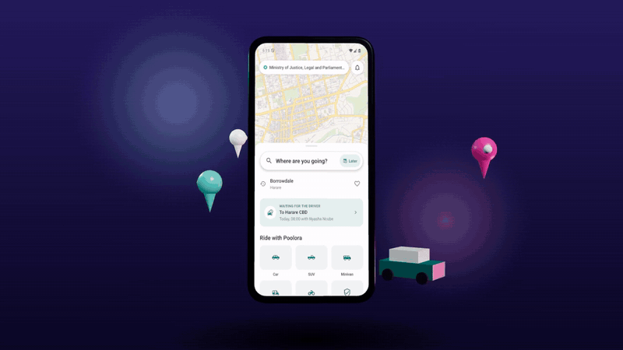
Poolora
Smart ride-sharing, parcel and trip pooling
Launching first in Zimbabwe · Harare
B.Tech Computer Science and Engineering · Final Year Project
Presented by: Nkosinathi Michael Sibanda
Project guide: ________________
Department of Computer Science and Engineering · 2026
Notes:
Introduce yourself and the project. Poolora lets people travelling the same way share a car, send a parcel with someone already going, or plan a group trip. It is being launched first in Zimbabwe, starting with Harare.

Slide 2




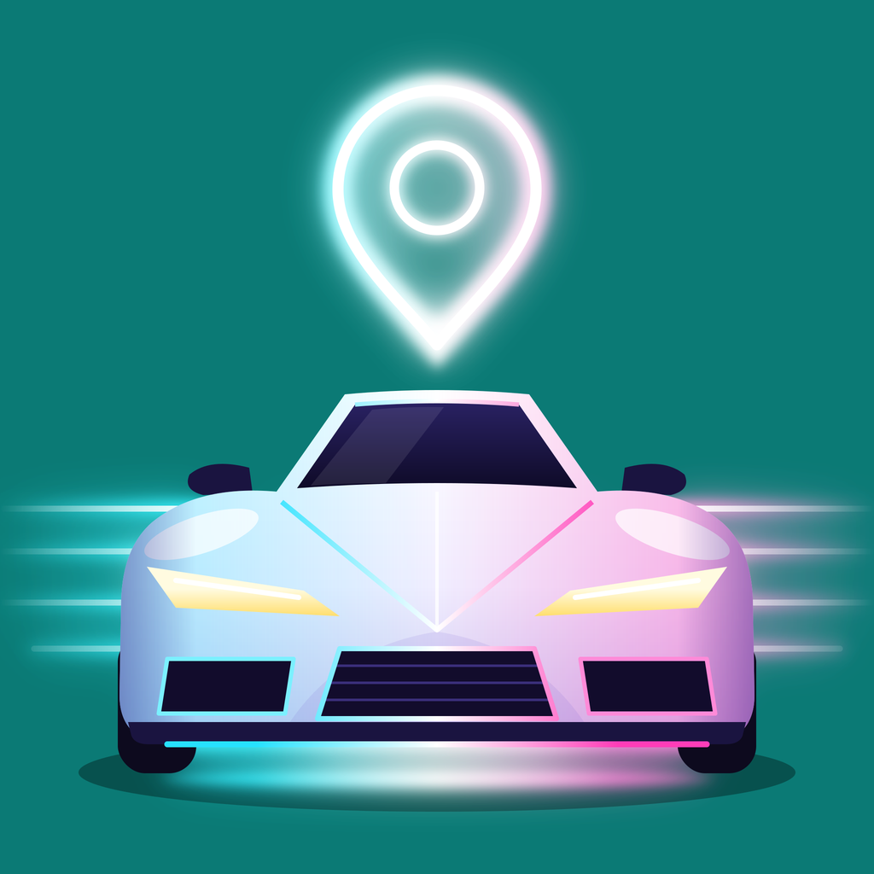
Getting around Harare today
Cheap options are crowded or unsafe; safe options are expensive; private cars run half empty.
Crowded public transport
Taxi apps cost more
ZUPCO charges US$0.50 up to 20 km but cannot meet demand, so private kombis and unlicensed "mushikashika" fill the gap.
inDrive, Vaya and others charge about US$2–4 for 5 km, several times a kombi fare, and drivers are raising prices.
Empty seats
Safety and trust
Petrol is about US$2.06 a litre, yet most cars on commute routes carry one person. The seats beside them go unused.
Informal lifts have no verified drivers, no record of the trip and no quick way to get help.
2
Poolora · Final year project · 2026
Notes:
Harare commuters have cheap but crowded buses and kombis, or taxi apps that cost several times more. Fuel is over two dollars a litre, and most private cars on commute routes carry only the driver. Figures are from September 2026; sources are at the end.

Slide 3
Objectives
1
Let drivers publish scheduled rides and riders book seats anywhere along the route, in the right direction
2
Take payment safely by EcoCash, OneMoney, InnBucks, card or wallet, with fair, automatic refunds
3
Keep riders safe: verified drivers, live tracking, SOS, trip sharing and check-ins
4
Suggest fair seat prices from distance, vehicle, commute hours, holidays and demand
5
Give administrators one dashboard for verification, disputes, SOS, payouts and reports
6
Extend pooling to parcels and to group trips with shared expenses
7
Build for one market first (Zimbabwe) so that a new country is configuration, not a rewrite
3
Poolora · Final year project · 2026
Notes:
These are the goals the project set out to meet; each is covered by a later slide.

Slide 4
Existing options vs Poolora
 | Kombi / ZUPCO | Taxi apps (inDrive, Vaya) | Poolora
Price, 15 km | US$0.50–1 (ZUPCO US$0.50) | US$2–4 for 5 km | US$1 a seat (car)
Booking | Queue at the rank | On demand, fare negotiated | Scheduled seat, paid upfront
Matching | Fixed routes | Pickup near the driver | Anywhere along the driver's route, right direction
Payment | Cash | Mostly cash | EcoCash, OneMoney, InnBucks, card, wallet
Cancelling | — | Free; frequent cancellers blocked | 100% back from 24 h, free for 30 min after acceptance
Safety | None | Ratings | Verified drivers, SOS, live share, check-ins
Also | — | Some deliveries | Parcels with delivery codes, group trips
4
Poolora · Final year project · 2026
Notes:
How Poolora differs from what Harare commuters use now. Taxi apps are on-demand and mostly cash; kombis are cheap but informal. Poolora is scheduled seat booking with upfront mobile-money payment and safety features.

Slide 5
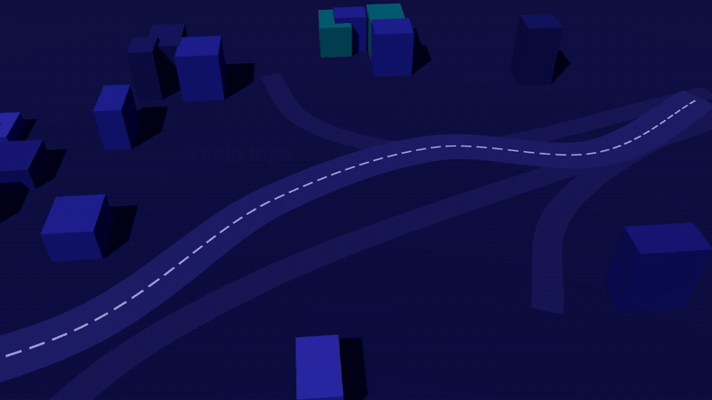



One platform, three kinds of pooling
Drivers who are making the trip anyway sell their empty seats and boot space.
Ride pooling
Book a seat in a car, SUV, minivan, auto or on a bike going your way. US$1 for a 15 km commute.
Parcel pooling
Send a parcel with a driver already on the route; the recipient hands over a delivery code.
Trip pooling
Plan a group trip, find partners, vote on activities and split costs to the cent.
5
Poolora · Final year project · 2026
Notes:
The animation shows the idea: three solo trips become one shared car. Poolora pools three things: seats in cars already making a trip, parcel space, and group trips.

Slide 6





How a shared ride works
From posting a ride to rating it, in five steps.
1
2
3
4
5
Driver posts
Rider searches
Books and pays
Rides live
Rates and settles
Route, time (at least 2 h ahead), up to 3 stops, seats and a price within the suggested range
Matched anywhere along the route, ranked by distance, time, rating and reliability
EcoCash, OneMoney, InnBucks, card or wallet. Unpaid requests close after 15 min
Driver arrives, picks up, drops off; live map, SOS and check-ins throughout
Both rate each other; the driver's share (fare less 15%) goes to their wallet
6
Poolora · Final year project · 2026
Notes:
The whole ride in five steps. Payment is taken when the rider books; the driver accepts, and the driver is paid when the rider is dropped off.

Slide 7
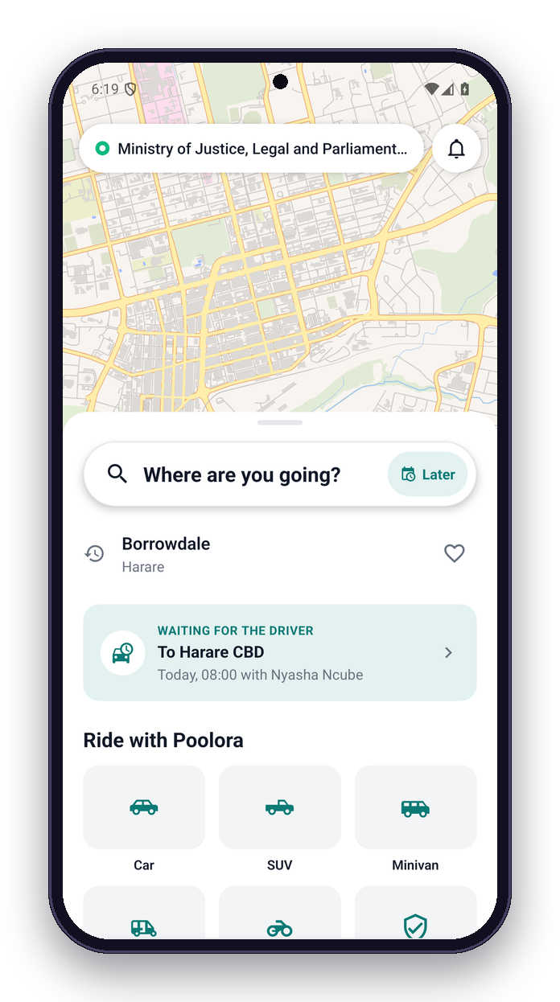
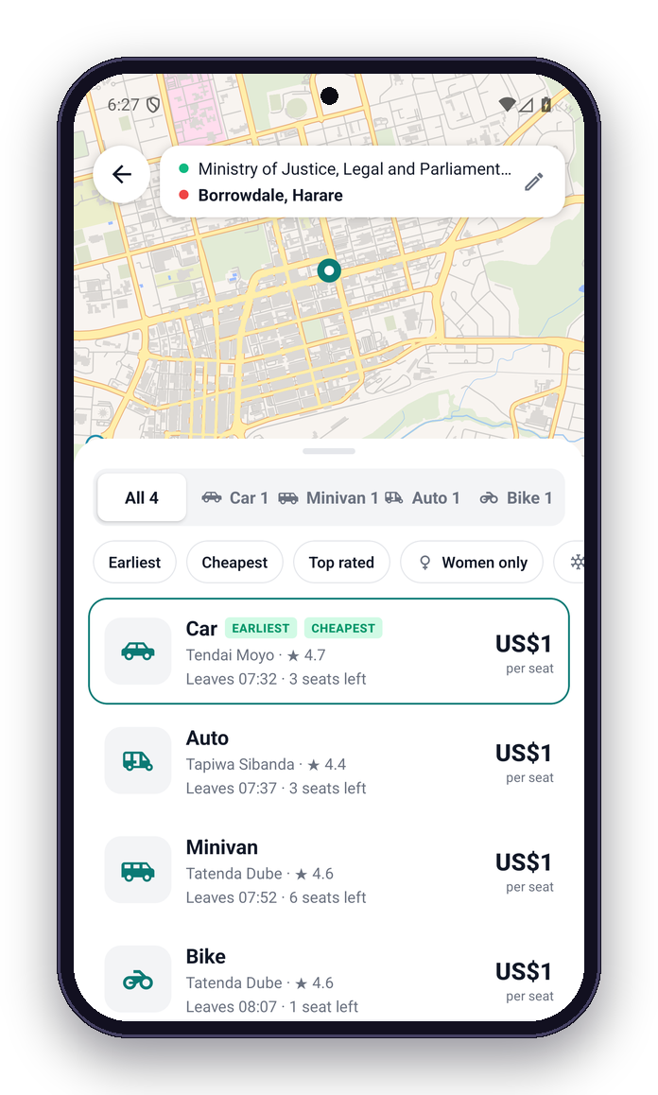
Find a ride
Search from where you are; results show every kind of vehicle going your way.
Search any place in Zimbabwe (OpenStreetMap)
Filter by vehicle; sort by time, price or rating
Seat prices in US dollars; US$1 for about 11 km
Car, SUV and bakkie, minivan, auto (tuk-tuk), bike
7
Poolora · Final year project · 2026
Notes:
The rider home screen on a Harare map, with the five vehicle classes. Searching Borrowdale lists every ride passing that way: car, minivan, auto and bike, with price, time and seats left.

Slide 8
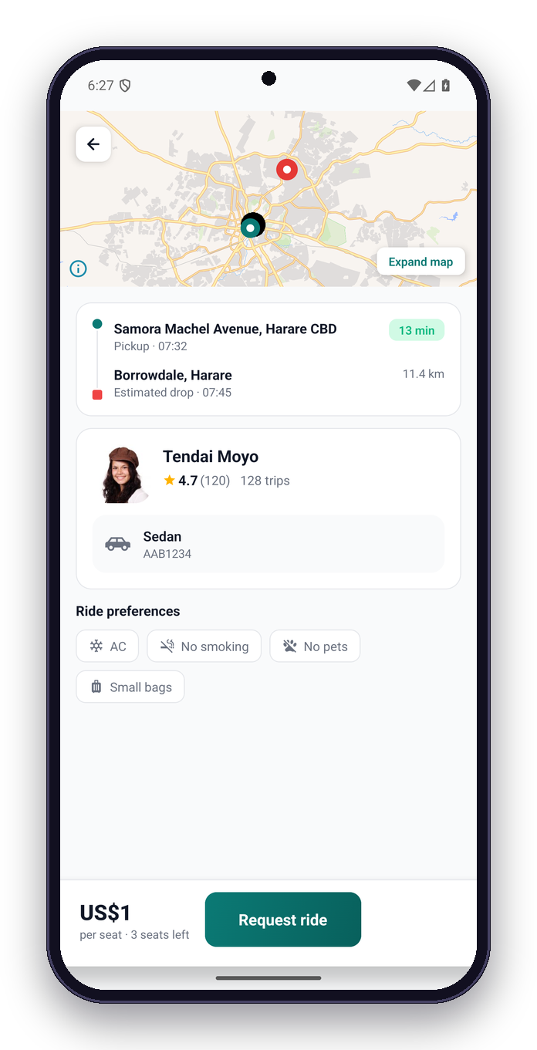
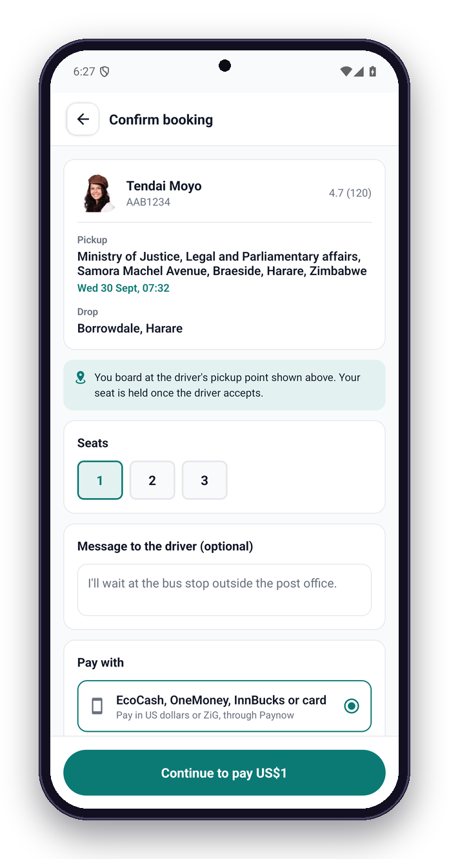
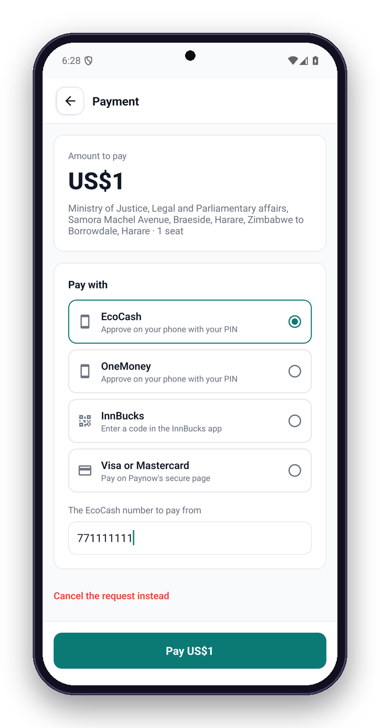
Book and pay
See the driver and the route, choose seats, pay by mobile money or card through Paynow.
Verified driver, rating and trips
EcoCash, OneMoney, InnBucks or card, in US$ or ZiG
8
Poolora · Final year project · 2026
Notes:
Ride details show the driver, rating, vehicle and route. Booking takes a message for the driver and the payment method. Payment goes through Paynow: EcoCash and OneMoney push a PIN prompt to the phone, InnBucks gives a code, cards open Paynow's secure page.

Slide 9
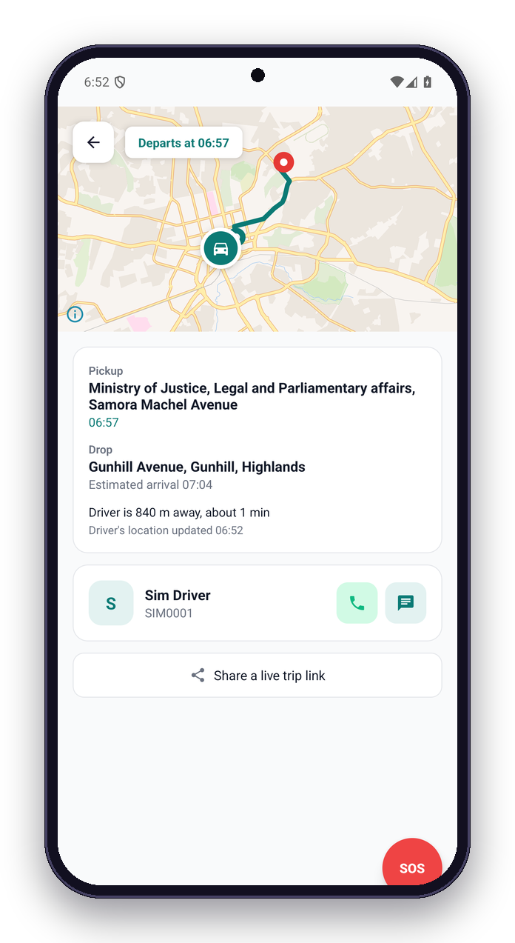
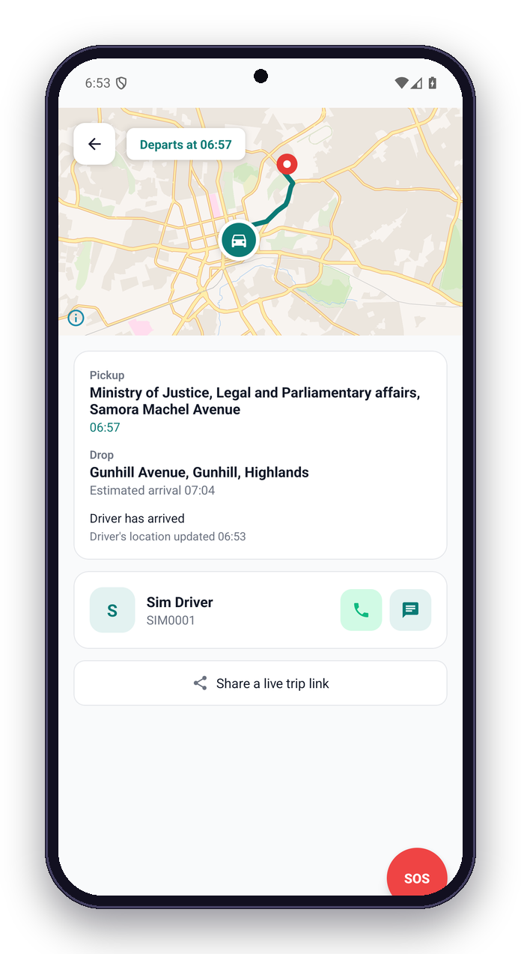
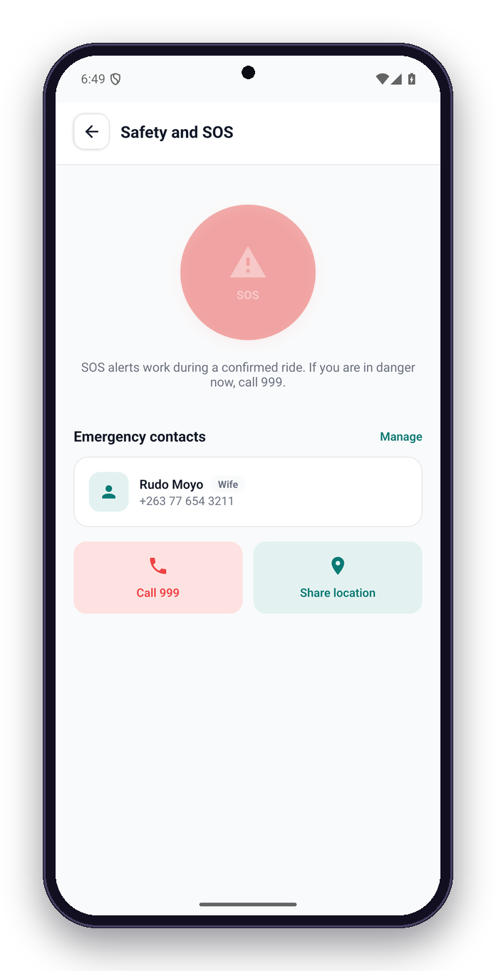
On the road
Follow the car live; the rider sees each step and can raise an SOS at any time.
Contacts get a live-location link
Live distance and time to pickup
9
Poolora · Final year project · 2026
Notes:
A simulated ride in Harare: the app shows the car approaching, then "Driver has arrived". The SOS screen alerts the safety team and emergency contacts; 999 is one tap away.

Slide 10
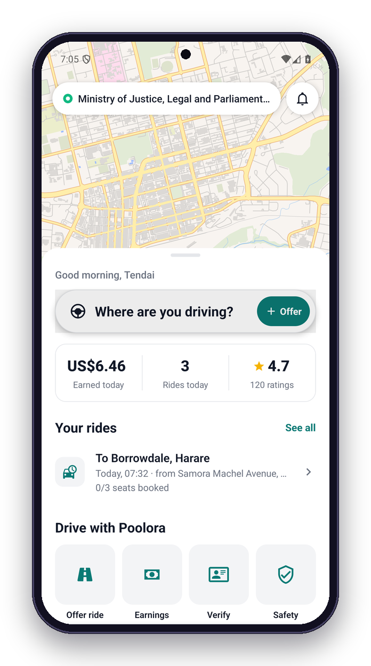
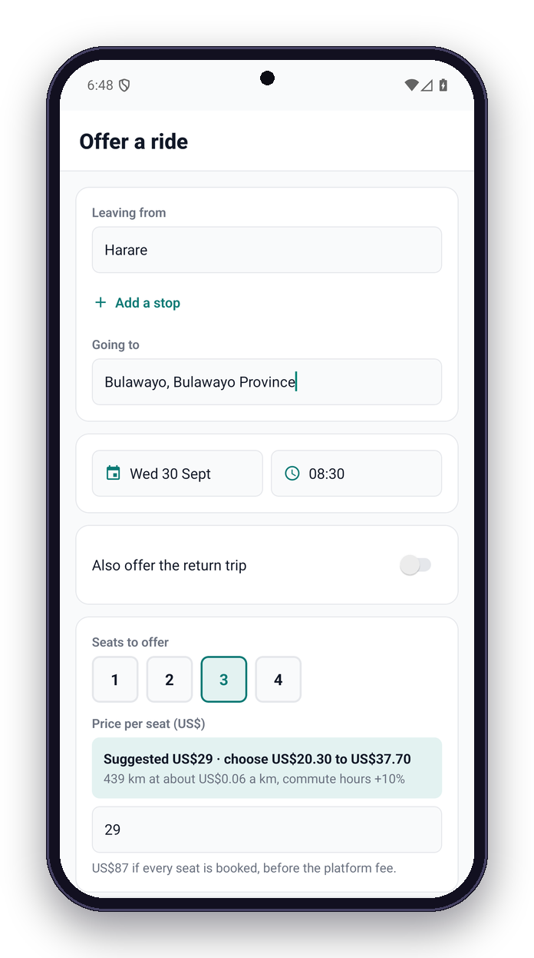
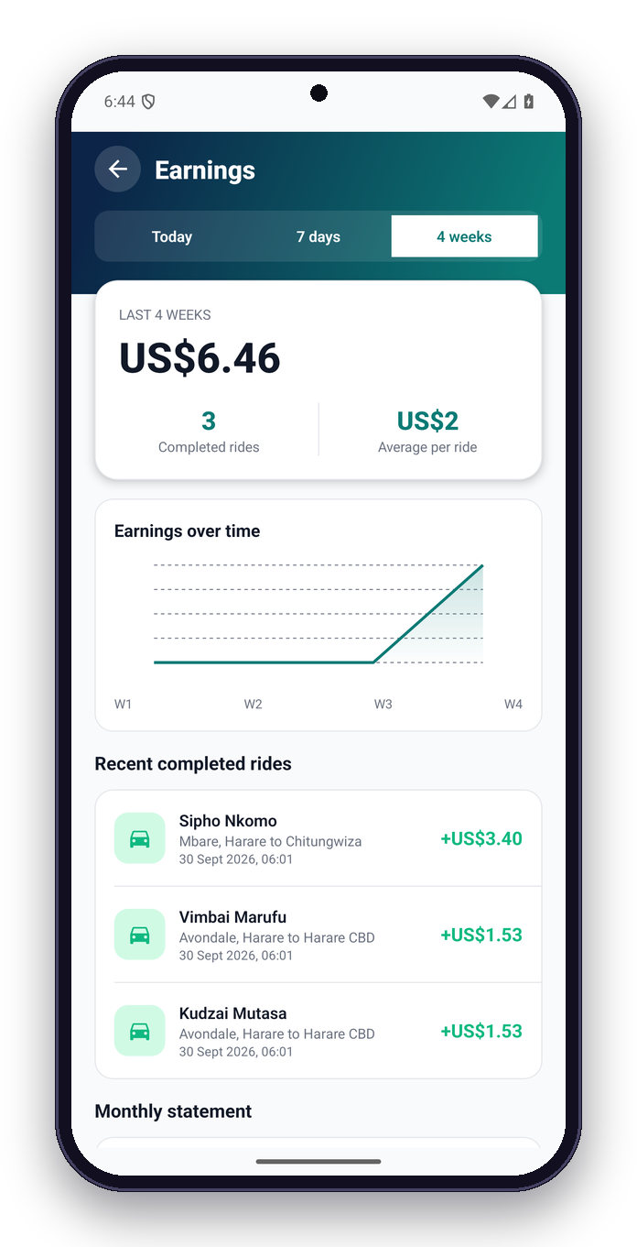
Drive and earn
Post a ride in a minute; Poolora suggests a fair price and shows what the trip earns.
Earnings by day, week and month
Suggested price and the allowed range
10
Poolora · Final year project · 2026
Notes:
Drivers see today's earnings and upcoming rides. Posting Harare to Bulawayo suggests US$26.50 a seat off-peak (US$29 in commute hours) from the route distance and vehicle; the driver can choose within 30%.

Slide 11
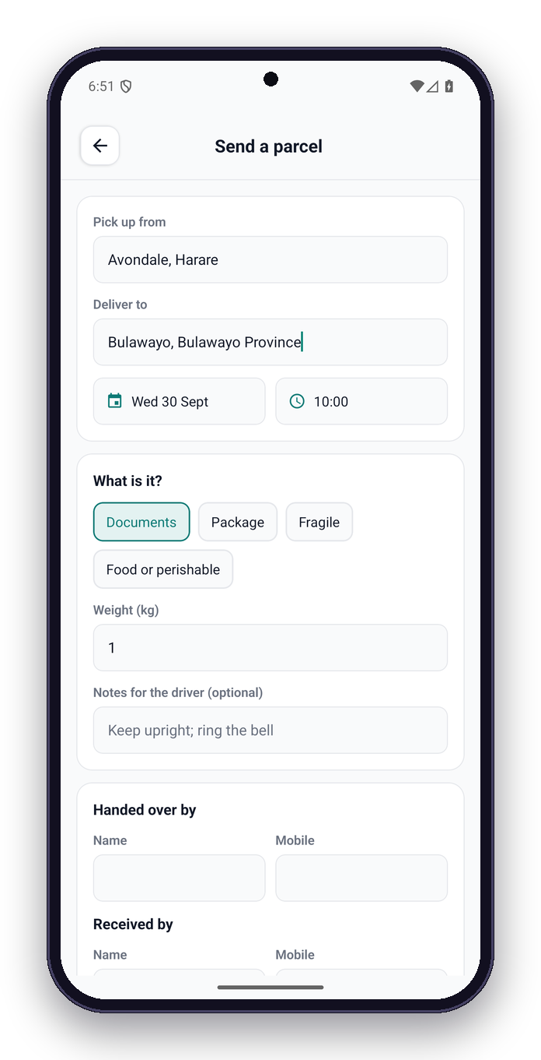
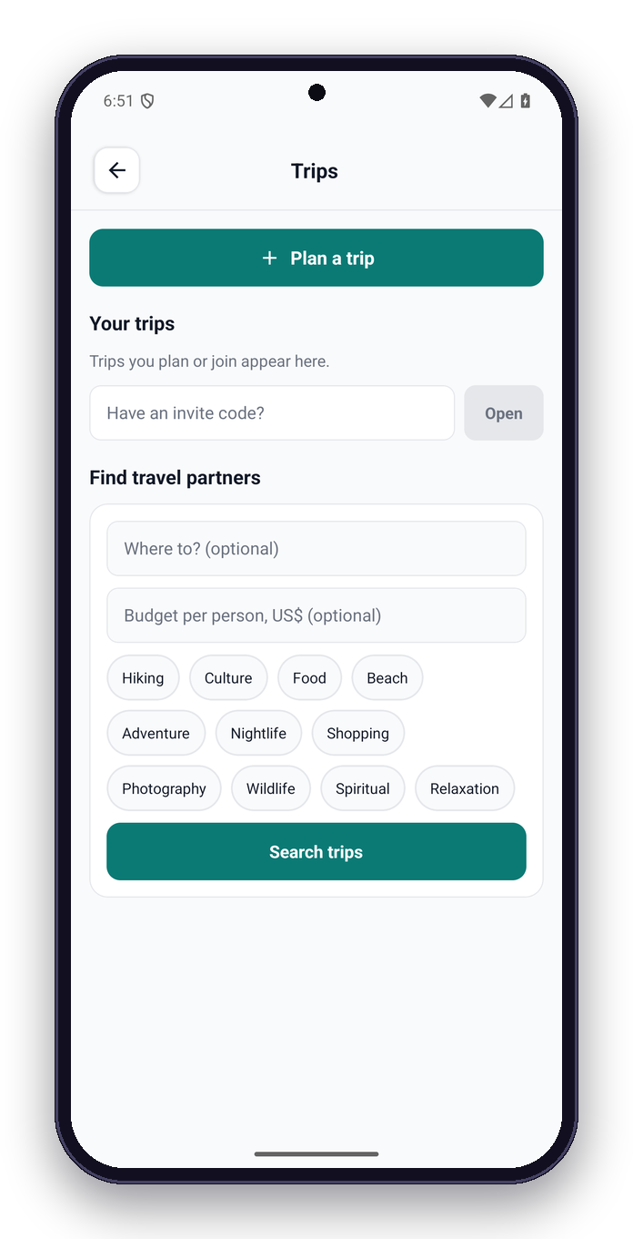
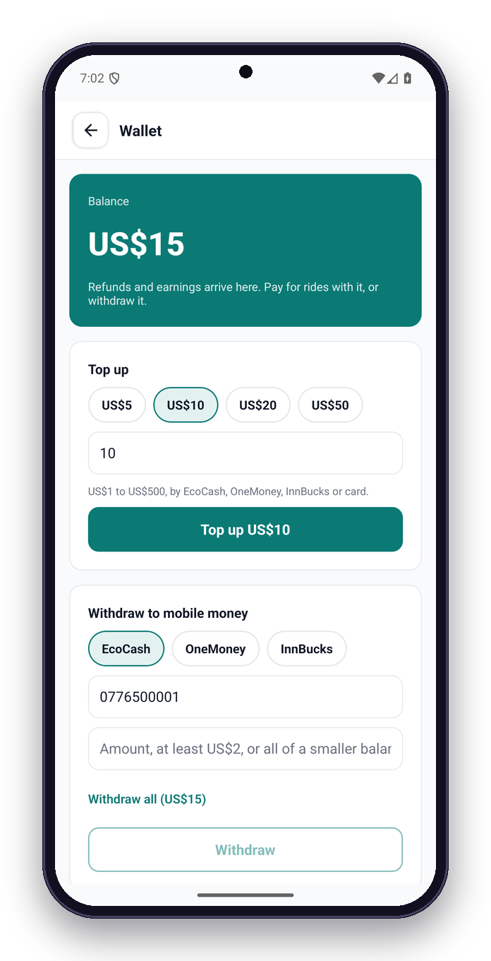
More than rides
Parcels travel with drivers already on the route; groups plan trips together; one wallet for everything.
Photo proof at pickup and delivery; delivery code
Withdraw US$2–US$1000 to mobile money
11
Poolora · Final year project · 2026
Notes:
Parcels are priced like a motorbike courier in town (about US$5.50 for 10 km) and near Zimpost between cities (about US$16 for 5 kg Harare to Bulawayo), with photo proof and a delivery code. Group trips match partners by interests, dates and budget. The wallet takes refunds and earnings and withdraws to mobile money.

Slide 12






System architecture
ML service
Python · FastAPI
Mobile app
React Native + Expo · riders and drivers
Backend API
Node.js · Express · TypeScript · 252 routes
MongoDB
34 collections · geo indexes
Admin web
React + Vite · operations
Redis + Kafka
Cache, limits, locks, events
Real-time gateway
Socket.IO · live GPS, chat, SOS
Website
Vite on Vercel · terms, privacy
External services
Paynow · OSRM, Photon, Nominatim · Firebase · Twilio · S3 · Claude
12
Poolora · Final year project · 2026
Notes:
Two clients talk to one backend over HTTPS and WebSockets. The backend owns the business rules, calls the ML service over HTTP, and uses MongoDB, Redis and Kafka. Paynow, OpenStreetMap services, Firebase, Twilio and Claude are the external services.

Slide 13














Technology stack
React Native + Expo
Android and iOS app
TypeScript
App, API, admin, website
Node.js + Express 5
REST API, 252 routes
Socket.IO
Live location, chat, SOS
MongoDB + Mongoose
Documents with 2dsphere indexes
Redis
Cache, rate limits, job locks
Kafka
Events (in-process fallback)
Python FastAPI
Demand, fraud, route order
Firebase
Google sign-in, push
OpenStreetMap
MapLibre tiles, OSRM routes, Photon
Paynow
EcoCash, OneMoney, InnBucks, card
Claude
In-app support assistant
Vite + React
Admin dashboard, website
Docker + Kubernetes
Containers, autoscaling
Jest + Vitest
535 automated tests
13
Poolora · Final year project · 2026
Notes:
TypeScript across the app, API and admin; Python for the ML service. Everything runs locally with Docker Compose and deploys to Kubernetes.

Slide 14
Algorithm: matching riders along a route
When a ride is posted, its road route from OSRM is stored as a GeoJSON LineString with a 2dsphere index
Search runs $geoNear on the route near the rider's pickup (within 2 km of the line by default)
Each candidate is projected onto the route: the pickup must come before the drop along the line (right direction)
Candidates are ranked by a weighted score; the fare is the seat price, shown before booking
Match score weights
Pickup distance
40%
Departure time
30%
Driver rating
15%
Acceptance rate
10%
Low cancellations
5%
14
Poolora · Final year project · 2026
Notes:
Matching is along the route, not just near the start. The route line is indexed; the rider must be picked up before the drop along the line; results are scored.

Slide 15
Fair prices, set against what people pay now
price = distance × rate(vehicle) × commute hours (+10%, not on public holidays) × surge (+20–50%) · drivers choose within ±30%
Commuting in Harare
Harare to Bulawayo (439 km)
ZUPCO bus, up to 20 km
US$0.50
Ordinary bus
US$15
Kombi
US$0.50–1
Poolora seat, car
US$26.50
Poolora seat, 15 km (car)
US$1
Poolora seat, minivan
US$28.50
Taxi app, 5 km
US$2–4
CityLink luxury coach
US$35
Rates a seat per km: bike US$0.04 · auto US$0.045 · hatchback US$0.05 · sedan US$0.06 · minivan US$0.065 · bakkie US$0.07 · SUV US$0.075. Never below US$1 or outside US$0.02–US$0.20 a km. Off-peak examples from the pricing code; market fares September 2026.
15
Poolora · Final year project · 2026
Notes:
Seat prices come from the route distance and a per-kilometre rate for the vehicle, about a car's running cost shared between riders, plus 10% in commute hours and a surge only when the demand forecast is high. A 15 km commute costs about a dollar, like a kombi; Harare to Bulawayo sits between the ordinary bus and the luxury coach.

Slide 16

Cancellations and refunds
Clear rules shown before the rider confirms; refunds land in the wallet at once.
Departure →
100% back
50% back
0% back
24 h or more before
2–24 h before
Under 2 h
Free for 30 minutes after the driver accepts, while the ride is 1 hour or more away
Everything back before the driver accepts, if the driver cancels, or if the driver moves the time
No-show: the driver waits 10 minutes at the pickup; then the fare goes to the driver, less the fee
Refunds go to the Poolora wallet at once and can be withdrawn to EcoCash, OneMoney or InnBucks
16
Poolora · Final year project · 2026
Notes:
Refunds follow simple rules: before the driver accepts, everything comes back; 30 minutes after acceptance it is still free if the ride is an hour or more away; then 100% from 24 hours, 50% from 2 hours, nothing after. Driver cancellations and changed times always refund in full. Paynow cannot refund, so money comes back to the wallet and can be withdrawn to mobile money.

Slide 17





Safety by design
For riders and drivers alike: the reason to choose Poolora.
SOS in 3 seconds
Pickup code
Every phone traced
Safety desk alerted at once; family get a live link 10 s later. No GPS needed; offline, it texts them from the phone
The rider gets in only when the driver has entered their 4-digit code: never the wrong car
The car and each rider during the ride, screen off too. Kept 30 days, or with any incident
Car trackers
Women-only, verified
Check-ins and alerts
A GPS tracker in the car keeps it traceable with every phone off; its panic button raises an SOS
Our team checks an ID and a selfie: only verified women post, find or book these rides
"Are you OK?" every 30 min, route-deviation alerts, and a live trip link for family
17
Poolora · Final year project · 2026
Notes:
Safety is what sets Poolora apart, and it covers the driver as much as the rider. SOS reaches the safety desk at once and the family ten seconds later. Every phone on a ride is traced, and a GPS tracker in the car keeps it traceable even if every phone is switched off. A pickup code means nobody gets into the wrong car. Women-only rides are for women whose ID our team has checked. All of it is covered by tests against a real database.

Slide 18



When an SOS is raised
Rider or driver, second by second, and even when a phone is switched off.
0 s
10 s
Every 5 s
Phone off?
5 min
Hold 3 s. The safety desk is paged by push and SMS and sees it live
Family get a link: where they are, the car and its plate. Cancel before then if pressed by mistake
Every phone on the ride and the car's own tracker report, screen off too
Its battery says why: ran out, or switched off. The car and other phones still report
Nobody has taken it? Every admin is paged again until someone does
What the safety team sees, to find everyone
Both people: photo, ID check, licence, mobile money numbers (registered to a name)
The car: make, colour, plate, photos, and its tracker
Every other rider on the ride, and the messages and calls between them
Who the danger is, if they said: the driver, a passenger, someone outside, medical
18
Poolora · Final year project · 2026
Notes:
What happens second by second when someone raises an SOS, whether rider or driver. The safety desk knows at once; the family ten seconds later, so an accidental press can be cancelled. Every phone on the ride and the car's own tracker keep reporting with the screen off. If a phone goes off, its last battery level tells the team whether it ran out or was switched off. Nobody can leave an SOS waiting: every admin is paged again every five minutes until someone takes it. And the team can identify everyone: both people, the car, the other riders, and the mobile money numbers they used, which are registered to a name.

Slide 19
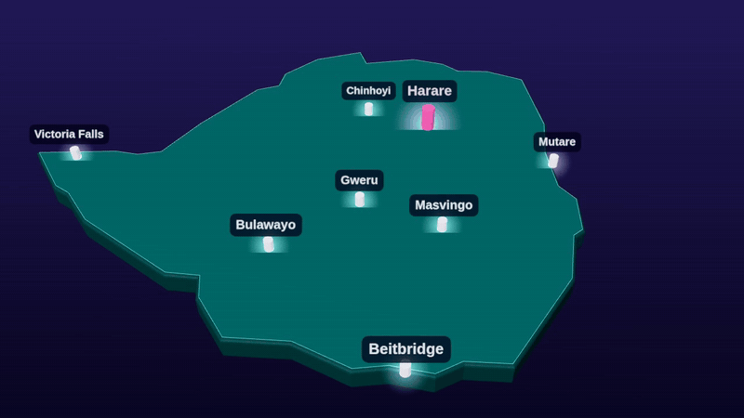

Built for Zimbabwe first
Everything country-specific lives in one market registry; a new country is an entry, not a rewrite.
US dollars, ZiG when enabled; EcoCash, OneMoney, InnBucks and cards through Paynow
+263 numbers (Econet, NetOne, Telecel), shown as +263 77 123 4567
13 public holidays, Easter and Heroes' Day included, feed the demand forecast
Harare time (CAT) everywhere, 24-hour clock
Emergency 999, police 995, ambulance 994
Car, SUV and bakkie, minivan, auto (tuk-tuk), bike; Zimbabwe number plates
19
Poolora · Final year project · 2026
Notes:
Everything country-specific lives in one market registry: time zone, phone format, currency, emergency numbers, map bounds and now the public holidays. Zimbabwe is the first entry; another country is a new entry plus its payment provider.

Slide 20
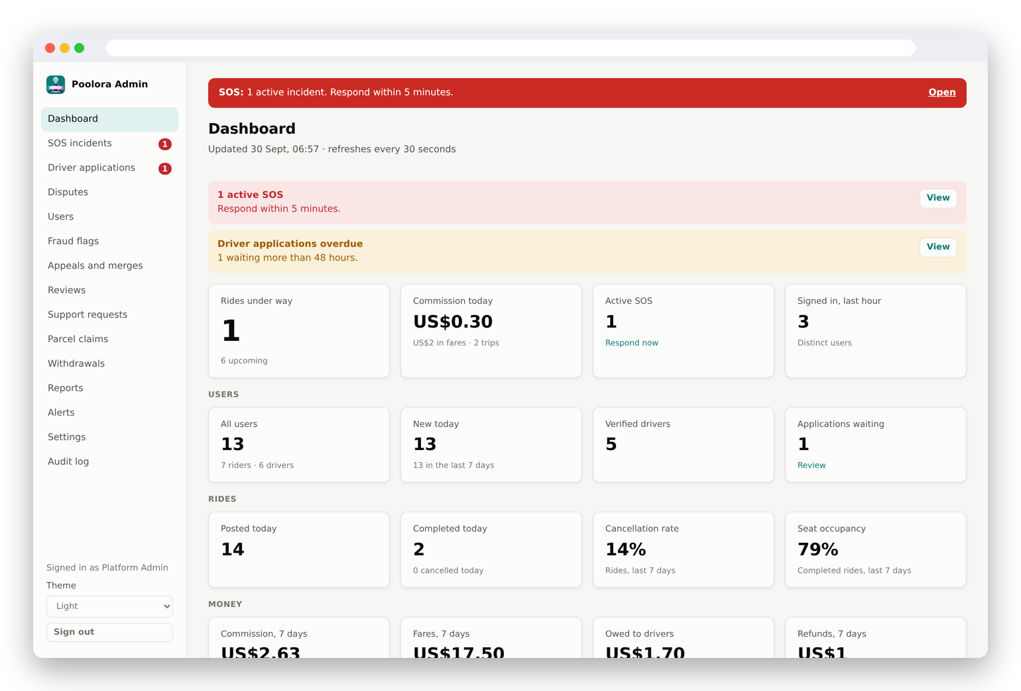
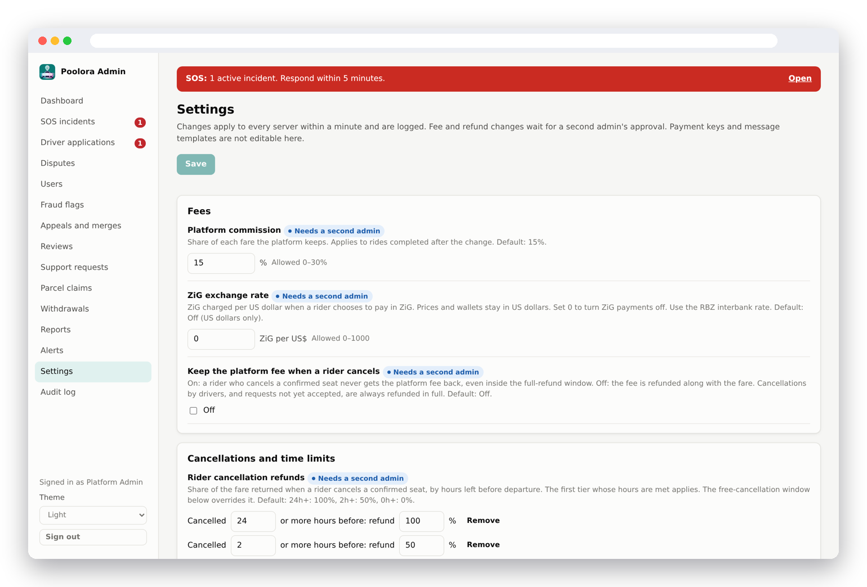
Admin dashboard (web)
Live figures, SOS desk, driver checks, disputes, payouts and settings; every change is logged.
Settings such as fees and refund tiers need a second admin's approval and can be reverted for 24 hours.
20
Poolora · Final year project · 2026
Notes:
The web dashboard is how the team runs the service: live figures, SOS incidents, driver applications, disputes, payouts, and settings such as the refund tiers, each change logged and critical ones needing a second admin.

Slide 21
Database design
MongoDB, 34 collections. Places are GeoJSON points and lines with 2dsphere indexes.
Core
Money
Safety
Admin
Pooling
User (profile, KYC, vehicles, contacts)
Ride (route line, stops, vehicle)
Booking (pickup, drop, fare, refunds)
Rating, Message
Payment, GatewayCharge (Paynow)
Wallet, WalletTransaction
CoinLedger, WithdrawalRequest
EmergencyRecord, EmergencyToken
TripShare, Dispute, Appeal
SupportTicket
AdminAuditLog, AdminNote
PlatformSettings (two-admin changes)
AlertRule, ReportSchedule
ParcelPooling (codes, photos, claims)
Trip (members, votes, expenses)
RideAlert, SavedRoute
21
Poolora · Final year project · 2026
Notes:
MongoDB document store. Places are GeoJSON with 2dsphere indexes; the ride stores its route line for along-the-route search.

Slide 22
Testing and results
410
116
9
68k
backend tests
58 suites, all passing
mobile app tests
34 suites, all passing
admin web tests
Vitest
lines of code
TypeScript and Python
Jest unit and integration tests on a real in-memory MongoDB; money flows tested end to end
Vitest for the admin web; TypeScript, ESLint and tests in CI
Ride simulator: a bot driver or rider for a full trip on one phone
Android emulator runs: sign-in, booking, Paynow screens, live ride, account closure
Found by running the app, then fixed with a test
Posting any ride crashed (a recursive event payload)
Rate limits per IP would lock out users behind carrier NAT
A payment landing as a request expired was never refunded
Under-18 sign-ups; no way to close an account
Same-day cancellations lost the whole fare
22
Poolora · Final year project · 2026
Notes:
Numbers are read from the test runs when the deck is built. The emulator testing on 29 and 30 September found defects that unit tests missed, including one that made posting any ride fail.

Slide 23


Deployment
Containers
Kubernetes
Operations
Each service ships as an image
Docker Compose runs the whole stack locally
Backend and ML deployments with a horizontal pod autoscaler
MongoDB, Redis and Kafka as StatefulSets
Ingress with TLS, network policies, disruption budgets
Scheduled database backups
Health checks and Prometheus metrics
Admin web and website as static sites on Vercel
KYC files in S3, Cape Town region
23
Poolora · Final year project · 2026
Notes:
Containers for every service; Kubernetes manifests with autoscaling, backups and monitoring; the two web apps are static sites on Vercel.

Slide 24
Challenges and what I learned
Moving the whole product to a new country
Payments without refunds
Currency, phones, time, maps, payments and law all changed; a single market registry made the next country cheap.
Paynow has no refund API, so every refund goes to an in-app wallet that can be withdrawn to mobile money, with idempotent keys.
Tests that mock too much
Fair rules need real prices
Every suite mocked the event bus, so a crash when posting rides slipped through; now key modules keep one real test.
Refund tiers and fares were rechecked against kombis, ZUPCO, inDrive and intercity buses before launch.
24
Poolora · Final year project · 2026
Notes:
The hardest parts, and what they taught.

Slide 25

Status and future scope
The product is built and tested; launch depends on licences, live payments and the new e-hailing rules.
Done
Before launch
Rider and driver app, admin web, website
POTRAZ data controller licence and a Data Protection Officer
Paynow payments (test mode), wallet and withdrawals
Lawyer's review of the terms and privacy policy
Safety: SOS, every phone traced, car trackers, pickup codes
Paynow live mode and a business mobile money account
Parcels and group trips
A Zimbabwe support number (today +91)
In-app support assistant (Claude)
Align with the e-hailing regulations (transition ends about February 2027)
Account closure, 18+, per-user rate limits
App rebuild and Play Store safety declarations
25
Poolora · Final year project · 2026
Notes:
What is done and what is left before real users. The legal and payment items are paperwork, not code. The e-hailing regulations are being written during a five-month transition from 8 September 2026.

Slide 26
Conclusion
Poolora pools seats, parcel space and group trips in one app
Built for Zimbabwe: US dollars and mobile money, Harare time, local holidays and vehicles
Safety, payments, refunds and operations are in place and tested
Launch needs licences and live payments, not more code
Thank you · Questions?
26
Poolora · Final year project · 2026
Notes:
Summarise: a working pooling platform, localised for Zimbabwe, with safety, payments and operations in place. Then take questions.

Slide 27
Sources
Market figures checked in September 2026. Poolora figures are read from the code when the deck is built.
Zimpricecheck, "Urban ZUPCO, intercity bus fare and transport costs", 29 Sept 2026 · zimpricecheck.com
CityLink Luxury Coaches, routes and fares · citylinkcoaches.co.zw
ZERA fuel prices via GlobalPetrolPrices, 17 Sept 2026 · globalpetrolprices.com/Zimbabwe
NewsDay, "Adjust to our ride fares or walk, inDrive drivers tell Zimboz" · newsday.co.zw
Equity Axis, "Zimbabwe gives inDrive, Tap & Go and Bolt five months…", Sept 2026 · equityaxis.net
Things to Do in Zimbabwe, "Taxis & rideshare in Zimbabwe (2026)" · thingstodoinzimbabwe.com
NewZimbabwe, "Kombis now demanding fares in US dollars" · newzimbabwe.com
inDrive help, "How to cancel a ride" · indrive.com; BlaBlaCar carpool cancellation policy · blablacar.com
Zimbabwe outline: Natural Earth via johan/world.geo.json (public domain)
27
Poolora · Final year project · 2026
Notes:
Where the market figures came from. Prices change often; these were checked in September 2026.

