Slide 1
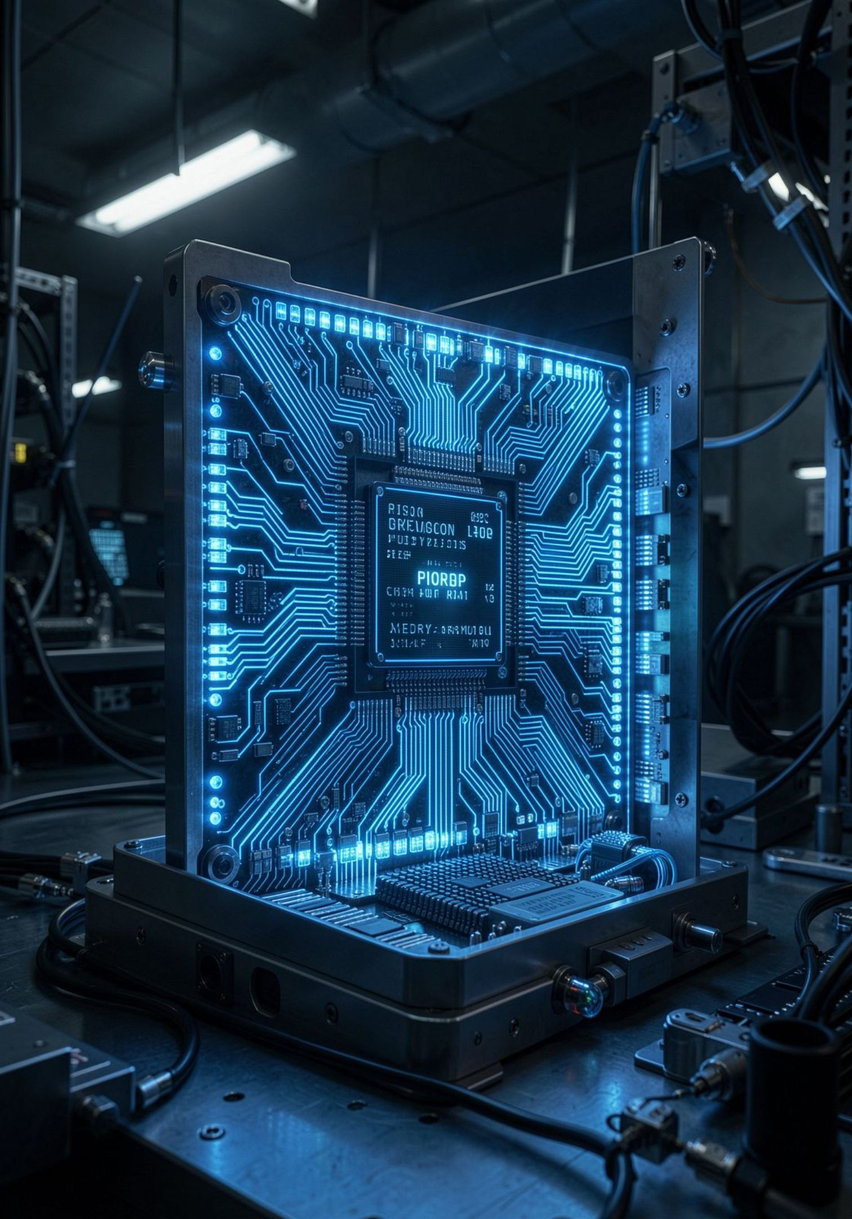
Quantum Computing: The Next Frontier of Technology
From theory to transformation — understanding the science, the hardware, and the breakthroughs reshaping our world.
INTRODUCTION

Slide 2
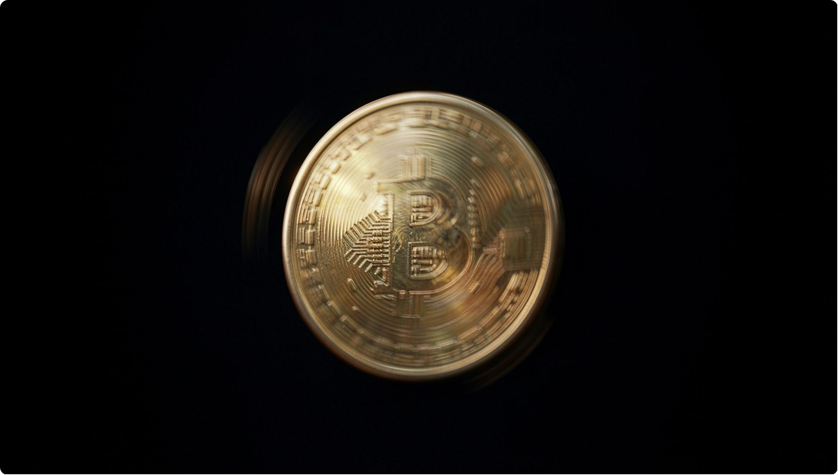
CORE CONCEPT
From Bits to Qubits
Classical Bit
Like a light switch — either 0 or 1. One state at a time.
Quantum Qubit
Like a spinning coin — simultaneously 0, 1, or a blend of both. This is superposition.
Qubits unlock exponential computing power by exploring many states at once.

Slide 3
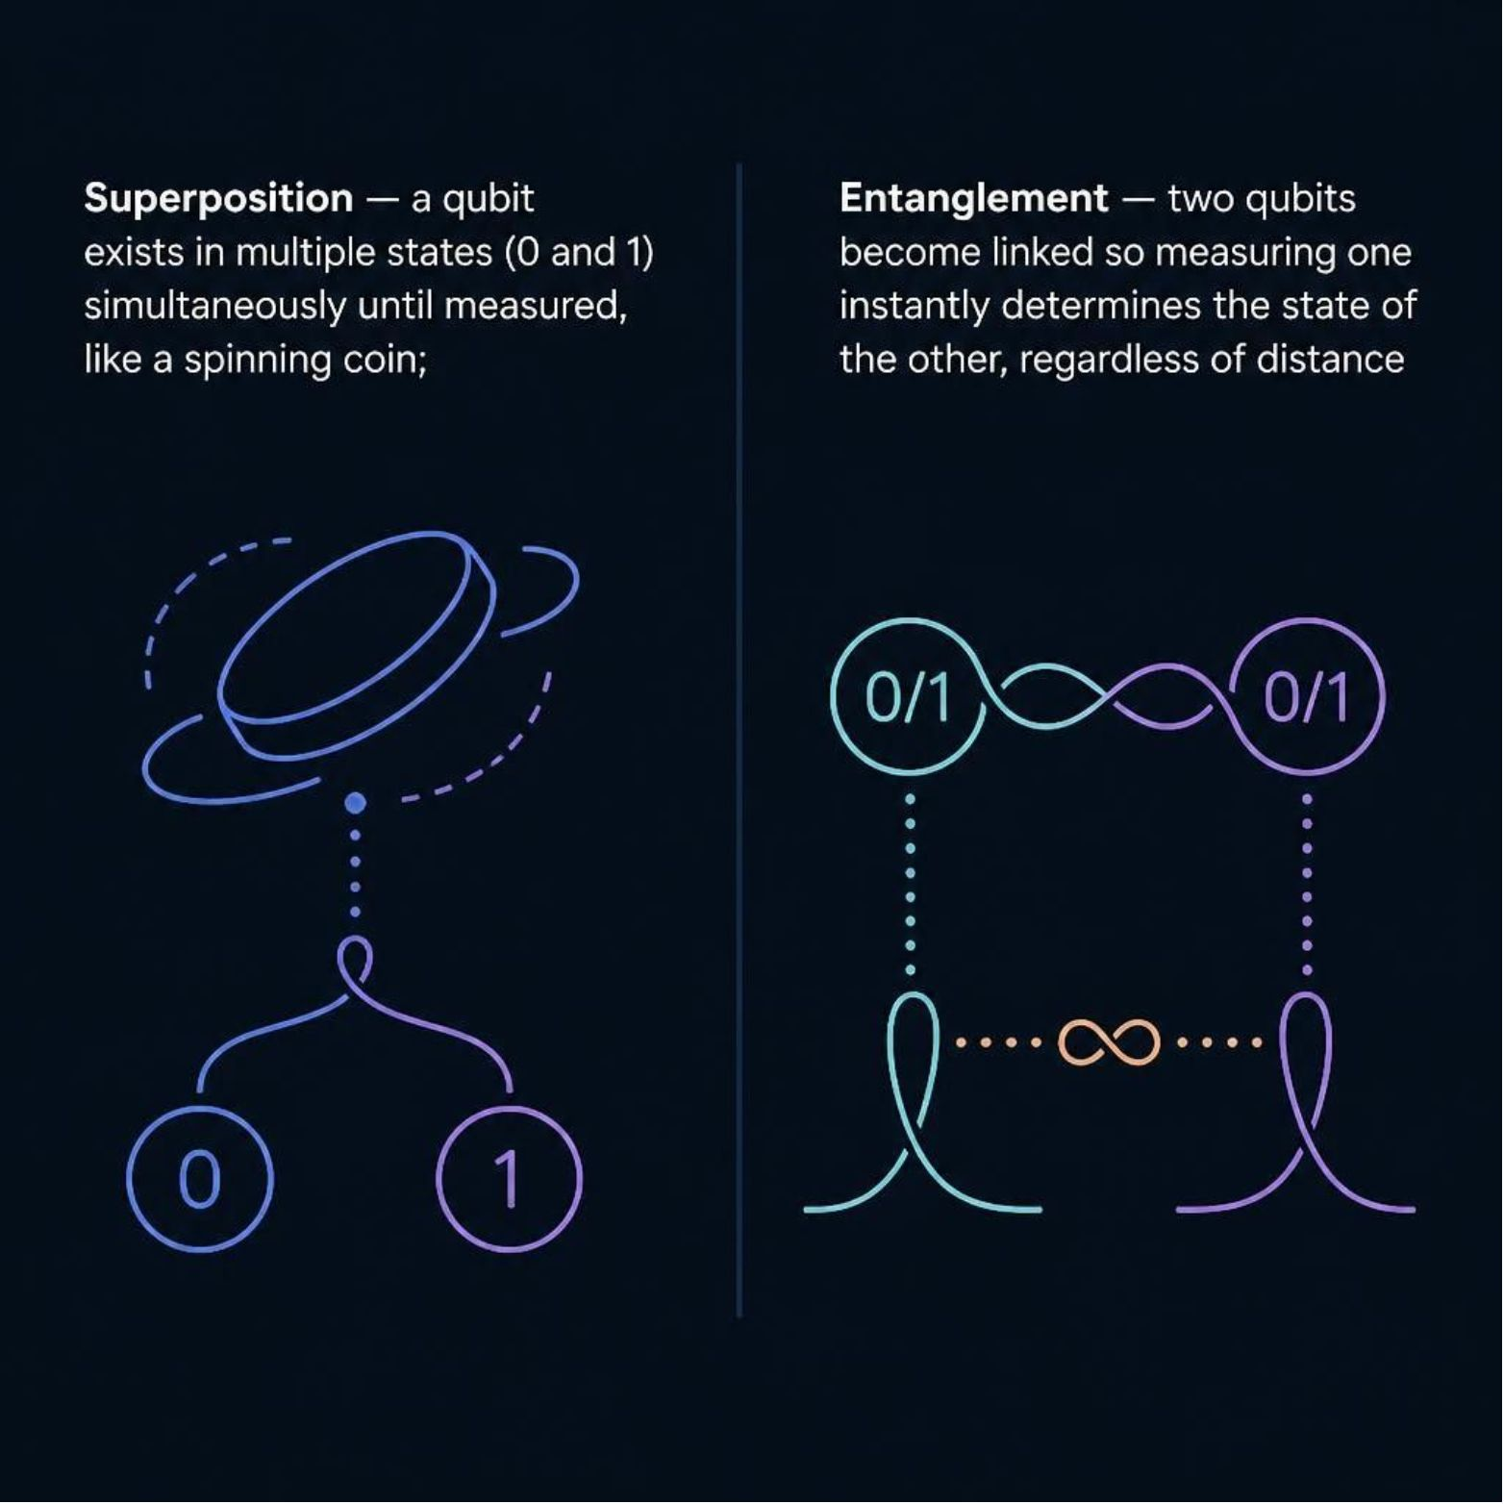

CORE CONCEPT
The Magic: Superposition & Entanglement
Superposition
Qubits explore multiple solutions at once, enabling massive parallel computation.
Entanglement
Measuring one qubit instantly influences its partner — even across vast distances. Einstein called it "spooky action at a distance."
Together, these properties give quantum computers their extraordinary power.

Slide 4
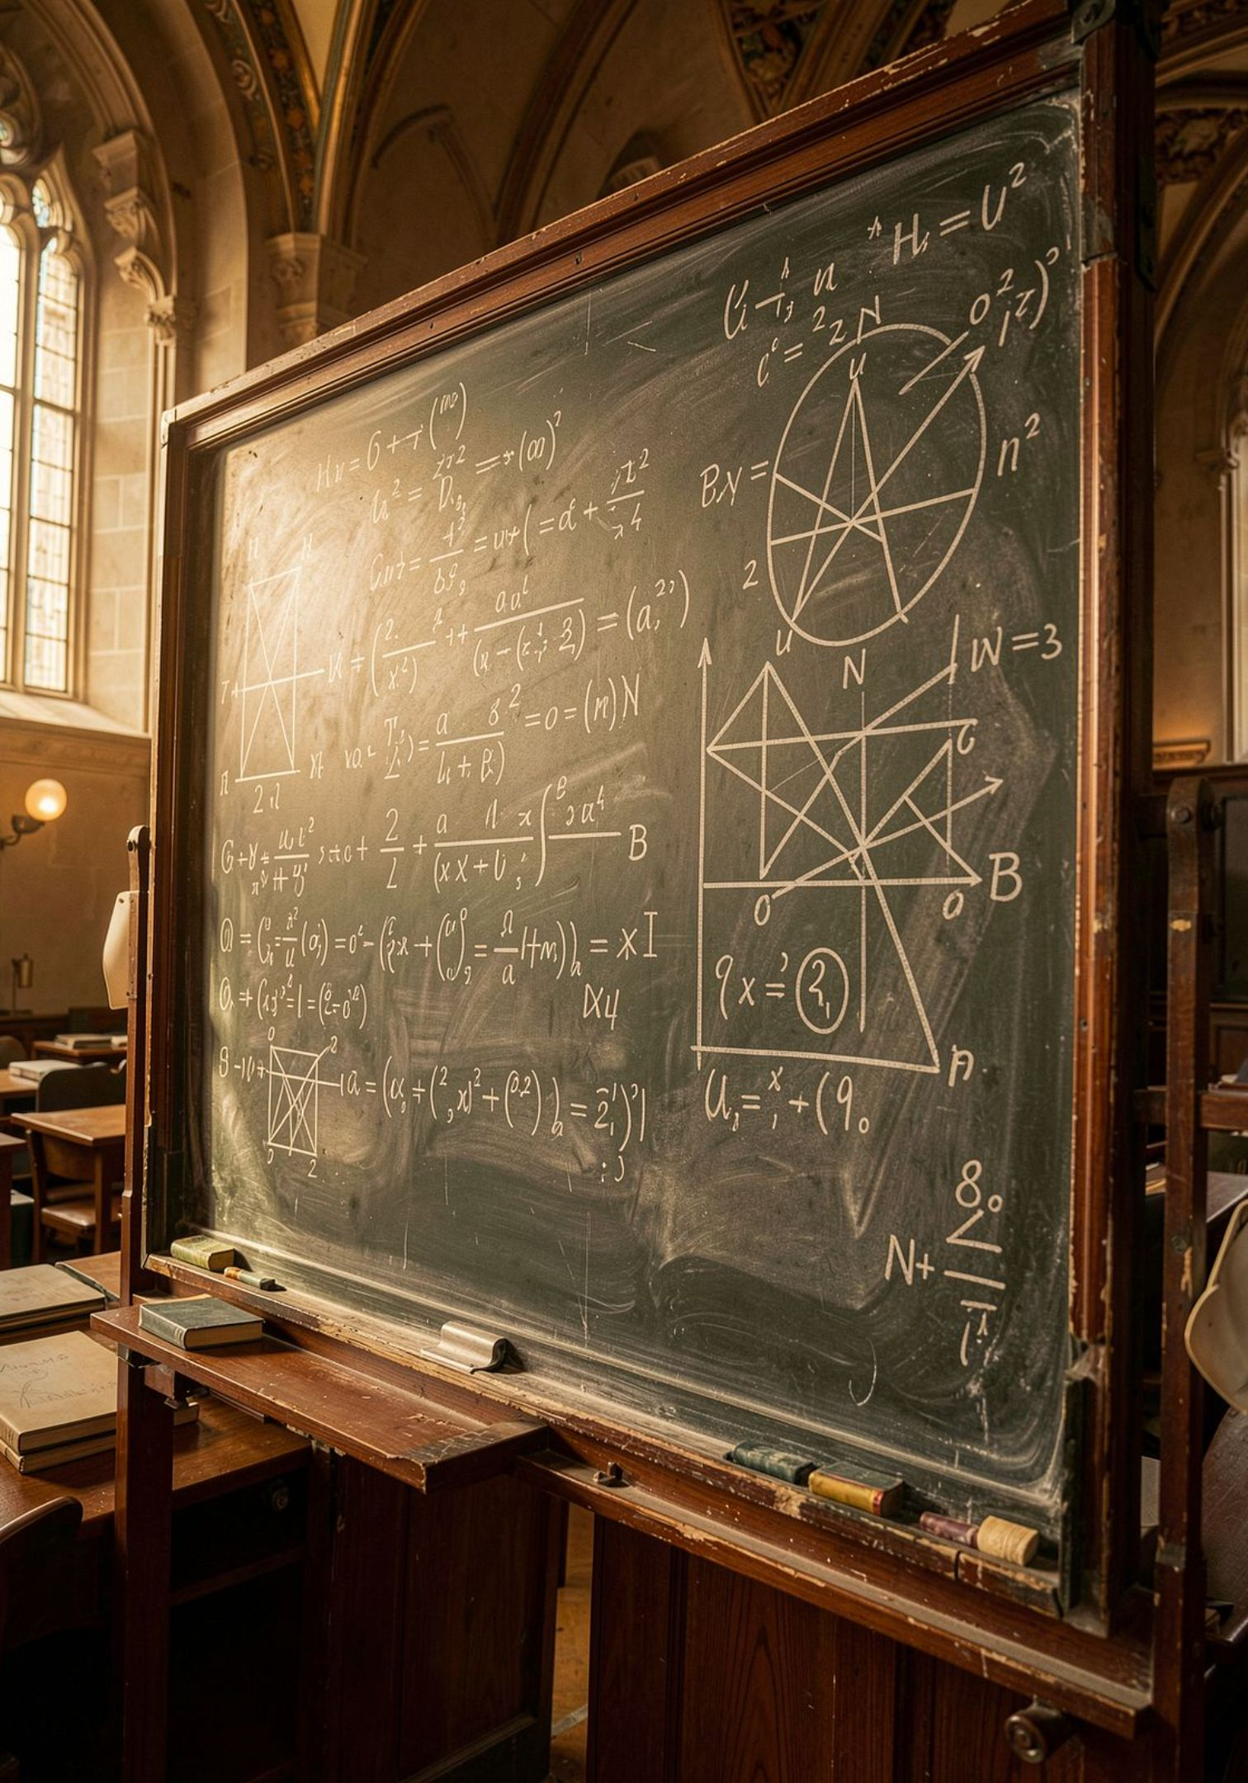
HISTORY
The Seed Idea: Richard Feynman (1982)
"Nature isn't classical, dammit. If you want to make a simulation of nature, you'd better make it quantum mechanical."
Feynman argued that simulating the physical world requires a computer built from quantum components — not classical bits. This insight launched the entire field of quantum computing.

Slide 5
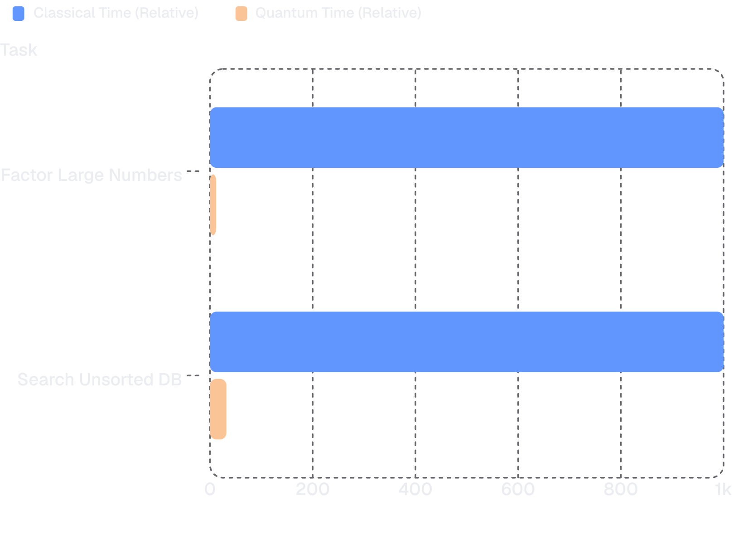
HISTORY
The Breakthroughs: Shor & Grover
1994 — Peter Shor
1996 — Lov Grover
Proved quantum computers can factor large numbers exponentially faster, threatening RSA encryption.
Found a quantum method to search unsorted databases quadratically faster than any classical approach.

Slide 6
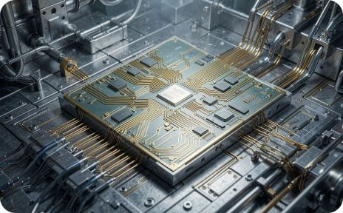
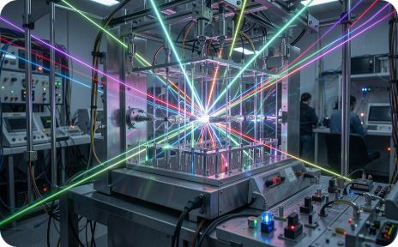
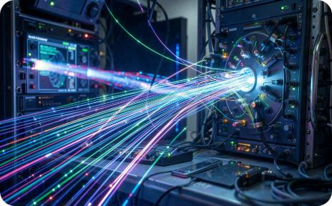
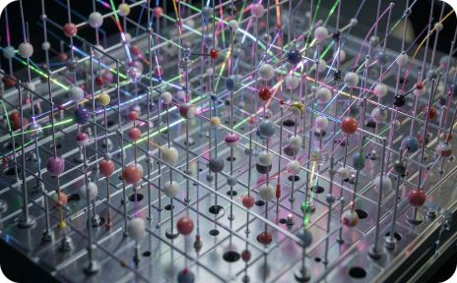
HARDWARE
Hardware Reality: The Four Big Bets
Superconducting Circuits
Trapped Ions
Photonic Systems
Neutral Atoms
High stability and long coherence times, ideal for precision.
Operates at room temperature, great for quantum networking.
Scalable arrays enabling complex logic operations.
Fast gates, but requires near-absolute-zero temperatures.

Slide 7
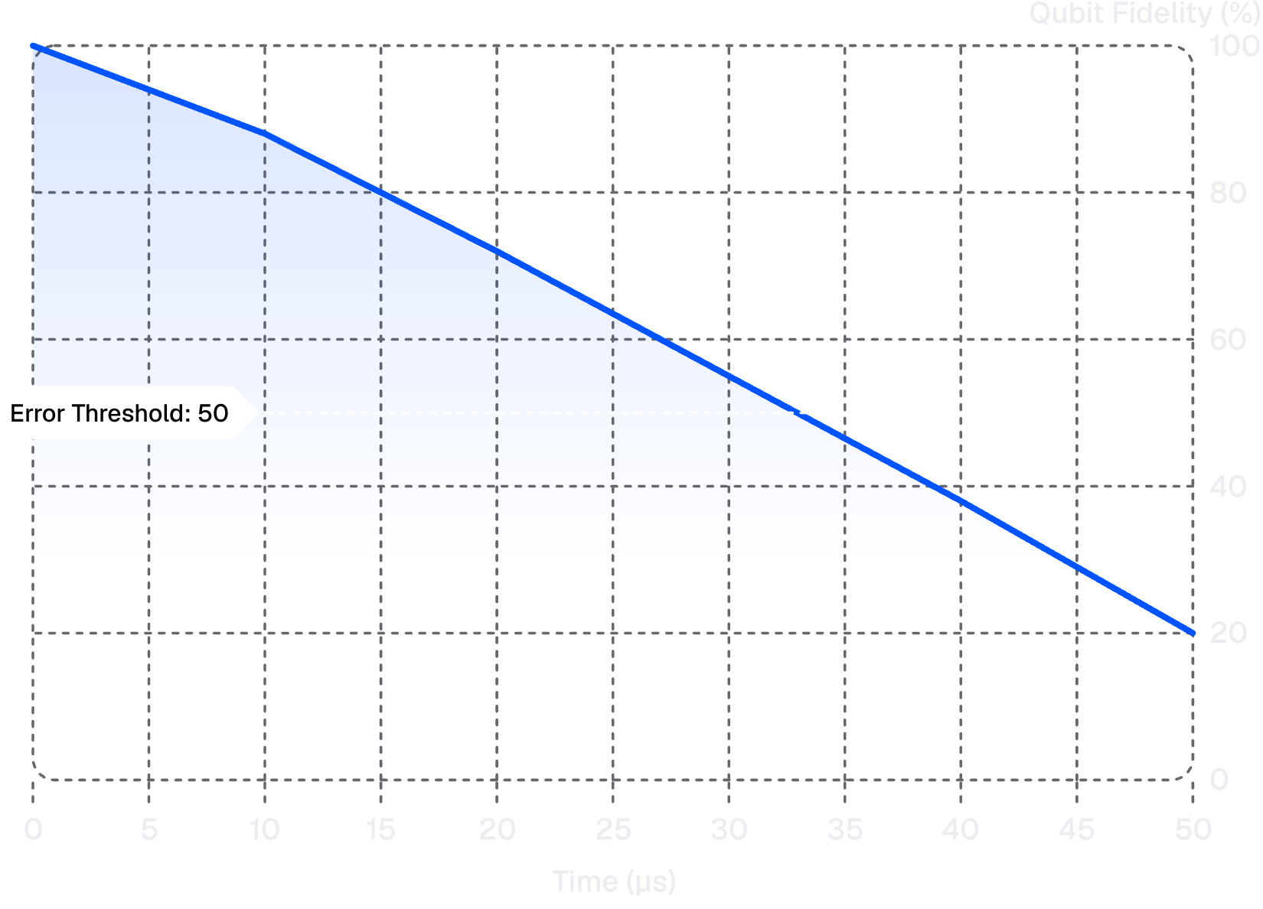
CHALLENGE
The Achilles Heel: Decoherence & Noise
Why Qubits Are Fragile
Qubits interact with their environment — heat, vibration, electromagnetic fields — causing decoherence: the loss of quantum information.
Environmental noise introduces errors
Fidelity decays rapidly over time
Below threshold → computation fails

Slide 8
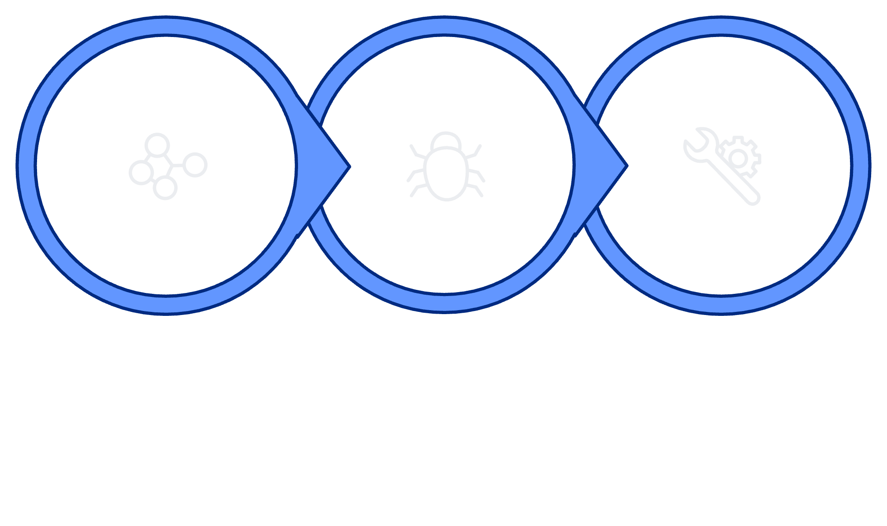
SOLUTION
The Solution: Quantum Error Correction
Encode
Detect
Correct
By encoding one reliable logical qubit across many noisy physical qubits, we can detect and correct errors without destroying quantum information. Once we cross the fault-tolerance threshold, scaling up adds reliability — not just complexity.

Slide 9
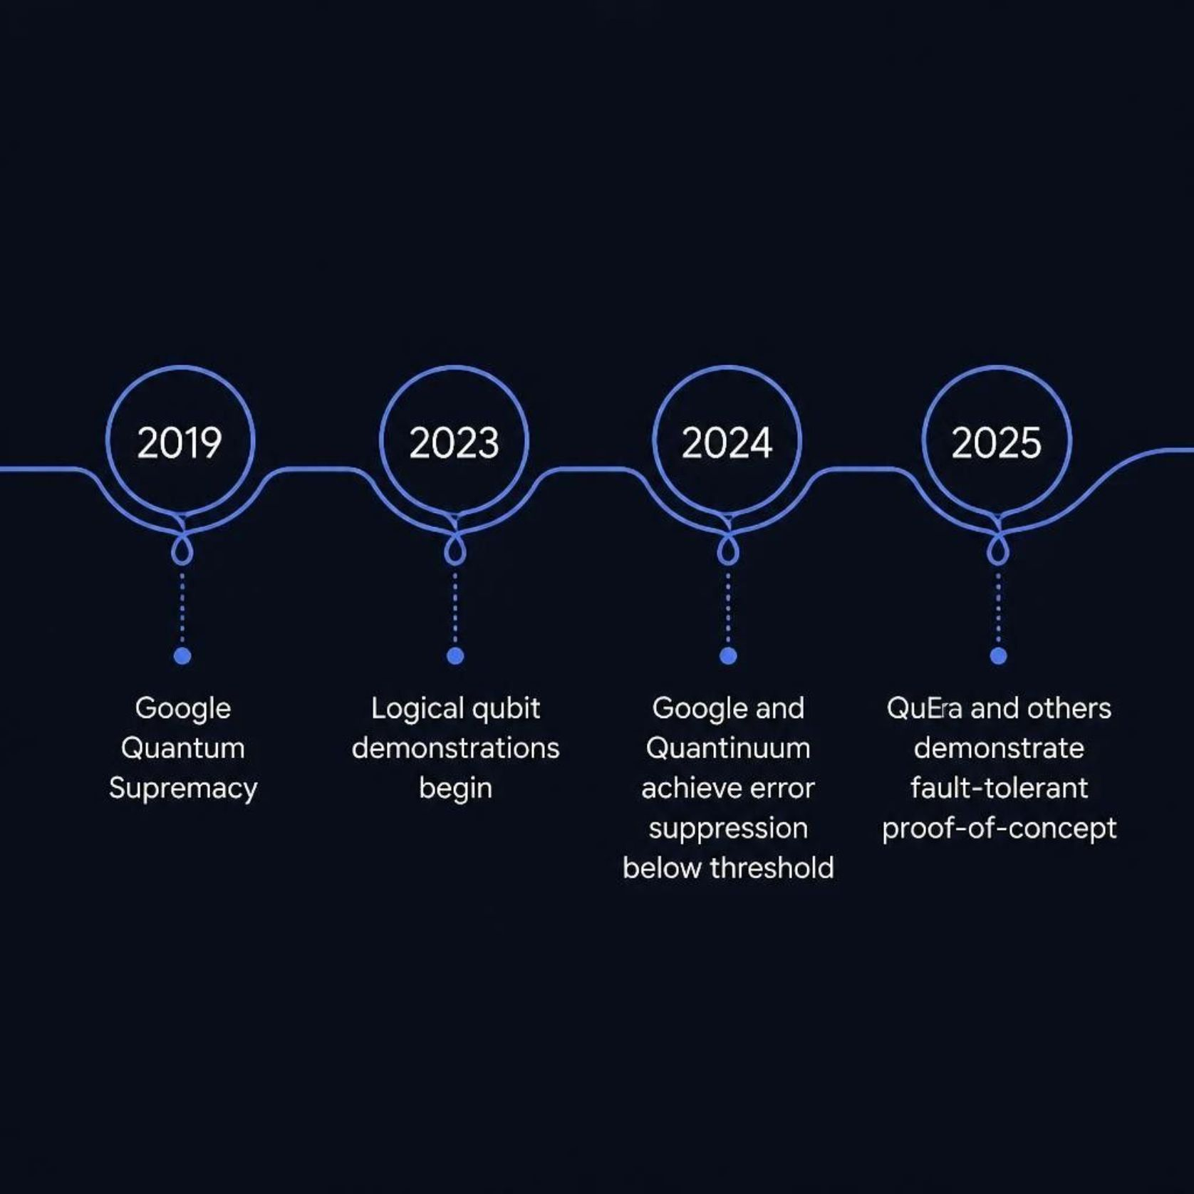
MILESTONES
Current Era: 2024–2025 Breakthroughs
What Changed
For the first time, logical qubits outperform their physical components — a critical step toward practical quantum computing.
Google
Quantinuum
QuEra
Reduced error rates below threshold
Demonstrated reliable logical gates
Neutral-atom error suppression

Slide 10
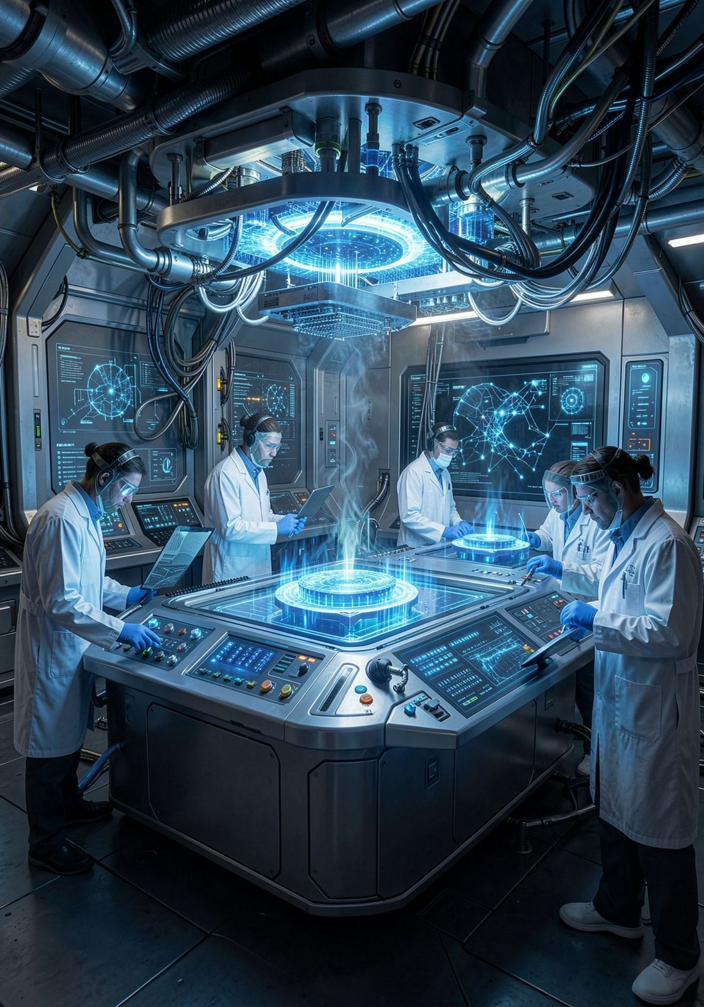

THE ROAD AHEAD
The Future: What Comes Next
Drug Discovery
Simulate molecular interactions to accelerate pharmaceutical breakthroughs.
Material Science
Design new materials — superconductors, batteries, catalysts — atom by atom.
Optimization
Solve logistics, finance, and supply chain problems at unprecedented scale.
The next decade moves quantum computing from experimental hardware to industry-changing solutions.

Slide 11
THANK YOU
Quantum Computing: The Next Frontier of Technology
From theory to transformation — understanding the science, the hardware, and the breakthroughs reshaping our world.

