Slide 1

Proposals to dognition
Mohini nath

Slide 2
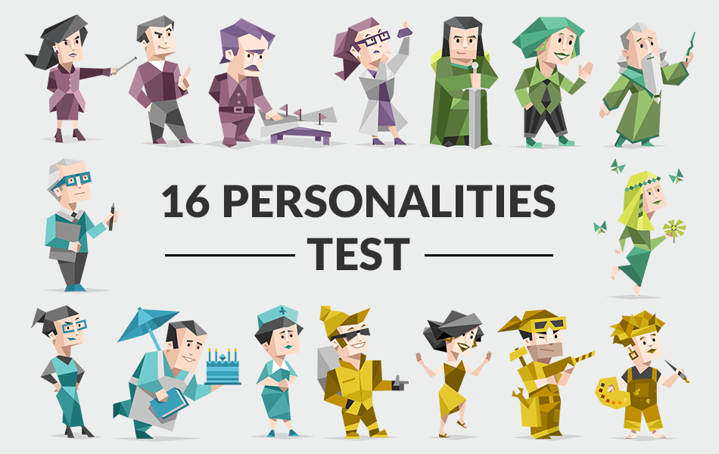
HAVE YOU EVER GIVEN ONE OF THESE TESTS?

Slide 3
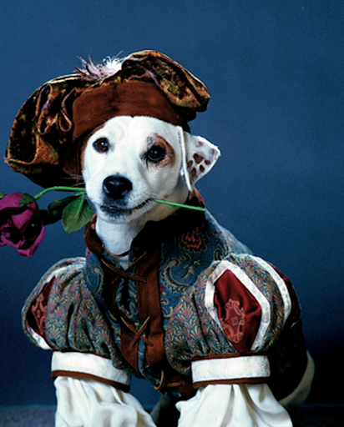
INFP

Slide 4
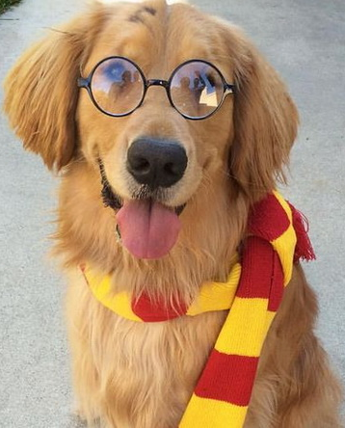
istp

Slide 5

ENTJ

Slide 6
Outline
Our smart goal
Findings
Closing remarks

Slide 7
Increase the total number of tests performed a week by 20% within the next 6 months
Our smart goal is to

Slide 8
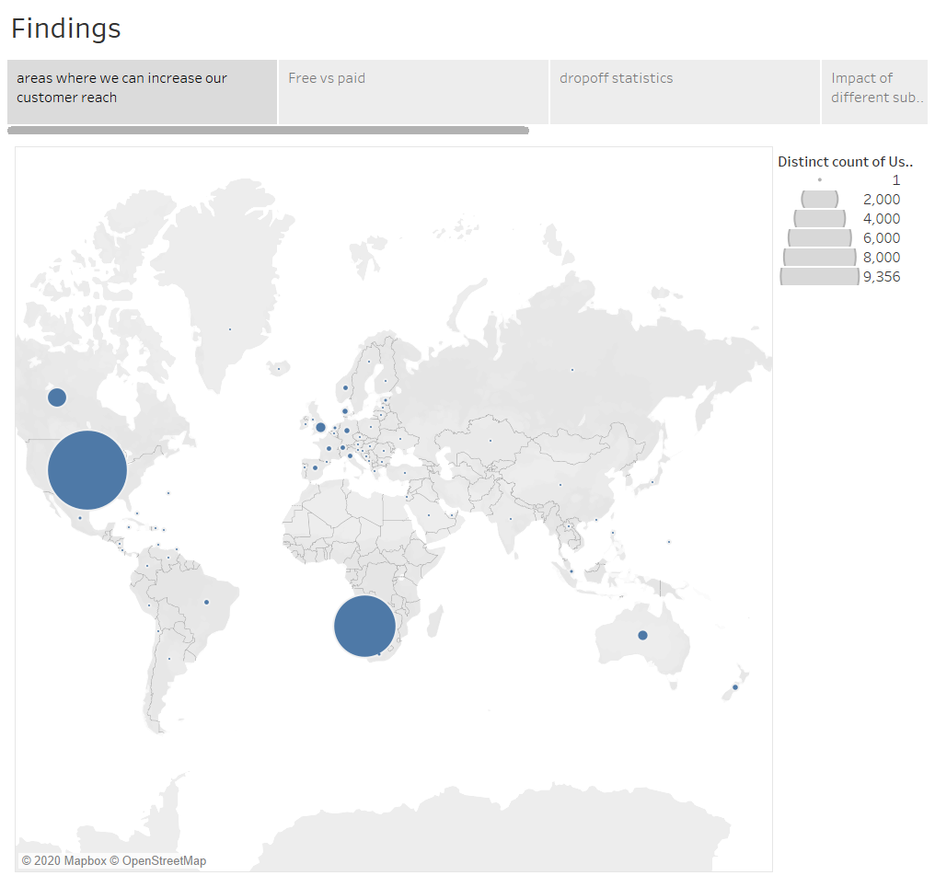
Notes:
Large population countries like china india or with large pet dog populations like brazil, japan and russia

Slide 9
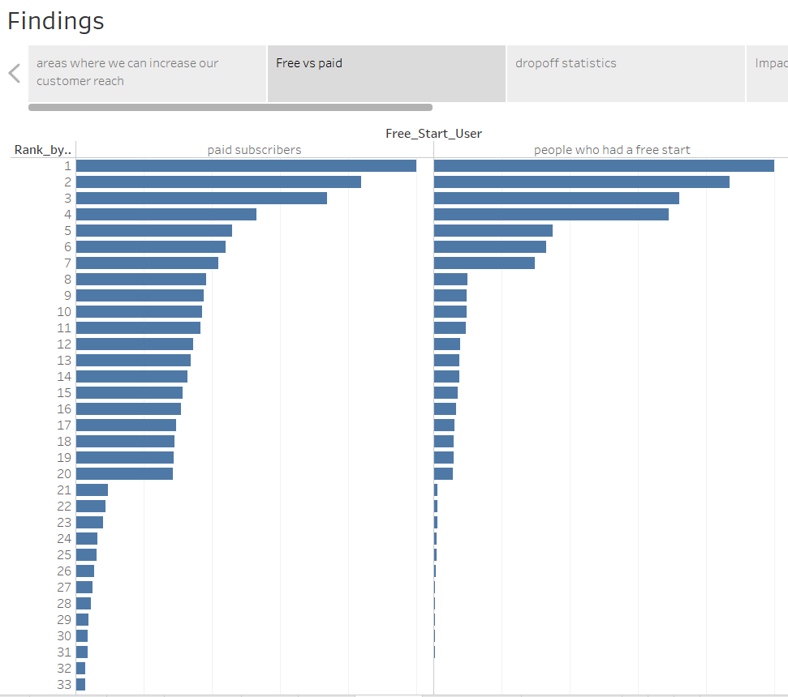
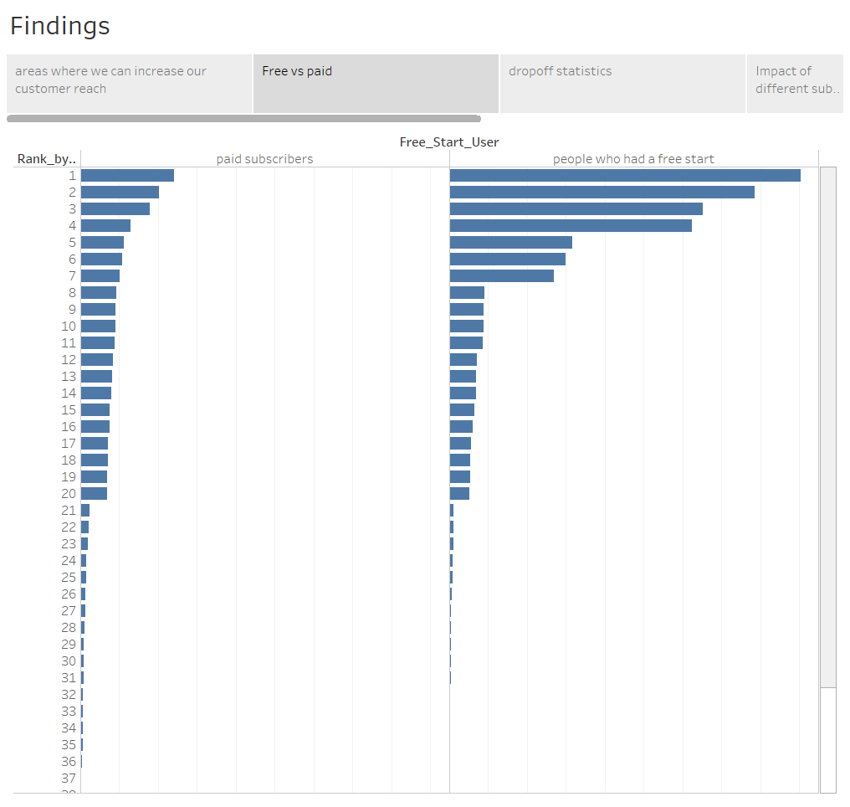
Notes:
Paid subscribers tend to do more tests

Slide 10
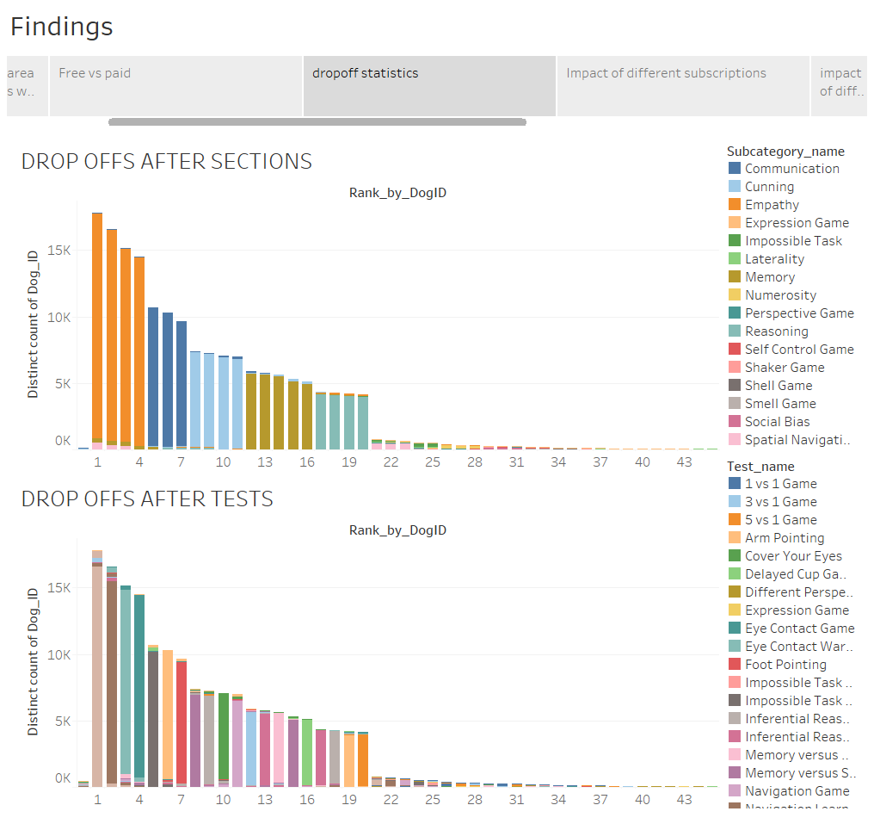
Notes:
More drop off after subcategories are over

Slide 11
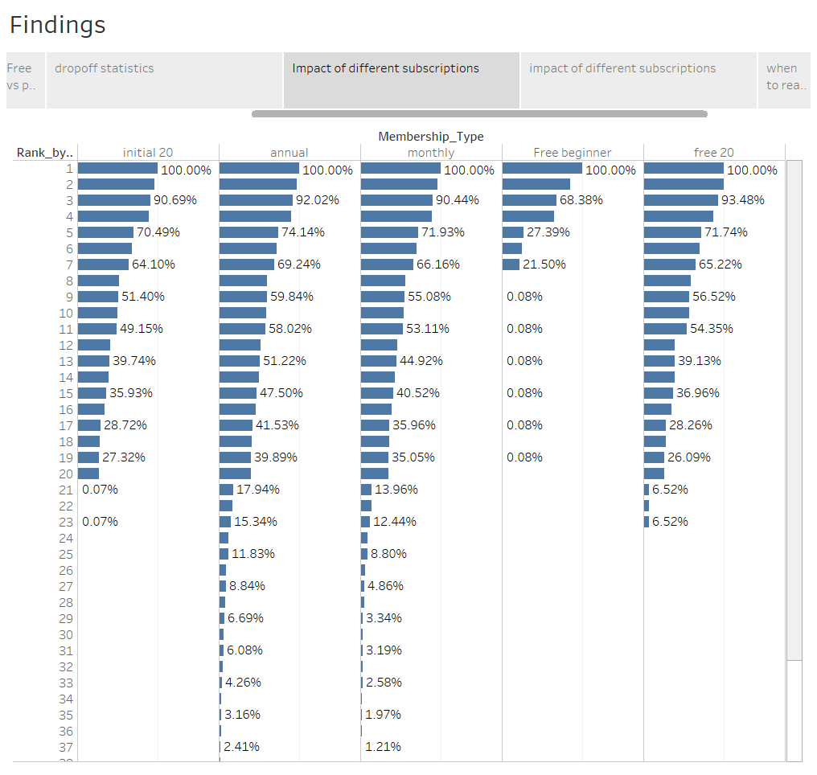

Slide 12
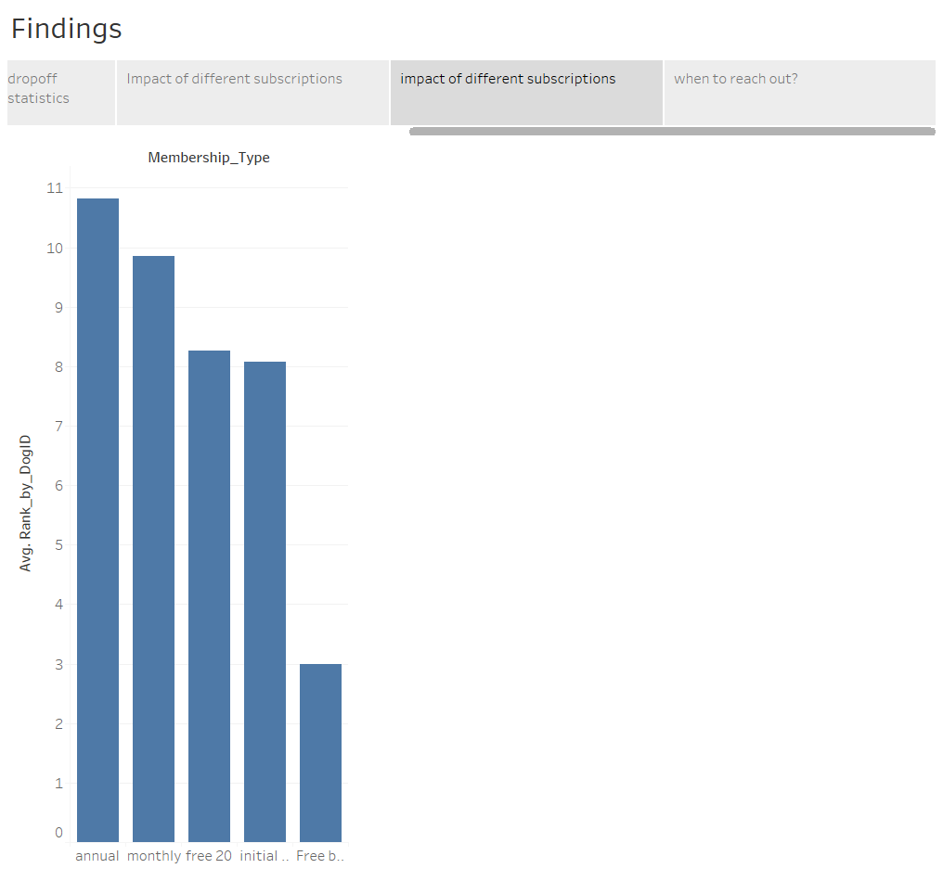
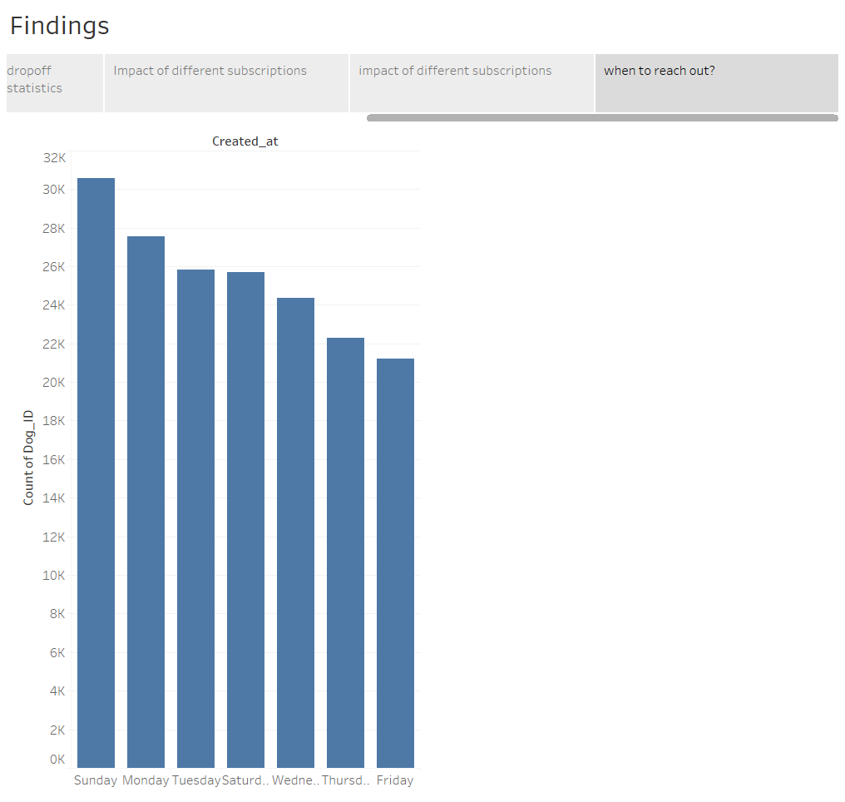

Slide 13

Suggestions to increase customer base
Target advertising to citizens of a broader geography demographic
Provide discounts on annual subscriptions

Slide 14

Suggestions to increase number of tests taken by existing customers
Shuffle up the sections. The highest drop offs take place after the empathy sections or the eye contact game
Send target reminders
Encourage people to be annual subscribers

Slide 15
Explanations at: Dognition.mp4

