Slide 1


Brainstorm 2D Engineering Design Drafting App Nathnael Shawl - EME
Addis Ababa Science
&
Technology University(AASTU)

Slide 2

What is Brainstorm?
Painting Applications
2D cad applications
Brainstorm

Slide 3
App Features
Ability to draw
Circle
Rectangle ( center and corner )
Square
Ellipse
Polygons(with varying number of sides)
Lines
Polylines
Bezier curves
Pencil drawings( simple and flat end marker)

Slide 4
Cont.…
Supports
Editing, and manipulation of shapes
CAD features as dimensions and rectangle fillets
Color and thickness adjust
Saving and opening PNG files
And more…

Slide 5
Cont.…
Advantages over Paint
Advantages over CAD
Ability to create customizable shapes(e.g. d/t polygons)
Create very flexible curves
Polylines
Dedicated dimension displays
Smooth shape thickness selections
Minimalistic user interface(easy to learn)
Needs lower computing power
Free for every one

Slide 6
Cont.…
General Disadvantages
Not flexible as much as CAD applications
Used only for pre-drafting (not for final production)
Comparatively some features like flood fill are slower due to programming simplicity compromises

Slide 7

Design objectives
Increase design and setup speed(Zero learning curve)
Light duty memory usage
Simple and easy UI design
Open source development
Focus on fine algorithm rather than code complication

Slide 8
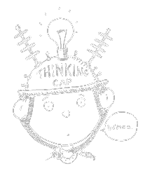
Used methods
Programming language used
Python – easy and fast development
GUI libraries used
Pygame and Tkinter – free and flexible
Scientific libraries used
Numpy and Scipy – for curvature interpolations

Slide 9
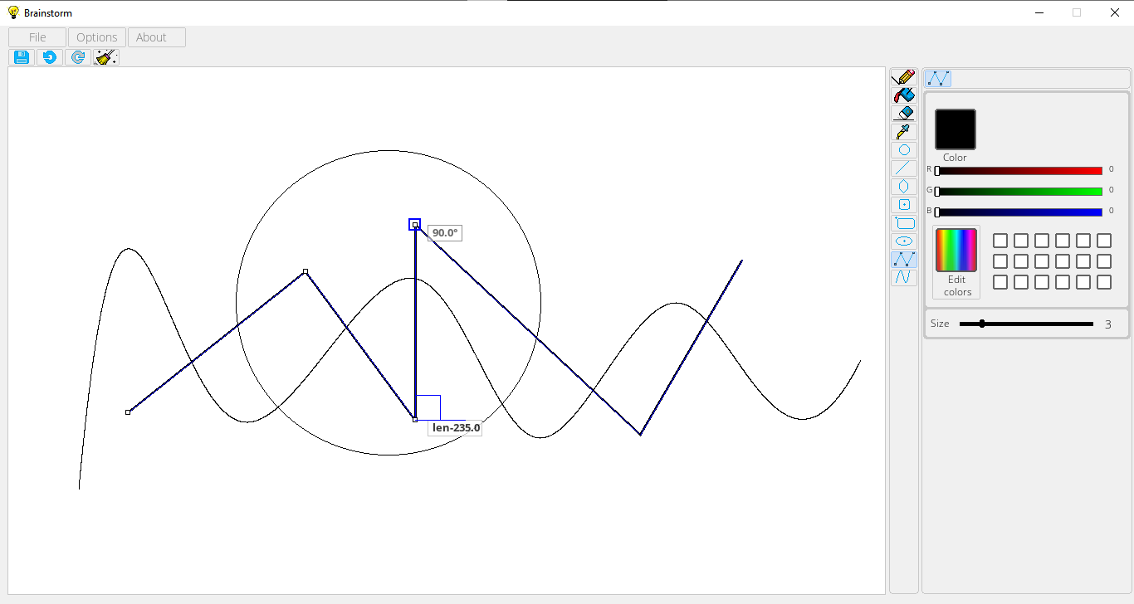
User-Interface Design
Drawing tools
Utilities
Drawing section
Utilities

Slide 10
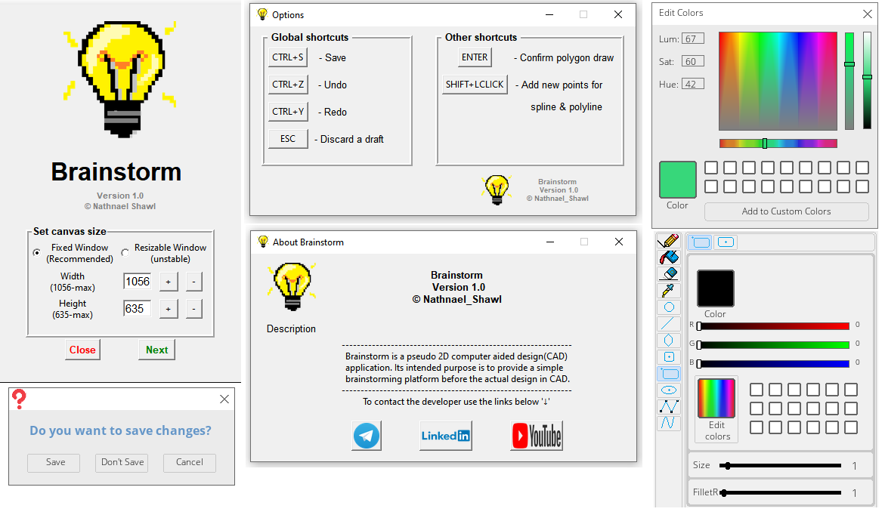

Slide 11
Program organization
Main
Entry point and also a center to execute core commands.
Initializing the app and also controlling actions as a bridge to other modules.
Basically sets up program defaults and controls presets
Global setter
Main Interface
Responsible drawing all main window user interface using pygame modue
Talks with Global setter to manage actions

Slide 12
Program organization
Drawing tools
Drawing and editing shapes on the screen
Lines and curves
Different shape
Mathematical and geometrical calculations take place
Action tools
Contains action tools
Eye dropper and
Flood fill tool
Utilities
Supporting functions to manage repetitive tasks like
Buttons
Shape manipulators

Slide 13
Program organization
Drag, drop boxes
Creates several Drag and drop boxes for users to manipulate values
File manager
Responsible for opening existing files, creating new files and also saving files
Exit control
Manages activities when user wants to exit the application

Slide 14
Program organization
Splash screen
Creates window when program is initialized at first.
Enable user to set window size and other features
Option window
Display shortcut showing menu
About window
Shows information about Brainstorm
Check module
Not mandatory module
It checks if third party modules are installed

Slide 15

Any questions

