Slide 1
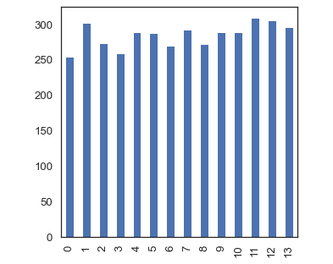
Bar Graph of Weight Times
The plot below shows customers with their weight times

Slide 2
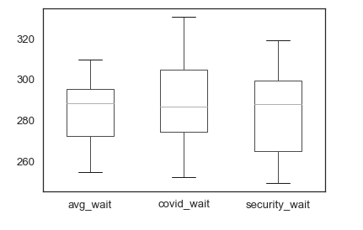
Boxplot of Weight Times
A boxplot showing three instances where the avg wait time during the day was too high

