Slide 1
Layers Program
Computation of Floquet Amplitudes and Scattered Fields from Periodic Arrays of Stacked Loaded Wires

Slide 2
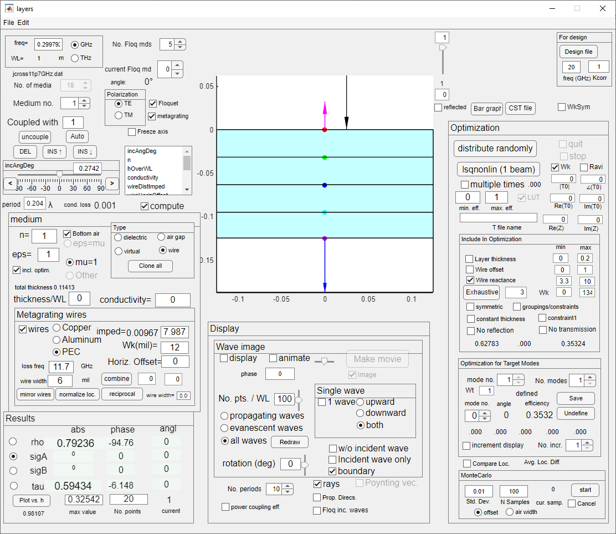
Within Matlab
Run layers_App.mlapp OR run appdesigner from command line , enter editor of layers_App.mlapp, and press the green arrow to run it.
From within layers_App: File > Open > and choose a .dat file. (How to create the .dat file will be discussed elsewhere.) Data and program files must be in the same folder.
IMPORTANT: wavelength=1, so almost all distances are relative to wavelength.
If the graphics get loused up, press the “redraw” button.
If the data file included information related to Wk, the Wk checkbox is checked.
To perform an exhaustive search, check WkSym checkbox if symmetric, fill in the distance, and click “Exhaustive”.

Slide 3
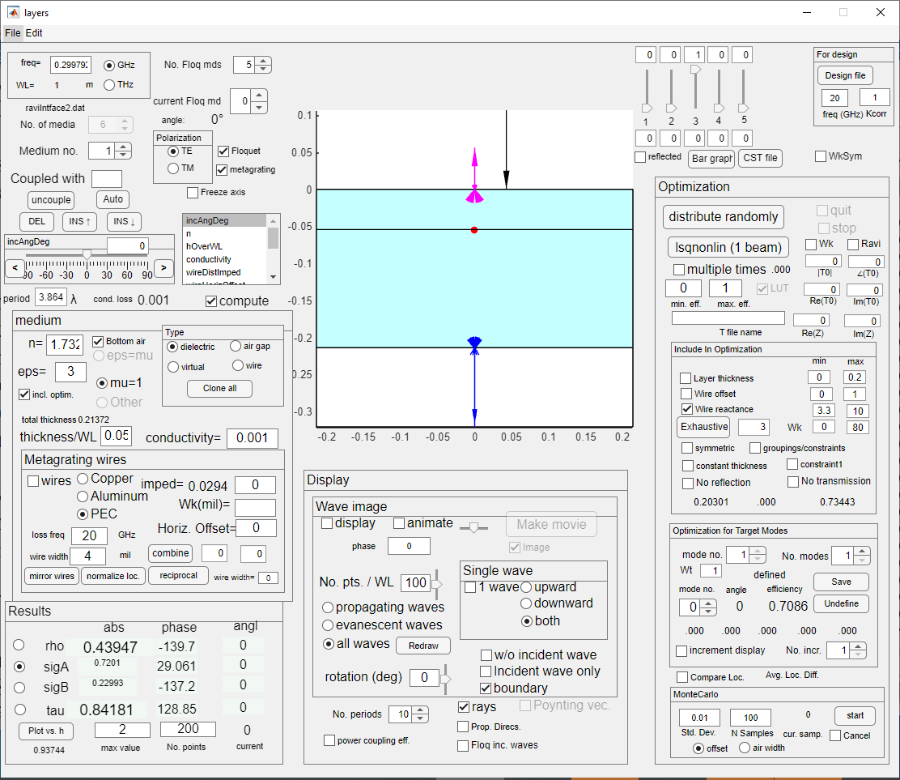
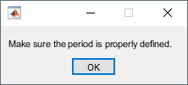
To get the curves representing the Im(Z) vs. Wk and Re(Z) vs. Wk for each layer, read the .dat file for the layer of interest (say ravIntface2.dat for interface 2). Preparation of such a file will be discussed separately. The resulting window is shown.
Click the "Ravi" checkbox. The user will be reminded to fix the period. Do this by entering the period in the edit box. In our case we entered .2041. In the wire panel, enter the frequency (20 in our case). Click the “CST file” button to create a data file that CST can read. The file will have the same name as the current data file, but with “CST” added to its name (ravIntface2CST.dat).
In CST, all dimensions are in mm.
CST must now be run.
Continued…

Slide 4
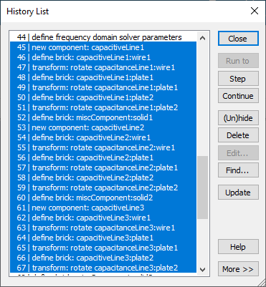
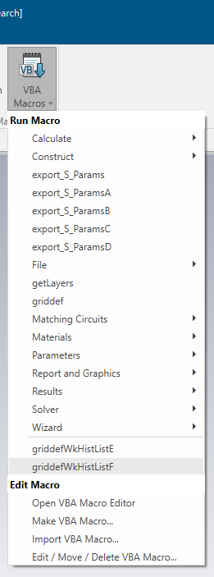
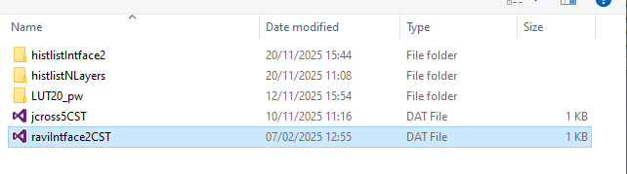
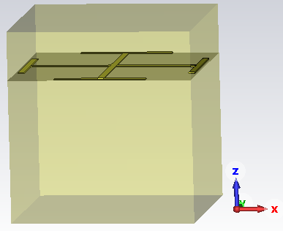
A general CST file has been prepared called histlistIntface2.cst. The parameters in the Parameter List should not be changed, except possibly for freqGHz (20), epsPCB (dielectric constant of PCB (3), tanDeltaPCB (.001), wirewidthmil (4), wgapmm (wirewidthmm), L (.2041*lambda), stripthickness (.018), isMetal (1 to indicate copper). If the frequency is changed, the frequency limits for the .cst file would have to be changed. If a parameter has changed, or if the .dat file has changed, then a change is required in the History List. All the geometrical operations must be removed. That is, delete (Delete button) lines 45 to the end. Then press Update. Then, on the Home tab, click on VBA Macros, and choose griddefWkHistListF from the list. Choose the ravIntface2CST.dat from the list that appears. This results in
Continued…

Slide 5
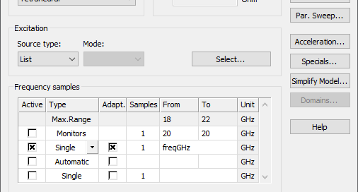
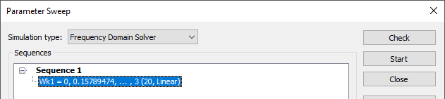
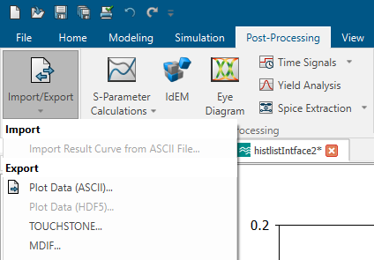
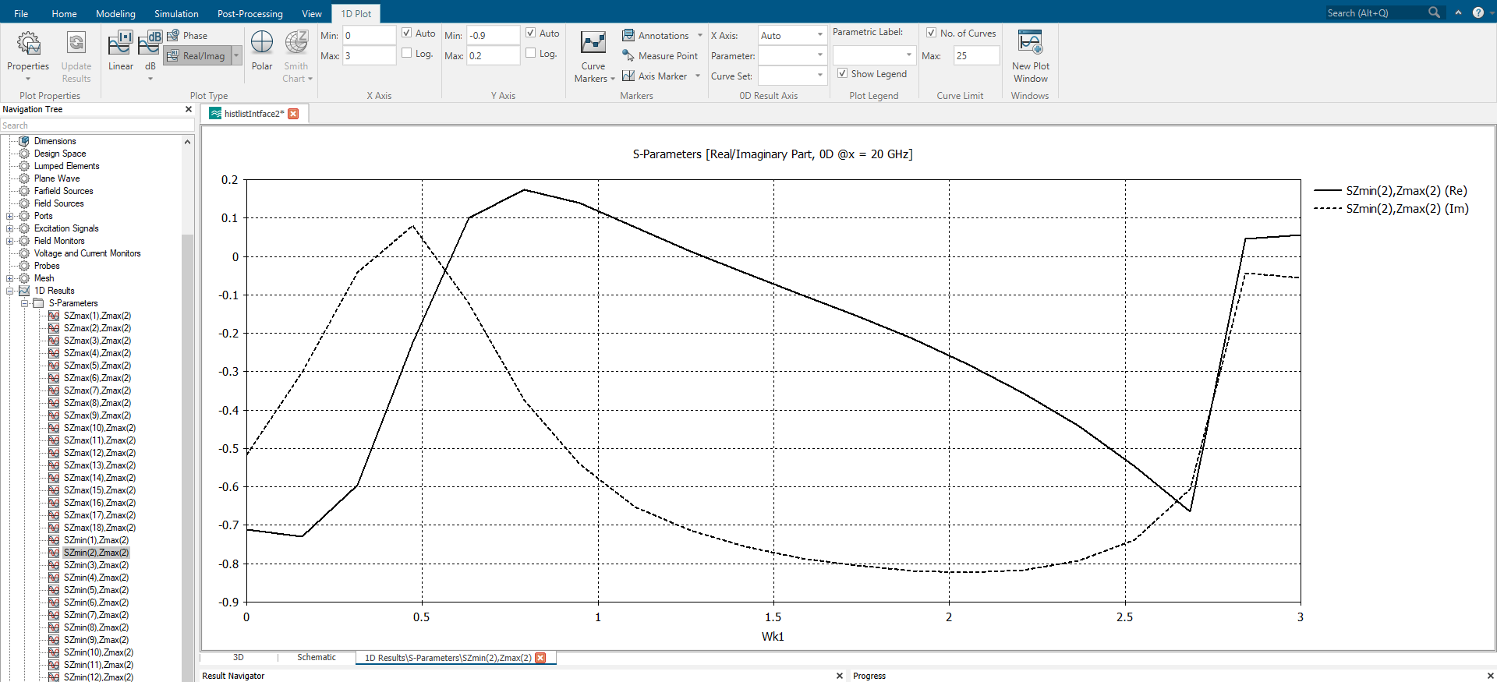
Our goal is to vary the length W of the legs of the Jerusalem cross, and to record the corresponding values of the transmission coefficient T. This may be accomplished by executing with the FD model, setting up a sweep over Wk1 from 0 to, say, 3 mm, and pressing “Start”.
When the sweep is complete, in the Navigation Tree -> 1D Results -> S-Parameters select Szmin(2),Zmax(2). In the 1D Plot tab, select real/imag, which will display a plot as a function of Wk1. To save this data to a file, on the “Post-Processing” tab, click on “Import/Export, and then click on “Plot Data (ASCII), and name the data file, say, raviIntface2transmission.txt. Move this file to the same folder as the Matlab files.
Continued…
Wk1

Slide 6
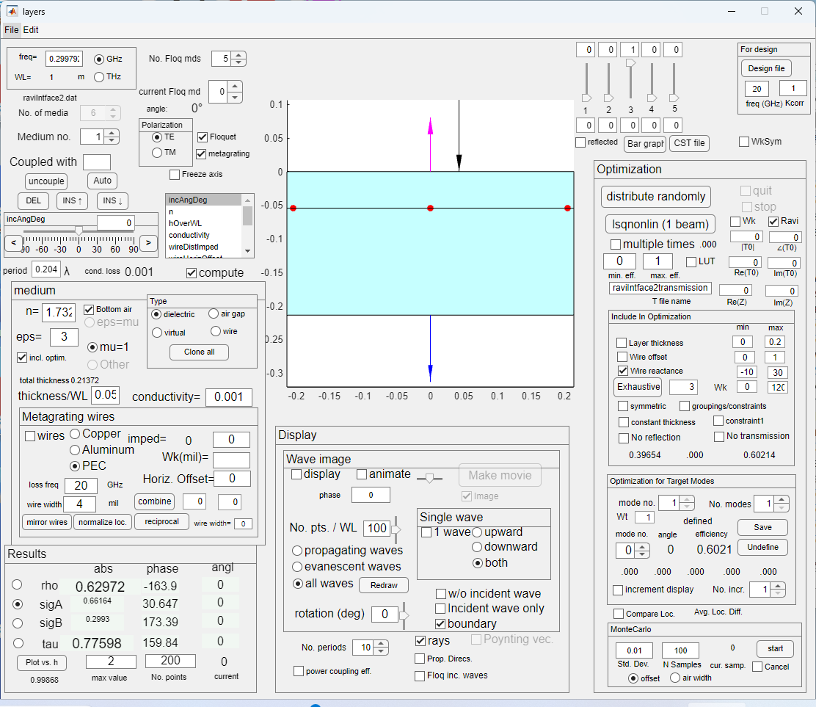
Return now to the Matlab window that we considered before moving to CST. Make sure the Ravi checkbox is checked. In the "Include in optimization" panel, click on the "wire reactance" checkbox. Define the constraints as, say, -10 to 30. Click the "save" button in that panel to define the optimization configuration. Enter the name of the file created in CST (“raviIntface2transmission.txt”) in the space labelled “T file name”.
Click the lsqnonlin pushbutton. For each Wk in the file, LAYERS will
use optimization to find the impedance Z that provides this transmission coefficient (Re and Im) on the file for that Wk.
Continued…

Slide 7
The results are given in two plots. Only the values Wk for which the optimization succeeded are plotted. 0<Wk<120 mil. Note that for Wk<80, the reactance is capacitive (Im(Z)>0). For Wk>80 the reactance is inductive, but the real part (losses) start increasing exponentially. The inductive reactance is also increasing exponentially. This might be indicative of the method failing for Wk>80. We therefore limit ourselves to Wk<80.

Slide 8
To perform an exhaustive search, check WkSym checkbox if symmetric, fill in the distance, and click “Exhaustive”.
The results from the exhaustive search will be written on a file called LUT.opt or technionLUT.opt. To process this file:
Open the LUT window by clicking in the LUT checkbox.

Slide 9
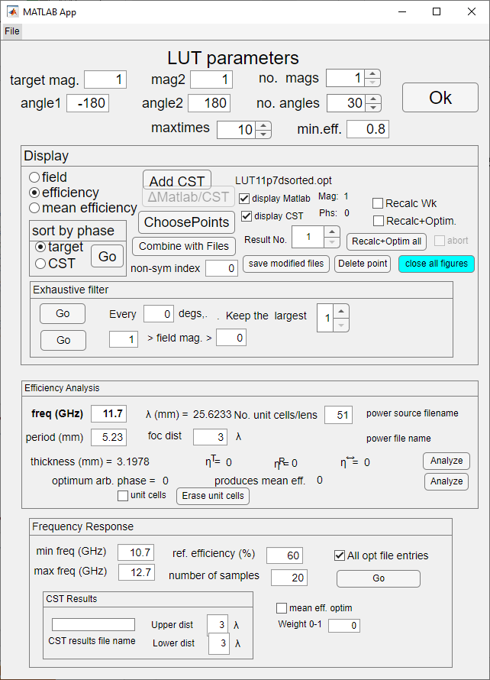
Consider changing the name of the file so that it won’t be overwritten next time. Call it LUT11p7d.opt. Open the file file>open opt file.
Each point in the file represents 5 values of Wk. The points are not ordered by phase. In order to process them, we must order them by phase. This creates a new .opt file with the same name, but with “sorted” after the name.
Open this file as before.

Slide 10
For the LUT, we only require points on the cloud periphery. Define the parameters for choosing these points. Suppose we want 2 results in every 5 degrees of phase. The results are shown below. To save this, press “save modified files” button. This will save it to a file with the same name, followed by “mod”. To edit this file, it must be opened through the file menu. In order to avoid having to many figures open, “close all figures” may be clicked.

Slide 11
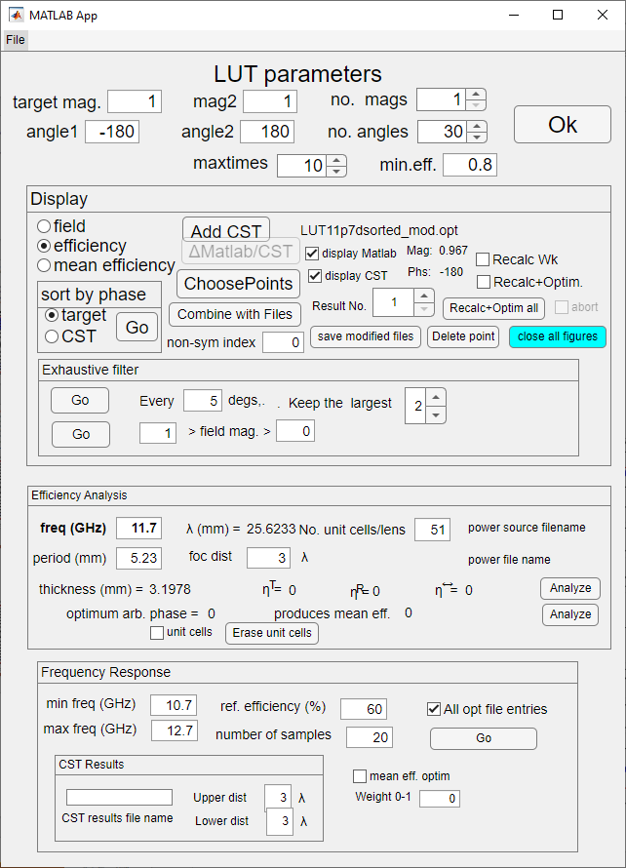
Having opened this reduced file, we can edit it by deleting points.

Slide 12
d=.2041 λ = 205.8961 mil=5.2297 mm
f=11.7 GHz
λ = 25.6233 mm =1008.8 mil
Unit Cell
(top view)
4.7726 mm = 187.8961 mil
3 mil
6 mil=.0059λ

Slide 13
f=11.7 GHz
λ = 25.6233 mm =1008.8 mil
Incident wave
.018 mm
30 mil = .762 mm = 0.0297λ
2 mil = .0508 mm = 0.0020λ
PCB
ε=3, tanδ=.001
126 mil
=3.2004 mm
=.1249λ
glue
ε=3, tanδ=.001
Unit Cell
(side view)

