Slide 1


TEXT MINING Presidential Election 2016: Trump Vs. Clinton
System Simulation | SS 2018 | Natalie Priebe |14.07.2018
Notes:
Key question: What is you name and where are you coming from?
Hello everybody and welcome to my presentation.
My name is Natalie Priebe and I'm from Germany.
Today I would like to present to you my project in the field of text mining.
The topic is the presidential election in America in 2016.

Slide 2

Notes:
Key questions: Why have you chosen your problem, your topic? Why your problem could be interesting for your audience?
In my project, I analyzed Donald Trump and Hillary Clinton's speeches on the presidential elections in America in 2016 using text mining in R.
I chose the topic because I wanted to analyze in which aspects the speeches differ and what the core concepts are.
This example is also interesting for you because it shows a simple method to get a good overview of long speeches or even texts.

Slide 3
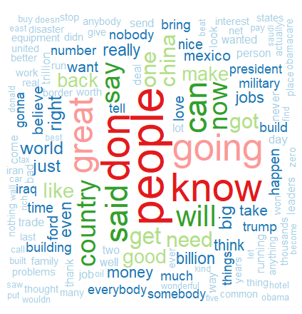
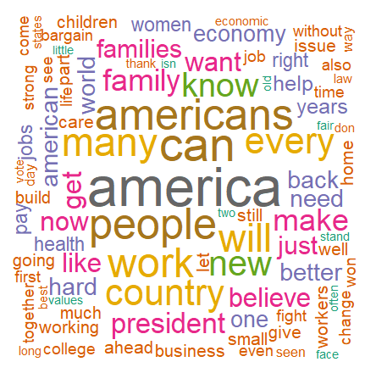
Wordclouds
TRUMP
CLINTON
14.07.2018 | Natalie Priebe | System Simulation
3
Notes:
Key question: How have you solved your problem?
For the analysis of the speeches I created word clouds and histograms of both speeches with the help of R in R-Studio.
On this slide you can see the word clouds. They show all words of the speeches that occur at least 2 times. The larger the words are represented, the more often they are called.

Slide 4
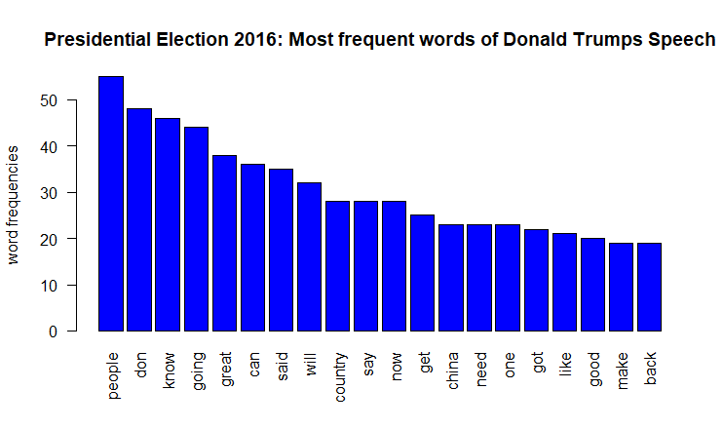
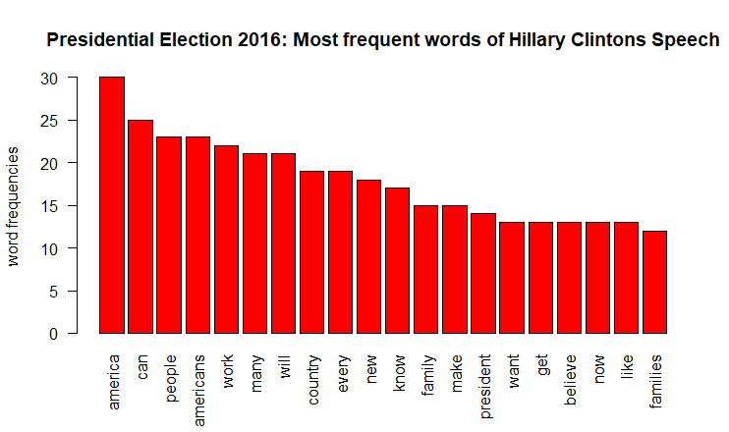
Histograms
TRUMP
CLINTON
14.07.2018 | Natalie Priebe | System Simulation
4
Notes:
Key question: How have you solved your problem?
On this slide you can see the histograms generated with R-Studio. They show the frequency of the 20 most frequently used words of the respective speech. So you can see how often the words appear in the speech.

Slide 5
Analysis
TRUMP | CLINTON
focus on money, military and other countries more repetition on verbs and adjectives | focus on America, family and economy more repetition on keywords
fewer repetition of keywords | fewer repetition of verbs and adjectives
style: hard, strict and cool | style: soft, motherly and warm
a lot of the same terms with different repetitions and context!
Donald Trump won! | Hillary Clinton failed!
Notes:
After generating word clouds and histograms, the next step is to analyze them.
The analysis has noticed that Trump focuses more on facts like money, military and other countries like Mexico or China.
On the other side, Clinton talks more about America and Americans, family and economy.
In her speech there are more repetitions of keywords, so the audience will keep them in mind. In Trumps speech there are more repetitions on verbs and adjectives, for example “great” which he is famous for (“MAKE AMERICA GREAT AGAIN”).
The style of both speeches are very different. Trump is hard, strict and cool – Clinton soft, motherly and warm.
All in all they use a lot of same terms, but in different repetitions and contexts.
Trump won the presidential election and Clinton failed.

Slide 6
CONCLUSION
Wordcloud – good overview of entire speech, especially about
Linguistic style and word choice
Keywords
Frequency
Key message
Histogram – detailed overview of most used words + exact number of repetitions.
Both Tools – well suited to get an overview of complex speeches
Notes:
Key questions: What was the most remarkable by solving your problem? What point have you been stopped?
All in all word clouds are a good method for giving an overview about the entire speech, for example the key message, linguistic style and the word choice.
Histograms can be used for a detaild overview of the most used words or exact numbers of repetitions.
Both tools together well suited to get an overview of complex speeches like Trumps or Clintons speech for the presidental election in 2016.

Slide 7
REFERENCES
Picture Clinton VS Trump: http://spillthatea.com/livestream-video-last-2016-presidential-debate-watch-hillary-clinton-vs-donald-trump/ (Access: 28.06.2018)
Picture Germany flag: https://de.wikipedia.org/wiki/Flagge_Deutschlands (Access: 01.07.2018)
Picture US flag: http://www.clker.com/clipart-waving-us-flag.html (Access: 28.06.2018)
Portraits Clinton: https://en.wikipedia.org/wiki/Hillary_Clinton (Access: 28.06.2018)
Portrait Trump: https://en.wikipedia.org/wiki/File:Donald_Trump_official_portrait.jpg (Access: 28.06.2018)
Speech Donald Trump: http://time.com/3923128/donald-trump-announcement-speech/ (Access: 28.06.2018)
Speech Hillary Clinton: https://edition.cnn.com/2016/11/09/politics/hillary-clinton-concession-speech/index.html (Access: 28.06.2018)
Notes:
Here you can find my references.

Slide 8
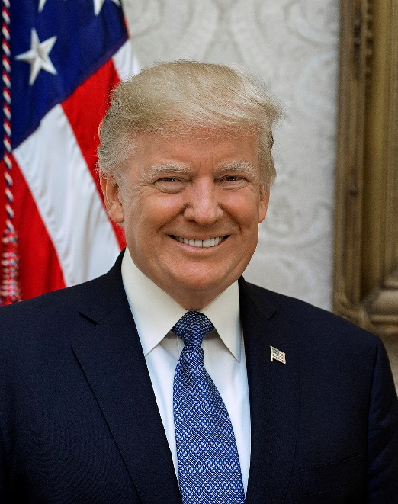
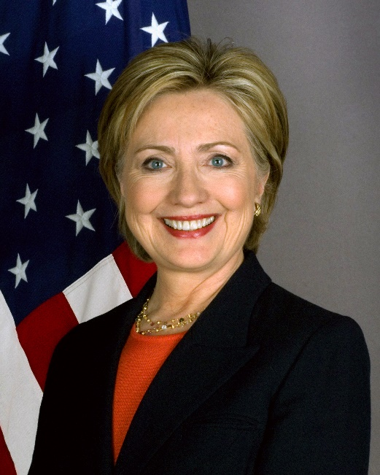
THANK YOU FOR YOUR ATTENTION!
Natalie Priebe | 14.07.2018
https://github.com/natiiih/systemsimulation_priebe.git
Notes:
Thank you very much for your attention!
If there are any questions, please ask!

