Slide 1


Slide 2
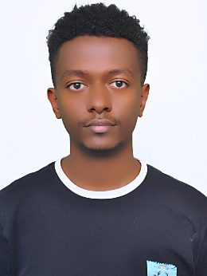
Let me introduce my self
II am Natnael Abnew from Ethiopia.
I am currently a third year civil engineering student at Addis Abeba University.
I have a much love for the tech field. Especially for cyber security.

Slide 3
project introduction and objectives
Project name: Personal Portfolio Website(PPW)
Introduction
PPW is a web site that is built for the intent of using a site as a resume and attract employers.
What is the objective of Personal Portfolio Website
A portfolio website highlights your best work by visually showcasing examples of work/project, while a resume only provides bullet points. When people or potential employers see your portfolio, they can get a glimpse of your skills.
There are two main reasons why you will build your portfolio website as part of this course:
• You will practice the HTML, CSS and Bootstrap skills we learned so far
• Having a portfolio website greatly improves your chance of being noticed by prospective employers
▪ Having a portfolio website might sometimes backfire if your website is not that impressive.

Slide 4


