Slide 1
Machine Learning for Accommodation Ranking
Comparing Classical and Deep Learning Approaches Using Session Data
Machine Learning Module - Online University of Essex

Slide 2
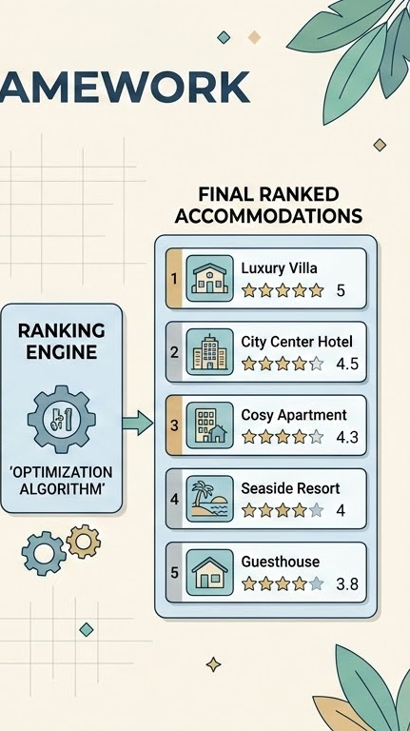
Outline
1
Project introduction & problem formulation
2
EDA & preprocessing
3
Experimental design & model selection
5
Modelling, tuning & evaluation
6
Conclusions, limitations & next steps
Conclusions, limitations & next steps

Slide 3
1. Project introduction & problem formulation

Slide 4
1.1. Project introduction
Comparing Classical and Deep Learning for Accommodation Ranking
The problem
Online accommodation platforms need to determine which available properties to show most prominently.
Project aim
Use Trivago search-session data to investigate machine-learning approaches for ranking candidate accommodations by likelihood of click.
Dataset: Trivago RecSys Challenge 2019 interaction and accommodation metadata. (Mahajan, 2019)
Approach: Compare classical and deep-learning models using a shared prediction task, predictor set and evaluation metrics. (Yu et al., 2024).
(Tooling used can be found in Appendix C)
User searches for accommodation
Candidate list:
available properties
Ranking candidates:
Ranking system
Accommodation A
Accommodation B
Accommodation n
Clicked accommodation

Slide 5
1.2. Ranking & recommendation in online travel
Why recommendation matters?
Travellers make decisions in information-rich environments, creating a need to surface relevant alternatives (Flórez et al., 2025).
What drives relevance?
User preferences & behaviour • Search/session context • Item attributes • Contextual factors (Adamczak et al.; Flórez et al., 2025; Zaidi et al., 2026).
Key recommender-system challenges (Flórez et al., 2025; Devanathan et al., 2025):
Context dependency — relevance changes with location, time and other situational factors
Data sparsity & cold start — limited interaction history can constrain personalisation
Heterogeneous data — behavioural, contextual and item information must be integrated
Model complexity — more sophisticated models can improve representational capacity while reducing inherent interpretability
Effective travel recommendation requires behavioural, contextual and item information to be combined while managing data sparsity, cold start and model interpretability.

Slide 6
1.3. From Data Discovery to Research Question
Deciding on the ranking system based on the available data
Chosen recommender approach: knowledge-based, session-context ranking
Search context:
Searched destination
Used filters / sorts
Session context:
Session ID, user ID and timestamp
Number of action within session
Returned candidate IDs
Clickout event, including the clicked candidate’s ID
Platform (market, Trivago’s platforms), device, city
Accommodation Attributes:
Accommodation ID
Accommodation attributes such as facilities, amenities, theme, etc.
Missing: meaningful long-term user history/profile
predominantly a session-based cold-start setting
Search / session context
Candidate accommodations (from Trivago impressions)
Accommodation attributes (metadata)
Ranking model
Relevance score per candidate
Ranked accommodation list
Most likely clicked candidate (ranked 1st)
(Theobald, 2024)

Slide 7
1.5. Research question:
Can deep-learning approaches improve session-based accommodation ranking compared with classical machine-learning approaches, and is any improvement sufficient to justify their additional complexity?

Slide 8
2. Exploratory Data Analysis (EDA) & preprocessing

Slide 9
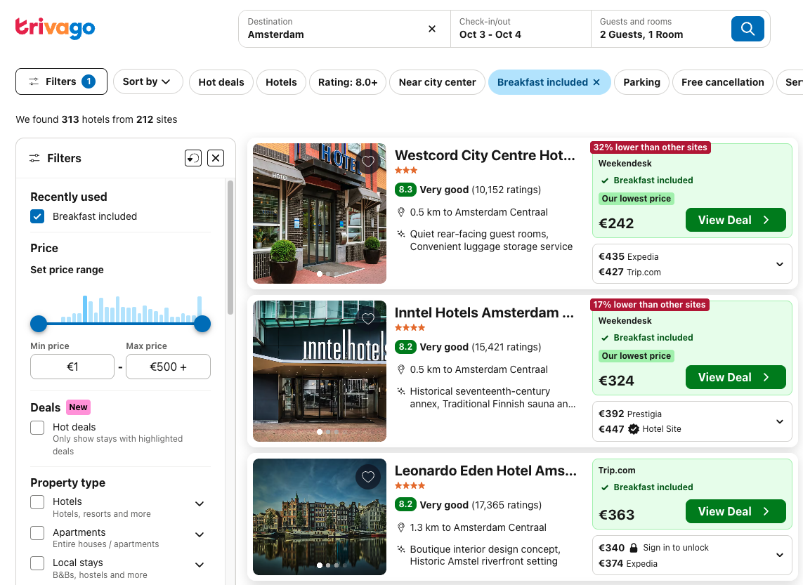
2.1. Dataset overview
Data: Trivago RecSys Challenge Data 2019 (Mahajan, 2016).
Data shape: 36.4M rows and 12 columns, some of which had high cardinality.
Overall description:
Multiple columns - Session information
Impression - Accommodation candidate list
Clickout - representing the clicked candidate
Limited long-term user history/profile information creates a predominantly session-based cold-start setting. (Theobald, 2024)
To make experimentation computationally feasible, 10% of complete sessions were sampled, preserving all interactions and their sequential structure within each selected session.

Slide 10
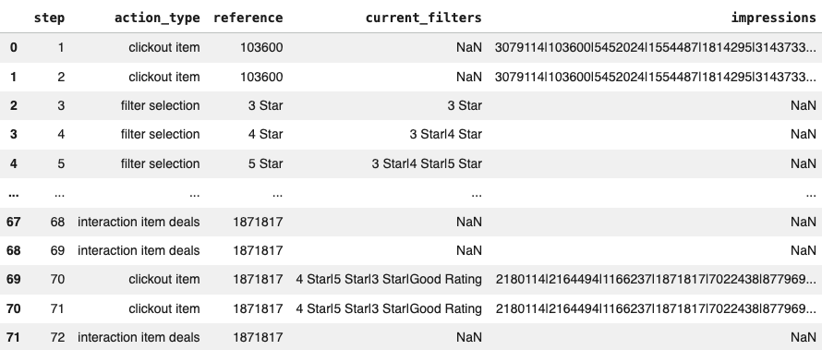
2.2. From sequential structure to a reconstructed ranking event
User sessions contain multiple actions such as searches, filtering, sorting, accommodation interactions and clickouts. Session actions are sequentially ordered by step, allowing behaviour preceding each clickout to be reconstructed.
Each clickout was treated as a ranking event and uniquely identified by session_id and step. Complete sessions were retained so that only interactions preceding each event could be used to construct behavioural predictors.

Slide 11

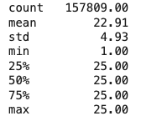
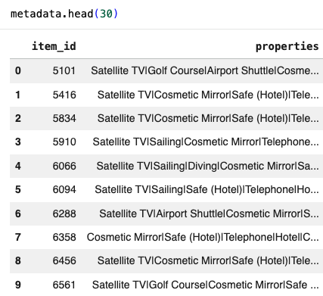
2.3. EDA: From impression lists to candidate-level observations
1-25 candidates in each impression, ranked based on some existing logic by Trivago. These were associated with a ‘clickout item’ and a ‘reference’, representing the clicked candidate.
The metadata dataset contained a list of accommodations, their attributes (under ‘properties’) and ID.
Candidate accommodations had >99.9% metadata coverage.
84.6% of unique selected filter values had a direct match in the property-attribute vocabulary.
Based on this, a candidates dataset was created, as well as a filter_match column.

Slide 12
2.4. Associations between potential predictors and target variable
Current candidate position:
  1st position had a click-through rate of approximately 32%, 2nd position had 11%, and 3rd position had 8%
  Strongly associated with click outcome, but excluded from predictors because it reflects exposure created by Trivago's existing ranking.
Price:
  Clicked candidates had a median relative price of 0.917 versus 1.00 for non-clicked candidates; the distributions differed significantly (Mann–Whitney U test, p < .001).
  The constructed relative_price feature was subsequently retained as a predictor for modelling.
Filters:
  Candidates whose ‘properties’ matched at least one ‘current_filters’ in the preceding behavioural sequence had a click rate of 4.77%, compared with 4.33% for candidates without a match.
  A chi-square test found a significant association with click outcome, χ²(1) = 116.29, p < .001, but the effect was extremely small (Cramér's V = 0.006).
  A filter_match representing this relationship was constructed as a column

Slide 13
2.5. Associations between potential predictors
‘city’ and ‘platform’
  Cramér's V = 0.705, indicating substantial association.
  Despite the substantial association between city and platform, both were retained because they represent conceptually different contextual information. Their contribution was therefore evaluated during modelling rather than excluding either variable based solely on pairwise association.
‘device’ and ‘platform’
  Showed a weak association (Cramér's V = 0.183), suggesting that platform and device capture largely different contextual information
‘price’ and ‘city’
  Candidate prices were grouped by city
  Among 570 cities with ≥1,000 candidate observations, median candidate prices ranged from €15 to €302.50.
  This indicated substantial variation in typical prices across destinations, motivating a context-relative price feature.
  relative_price = candidate price relative to the median candidate price within the same ranking event.
  Both absolute and relative price were retained for modelling.

Slide 14
2.6. Managing higher-cardinality features
Feature | EDA finding | Processing decision
City | 12,320 unique destinations; most frequent city only 1.8% | Cities occurring fewer than 50 times in the training data were grouped into Other before categorical encoding.
Filters | ~130 unique filter values; individual categories were relatively sparse | Individual filters were not encoded directly. Constructed binary filter_match, indicating whether ≥1 previously selected filter matched a candidate property
Properties | ~157 unique accommodation (candidate) attributes; each accommodation could have multiple properties | Not encoded individually. Used with selected filters to construct filter_match, reducing a multi-valued high-cardinality field to a candidate-level behavioural feature
High-cardinality features were retained where useful, but rare or multi-valued categories were consolidated or transformed to limit dimensionality and sparsity.

Slide 15
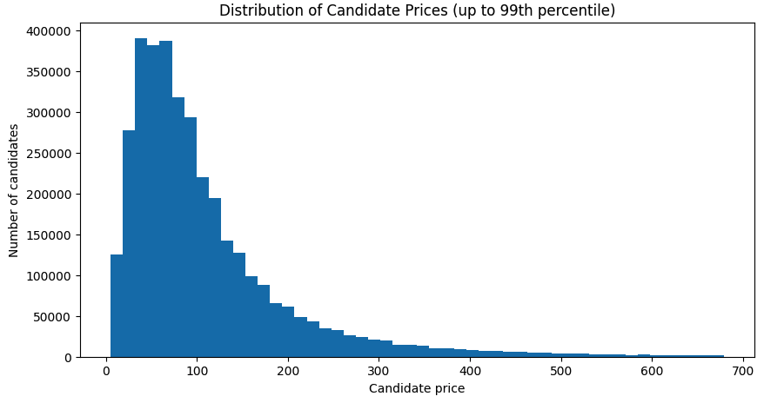
2.7. Candidate price is strongly right-skewed
Price:
Accommodation prices were strongly right-skewed (median €82 vs mean €120, with extreme values up to €10,000)
For models requiring scaled numerical inputs, candidate price was log-transformed before scaling to reduce skew and the influence of extreme values (Géron, 2025).

Slide 16
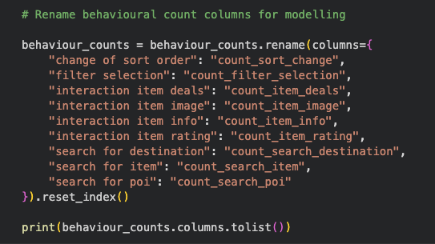
2.8. Turning session behaviour into predictors
Each ranking event was associated with its preceding sequence of non-clickout interactions.
Only behaviour occurring before the ranking event was used, preventing target leakage.
Nine behavioural count features were constructed:
  Searches: counts of destination, item and POI searches
  Candidate interactions: counts of image, info, rating and deals interactions
  Search refinement: counts of filter selections and sort changes

Slide 17
2.9. From the raw data to the final modelling dataset
1
Sample complete sessions
10% sample, retaining all interactions
Data exclusions:
5 sessions excluded due to ambiguous clickout sequences
83 ranking events (0.053%) excluded because the clicked item was absent from the candidate set
2
Identify ranking events
Each clickout = one ranking event
1
Link preceding behaviour
Associate interactions occurring before each event
1
Expand candidate lists
One row per candidate per ranking event
Final dataset:
Unit: candidate within a ranking event
Target: clicked / not clicked
Predictors: candidate + context + preceding behaviour
No leakage: only information available by the ranking event
1
Join accommodation metadata
>99.9% candidate coverage
1
Construct target
Clicked = 1; other candidates = 0
1
Engineer predictors
Candidate, context and behavioural features
Final candidate dataset: ~3.61M rows across 157,726 valid ranking events

Slide 18
3. Experiment design and model selection

Slide 19
3.1. Model selection: Classical ML versus Deep Learning
Two classical and two deep-learning approaches were selected to compare ranking performance against increasing modelling complexity (See appendix A and B for detailed comparison).
Classical ML
Deep Learning
Logistic Regression (LR)
Simple, interpretable classical baseline for estimating click probability.
LightGBM LambdaRank
Tree-based learning-to-rank model designed to optimise ranking within candidate groups.
Multilayer Perceptron (MLP)
Deep-learning model capable of learning nonlinear interactions between behavioural, contextual and candidate features.
Wide & Deep
Combines direct effects of selected features with nonlinear representation learning.
Sources: Covington, Adams and Sargin, 2016; Sugiura, Yamagishi and Kishimoto, 2024; Géron, 2025; Devanathan et al., 2025; Zaidi, Rincon and Hassantabar, 2026
Sources: Covington, Adams and Sargin, 2016; Ramírez et al., 2024; Zaidi, Géron, 2025; Rincon and Hassantabar, 2026
For fair comparison, all models used the same observations, binary click target and 15 underlying predictors. Preprocessing and feature representation were adapted where required by each model architecture (Yu et al., 2024).

Slide 20
3.2. Experimental design
Complete sessions were split 70% / 15% / 15% into training, validation and test sets, preventing the same session from appearing across multiple splits. The test set remained untouched until final model evaluation.
Same train/validation observations and predictor set were used across models to enable a fair comparison.
Evaluation: Established ranking metrics captured complementary aspects of how highly each model ranked the observed clicked candidate:
HR@1 — whether the clicked accommodation is ranked first.
MRR — rewards placing the clicked accommodation higher across the entire ranking.
NDCG@5 — ranking quality near the top five.
NDCG@10 — ranking quality within the top ten.
(Adamczak et al., 2020; Theobald, 2024; Zhu and Klabjan,2020)
Train data
10% Sampled and split by complete sessions
70% for train: model fitting
15% for validation: hyperparameter tuning and model comparison during development
15% for test: Final evaluation of the selected models

Slide 21
4. Modelling, tuning & evaluation

Slide 22
Base model results before tuning
Among the initial learned models, MLP achieved the strongest overall ranking performance, while Logistic Regression provided the strongest classical baseline for further tuning. These two models were selected for targeted hyperparameter tuning.
Ranking | HR@1 | MRR | NDCG@5 | NDCG@10
Reference ranking: Trivago's original candidate order | 31.75% | 0.458 | 0.469 | 0.523
Classical models
Logistic Regression | 11.17% | 0.252 | 0.239 | 0.308
LightGBM LambdaRank | 9.81% | 0.238 | 0.225 | 0.296
Deep learning models
MLP | 11.52% | 0.258 | 0.247 | 0.317
Wide & Deep NN | 11.14% | 0.252 | 0.240 | 0.310

Slide 23
Targeted Hyperparameter Tuning
Targeted tuning was applied to the strongest classical baseline, using validation log loss to select configurations. Parameters were varied sequentially, with the best validation configuration carried forward to the next experiment (Géron, 2025).
Experiments included (Géron, 2025):
1. LR Hyperparameter Tuning:
Regularisation: Compared L1, L2 and Elastic Net, which impose different constraints on model coefficients and can affect sparsity and generalisation. Each was tested at α = 0.00001, 0.0001 and 0.001, spanning weaker to stronger regularisation (Géron, 2025; Scikit-learn, 2026).
SGD learning rate: Using the selected regularisation configuration, compared learning rates to test convergence behaviour while holding the model specification constant (Géron, 2025).
Other parameters were held constant to isolate the effect of the hyperparameters being tuned and maintain comparability across configurations.
Held constant throughout LR tuning: loss = log loss, class weight = balanced, max iterations = 1,000, tolerance = 0.001, random state = 42, and the same training/validation data and preprocessing.

Slide 24
Targeted Hyperparameter Tuning
2. MLP Hyperparameter Tuning (Géron, 2025)
Architecture: Compared 128→64 (baseline) → 64→64 (reduced model capacity) → 64→64→64 (tested whether additional depth improved performance).
Learning rate: Tuned the learning rate using the selected architecture, while keeping Adam, ReLU and batch size 1024 fixed.
Activation function: Using the selected architecture and learning rate, compared ReLU (baseline), Leaky ReLU and ELU to test alternative nonlinear activation functions (Géron, 2025).
Held constant throughout MLP tuning: Adam and batch size 1024 were retained to constrain the search space and computational cost. Tuning focused on model capacity, learning rate and nonlinear activation, using the same training/validation data and preprocessing throughout.

Slide 25
LR tuning results
Hyperparameters were selected using validation log loss; the final tuned model was then evaluated using ranking metrics.
Targeted tuning produced only marginal improvements across the validation ranking metrics. Within the tested configurations, tuning had limited impact on ranking performance.
Validation ranking metric | Baseline LR | Tuned LR
HR@1 | 11.17% | 11.18%
MRR | 0.2521 | 0.2524
NDCG@5 | 0.2398 | 0.2403
NDCG@10 | 0.3088 | 0.3093
Final selected LR model configuration:
Penalty: Elastic Net
Alpha: 1e-5
L1 ratio: 0.15
Learning rate: optimal
Class weight: balanced
See D and E in appendix for compared results across experimentation.

Slide 26
MLP tuning results
The hyperparameters and final tuned model followed the same evaluation framework as the LR one.
Tuning produced small, consistent improvements across all validation ranking metrics.
Metric | Baseline MLP | Tuned MLP
HR@1 | 11.52% | 11.66%
MRR | 0.2581 | 0.2595
NDCG@5 | 0.2472 | 0.2486
NDCG@10 | 0.3175 | 0.3191
Final selected MLP model configuration:
Layers: 64 → 64
Activation function: ReLU
Optimiser: Adam
LR: 0.0001
batch size: 1024
See F in appendix for compared results across experimentation.

Slide 27
Final evaluation on the untouched test set
The final models were evaluated once on the held-out test set using the same ranking metrics.
MLP achieved the strongest MRR and NDCG performance, while LightGBM achieved the highest HR@1 among the learned models. Differences between the learned models were small.
Learning rate | HR@1 | MRR | NDCG@5 | NDCG@10
Tuned LR | 11.35% | 0.2545 | 0.2437 | 0.3111
LightGBM | 11.73% | 0.2585 | 0.2475 | 0.3165
Tuned MLP | 11.54% | 0.2586 | 0.2484 | 0.3181
Wide & Deep | 11.18% | 0.2542 | 0.2442 | 0.3123
Trivago’s original ranking | 32.61% | 0.4646 | 0.4747 | 0.5286

Slide 28
Model interpretability: LR coefficients vs SHAP for MLP
Here we answer the following question:
Which features drive the tuned MLP, and does it identify materially different relationships from Logistic Regression?
LR:
Filter match (+0.265): matching a selected filter increases the model's click log-odds.
Candidate price (−0.176): higher prices are associated with lower predicted click propensity, holding other inputs constant.
Sort changes (−0.022): retained, but the relationship is very small.
Relative price and the other eight behavioural variables: coefficients were shrunk to zero.
Learnings:
Positive coefficients increase predicted click log-odds; negative coefficients decrease them, holding other encoded features constant.
Elastic Net reduced several numerical/behavioural coefficients to zero, including relative_price.
Model details analyses can be found in Appendix item G.

Slide 29
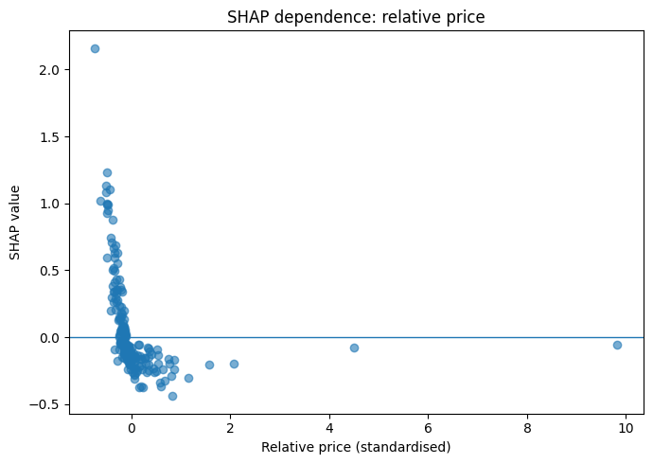
Model interpretability: LR coefficients vs SHAP for MLP
MLP:
Relative price: Shows a pronounced nonlinear relationship with MLP output, despite being reduced to zero by Elastic Net LR.
Candidate price: Shows a broadly negative relationship, consistent with LR, but with additional nonlinearity.
Other features: Contextual categorical and behavioural features also contribute to MLP predictions.*
Learning:
The MLP captured relationships not represented by the fitted linear model, particularly for relative price, but this translated into only modest improvements in ranking performance.
*Aggregated SHAP magnitudes for categorical features should be interpreted cautiously because they combine multiple one-hot encoded columns.
Model details analyses can be found in Appendix items H-J.
Figure 2: SHAP dependence for relative_price (Author’s own work, 2026)

Slide 30
5. Conclusions, limitations and next steps

Slide 31
Conclusions: answering the research question
Performance
MLP achieved the strongest MRR and NDCG, while LightGBM achieved the strongest HR@1 among learned models.
Differences were small: compared with tuned LR, MLP improved MRR by 0.0041 and NDCG@10 by 0.0070.
Relative model performance also varied between validation and test.
Complexity & interpretability
SHAP indicates that the MLP captured nonlinear relationships not represented by the fitted LR model, particularly for relative price.
LR remained substantially easier to interpret directly through its coefficients.
Research question conclusion
Deep learning produced a modest improvement over LR, but did not demonstrate a clear advantage over classical ML relative to its additional complexity and lower interpretability.
Note: All learned models substantially underperformed Trivago's original ranking. One possible explanation is that the original ranking uses richer signals unavailable in this dataset.

Slide 32
Ethical Considerations & Potential Bias (Leslie, 2019; Regulation (EU) 2016/679)
Bias & fairness: Bias & fairness: Historical interaction data may reproduce existing exposure patterns or behavioural differences. Aggregate ranking performance may conceal differences between user or accommodation segments. A subgroup diagnostic found differences in MLP ranking performance across levels of city representation (Appendix K). Demographic attributes were unavailable, so demographic fairness could not be assessed.
Explainability & transparency: Recommendations influence what users see and potentially what they choose. Users should therefore be able to understand why accommodations are recommended and identify potential gaps between their preferences and the system's assumptions.
Privacy & consent: Session and behavioural data should be collected and processed with appropriate transparency, data minimisation and a valid legal basis under applicable data-protection requirements.
Responsible deployment: Offline ranking performance alone is insufficient. Deployed systems should be monitored for performance across relevant segments, behavioural changes and unintended disparities..

Slide 33
Limitations
Dataset and behavioural context
No long-term user history or personal profile information. Recommendations rely on current session/search context.
Clicks used as the relevance signal, but a click does not necessarily represent booking or true preference.
The analysis uses a 10% sample of complete sessions, primarily for computational feasibility.
Observational / ranking bias
Candidate position was strongly associated with clicks but excluded as a predictor because it reflects exposure from Trivago's existing ranking.
Consequently, observed clicks are likely influenced by the ranking system that generated the data.
The project evaluates re-ranking of an existing candidate set, not end-to-end candidate generation and recommendation.
Modelling scope
Hyperparameter tuning was deliberately targeted rather than exhaustive because of computational cost.
Only four selected modelling approaches were compared.
Small differences between models and changes in their relative performance between validation and test limit conclusions about the superiority of individual architectures.
Computational constraints
Computational constraints influenced the sample size, scope of hyperparameter tuning and coding practices.

Slide 34
Next Steps
1. Strengthen the current comparison
Evaluate L2-regularised LR to assess feature contributions without the sparsity introduced by Elastic Net, and broaden hyperparameter tuning where computationally feasible.
2. Improve representation of user intent
Explore richer sequential representations of session behaviour and, where available, longer-term user history.
3. Improve the learning objective and evaluation
Use stronger outcome signals, such as bookings or conversion, and explicitly address position/exposure bias.
4. Extend towards production evaluation
Evaluate online through controlled experiments, monitoring ranking performance, user outcomes and relevant segments.

Slide 35
Next Steps: Deployment
1. Continue iterating to reach better ranking results
2. Build a redeployment pipeline:
Feature processing
MLP inference API
Candidate score
Ranked accommodation
User session
3. Ensure scalability and reliability
(Upadhyay, 2025; Caballar and Stryker, 2026)

Slide 36
Thank you

Slide 37
Appendix

Slide 38
A: Classical ML Model Comparison
Criteria |  | Logistic Regression |  | LightGBM with LambdaRank objective
Ranking Suitability |  | Predicts ranking indirectly, learning by relationships present in a row, and not by relationships between rows. 🔵⚪⚪ |  | LambdaRank is specifically designed to learn relative ordering within candidate groups and optimise ranking. 🔵🔵🔵
Mixed Data Handling |  | Supports numerical variables, and encoded categorical variables. 🔵🔵⚪ |  | Supports numerical and categorical features. 🔵🔵🔵
Non-linear Relationships & Interactions |  | Primarily learns linear/additive relationships, or requires feature engineering. 🔵⚪⚪ |  | As a Decision trees model, it naturally capture non-linear relationships and interactions between features. 🔵🔵🔵
High-Cardinality Handling |  | Requires encoding for categorical variable, which can lead to very large sparse feature spaces. 🔵⚪⚪ |  | Doesn’t require one-hot encoding, which helps maintain a lower feature space. 🔵🔵🔵
Scalability / Computational Efficiency |  | Comparatively simple but with large dataset can computationally expensive. 🔵🔵⚪ |  | Designed for efficient training on large tabular datasets, but much more computationally complex than LR 🔵⚪⚪
Explainability |  | Coefficients allows straightforward interpretation. 🔵🔵🔵 |  | Less interpretable, but supported by techniques such as SHAP. 🔵🔵⚪
Sources: Covington, Adams and Sargin, 2016; Sugiura, Yamagishi and Kishimoto, 2024; Géron, 2025; Devanathan et al., 2025; Zaidi, Rincon and Hassantabar, 2026

Slide 39
B: Deep Learning Model Comparison
Criteria |  | Dense Neural Network / MLP |  | Wide & Deep NN
Ranking Suitability |  | assigns relevance scores to individual candidates, which can then be sorted into a ranking. 🔵🔵⚪ |  | Assigns relevance scores to individual candidates, which can then be sorted into a ranking. 🔵🔵⚪
Mixed Data Handling |  | Supports continuous features and categorical/contextual features through encoding or embeddings. 🔵🔵🔵 |  | Combines a direct “wide” pathway with a deep pathway, allowing different feature representations to contribute to predictions. 🔵🔵🔵
Non-linear Relationships & Interactions |  | Can learn complex non-linear relationships and feature interactions. 🔵🔵🔵 |  | Deep layers learn complex non-linear relationships, while the wide pathway preserves direct feature relationships. 🔵🔵🔵
High Cardinality Handling |  | Supports learned embeddings for high cardinality categorical features. 🔵🔵🔵 |  | Supports learned embeddings for high-cardinality categorical features. 🔵🔵🔵
Scalability / Computational Efficiency |  | Scalable to large datasets, but requires greater computational resources and tuning. 🔵🔵⚪ |  | Scalable to large datasets, but more computationally demanding and complex than a standard MLP. 🔵⚪ ⚪
Explainability |  | Low explainability, but post-hoc XAI can be applied. 🔵🔵⚪ |  | Low explainability. Post-hoc XAI can be applied, but interactions between the wide & deep can make predictions harder to interpret. 🔵⚪⚪
Sources: Covington, Adams and Sargin, 2016; Ramírez et al., 2024; Zaidi, Géron, 2025; Rincon and Hassantabar, 2026

Slide 40
C: Tooling & implementation environment
Tool | Use in this project
Python | Data preparation, feature engineering, modelling and evaluation
Google Colab | Notebook environment and GPU-accelerated neural-network training
pandas / NumPy | Data manipulation, session reconstruction and feature engineering
scikit-learn | Preprocessing and Logistic Regression using SGDClassifier (Pedregosa, F. et al., 2011)
LightGBM | LambdaRank learning-to-rank model (Ke, G. et al., 2017)
PyTorch | MLP and Wide & Deep neural networks, mini-batch training and GPU execution (Paszke, A. et al., 2019)
Google Drive | Dataset and model-checkpoint storage
Github | Storing the Jupyter notebook files (Halimi, 2026)
Implementation approach: Classical ML models were implemented with scikit-learn and LightGBM, while deep-learning models were implemented in PyTorch and trained using GPU acceleration in Google Colab.

Slide 41
D: LR regularisation tuning results
Penalty | α | Validation log loss
Elastic Net | 0.00001 | 0.655873
Elastic Net | 0.0001 | 0.688797
L2 | 0.00001 | 0.692007
L2 | 0.0001 | 0.704295
L2 | 0.001 | 0.706332
Elastic Net | 0.001 | 0.706391
L1 | 0.001 | 0.719664
L1 | 0.0001 | 0.816161
L1 | 0.00001 | 0.850463
Table 1: Validation log loss across LR regularisation configurations(Author’s own work, 2026)

Slide 42
E: LR learning-rate tuning with Elastic Net (α = 1 × 10⁻⁵)
Learning rate | η₀ (initial learning rate) | Validation log loss
optimal | N/A | 0.655873
invscaling | 0.001 | 0.694651
invscaling | 0.01 | 0.697591
invscaling | 0.1 | 0.702680
Table 2: Validation log loss across LR learning-rate configurations (Author’s own work, 2026)
Held constant: Elastic Net regularisation, α = 0.00001, L1 ratio = 0.15, class weight = balanced, max iterations = 1,000, tolerance = 0.001.

Slide 43
F: MLP tuning results during experimentation
Architecture and learning-rate experiments kept Adam, ReLU and batch size consistent with the baseline model.
Architecture experiment:
Learning rate experiment with 64 → 64:
Activation function experiment with
64 → 64 and 0.0001 LR:
Architecture | Validation Loss rate | Best Epoch
Baseline 128 → 64 | 0.176180 | 3
64 → 64 | 0.176067 | 3
64 → 64 → 64 | 0.176257 | 2
Learning rate | Validation Loss rate | Best Epoch
0.001 | 0.176067 | 3
0.0001 | 0.175847 | 9
Activation function | Validation Loss rate | Best Epoch
ReLU | 0.175847 | 9
Leaky ReLU | 0.175914 | 13
ELU | 0.176241 | 18
Table 3, 4 and 5: MLP tuning results(Author’s own work, 2026)
The 64→64 architecture achieved a modestly lower validation loss (0.176067), compared with baseline architecture. Adding a third hidden layer did not improve performance.
Reducing the learning rate from 0.001 to 0.0001 lowered validation loss from 0.176067 to 0.175847, so 0.0001 was carried forward to the activation-function experiment.
ReLU achieved the lowest validation loss and reached its best result in fewer epochs than Leaky ReLU and ELU, so it was retained for the final model.
Final selected MLP model configuration: 64 → 64 | ReLU | Adam | LR = 0.0001 | batch size = 1024

Slide 44
G: LR Coefficients Analysis Results
Non-categorical Features
feature | coefficient
2 | filter_match | 0.264545
1 | relative_price | 0
5168 | count_item_deals | 0
5167 | count_filter_selection | 0
5171 | count_item_rating | 0
5172 | count_search_destination | 0
5169 | count_item_image | 0
5170 | count_item_info | 0
5173 | count_search_item | 0
5174 | count_search_poi | 0
5166 | count_sort_change | -0.02202
0 | candidate_price | -0.176253
Strongest positive coefficients |  |  |  | Strongest negative coefficients
 | feature | coefficient |  |  | feature | coefficient
5082 | city_lr=Åre, Sweden | 0.936155 |  | 5163 | device=desktop | -1.349741
5097 | city_lr=İnegöl, Turkey | 0.934857 |  | 5164 | device=mobile | -1.335908
1195 | city_lr=Desaru, Malaysia | 0.9081 |  | 5165 | device=tablet | -1.207865
616 | city_lr=Bora Bora, French Polynesia | 0.883854 |  | 3857 | city_lr=Salvador Bahia, Brazil | -0.345454
… |  |  |  | …
Table 6: Largest positive individual encoded coefficients (Author’s own work, 2026)
Table 7: Largest negative individual encoded coefficients (Author’s own work, 2026)
Tables 6 and 7 demonstrate strong but sparse impact.
Table 8 demonstrates weak but targeted impact, with most behavioural metrics having no impact, probably due to the regularisation method that zeroed them out.
Table 8: all non-categorical features and their coefficient values (Author’s own work, 2026)

Slide 45
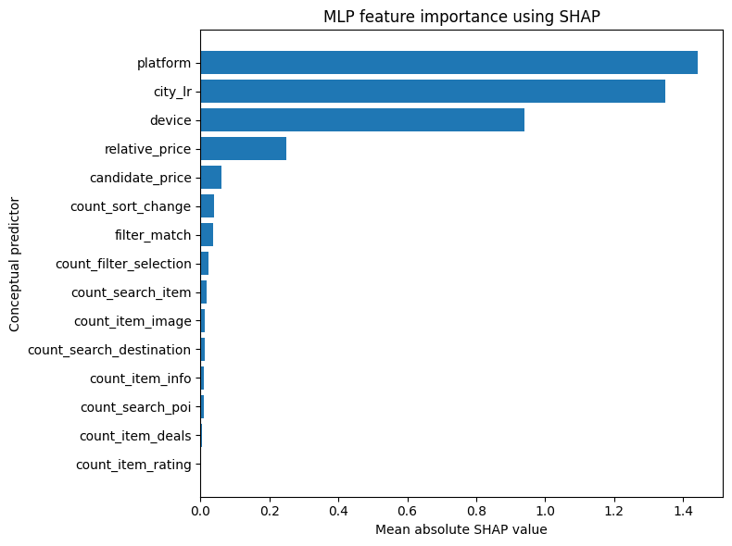
H: MLP SHAP Analysis Results
Conceptually aggregate features and their SHAP results
feature | mean_abs_shap
0 | platform | 1.443412
1 | city_lr | 1.349105
2 | device | 0.93918
3 | relative_price | 0.248289
4 | candidate_price | 0.060173
5 | count_sort_change | 0.038842
6 | filter_match | 0.036926
7 | count_filter_selection | 0.023832
8 | count_search_item | 0.01699
9 | count_item_image | 0.011811
10 | count_search_destination | 0.011123
11 | count_item_info | 0.010778
12 | count_search_poi | 0.008984
13 | count_item_deals | 0.003341
14 | count_item_rating | 0.002522
Table 9: MLP feature importance using SHAP (Author’s own work, 2026)
Figure 1: MLP feature importance using SHAP (Author’s own work, 2026)
The fitted LR model produced a sparse coefficient pattern, consistent with Elastic Net regularisation. Several behavioural features were reduced to zero, while candidate price and filter match retained non-zero coefficients.

Slide 46
I: MLP SHAP Analysis Results
Figure 2 represents SHAP dependence for relative price in the tuned MLP. Relatively lower-priced candidates generally increased the model score, while higher relative prices tended to reduce it. The non-linear pattern contrasts with the tuned Elastic Net Logistic Regression model, which reduced the relative-price coefficient to zero. SHAP values represent contributions to the MLP output score and should not be interpreted as causal effects.
Figure 2: SHAP dependence for relative_price (Author’s own work, 2026)

Slide 47
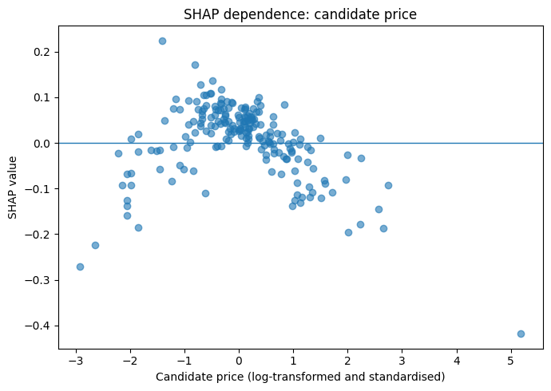
J: MLP SHAP Analysis Results
Figure 3 represents SHAP dependence for candidate_price in the tuned MLP. The results we see correspond with the negative coefficient (−0.176) in the LR model, with additional non-linearity revealed.
Figure 3: SHAP dependence for candidate_price (Author’s own work, 2026)

Slide 48
K: City_representation bias check
Group | Training events per city group | Median | Unique cities | Test events | MRR | NDCG@10
Lower | 2–51 | 16 | 2,126 | 7,783 | 0.2562 | 0.3157
Medium | 52–360 | 141 | 314 | 7,802 | 0.2415 | 0.2972
Higher | 373–7,402 | 1,470 | 32 | 7,688 | 0.2784 | 0.3417
Table 9: Comparing MLP model performance by city representation (Author’s own work, 2026)
Finding: Ranking quality varies across destination-representation groups, with strongest performance for highly represented cities and weakest performance for medium-representation cities.
Interpretation: The pattern is not monotonic; rare-city grouping during preprocessing may affect the lower-representation group. The diagnostic identifies a disparity but does not establish its cause.

Slide 49
References and Bibliography

Slide 50
References
Adamczak, J. et al. (2020) ‘Session-based hotel recommendations dataset: As part of the ACM Recommender System Challenge 2019’, ACM Transactions on Intelligent Systems and Technology, 12(1), pp. 1–20. Available at: https://doi.org/10.1145/3412379
Caballar, R.D. and Stryker, C. (2026) What is model deployment? IBM. Available at: https://www.ibm.com/think/topics/model-deployment (Accessed: 1 October 2026).
Devanathan, B. et al. (2025) ‘Explainable AI framework using XGBoost with SHAP and LIME for multi-scale household energy forecasting’, IEEE Access. Available at: https://doi.org/10.1109/ACCESS.2025.3602673
Esmeli, R., Abdullahi, H., Bader-El-Den, M. and Can, A.S. (2024) ‘Session context data integration to address the cold start problem in e-commerce recommender systems’, Decision Support Systems, 187, article 114339. Available at: https://doi.org/10.1016/j.dss.2024.114339
Flórez, M. et al. (2025) ‘A context-aware tourism recommender system using a hybrid method combining deep learning and ontology-based knowledge’, Journal of Theoretical and Applied Electronic Commerce Research, 20(3), article 194. Available at: https://doi.org/10.3390/jtaer20030194
Géron, A. (2025) Hands-On Machine Learning with Scikit-Learn and PyTorch. Sebastopol, CA: O’Reilly Media (Accessed: 15 September 2026).
Google (n.d.) Google Colaboratory. Available at: Google Colab documentation (Accessed: 16 September 2026).

Slide 51
References
Halimi, N. (2026) Accommodation ranking assignment [GitHub repository]. Available at: https://github.com/natinat/accommodation-ranking-assignment (Accessed: 3 October 2026).
Ke, G. et al. (2017) ‘LightGBM: A highly efficient gradient boosting decision tree’, Advances in Neural Information Processing Systems, 30.
Leslie, D. (2019) Understanding artificial intelligence ethics and safety: A guide for the responsible design and implementation of AI systems in the public sector. The Alan Turing Institute. Available at: https://doi.org/10.5281/zenodo.3240529
Mahajan, P. (2019) Trivago RecSys Challenge Data 2019 [Dataset]. Kaggle. Available at: https://www.kaggle.com/datasets/pranavmahajan725/trivagorecsyschallengedata2019 (Accessed: 12 September 2026).
Molnar, C. (2025) Interpretable machine learning: a guide for making black box models explainable. 3rd edn. Chapters 14, 15 and 33. Available at: https://christophm.github.io/interpretable-ml-book/ (Accessed: 25 September 2026)
Nan, X., Parthasarathy, R. and Wang, C. (2023) ‘Personalized travel recommendation system based on data mining technology’, in Advances in Artificial Intelligence, Big Data and Algorithms, pp. 445–452. Available at: https://doi.org/10.3233/FAIA230840
Paszke, A. et al. (2019) ‘PyTorch: An imperative style, high-performance deep learning library’, Advances in Neural Information Processing Systems, 32.
Pedregosa, F. et al. (2011) ‘Scikit-learn: Machine learning in Python’, Journal of Machine Learning Research, 12, pp. 2825–2830.

Slide 52
References
Rahim M, N. and Basheer K.P, M. (2025) ‘A hybrid explainability framework for recommender systems using SHAP with natural language interpretations’, International Journal of Innovative Research and Scientific Studies, 8(6), pp. 687–703. Available at: https://doi.org/10.53894/ijirss.v8i6.9669
Ramírez, A. et al. (2024) ‘Towards explainable test case prioritisation with learning-to-rank models’, arXiv, arXiv:2405.13786. Available at: https://arxiv.org/abs/2405.13786 (Accessed: 15 September 2026).
Regulation (EU) 2016/679 of the European Parliament and of the Council of 27 April 2016 on the protection of natural persons with regard to the processing of personal data and on the free movement of such data (General Data Protection Regulation) [2016] Official Journal of the European Union, L119, pp. 1–88. Available at: https://eur-lex.europa.eu/eli/reg/2016/679/oj/eng (Accessed: 28 September 2026).
Sugiura, T., Yamagishi, Y. and Kishimoto, Y. (2024) ‘Leveraging LightGBM Ranker for efficient large-scale news recommendation systems’, in ACM RecSys Challenge 2024 (RecSys Challenge ’24). New York: ACM, pp. 27–31. Available at: https://doi.org/10.1145/3687151.3687156
Theobald, O. (2024) Machine learning: Make your own recommender system. Packt Publishing. Available at: https://learning.oreilly.com/library/view/machine-learning-make/9781835882061/ (Accessed: 24 September 2026).
Upadhyay, M. (2025) ‘Model deployment and orchestration: The definitive guide’, Mirantis, 29 August. Available at: https://www.mirantis.com/blog/model-deployment-and-orchestration-the-definitive-guide/ (Accessed: 1 October 2026).
Yu, X. et al. (2024) ‘Comparison of deep and conventional machine learning models for prediction of one supply chain management distribution cost’, Scientific Reports, 14, article 24195. doi: 10.1038/s41598-024-75114-9.
Zaidi, S.M.A., Rincon, E. and Hassantabar, S. (2026) ‘A multi-source ensemble approach to candidate generation for alternative vacation rental property recommendations’, arXiv, arXiv:2609.05748. Available at: https://arxiv.org/abs/2609.05748 (Accessed: 12 September 2026).

Slide 53
Bibliography
Cao, Z. et al. (2007) ‘Learning to rank: From pairwise approach to listwise approach’, in Proceedings of the 24th International Conference on Machine Learning. New York: ACM, pp. 129–136 (Accessed: 12 September 2026).
Covington, P., Adams, J. and Sargin, E. (2016) ‘Deep neural networks for YouTube recommendations’, in Proceedings of the 10th ACM Conference on Recommender Systems. New York: ACM, pp. 191–198. Available at: https://doi.org/10.1145/2959100.2959190
Le, J. (2021) ‘Recommendation system series part 8: The 14 properties to take into account when evaluating real-world recommendation systems’, Towards Data Science, 15 January. Available at: https://medium.com/data-science/recsys-series-part-8-the-14-properties-to-take-into-account-when-evaluating-real-world-recsys-f71cc6e1f195 (Accessed: 12 September 2026).
Tsai, C.-H. and Brusilovsky, P. (2018) ‘Beyond the ranked list: User-driven exploration and diversification of social recommendation’, Proceedings of the 23rd International Conference on Intelligent User Interfaces. New York: Association for Computing Machinery, pp. 239–250. Available at: https://doi.org/10.1145/3172944.3172959.
Zhu, X. and Klabjan, D. (2020) ‘Listwise learning to rank by exploring unique ratings’, in Proceedings of the Thirteenth ACM International Conference on Web Search and Data Mining (WSDM ’20). New York: ACM, pp. 798–806. Available at: https://doi.org/10.1145/3336191.3371814

