Slide 1
EthioEMR platform
Team EMR, Form Studio and AI assistant in one place
Notes:
EthioEMR platform: the team's EMR exactly as on GitHub main, with Form Studio, the AI assistant and the local speech service on top.

Slide 2

AGENDA
01
The problem
02
What the platform is
What we built on top of the team's EMR, how it fits together, and what comes next.
03
Architecture
04
Form Studio
05
AI assistant and speech
06
What comes next
02
Notes:
Six parts: the problem, what the platform is, the architecture, Form Studio, the AI assistant with speech, and what comes next.

Slide 3
THE PROBLEM
Four things cost builders and clinicians time today.
1
Forms are slow to build and check
2
Clinicians type a lot
Each form is converted from a Bahmni export or a paper template, then checked by hand. A form saves only when every concept it uses exists on the server with the right type.
Complaints, findings and form fields are typed during the visit, one field at a time.
3
Amharic dictation
4
Help is scattered
Doctors speak Amharic mixed with English terms. General models fail on it: Whisper large‑v3 gave 90% character errors on our Amharic test.
National guidelines, form guides and field meanings sit in separate PDFs and documents, outside the EMR.
03
Notes:
Four problems: slow form building and checking, a lot of typing, Amharic dictation that general models cannot handle, and help that lives outside the EMR.

Slide 4
WHAT THE PLATFORM IS
One stack: the team's EMR exactly as on GitHub main, with our modules on top.
9147129
Part | What it is | Owner
distro/ | team images sha-9147129, MySQL 8.0.45 | distro team
content/ | Initializer config: forms, concepts | content team
gateway/, compose overlay | one entry point on :18200 | us
modules/ | Form Studio and AI assistant | us
services/asr-service | local speech-to-text, port 8767 | us
team distro main, unchanged
54 + 2
team apps plus our two modules
1
Open it at localhost:18200/openmrs/spa. When our modules are published to npm, each becomes one line in the team's distro and the overlay is no longer needed.
command to start: platform.ps1 up
04
Notes:
The distro folder is byte for byte GitHub main at 9147129. Everything platform-specific lives in one compose overlay file, the gateway template and modules.

Slide 5
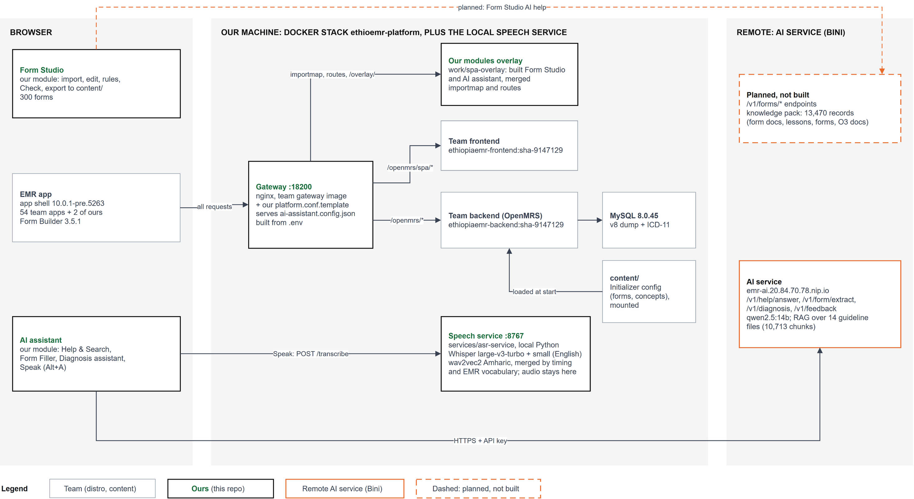
ARCHITECTURE
The browser talks to one gateway. Grey is the team's, black is ours, orange is the remote AI service.
Team images
Frontend and backend images at sha‑9147129. MySQL 8.0.45 with the v8 dump and ICD‑11.
Our gateway template
Adds our modules and the AI config from .env. The API key is not in git.
Two outside calls
Speech stays on this machine. AI questions go to Bini's service over HTTPS.
05
Notes:
Browser to gateway on port 18200. The gateway serves the merged importmap and routes from the overlay, the AI assistant config built from .env, passes /openmrs/spa to the team frontend and /openmrs to the backend, which uses MySQL and loads content at start.

Slide 6
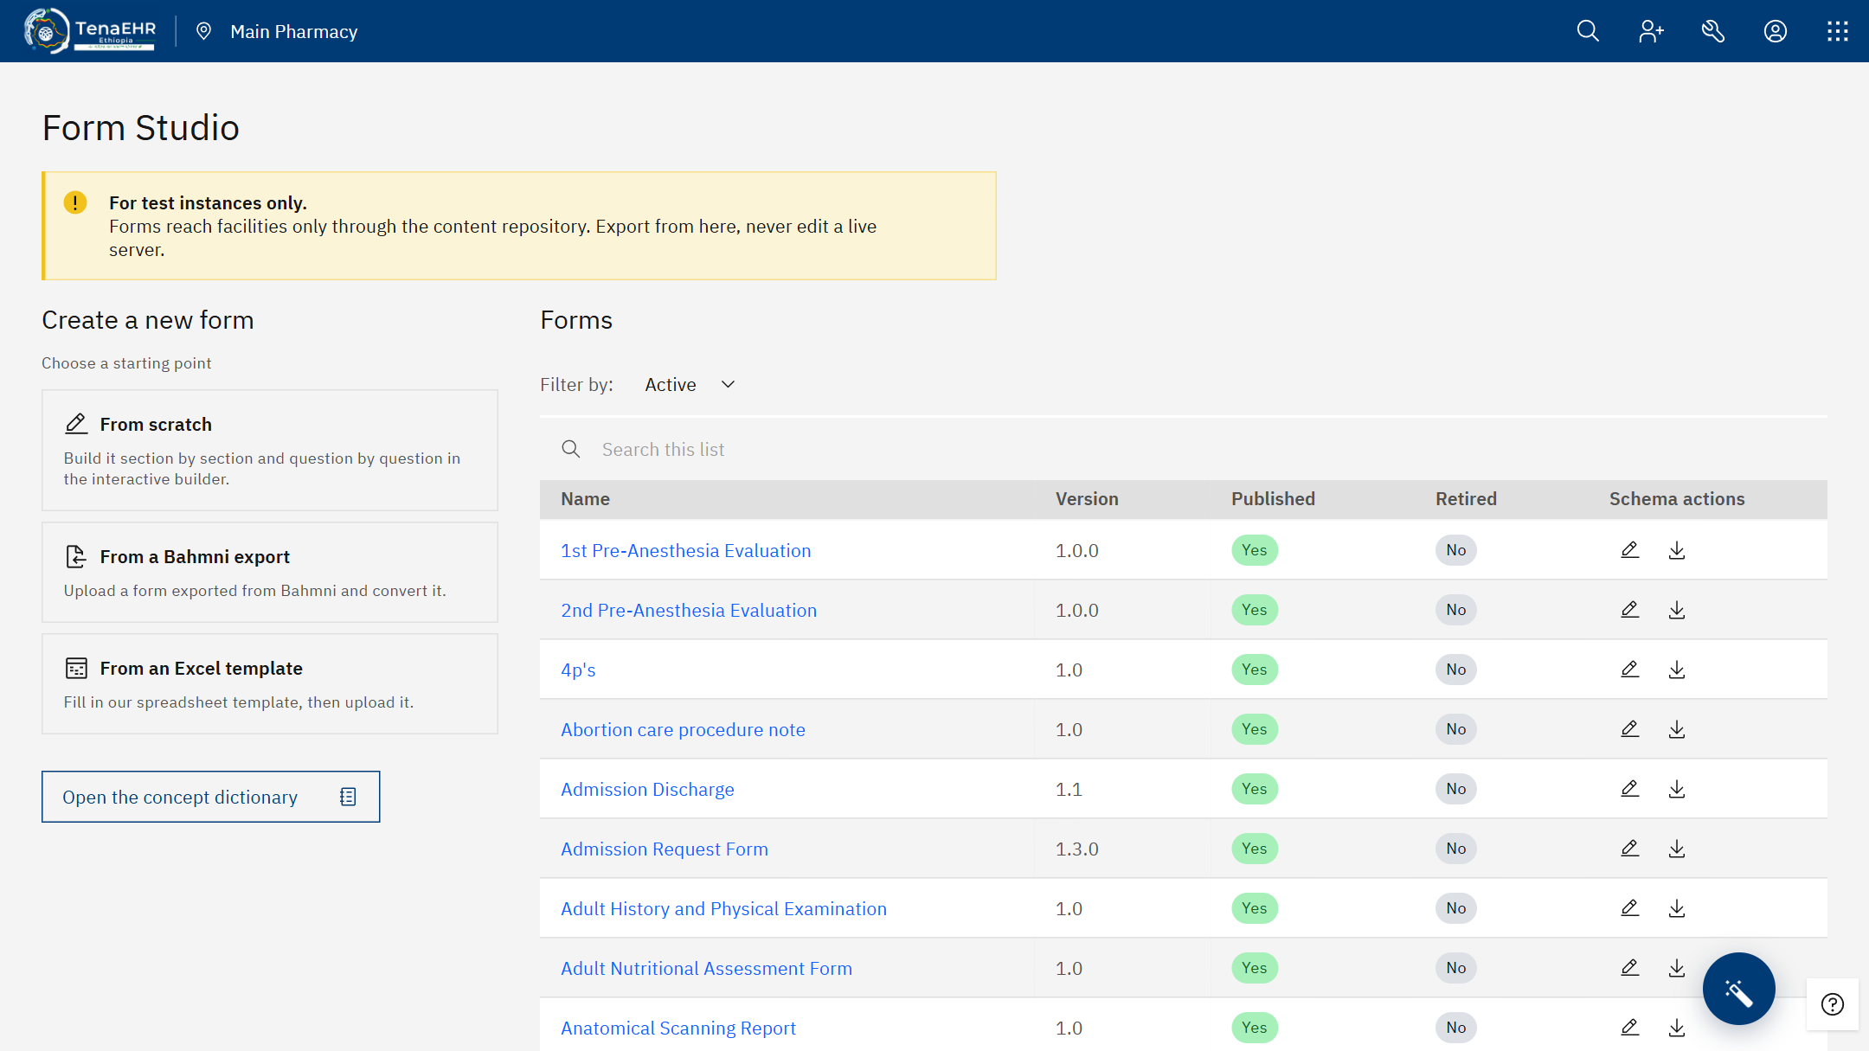
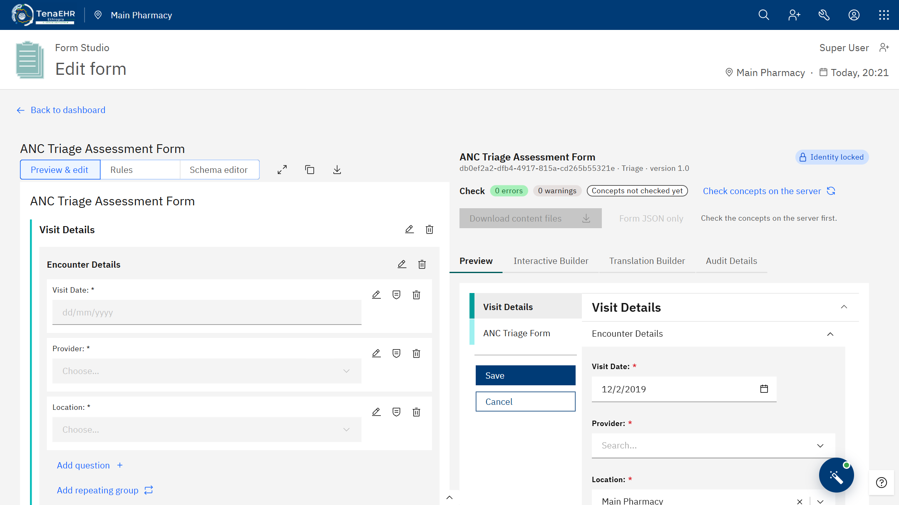
FORM STUDIO
An authoring module inside the EMR. It turns a source document into a checked O3 form.
1
Import
2
Edit
3
Rules
4
Check
5
Export
Bahmni export, Excel template or from scratch
preview and edit, interactive builder
show or hide, warnings, calculated values
errors, warnings, concepts on the server
content files for the content repository
Start page with 300 forms, and the editor with Check showing 0 errors. For test instances only: forms reach facilities through the content repository.
06
Notes:
Five steps: import, edit, rules, check, export. The start page lists 300 forms. Export writes content files; forms reach facilities only through the content repository.

Slide 7
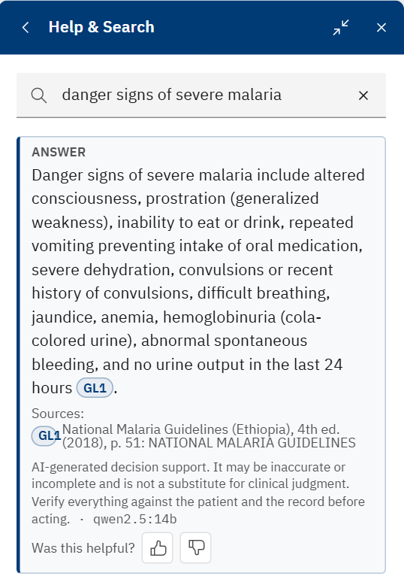
AI ASSISTANT
A panel on every EMR page, opened with Alt+A. Four tools.
1
Help & Search
Finds forms, fields and guides. Ask answers from the results and shows its sources.
2
Form Filler
Type or speak values; it fills one field at a time or the whole form.
3
Diagnosis assistant
A differential from the complaint and this patient's chart, with the records it relied on.
4
Speak
Dictate in Amharic or English. The local speech service writes it out.
RAG: the service retrieves guideline passages, answers only from them and cites them. 14 guideline files, 10,713 passages, model qwen2.5:14b.
07
Notes:
Screenshot: Help & Search on the synthetic patient Almaz Bekele, question 'danger signs of severe malaria'. The answer cites the National Malaria Guidelines, 4th edition, page 51.

Slide 8
SPEECH PIPELINE
Speak runs on our machine. Audio never leaves it, and no LLM touches the text.
Amharic engine
wav2vec2 Amharic. Writes English terms in Amharic letters.
Recording
Merge
Text
WAV from the Speak button
word by word, by timing
into the field or form
English engine
Whisper large-v3-turbo, confirmed by Whisper small.
An English word replaces the Amharic only if:
Results on our 15 s test: wav2vec2 Amharic 9% character errors; Whisper large-v3 alone 90%. Every output word comes from one of the two engines.
1 Whisper is reasonably sure
2 it sounds like what the Amharic engine heard
3 it is in the EMR vocabulary (28k concept and drug words)
08
Notes:
Mixed mode runs both engines on the same recording. mix.py merges them word by word without an LLM. Test audio was made with Microsoft Amharic neural voices; real recorded speech will score differently.

Slide 9
WHAT COMES NEXT
AI help inside Form Studio. Not built yet: it needs Bini's /v1/forms endpoints.
1
2
3
Explain errors
Draft rules and form JSON
Knowledge from our work
When Check finds a problem, the AI explains it in plain words and points to the rule.
The AI drafts. Our Check verifies each draft before it is accepted.
A knowledge pack of 13,470 records: form docs, lessons, our forms, plus O3 docs.
Who does what
Bini: /v1/forms/* endpoints (ask, suggest-concepts, explain-rule, draft-rule, review) and knowledge-pack ingest.
Us: the pack builder, an Ask button in the editor, and Check on anything the user accepts.
Not decided: dates for either side.
09
Notes:
The proposal and API contracts are in docs/ai-integration/form-studio-integration.md. None of the /v1/forms endpoints exist yet.

Slide 10


Questions & Discussions
Thank you
One stack, team main unchanged, our work on top. Questions and comments are welcome.
Open: localhost:18200/openmrs/spa
Docs: docs/platform/ in the ethioemr-platform repo
7
Notes:
Questions.

