Slide 1
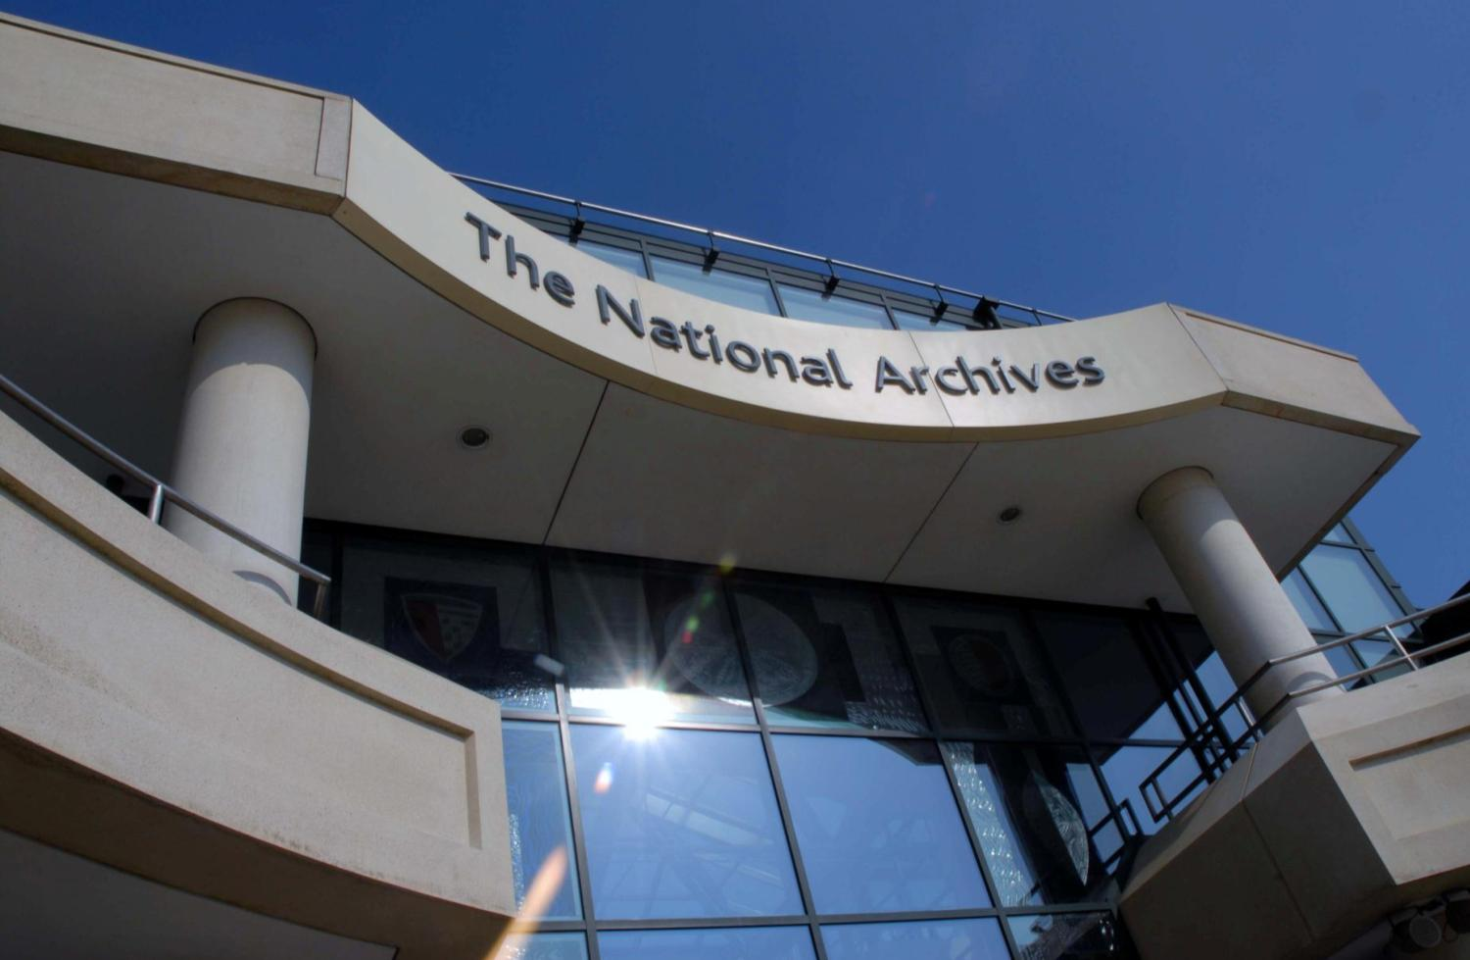
Digital Transfer Process
Digital Transfer User Group
Anthea Seles
17 September 2014

Slide 2

Digital Transfer Process
Four (4) Separate Stages :
Preparation for Transfer
Metadata Generation and Validation
Delivery of Transfer
Handover

Slide 3
PRE-TRANSFER REQUISITES
Completed:
Records Decision Panel (RDP)
Lord Chancellor’s Advisory Council (LCAC)
Agreement with TNA to include:
Folder structure for transfer
Simplified file list
Method of transfer (i.e. HDD or SFTP)
Encryption
Metadata elements
Notes:
Data needs to be pre-structured in folder list once appraisal and selection is completed to facilitate cross comparison

Slide 4
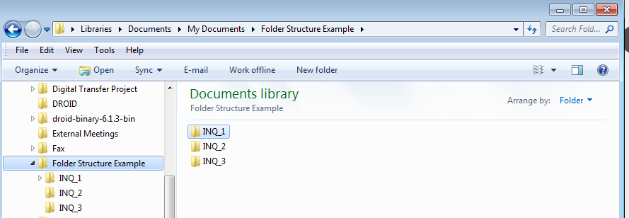
STEP 1: PREPARATION FOR TRANSFER
All files need to be placed in the agreed folder structure based on the cataloguing information received from IMC.

Slide 5
STEP 1: PREPARATION FOR TRANSFER
The folder structure will need to be exported from the preparation area in your systems to either SFTP or to HDD.
Talk to IT to move records to minimise alterations
HDD: Departments can use an encrypted TNA HDD or they may provide their own encrypted HDD.
If providing encrypted HDD need to ensure that decryption information is provided once the HDD is transferred.
For TNA encrypted drives we will provide the information for decryption and encryption

Slide 6
STEP 2: METADATA GENERATION AND VALIDATION
Once files are in the agreed folder structure you will generate a DROID report with checksum and closure information (Digital Transfer File List)
Two types of metadata files need to exist:
For the contents
For the metadata folders

Slide 7
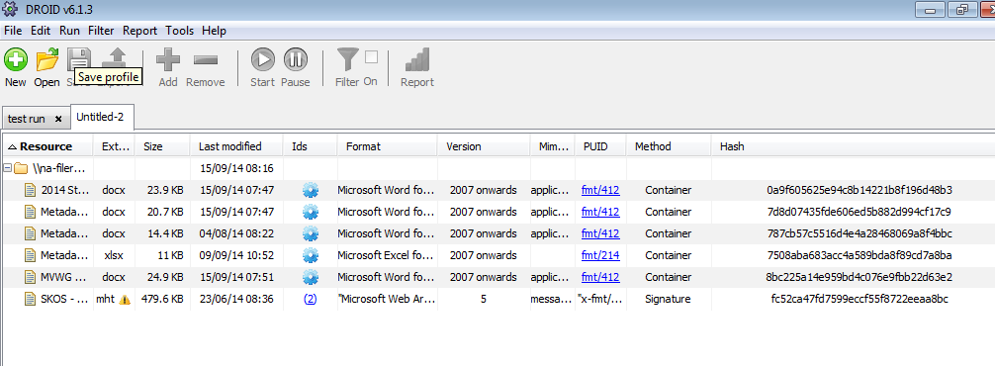
STEP 2: METADATA GENERATION AND VALIDATION

Slide 8
STEP 2: METADATA GENERATION AND VALIDATION
Metadata generated by DROID:
File name
File path (i.e. URI)
Date
File/Folder
checksum
Metadata to be added:
Copyright
Closure status
Closure start date
FOI Exemptions
FOI Decision Date
Description (Open/closed)
Alternate Description (if closed)

Slide 9
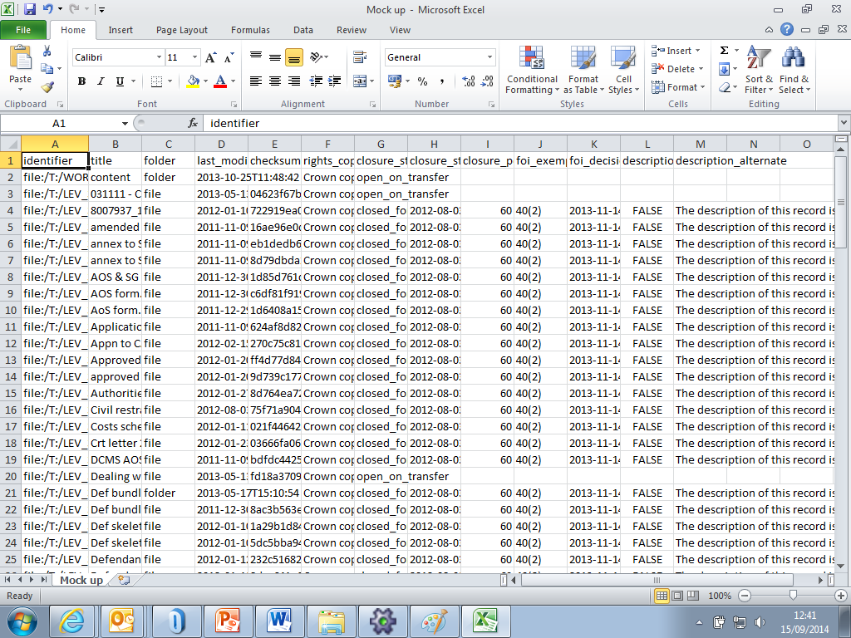
STEP 2: METADATA GENERATION AND VALIDATION

Slide 10
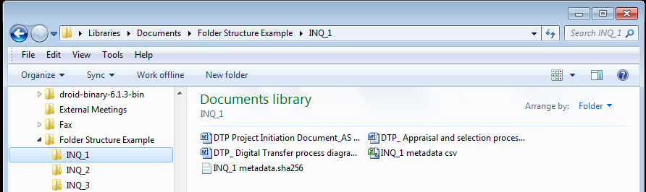
STEP 2: METADATA GENERATION AND VALIDATION
Metadata will have to validated using the CSV Validator
Pass/Fail report screen shot must be sent to Digital Transfer Team
Once metadata is validated you will need to generate the checksum for the metadata file.

Slide 11
STEP 3: DELIVERY OF TRANSFER
SFTP: We will agree a date to make space available along with transmission window.
Confirmation that the transmission is complete from OGD
Digital Transfer Team confirms receipt
HDD: OGD will send HDD via a trusted courier service. TNA will expect to receive expected date and time of delivery.
Receipt of delivery will be acknowledged by digital transfer team
This does not mean that records can be deleted from systems, only after confirmation of ingest by Digital Preservation can this be done
All transfers will need to be accompanied with a Digital Records Transfer Form

Slide 12

STEP 4: HANDOVER
This is an internal procedure where Digital Transfer Team hands over control of the transfer (SFTP or HDD) to Digital Preservation
Any errors that are detected after transfer will be forwarded to the Digital Transfer Team and OGDs will be contacted.

Slide 13
Any other questions can be directed to:
Anthea Seles, Digital Transfer Manager (anthea.seles@nationalarchives.gis.gov.uk)

