Slide 1
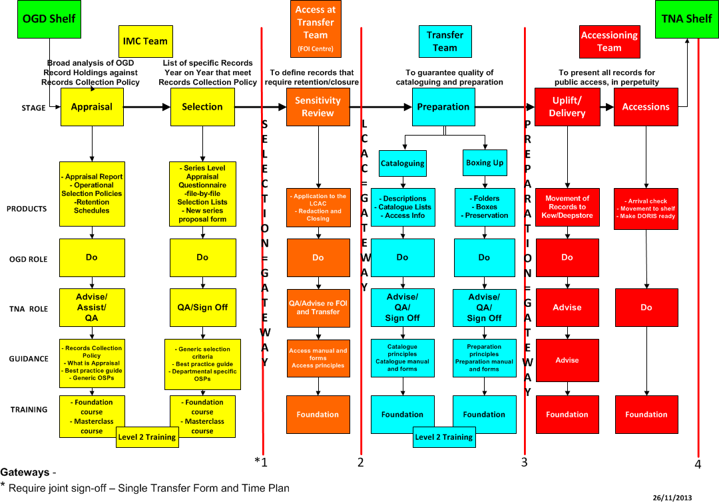

Paper Transfer Process - Gateways
This is how it is for paper:
1

Slide 2
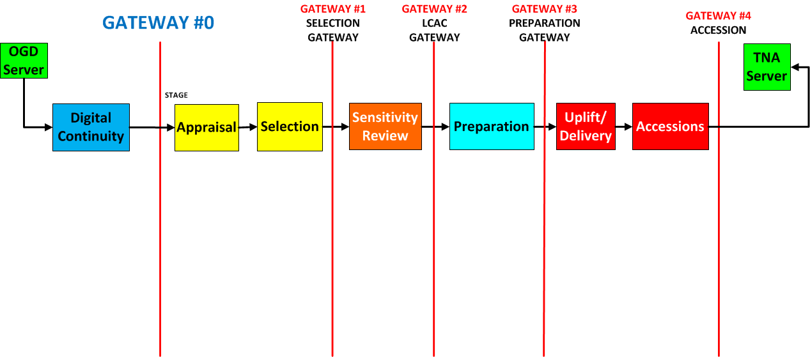



Digital Transfer Process - Gateways

