Slide 1
Stage 2: study the map
The National Archives> Heroes & Villains > Churchill & Dresden > Map
In the case study called ‘Why target Dresden?, look at source 5. This report on Dresden tells you where some important city buildings are located. Use the information in the report to find out where these places are and label them on the map (on the next slide):
  Law courts
  Factories
  Barracks
  State Museum of Applied Art
  Exhibition buildings
  Railway marshalling yards
  Hospital
(Choose ‘Insert’ and then ‘Text Box’ from the PowerPoint menu to make a label on the map. Then type in the words for the label.)

Slide 2
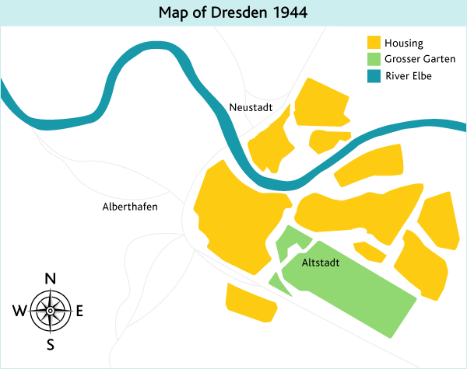
Notes:
Remember: locate on this map the law courts, factories, barracks, State Museum of Applied Art, exhibition buildings, railway marshalling yards and hospital. Choose ‘Insert’ and then ‘Text Box’ from the PowerPoint menu to make a label on the map. Then type in the words for the label.

Slide 3
Clues
Law courts – in the east, south of the river (between the river & Grosser Garten)
Factories – in west of the city (NW, W & SW)
Barracks – in the north
State Museum of Applied Art – in the east, south of the river (near the law courts)
Exhibition buildings - Grosser Garten
Railway marshalling yards - immediately south of the railway intersection
Hospital – east of the law courts & art museum

