Slide 1
BEHAVIORAL DRIVEN DEVELOPMENT

Slide 2
What is BDD?
BDD- Aims to bridge the gap between Business analyst and Developers and also manual QA with Automation testers.
BDD-History

Slide 3
What are supporting tools?
Cucumber(Ruby)/Freshen(PHP)
Jbehave(Java)/Nbehave(C#)
SpecFlow(C#)

Slide 4
What is GHERKIN?
Gherkin is the format of Cucumber specification.
Its business readable, Domain specific language which will let you to understand the software behaviour easily, since they are plain text.

Slide 5
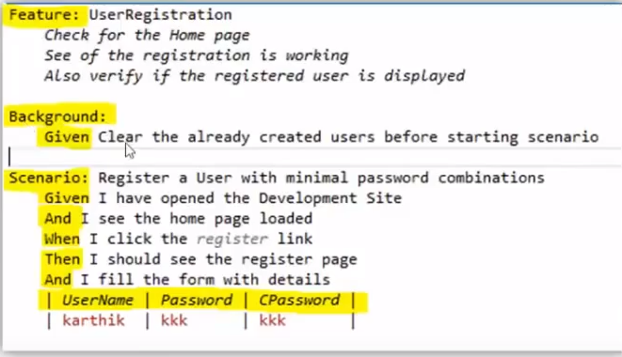
What is GHERKIN-SYNTAX?
Gherkin has very simple syntax as one highlighted below,

Slide 6
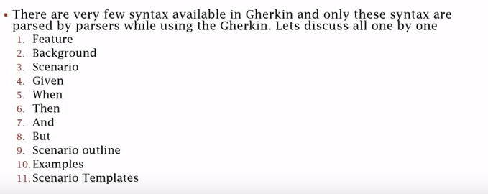
Continued..

Slide 7
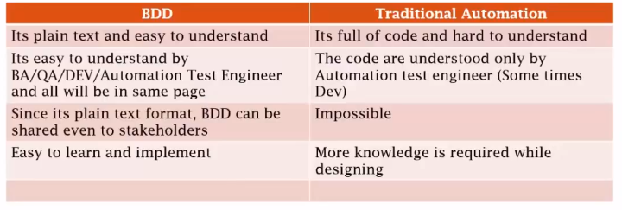
BDD VS TRADITIONAL

